Slide 1

PHANTOM
blindspot
detecting what the tracker cannot see
Papers presented this week:
1
Deep Cosine Metric Learning for Person Re-Identification — Nicolai Wojke, Alex Bewley· IEEE Winter Conference on Applications of Computer Vision (WACV) · 2018
2
"Multi-View Spatial Attention Embedding for Vehicle Re-Identification" —S. Teng, S. Zhang, Q. Huang and N. Sebe — IEEE Transactions on Circuits and Systems for Video Technology, vol. 31, no. 2, pp. 816-827—Feb. 2021,
3
[Optional — Click to enter if you found a third paper]
[Christine] · Week [5] · P.R.I.M.E. Summer 2026
P.R.I.M.E. Research Experience · blindspot-summer-2026 · APSU CSIT
1 / 7

Slide 2
blindspot
detecting what the tracker cannot see
Paper title:
[Click to enter full paper title]
Authors:
[Author names]
Venue & year:
[Conference / Journal · Year]
Link:
[arxiv.org/abs/... or DOI]
[Your name] · Week [N] · P.R.I.M.E. Summer 2026
P.R.I.M.E. Research Experience · blindspot-summer-2026 · APSU CSIT
1 / 7

Slide 3
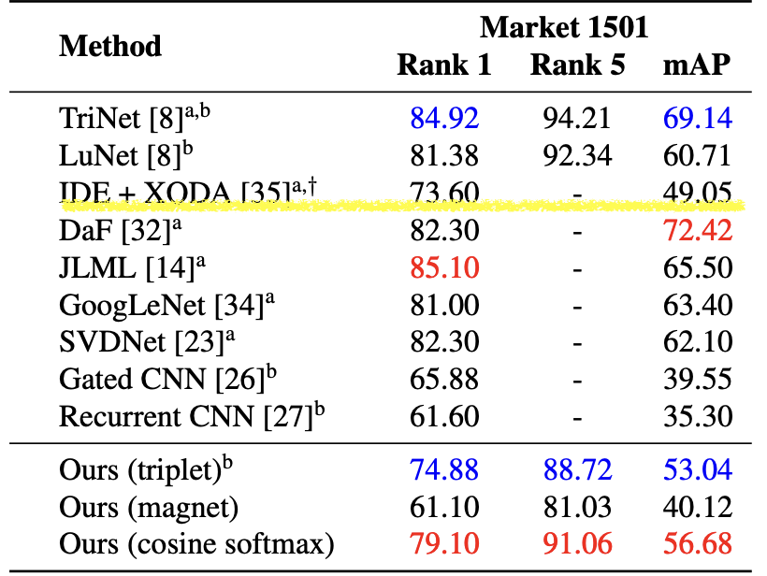
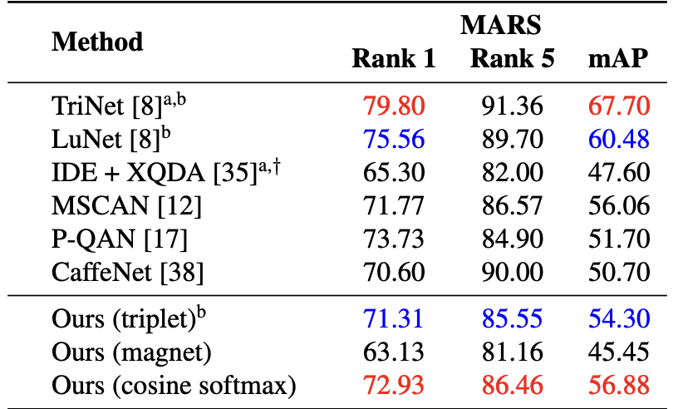
P.R.I.M.E. · blindspot-summer-2026 · Multi-Paper Presentation
2
Paper 1
Cover all four fields: argument, method, key finding, and your reaction
Main argument
Method or evidence
The main argument of this paper is what happens if we replace standard softmax with cosine softmax?
Authors used MARS and Market-1501 datasets.
Key finding
Your reaction
The most important results came from the Rank-1 and mAP (mean average precision)
What happens if we poison the feature embeddings?
Link / Citation:
arXiv:1812.00442v1 [cs.CV] 2 Dec 2018
P.R.I.M.E. Research Experience · blindspot-summer-2026 · APSU CSIT
2 / 7

Slide 4
P.R.I.M.E. · blindspot-summer-2026 · Multi-Paper Presentation
3
Paper 2
Cover all four fields: argument, method, key finding, and your reaction
Main argument
Method or evidence
This paper proposes a spatial-attention based embedding framework that learns different angles of vehicles so that the vehicle can be matched more accurately across different cameras and camera angles.
The datasets used were VeRi-776 and VehicleID
Key finding
Your reaction
The most important result was the mAP (mean average precision)
I thought this paper was very interesting since they took a different approach and made branches for the camera angles and got them to come together to create one embedding.
Link / Citation:
doi: 10.1109/TCSVT.2020.2980283
P.R.I.M.E. Research Experience · blindspot-summer-2026 · APSU CSIT
3 / 7

Slide 5
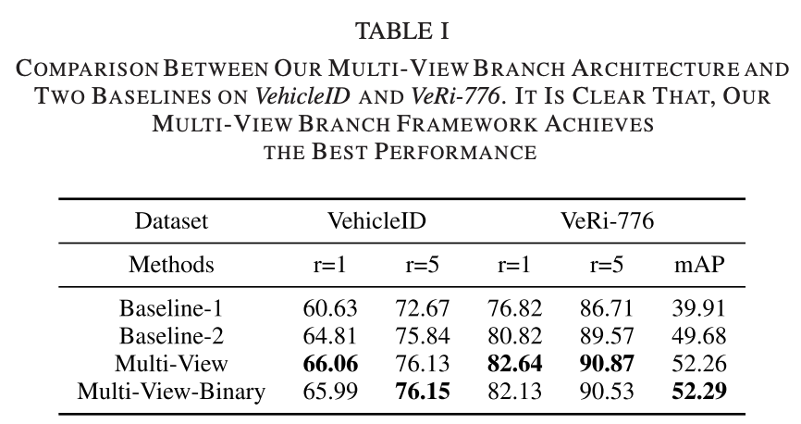
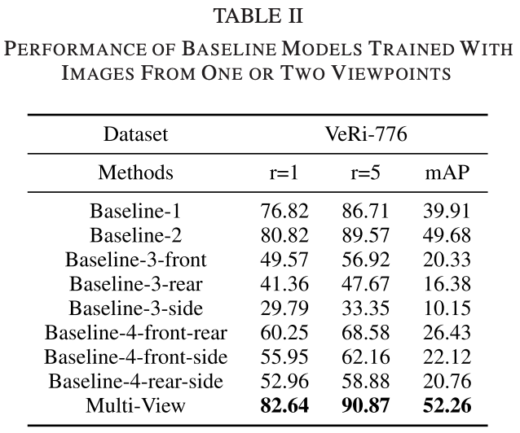
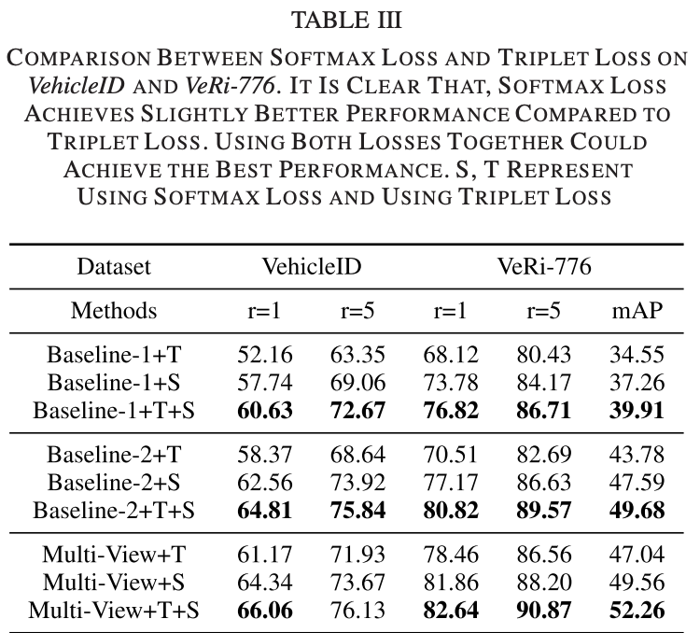
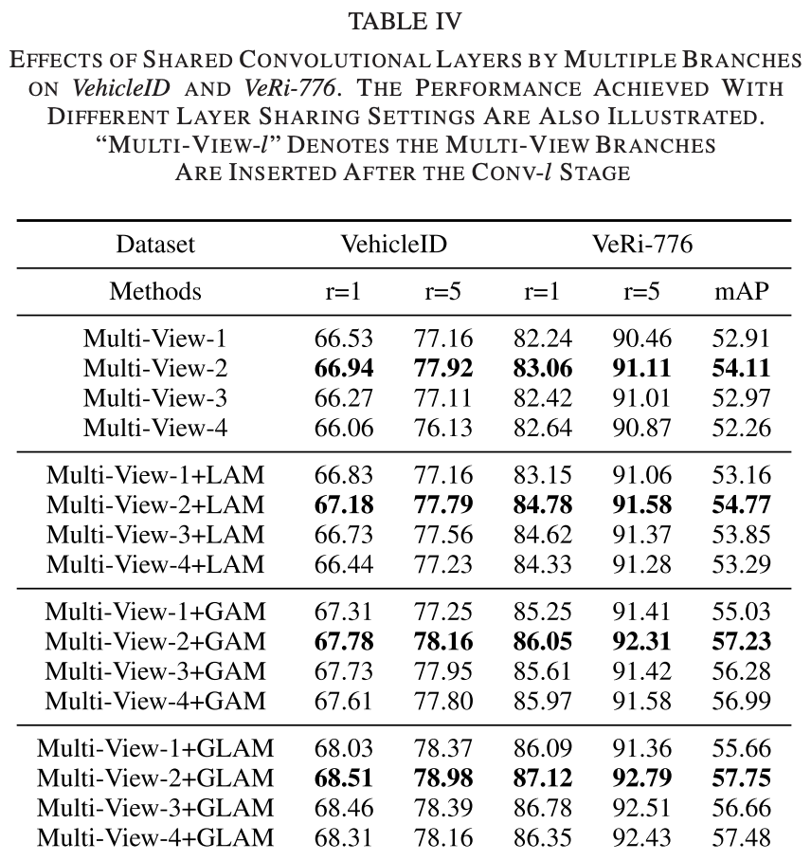

Slide 6
P.R.I.M.E. · blindspot-summer-2026 · Multi-Paper Presentation
4
Paper 3 — Optional
Use this slide if you found a third paper. Skip it if you only found two.
If you only found 2 papers this week, leave this slide blank and move straight to slide 5.
Main argument
Method or evidence
[One sentence: what does this paper claim?]
[What data or experiment did they use to show it?]
Key finding
Your reaction
[The single most important result]
[What surprised you or what question does it raise?]
P.R.I.M.E. Research Experience · blindspot-summer-2026 · APSU CSIT
4 / 7

Slide 7
blindspot · Paper Presentation
2
Main Argument
State the paper's central claim in ONE sentence. If you cannot say it in one sentence, keep refining.
[Click here and type the paper's main argument in one sentence]
Why does this matter?
[1–2 sentences: why does this claim matter to the PHANTOM project?]
P.R.I.M.E. Research Experience · blindspot-summer-2026 · APSU CSIT
2 / 7

Slide 8
blindspot · Paper Presentation
3
Method or Evidence
How did they show it? Describe the dataset, experiment, proof, or analysis.
Dataset or setting
Experimental approach
How they measured success
[What data did they use? How large? What domain?]
[What did they actually do? What comparisons did they make?]
[What metrics? What threshold for a good result?]
Additional notes on the method:
[Any additional context about how they conducted the study]
P.R.I.M.E. Research Experience · blindspot-summer-2026 · APSU CSIT
3 / 7

Slide 9
blindspot · Paper Presentation
4
Key Finding or Result
The single most important thing the paper found or demonstrated.
★ Main finding
[Describe the key result in 2–3 sentences. Be specific — include numbers if the paper reports them.]
Supporting result 1
Supporting result 2
[Secondary finding or supporting data point]
[Another supporting finding or comparison]
P.R.I.M.E. Research Experience · blindspot-summer-2026 · APSU CSIT
4 / 7

Slide 10
blindspot · Paper Presentation
5
Limitation or Open Question
What does this paper leave unsolved? What are you skeptical of?
What it leaves unsolved
What you are skeptical of
What question it raises for us
[What gap or assumption does this paper leave unaddressed?]
[What claim or result would you push back on and why?]
[What new question does this paper create for the blindspot project?]
Critical thinking prompt: Could you replicate this paper's results? What would you need?
P.R.I.M.E. Research Experience · blindspot-summer-2026 · APSU CSIT
5 / 7

Slide 11
P.R.I.M.E. · blindspot-summer-2026 · Multi-Paper Presentation
5
What Connects These Papers?
Look across all the papers you presented this week, what do they have in common?
Theme or pattern across this week's papers
How these papers connect to ALL prior reading
What idea, method, or approach shows up in more than one of the papers you read this week? Be specific — name the papers.
Do these papers agree with, contradict, or extend what you read in earlier weeks? Name specific prior papers.
Both the Wokje et. al and the Teng et. al focused on re-id and creating embeddings but do so in different ways.
These papers extend what I have read previously. Wojke et. al and Teng et. al agree with Hsu et. al in the sense that they are looking at the embeddings and grouping the same object in training.
What is still missing across everything you have read?
The biggest gap I have still seen is what happens when the embedding space in poisoned?
P.R.I.M.E. Research Experience · blindspot-summer-2026 · APSU CSIT
5 / 7

Slide 12
P.R.I.M.E. · blindspot-summer-2026 · Paper Presentation
7
Synthesis: Connecting the Papers
Starting from week 3, use this slide to connect ALL the papers you have read so far, not just this week's paper.
1
What pattern connects the papers?
2
Where is the gap?
3
Which paper surprised you most and why?
What theme, idea, or approach shows up across multiple papers you have read? Name at least two papers in your answer.
What has NOT been done yet across all the papers you have read? How does PHANTOM fill that gap?
Pick one paper from any week. What did it say that you did not expect — and did it change how you think about the project?
The theme I have seen from Liu et. al, Hsu et. al Teng et. al, and Wojke et al. has been about making the trackers better. Each paper wants to take what’s already been done and make it more sensitive to things like the background, or different angles.
None of the papers have talked about what happens when the embedding space is poisoned and how it could affect other cameras.
I thought the Teng et. al paper was very interesting. I think the method of splitting into different branches for each of the different viewpoints and then bringing them all back together to create one embedding makes a lot of sense.
This slide is pre-writing your Week 8 literature review. The patterns you identify here become the themes that organize the paper.
P.R.I.M.E. Research Experience · blindspot-summer-2026 · APSU CSIT
6/ 7

Slide 13
P.R.I.M.E. · blindspot-summer-2026 · Multi-Paper Presentation
7
One Question for the Group
End every presentation with one open question. It should come from the gap you identified, something the group can actually discuss.
❓
How do embedding space attacks affect cross-camera vehicle re-identification?
A good question is one you genuinely do not know the answer to. It should make the group think, not just recap what the papers said.
P.R.I.M.E. Research Experience · blindspot-summer-2026 · APSU CSIT
7 / 7

