Slide 1

blindspot
detecting what the tracker cannot see
Paper title:
BadNets: Evaluating backdooring attacks on deep neural networks
Authors:
Gu, T., Liu, K., Dolan-Gavitt, B., & Garg, S
Venue & year:
IEEE Access, 7, 47230–47244, 2019
Link:
https://doi.org/10.1109/ACCESS.2019.2909068
Christine · Week 02 · P.R.I.M.E. Summer 2026
P.R.I.M.E. Research Experience · blindspot-summer-2026 · APSU CSIT
1 / 7

Slide 2
blindspot · Paper Presentation
2
Main Argument
State the paper's central claim in ONE sentence. If you cannot say it in one sentence, keep refining.
This paper claims that deep neural networks can be maliciously trained to pass validation testing but still produce incorrect outputs if a trigger is present.
Why does this matter?
This matters to us because we are trying to do a similar experiment. Essentially this is like a precursor to the work we plan on doing since it is just on images and not videos.
P.R.I.M.E. Research Experience · blindspot-summer-2026 · APSU CSIT
2 / 7

Slide 3
blindspot · Paper Presentation
3
Method or Evidence
How did they show it? Describe the dataset, experiment, proof, or analysis.
Dataset or setting
Experimental approach
How they measured success
There were two datasets used for their experiments: MNIST handwritten digit dataset and U.S. traffic sign dataset. The MNIST dataset used images of digits 0-9, while the traffic sign dataset used 8,612 images.
Both datasets had two attack types performed on them: a single-target attack and an All-to-all attack. They compared the clean images to the triggered images for both datasets and in the single-target attack they wanted the results to output a specific incorrect result, while the all-to-all attack was intended to give a random incorrect result.
The threshold for a good result came from the average percentage of accuracy.
Additional notes on the method:
P.R.I.M.E. Research Experience · blindspot-summer-2026 · APSU CSIT
3 / 7

Slide 4
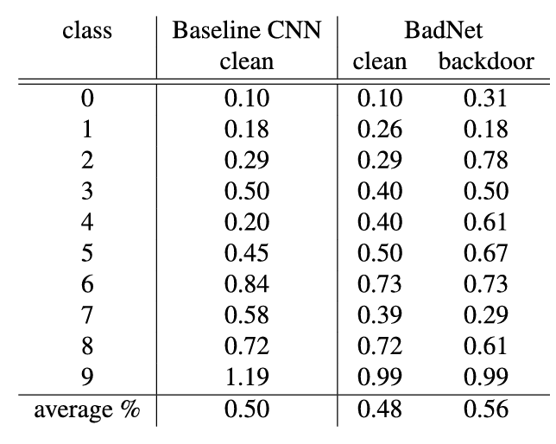
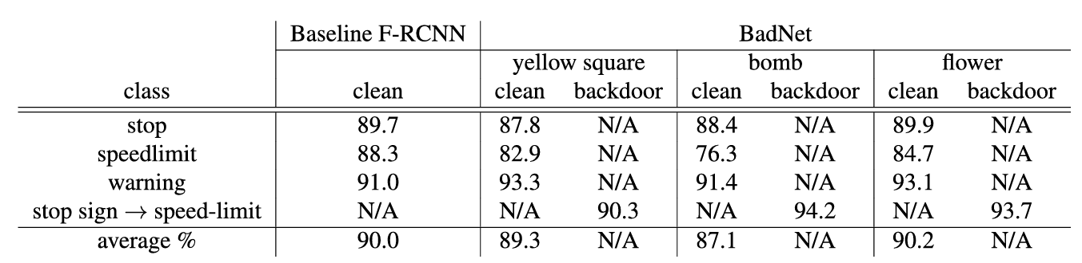
blindspot · Paper Presentation
4
Key Finding or Result
The single most important thing the paper found or demonstrated.
★ Main finding
The most important thing this paper demonstrated was that backdoor attacks are real and a potential threat. The authors had successful results to show that they two types of attacks they performed would not be caught. It also showed that backdoors can survive transfer learning.
Supporting result 1
Supporting result 2
P.R.I.M.E. Research Experience · blindspot-summer-2026 · APSU CSIT
4 / 7

Slide 5
blindspot · Paper Presentation
5
Limitation or Open Question
What does this paper leave unsolved? What are you skeptical of?
What it leaves unsolved
What you are skeptical of
What question it raises for us
How many poisoned samples are needed? What happens when much larger databases are used?
I am skeptical of whether this would work on other models.
Could we replicate this experiment in a multi-camera tracking scenario?
I think this experiment could be replicated if we used the same datasets and backdoored version types.
P.R.I.M.E. Research Experience · blindspot-summer-2026 · APSU CSIT
5 / 7

Slide 6
blindspot · Paper Presentation
6
Connection to Our Project
How does this paper change how you think about embedding-space poisoning in multi-camera tracking?
How this paper connects to blindspot:
This paper connects to blindspot because it shows that poisoned attacks can happen during training of the CNN model. This same idea could be applied to ReID systems
This paper supports our approach because...
This paper challenges our approach because...
it proves that backdoor attacks work in CNN feature representations.
it is only using image classification neural networks and not using multi-camera tracking.
P.R.I.M.E. Research Experience · blindspot-summer-2026 · APSU CSIT
6 / 7

