Slide 1

blindspot
detecting what the tracker cannot see
Paper title:
Blinding and blurring the multi-object tracker with adversarial perturbations
Authors:
Haibo Pang, Rongqi Ma, Jie Su, Chengming Liu, Yufei Gao, Qun Jin
Venue & year:
Neural Networks, Volume 176, 2024
Link:
https://doi.org/10.1016/j.neunet.2024.106331
Christine · Week 02 · P.R.I.M.E. Summer 2026
P.R.I.M.E. Research Experience · blindspot-summer-2026 · APSU CSIT
1 / 7

Slide 2
blindspot · Paper Presentation
2
Main Argument
State the paper's central claim in ONE sentence. If you cannot say it in one sentence, keep refining.
This paper is a study on whether or not creating small changes to video frames will cause tracking systems to stop seeing objects it was tracking or start tracking things that are essentially background objects.
Why does this matter?
This is important because this is similar to the experiment we will be running. This article shows us that the tracker we plan to test will most likely be vulnerable to an adversarial attack since it is an extension of ByteTrack.
P.R.I.M.E. Research Experience · blindspot-summer-2026 · APSU CSIT
2 / 7

Slide 3
blindspot · Paper Presentation
3
Method or Evidence
How did they show it? Describe the dataset, experiment, proof, or analysis.
Dataset or setting
Experimental approach
How they measured success
The datasets used for evaluation were: MOT16, MOT17, and MOT20. They don’t explicitly state the size but say that the test set contained 7 video sequences.
The authors created a new adversarial attack called Blind-Blur Attack that’s main goal was to blind the tracker from detecting real people or blurring the tracker so it mistakes the background for a person. They compared the performance of the tracker on clean data and then used blinded and blurred data.
Metrics:
MOTA
IDF1
HOTA
The threshold for a good result came from the difference between the performance of clean and attacked data.
Additional notes on the method:
They take into consideration things like random heavy noise and compare the results to other attacks like F&F and Hijacking.
P.R.I.M.E. Research Experience · blindspot-summer-2026 · APSU CSIT
3 / 7

Slide 4
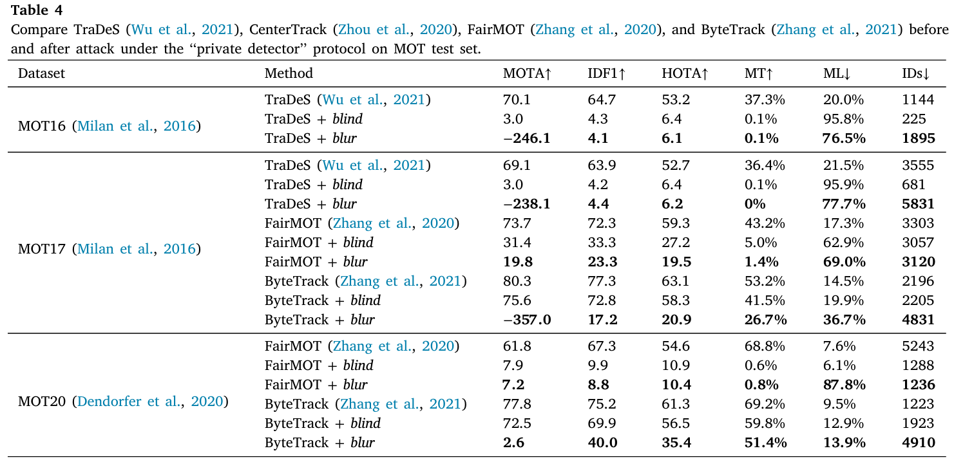
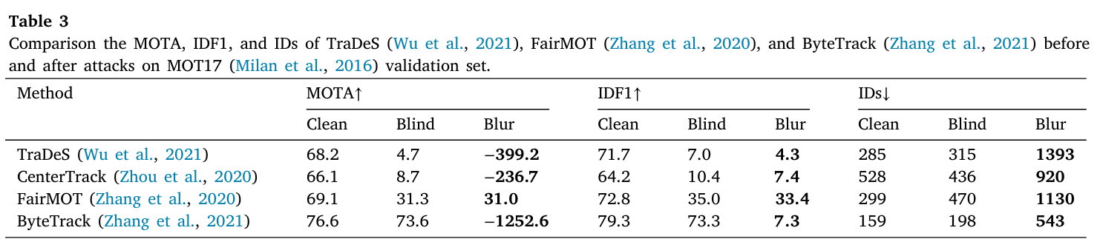
blindspot · Paper Presentation
4
Key Finding or Result
The single most important thing the paper found or demonstrated.
★ Main finding
This papers key result is the BBA degrades the performance of multi-object trackers. The tables below show how effective this attack was on four different trackers. This attack dramatically reduced the performance of the trackers it attacked.
Supporting result 1
Supporting result 2
[Secondary finding or supporting data point]
P.R.I.M.E. Research Experience · blindspot-summer-2026 · APSU CSIT
4 / 7

Slide 5
blindspot · Paper Presentation
5
Limitation or Open Question
What does this paper leave unsolved? What are you skeptical of?
What it leaves unsolved
What you are skeptical of
What question it raises for us
This study was mostly focused on tracking pedestrians so it’s difficult to say that this method would work on tracking any other objects. Also there was no testing with any defense mechanisms.
I would be skeptical of the fact that this was all done in a digital environment and not in a real-world setting.
Can an attack like this be replicated using multi-camera tracking?
I think this experiment could be replicated if we used the same datasets and trackers.
P.R.I.M.E. Research Experience · blindspot-summer-2026 · APSU CSIT
5 / 7

Slide 6
blindspot · Paper Presentation
6
Connection to Our Project
How does this paper change how you think about embedding-space poisoning in multi-camera tracking?
How this paper connects to blindspot:
This paper connects to blindspot because it shows that attacks can distort the trackers “eyes” and cause the performance to degrade and the output becomes unreliable. This is similar to what we want to do, which is to make the system form incorrect associations between observations.
This paper supports our approach because...
This paper challenges our approach because...
it shows that adding perturbations the tracker can make mistakes or misidentify objects it was tracking.
it only used single camera multi-object tracking.
P.R.I.M.E. Research Experience · blindspot-summer-2026 · APSU CSIT
6 / 7

