Slide 1
Ceph: A Scalable, High-Performance Distributed File System
Sage A. Weil, Scott A. Brandt, Ethan L. Miller, Darrel D. E. Long

Slide 2
Contents
Goals
System Overview
Client Operation
Dynamically Distributed Metadata
Distributed Object Storage
Performance

Slide 3
Goals
Scalability
  Storage capacity, throughput, client performance. Emphasis on HPC.
Reliability
  “…failures are the norm rather than the exception…”
Performance
  Dynamic workloads

Slide 4
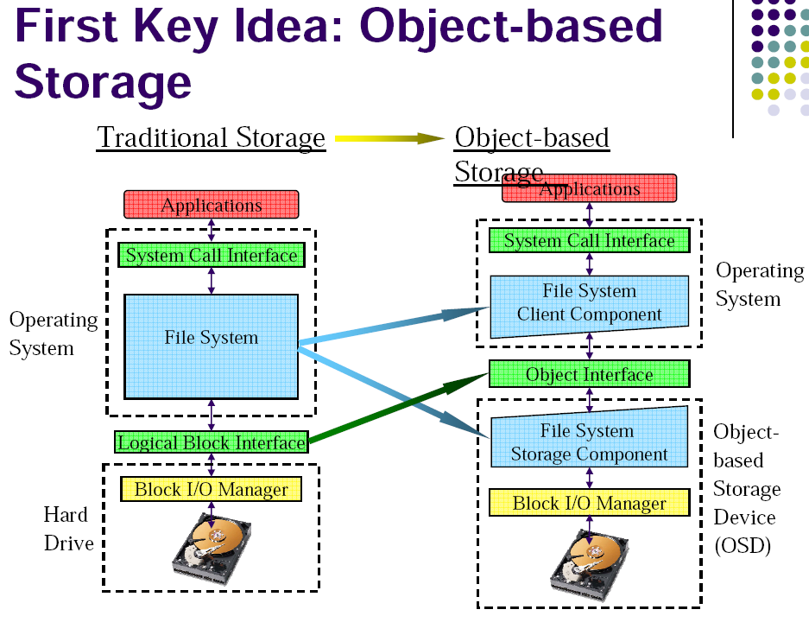

Slide 5
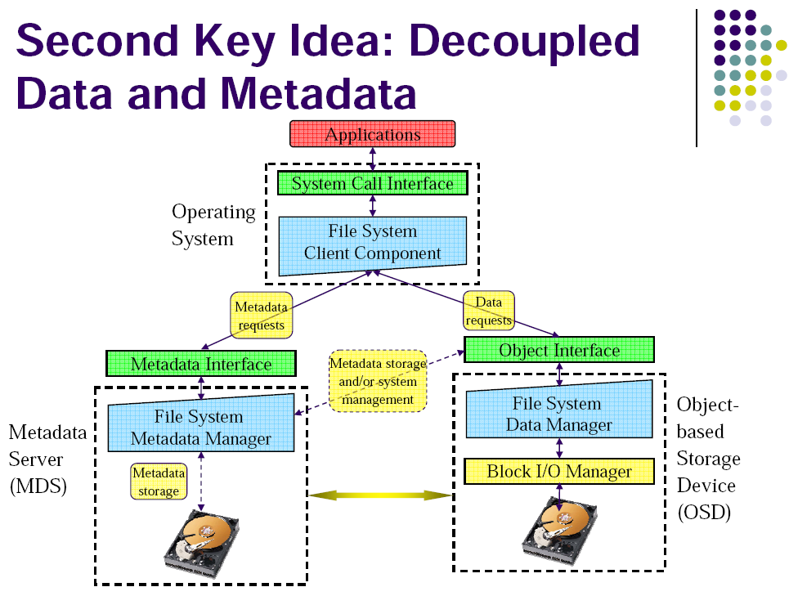

Slide 6
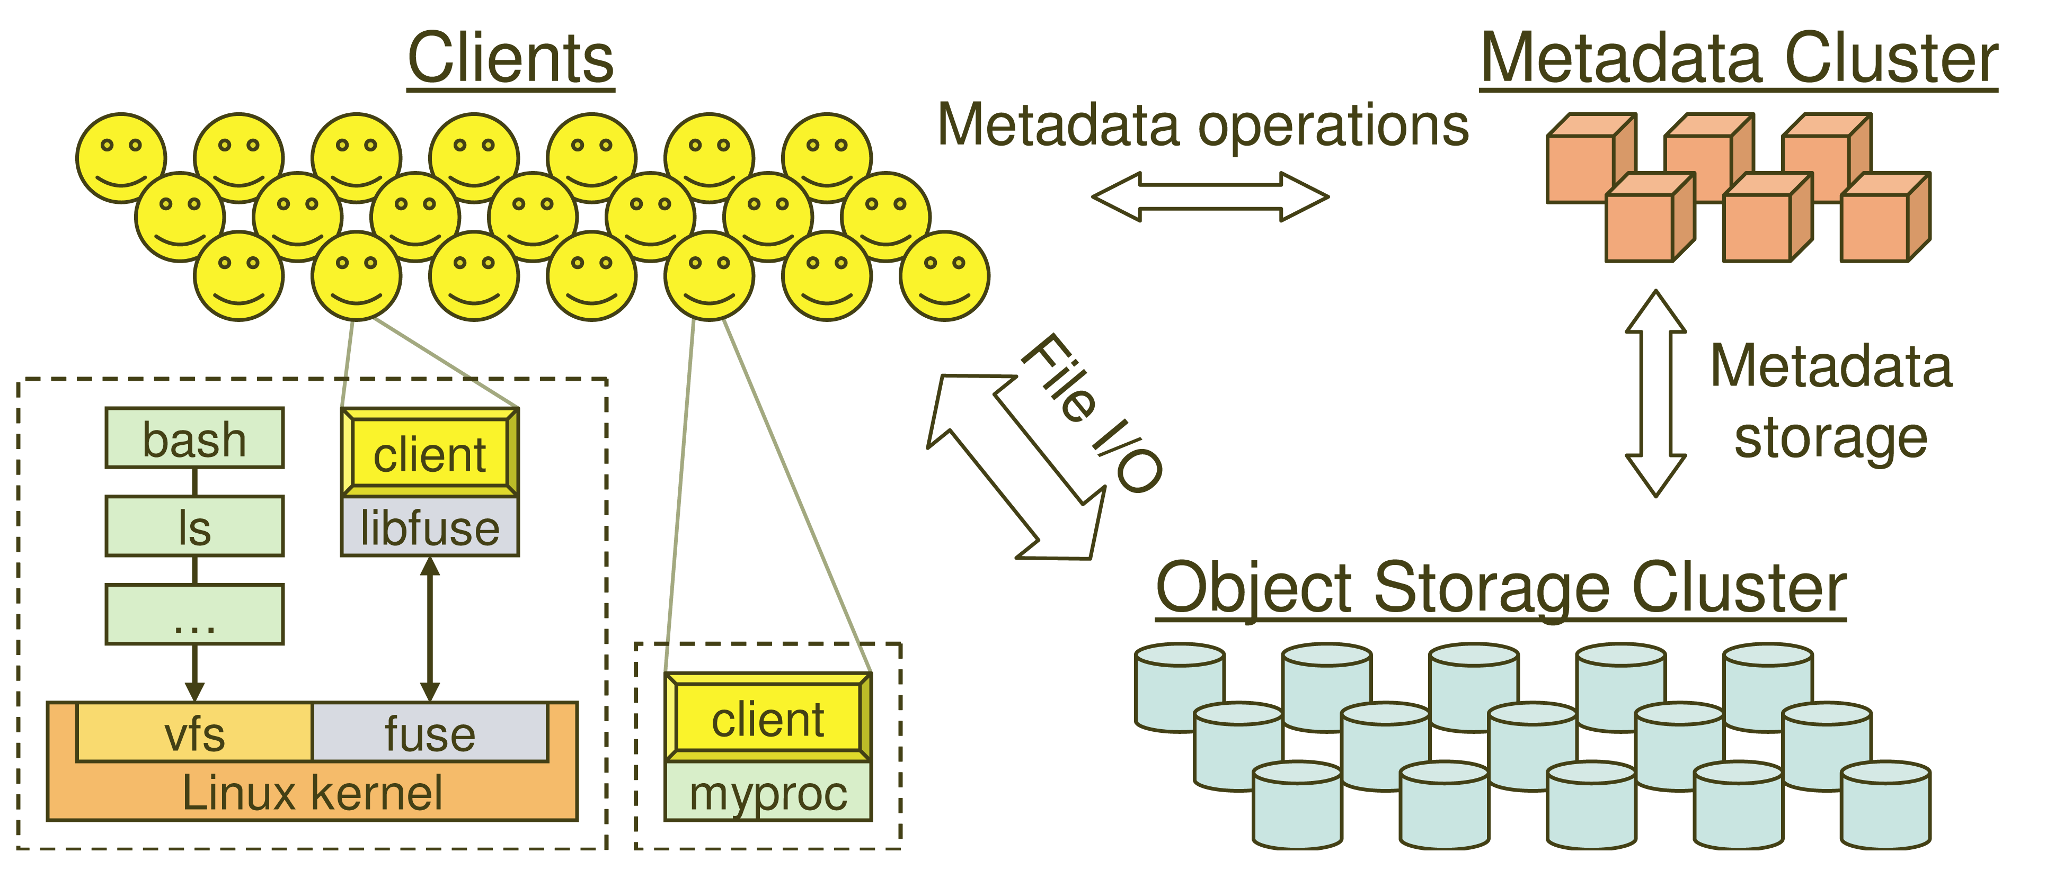
System Overview

Slide 7
Key Features
Decoupled data and metadata
  CRUSH
    Files striped onto predictably named objects
    CRUSH maps objects to storage devices
Dynamic Distributed Metadata Management
  Dynamic subtree partitioning
    Distributes metadata amongst MDSs
Object-based storage
  OSDs handle migration, replication, failure detection and recovery

Slide 8
Client Operation
Ceph interface
  Nearly POSIX
  Decoupled data and metadata operation
User space implementation
  FUSE or directly linked

Slide 9
Client Access Example
Client sends open request to MDS
MDS returns capability, file inode, file size and stripe information
Client read/write directly from/to OSDs
MDS manages the capability
Client sends close request, relinquishes capability, provides details to MDS

Slide 10
Synchronization
Adheres to POSIX
Includes HPC oriented extensions
  Consistency / correctness by default
  Optionally relax constraints via extensions
  Extensions for both data and metadata
Synchronous I/O used with multiple writers or mix of readers and writers

Slide 11
Distributed Metadata
“Metadata operations often make up as much as half of file system workloads…”
MDSs use journaling
  Repetitive metadata updates handled in memory
  Optimizes on-disk layout for read access
Adaptively distributes cached metadata across a set of nodes

Slide 12
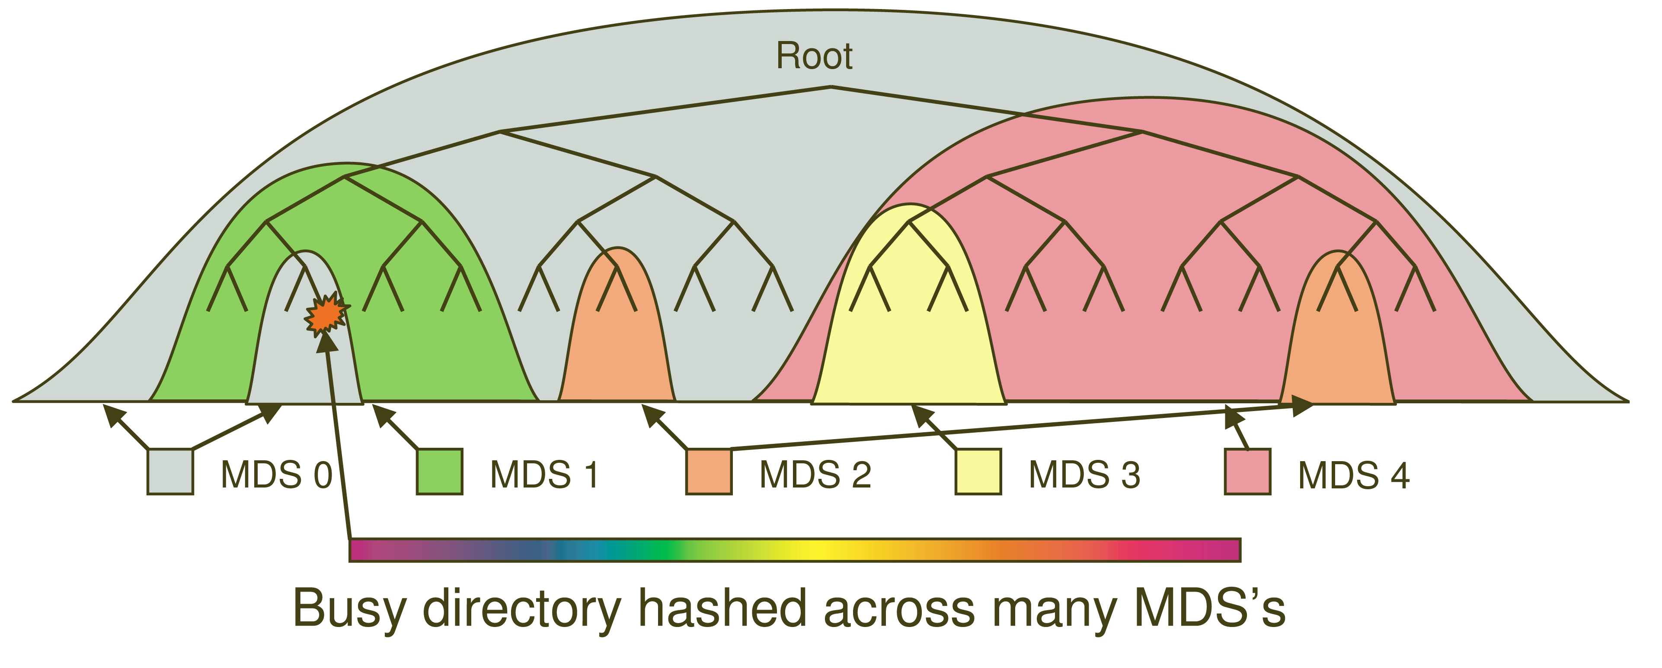
Dynamic Subtree Partitioning

Slide 13
Distributed Object Storage
Files are split across objects
Objects are members of placement groups
Placement groups are distributed across OSDs.

Slide 14
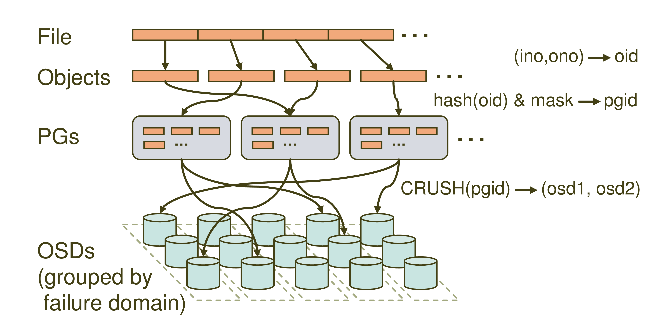
Distributed Object Storage

Slide 15
CRUSH
CRUSH(x) → (osd_{n1}, osd_{n2}, osd_{n3})
  Inputs
    x is the placement group
    Hierarchical cluster map
    Placement rules
  Outputs a list of OSDs
Advantages
  Anyone can calculate object location
  Cluster map infrequently updated

Slide 16
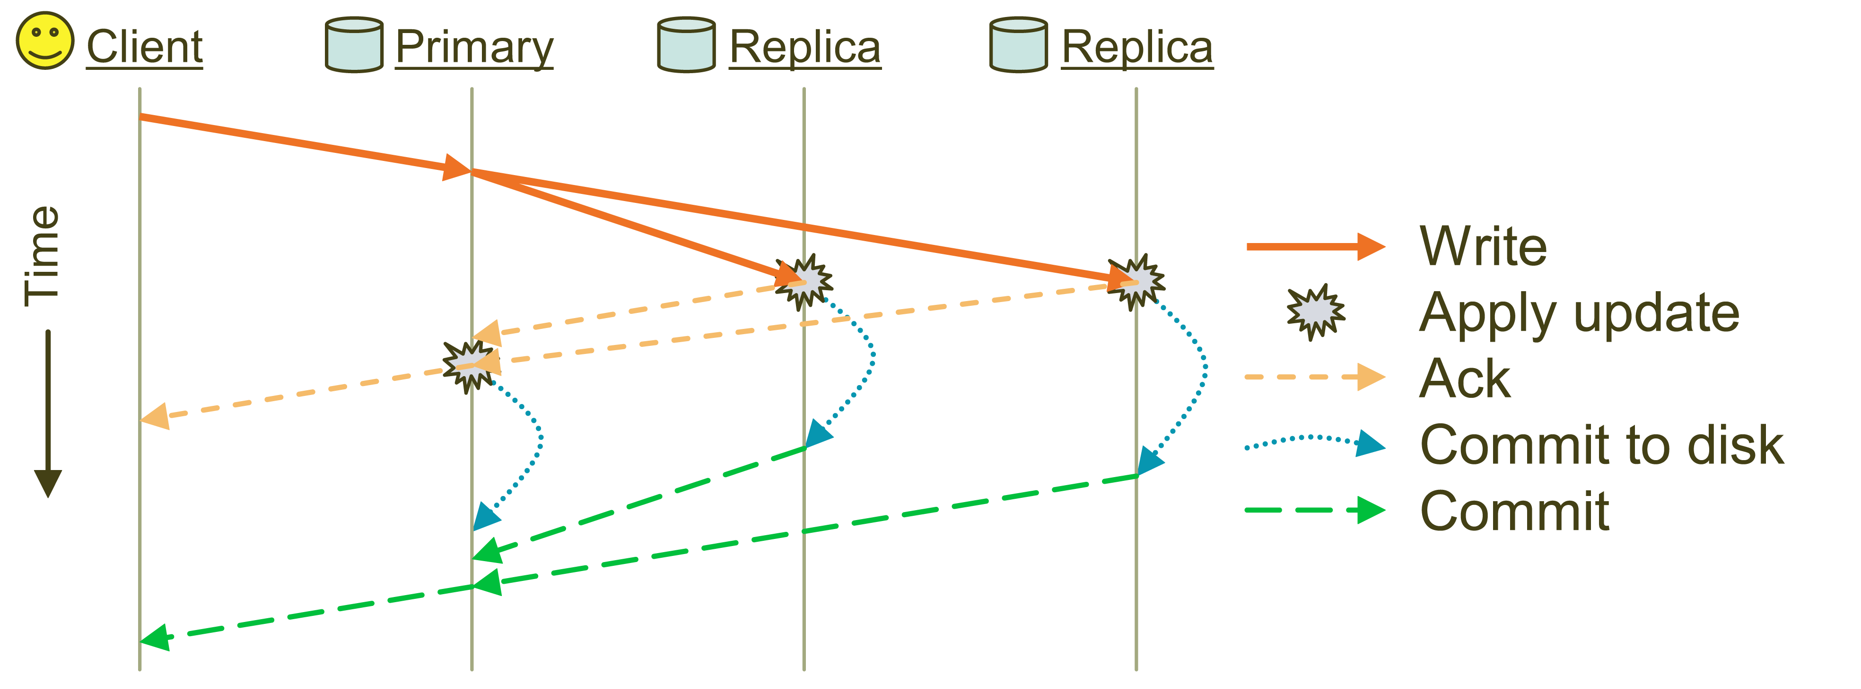
Replication
Objects are replicated on OSDs within same PG
  Client is oblivious to replication

Slide 17
Failure Detection and Recovery
Down and Out
Monitors check for intermittent problems
New or recovered OSDs peer with other OSDs within PG

Slide 18
Conclusion
Scalability, Reliability, Performance
Separation of data and metadata
  CRUSH data distribution function
Object based storage

Slide 19
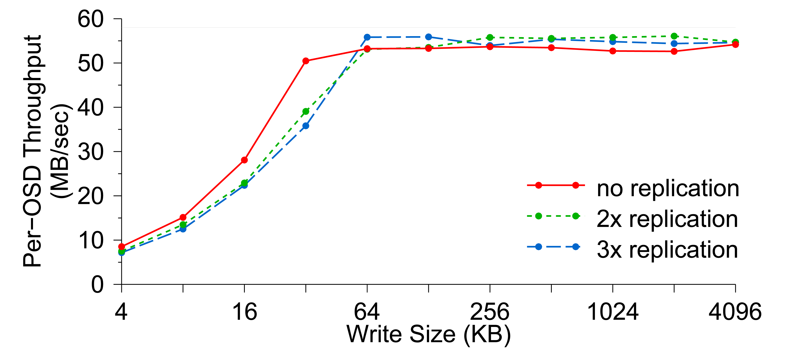
Per-OSD Write Performance

Slide 20
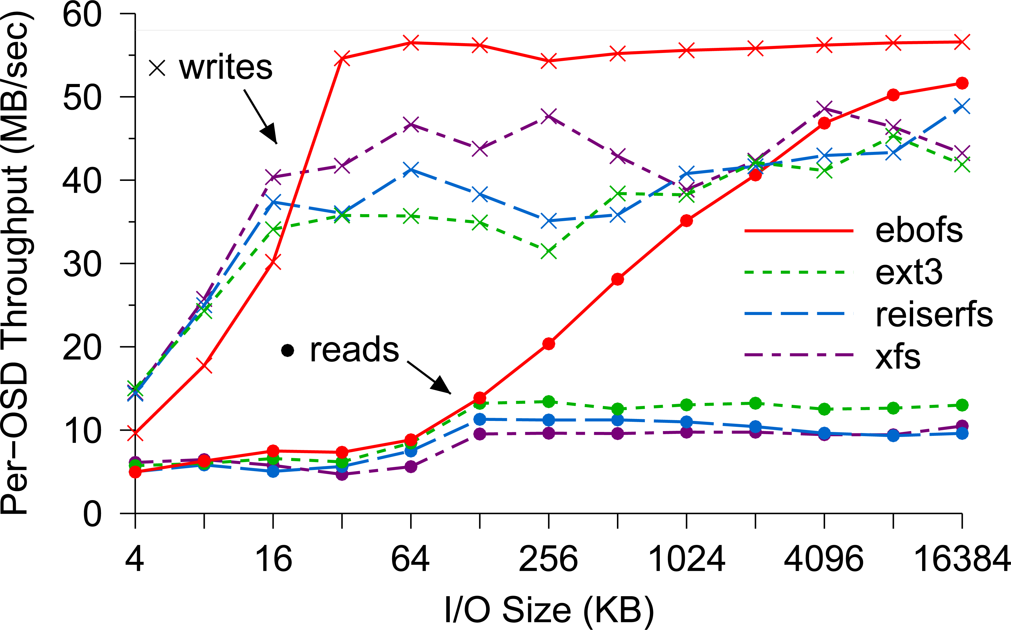
EBOFS Performance

Slide 21
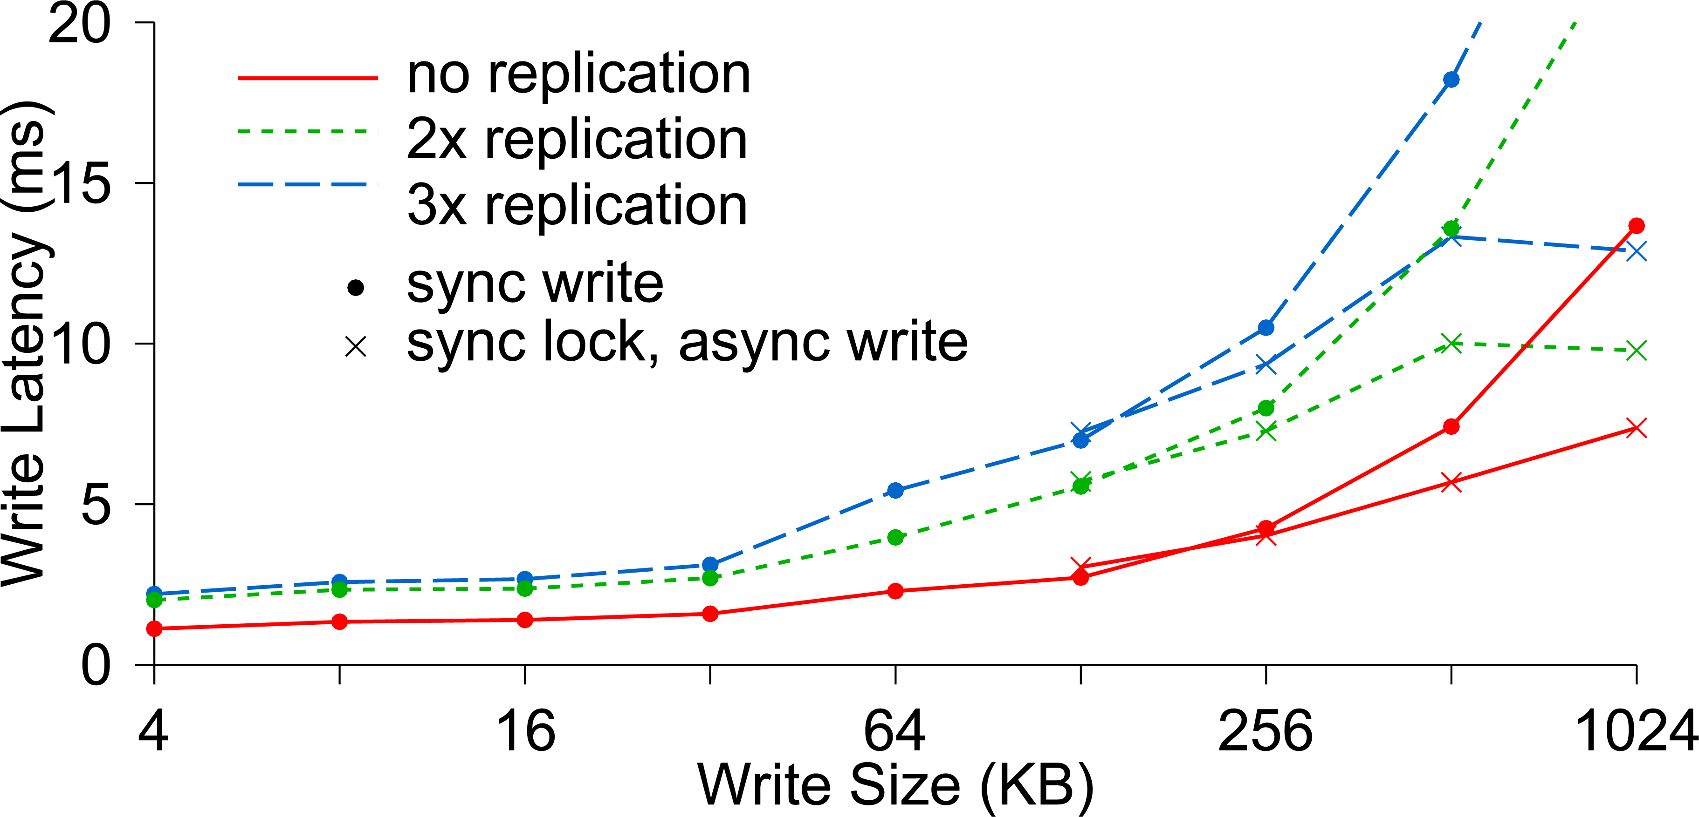
Write Latency

Slide 22
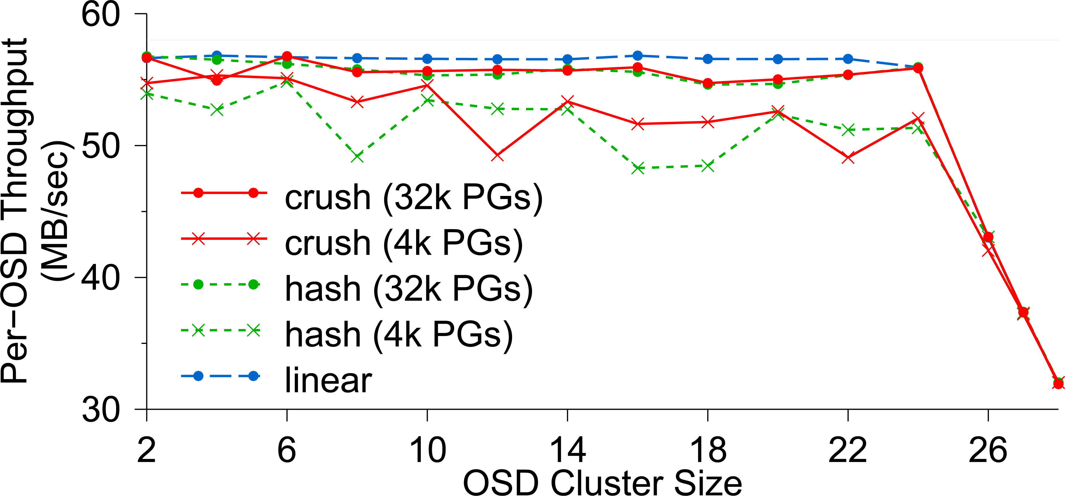
OSD Write Performance

Slide 23
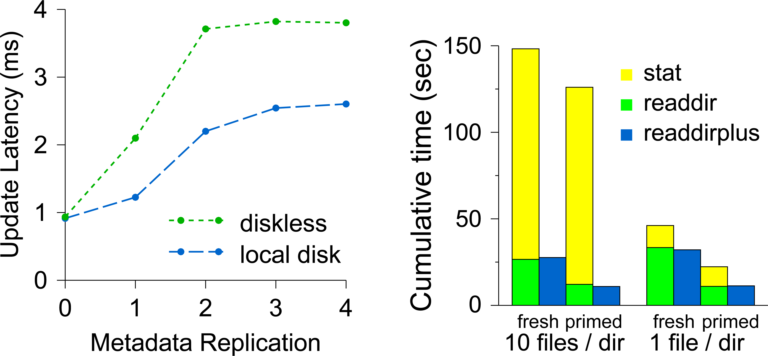
Diskless vs. Local Disk

Slide 24
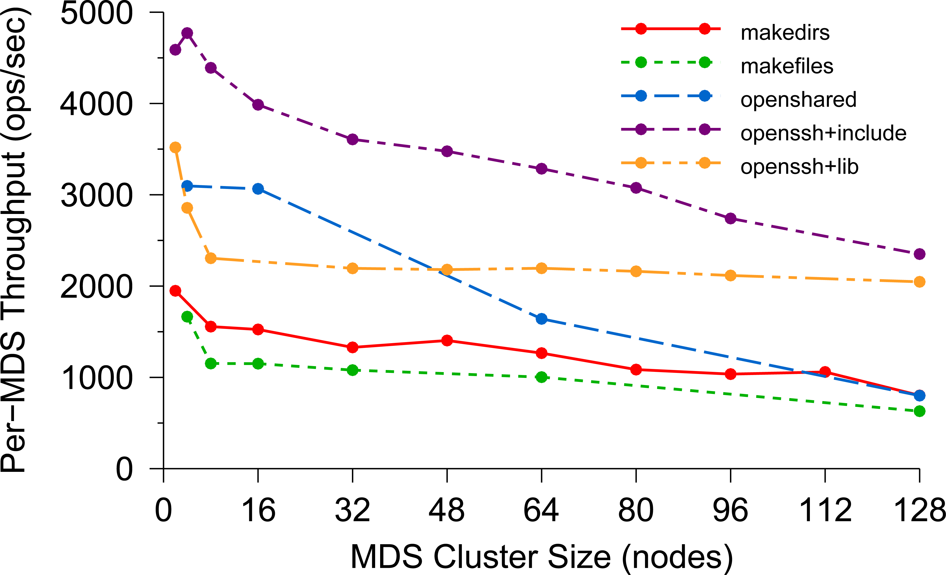
Per-MDS Throughput

Slide 25
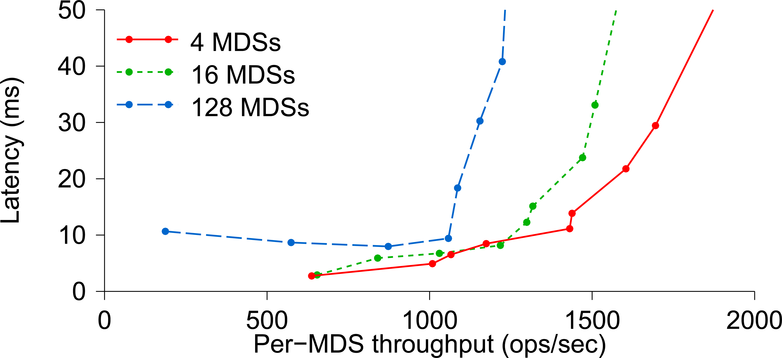
Average Latency

Slide 26
Related Links
OBFS: A File System for Object-based Storage Devices
  ssrc.cse.ucsc.edu/Papers/wang-mss04b.pdf
OSD
  www.snia.org/tech_activities/workgroups/osd/
Ceph Presentation
  http://institutes.lanl.gov/science/institutes/current/ComputerScience/ISSDM-07-26-2006-Brandt-Talk.pdf
  Slides 4 and 5 from Brandt’s presentation

Slide 27
Acronyms
CRUSH: Controlled Replication Under Scalable Hashing
EBOFS: Extent and B-tree based Object File System
HPC: High Performance Computing
MDS: MetaData server
OSD: Object Storage Device
PG: Placement Group
POSIX: Portable Operating System Interface for uniX
RADOS: Reliable Autonomic Distributed Object Store

