Slide 1
ZIL Performance Improvements for Fast Media
Saji Nair

Slide 2
Agenda
ZIL (ZFS Intent Log) overview
Performance bottlenecks when using a low latency media (NVMe SSD) as SLOG
Proposed design changes
Performance results
Limitations with proposed design
Q & A

Slide 3
ZIL (ZFS Intent Log) Overview

Slide 4
ZIL overview – SLA for sync operations
File system namespace is up to date.
All pending name space operaions (creates, renames, deletes etc) have to be persisted on-disk before responding to any synchronous operation such as fsync, sync writes.
All relevant data and metadata for the object being operated on must be written to persistent storage.
For a workload which is purely sync writes (no name space operations), all concurrent writes are independent – Do not depend on any other outstanding writes.
No guarantee on the order in which independent concurrent operations finish.
Optional separate vdev for persisting log entries (SLOG)
On-disk log entries are organized as a linked list
On a crash/power outage, log is replayed as part of importing the pool

Slide 5
ZIL overview - What is ZIL, SLOG
ZIL (ZFS intent log) is ZFS software component which implements a log of modify operations
All modify operations are logged in-memory, Synchronous operations are committed to persistent media
By default, ZIL uses data vdevs as persistent store.
Optionally separate vdev (called SLOG – separate log device) could be used as persistent store
Faster media (such as NVMe SSDs) as SLOG helps to improve performance

Slide 6
ZIL overview - What is ZIL, SLOG
Workload specific tuning – “logbias”
“Logbias = Latency” – smaller data blocks (less than 32K) written twice for sync operations
“Logbias = Throughput” – All data blocks written to final destination in data vdev
On-disk log entries are organized as a linked list
On a crash/power outage, log is replayed as part of importing the pool

Slide 7
ZIL overview - Terminology
In-memory state for ZIL corresponding to a dataset
Zilog
Sync_itxs
Logs namespace operations, all sync operations – Per dataset
Async_itxs
Logs other modify operations – AVL tree, tracking per object operations
Itx (log record) – Intent transaction
In memory data structure tracking each modify operation, tracked per transaction group across two lists, itx_sync, itx_async
LWB – Log Write Block
In memory representation of a disk block written out, holding one ore more itxes (log records)
zil_lwbs
List of in-flight LWBs

Slide 8
ZIL overview : How it works
All modify operations are added as an itx
Namespace operations and sync operations (operations done on an object which has atleast one open which is O_SYNC) are added to sync_list (i_sync_list)
Async operations on an object are added to per-object list (i_async_tree)
As part of an operation (such as fsync or a sync write) which needs to commit the relevant pending modify operations..
Gather all relevant pending itxes – all itxes in sync_list and all itxes for corresponding object in async list
Assign the itxes to a LWB, write out through zio pipeline, wait for that LWB and all other pending LWBs to finish before responding to the thread waiting on.

Slide 9
On-disk linked list – Why ?
Needed for ZIL replay
Needed to read the LWBs spread across disk(s)
Required for replaying the records in-order
Enforces operations dependency
If an LWB carries a namespace operation, need that to finish before responding to a write which is part of a succeeding block.
SLOG vdev
zilog
LWB3
LWB4
LWB2
LWB1
LWB5
LWB6

Slide 10
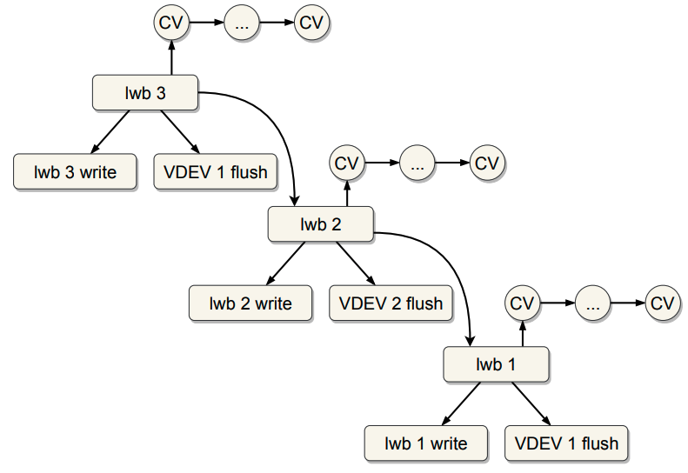
On-disk linked list – How ?
ZIO pipeline is used for writing out LWBs
ZIO hierarchy is used for enforcing LWB chain dependency
Each LWB written out becomes parent of the last pending LWB.
Also enforces that the on-disk list of blocks are always complete.
Image from 2017 OpenZFS talk

Slide 11
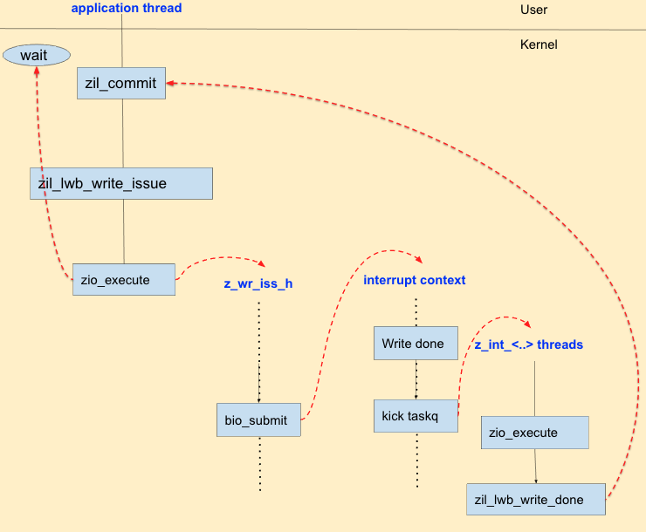
Why is zio pipeline bad for ZIL writes ?
ZIO pipeline causes multiple context switches
Significant when a faster media (less than 100us latency) is used as SLOG
Multiple zios (write, flush, root) involved before the application thread can be woken up
Zio dependency due to ordering of operations and to preserve linked list on-disk adds more wait times and context switches.

Slide 12
Why is on-disk linked list bad ?
Limits ZIL write performance
Extra context switches in ZIO pipeline
One stalled LWB write can starve everything after that.
Adds unnecessary dependency between LWBs
Even when all operations across LBWs are independent (such as writes), to form the complete chain, the each LWB depends on all the previous ones to be written out.
Each LWB written out becomes parent of the last pending LWB.
Also enforces that the on-disk list of blocks are always complete.

Slide 13
Example day
To Recap…

Slide 14
ZIO pipeline is inefficient for ZIL writes.
With a faster SLOG device, the context switch overhead becomes significant part of the overall latency.
ZIL writes enforces LWB dependency even when operations across the LWBs are completely independent.
On-disk linked list layout enforces LWB dependency to make sure the list is always completely formed.

Slide 15
Example oday
What if …

Slide 16
An NVMe SSD with extremely low latency (less than 50us) is used as SLOG
Workload is 100% random writes, each less than 8K in size.
Thus no dependency between operations.
ZIO pipeline is not used, and a blocking write is done on behalf of application thread to write out an LWB.
On-disk layout for LWBs are not a linked list, thus no need to enforce dependency between LWBs

Slide 17
Performance test - Configuration
CentOS Linux VM (Kernel version – 5.0) - 64GB memory, 32 vcpus
Four zpools – 4 data vdevs, 2 metadata vdevs per zpool
Record size – 8K
2 Intel NVMe SSDs in PCI-Passthrough mode
Two NVMe log devices per pool, each a namespace from NVMe drive

Slide 18
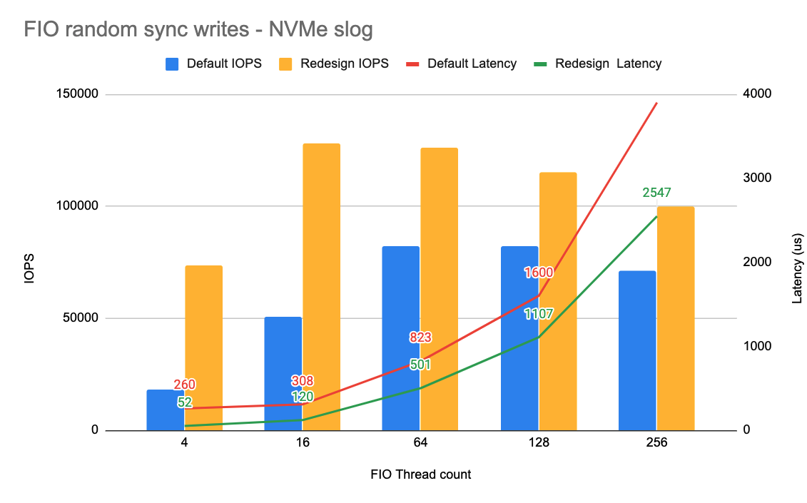
Performance test Results
Up to 4x IOPS and similar reduction in latency

Slide 19
That’s great! But…
How do we do the replay without an on-disk linked list of LWBs ?
How do we meet the SLA for synchronous operations ?
What if the workload is a mix of namespace operations and writes

Slide 20
How do we do the replay without an on-disk linked list of LWBs ?

Slide 21
Avoid on-disk linked list
LWBs are scattered in a well-defined region on disk for each txg
Per LWB sequence number for enforcing ordering for replay
Replay scans the region, forms a balanced BST using sequence number to get an ordered list
Need separate allocation logic and vdev
Or a dedicate part of data vdev
Status – In concept, relatively straight forward to do
SLOG vdev
L3
L2
L1
L4
L6
L5
Txg 1
L6
L8
L7
L10
L11
L12
Txg 2
L15
L14
L13
L16
L19
L18
Txg 2

Slide 22
How do we meet the SLA for synchronous operations ?

Slide 23
Enforce “required” dependency
Define “Namespace LWB” – LWB which carries a namespace operation
Keep track of all pending namespace LWBs
Form a dependency chain for LWBs based on whether namespace operations are pending or not.
An LWB is completely independent if there are no namespace LWBs pending
An LWB depends only on the last pending namespace LWB to finish.
Each LWB write carries data that thread needs to wait on and any namespace operations, but not data for any other thread.

Slide 24
Enforce “required” dependency
Zilog
Tracking namespace operations separately allows us to deterministically identify if we need to force the succeeding LWBs to wait for the namespace operations to be committed.
Logs only namespace operations – Per dataset
Sync_itxs
Logs other modify operations (including sync writes) AVL tree, tracking per object operations..
Async_itxs
zil_ns_lwbs
List of pending namespace LWBs

Slide 25

Example – Before
T1
Zilog
Create F1
Sync_itxs
Create F1
With default sync mode, Create succeeds immediately
Time
Async_itxs
zil_lwbs

Slide 26
Example – Before
T1
Zilog
T2
Create F1
Sync_itxs
Create F1
Open F2 (S)
Time
Open Succeeds
Async_itxs
zil_lwbs

Slide 27
Example – Before
T1
Zilog
T2
Create F1
Sync_itxs
Create F1
Open F2 (S)
Write F1
Time
Write Succeeds
Async_itxs
Write F1
zil_lwbs

Slide 28
Example – Before
T1
Zilog
T2
Create F1
Sync_itxs
Create F1
Write F2
Open F2 (S)
Write F1
Write F2
Time
Since this write is sync write, added to per dataset sync list
Async_itxs
Write F1
zil_lwbs

Slide 29
Example – Before
T1
Zilog
T2
Create F1
Sync_itxs
Open F2 (S)
Write F1
Write F2
Time
Async_itxs
Write F1
LWB1
Since write is sync, commit that write and all pending sync operations
zil_lwbs
C F1
W F2
lwb_waiters
T2

Slide 30
Example – Before
T1
Zilog
T2
Create F1
Sync_itxs
Open F2 (S)
Write F1
Write F2
Time
Fsync F1
Async_itxs
Child
LWB1
LWB2
Commit async write on F1 through new LWB, making it parent of pending LWB
zil_lwbs
C F1
W F2
W F1
lwb_waiters
lwb_waiters
T2
T1

Slide 31
Example – Before
T1
Zilog
T2
Create F1
T3
Sync_itxs
Open F2 (S)
Write F1
Write F2
Open F3 (S)
Time
Fsync F1
Write F3
Async_itxs
Child
Child
LWB1
LWB2
LWB3
Note that LBW2 and LWB3 are independent without the presense of Create in LWB1
zil_lwbs
C F1
W F2
W F1
W F3
lwb_waiters
lwb_waiters
lwb_waiters
T2
T1
T3

Slide 32
Example – Before
T1
Zilog
T2
Create F1
T3
Sync_itxs
Open F2 (S)
Write F1
Write F2
Open F3 (S)
Time
Fsync F1
Write F3
Async_itxs
Child
LWB2
LWB3
LWB1 finishes, so we can respond to write F2 through T2
zil_lwbs
W F1
W F3
lwb_waiters
lwb_waiters
T1
T3

Slide 33
Example – Before
T1
Zilog
T2
Create F1
T3
Sync_itxs
Open F2 (S)
Write F1
Write F2
Open F3 (S)
Time
Fsync F1
Write F3
Async_itxs
Child
LWB2
LWB3
zil_lwbs
W F1
W F3
IO done, But need to wait for child to finish before waking up T3
lwb_waiters
lwb_waiters
T1
T3

Slide 34
Example – After
T1
Zilog
T2
Create F1
T3
Sync_itxs
Open F2 (S)
Write F1
Write F2
Open F3 (S)
Time
Fsync F1
Write F3
Async_itxs
Note that LWB2 & LWB3 are dependent only on LWB1, which has a namespace operation.
LWB1
zil_ns_lwbs
C F1
W F2
LWB2
LWB3
lwb_waiters
lwb_ns_waiters
W F1
W F3
T2
lwb_waiters
T1
lwb_waiters
T3

Slide 35
Example – After
T1
Zilog
T2
Create F1
T3
Sync_itxs
Open F2 (S)
Write F1
Write F2
Open F3 (S)
Time
Fsync F1
Write F3
Async_itxs
LWB2
LWB3
W F1
W F3
zil_ns_lwbs
lwb_waiters
T1
lwb_waiters
T3
LWB1 finishes, T2 responds to the write. At this point LWB2 and LWB3 are completely independent and can finish in any order

Slide 36
Limitations
New on-disk layout & replay based on the new on-disk layout needs to be implemented
Potential performance drop for throughput bound workloads
Needs L0 writes to data vdev support with SLOG, get maximum throughout for that without zio pipeline.
Large commits needing more than one LWB needs to be serialized – Provide parallelism
Fsync for entire dataset (variant of above) is inefficient
Support for mirrored slog.

Slide 37
Summary
Avoid zio pipeline in ZIL write path
Make LWB dependency to be more intelligent thus avoid serialization
New on-disk layout for LWBs without need for a linked list
Part of these proposals are implemented
Upto 4x performance improvement for random writes – Both IOPS and latency.

Slide 38
Q & A

Slide 39
Example – How ZIL works today
Backup slides – Walk through example

Slide 40
Example – How ZIL works today
Example – How ZIL works today

Slide 41
Example – How ZIL works today
Zilog
Logs namespace operations, all sync operations – Per dataset
Sync_itxs
Time
Logs other modify operations – AVL tree, tracking per object operations
Async_itxs
zil_lwbs
List of pending LWBs

Slide 42
Example – How ZIL works today
T1
Zilog
Create F1
Sync_itxs
Create F1
Thread-1 creates a new file, F1
Since its namespace operation, add to per data set sync_itx list
Time
Async_itxs
zil_lwbs

Slide 43
Example – How ZIL works today
T1
Zilog
Create F1
Sync_itxs
Create F1
With default sync mode, Create succeeds immediately
Time
Async_itxs
zil_lwbs

Slide 44
Example – How ZIL works today
T1
Zilog
T2
Create F1
Sync_itxs
Create F1
Open F2 (S)
Time
Thread-2 Opens file F2 in sync mode (O_SYNC)
Async_itxs
zil_lwbs

Slide 45
Example – How ZIL works today
T1
Zilog
T2
Create F1
Sync_itxs
Create F1
Open F2 (S)
Time
Open Succeeds
Async_itxs
zil_lwbs

Slide 46
Example – How ZIL works today
T1
Zilog
T2
Create F1
Sync_itxs
Create F1
Open F2 (S)
Write F1
Time
Async_itxs
zil_lwbs

Slide 47
Example – How ZIL works today
T1
Zilog
T2
Create F1
Sync_itxs
Create F1
Open F2 (S)
Write F1
Time
Async_itxs
Write F1
Since this write is async, added to per object async list
zil_lwbs

Slide 48
Example – How ZIL works today
T1
Zilog
T2
Create F1
Sync_itxs
Create F1
Open F2 (S)
Write F1
Time
Write Succeeds
Async_itxs
Write F1
zil_lwbs

Slide 49
Example – How ZIL works today
T1
Zilog
T2
Create F1
Sync_itxs
Create F1
Open F2 (S)
Write F1
Write F2
Time
Sync Write on F2
Async_itxs
Write F1
zil_lwbs

Slide 50
Example – How ZIL works today
T1
Zilog
T2
Create F1
Sync_itxs
Create F1
Write F2
Open F2 (S)
Write F1
Write F2
Time
Since this write is sync write, added to per dataset sync list
Async_itxs
Write F1
zil_lwbs

Slide 51
Example – How ZIL works today
T1
Zilog
T2
Create F1
Sync_itxs
Open F2 (S)
Write F1
Write F2
Time
Async_itxs
Write F1
Since write is sync, commit that write and all pending sync operations
zil_lwbs
C F1
W F2
lwb_waiters
T2

Slide 52
Example – How ZIL works today
T1
Zilog
T2
Create F1
Sync_itxs
Open F2 (S)
Write F1
Write F2
Time
Fsync F1
Async_itxs
Write F1
Fsync on F1 through T1
zil_lwbs
C F1
W F2
lwb_waiters
T2

Slide 53
Example – How ZIL works today
T1
Zilog
T2
Create F1
Sync_itxs
Open F2 (S)
Write F1
Write F2
Time
Fsync F1
Async_itxs
Child
Commit async write on F1 through new LWB, making it parent of pending LWB
zil_lwbs
C F1
W F2
W F1
lwb_waiters
lwb_waiters
T2
T1

Slide 54
Example – How ZIL works today
T1
Zilog
T2
Create F1
T3
Sync_itxs
Open F2 (S)
Write F1
Write F2
Open F3 (S)
Time
Fsync F1
Async_itxs
Child
zil_lwbs
C F1
W F2
W F1
lwb_waiters
lwb_waiters
T2
T1

Slide 55
Example – How ZIL works today
T1
Zilog
T2
Create F1
T3
Sync_itxs
Open F2 (S)
Write F1
Write F3
Write F2
Open F3 (S)
Time
Fsync F1
Write F3
Async_itxs
Sync Write on F3, added to sync_itx
Child
zil_lwbs
C F1
W F2
W F1
lwb_waiters
lwb_waiters
T2
T1

Slide 56
Example – How ZIL works today
T1
Zilog
T2
Create F1
T3
Sync_itxs
Open F2 (S)
Write F1
Write F2
Open F3 (S)
Time
Fsync F1
Write F3
Async_itxs
Child
Child
New LWB, committing write on F3, semantically it is dependent only on LWB1 for the create operation
zil_lwbs
C F1
W F2
W F1
W F3
lwb_waiters
lwb_waiters
lwb_waiters
T2
T1
T3

Slide 57
Example – How ZIL works today
T1
Zilog
T2
Create F1
T3
Sync_itxs
Open F2 (S)
Write F1
Write F2
Open F3 (S)
Time
Fsync F1
Write F3
Async_itxs
Child
LWB1 finishes, so we can respond to write F2 through T2
zil_lwbs
W F1
W F3
lwb_waiters
lwb_waiters
T1
T3

Slide 58
Example – How ZIL works today
T1
Zilog
T2
Create F1
T3
Sync_itxs
Open F2 (S)
Write F1
Write F2
Open F3 (S)
Time
Fsync F1
Write F3
Async_itxs
Child
zil_lwbs
W F1
W F3
IO done, But need to wait for child to finish before waking up T3
lwb_waiters
lwb_waiters
T1
T3

Slide 59
Example – How ZIL works today
T1
Zilog
T2
Create F1
T3
Sync_itxs
Open F2 (S)
Write F1
Write F2
Open F3 (S)
Time
Fsync F1
Write F3
Async_itxs
Fsync F2
Child
Since there are pending LWBs, T2 needs to wait for all of them to be done.
Note that we don’t really have to do this since there is no pending namespace operations
zil_lwbs
W F1
W F3
lwb_waiters
lwb_waiters
T1
T3
T2

Slide 60
Example – How ZIL works today
T1
Zilog
T2
Create F1
T3
Sync_itxs
Open F2 (S)
Write F1
Write F2
Open F3 (S)
Time
Fsync F1
IO done, notifies parent, wakes up T1
Write F3
Async_itxs
Fsync F2
Child
zil_lwbs
W F1
W F3
lwb_waiters
lwb_waiters
T1
T3
T2

Slide 61
Example – How ZIL works today
T1
Zilog
T2
Create F1
T3
Sync_itxs
Open F2 (S)
Write F1
Write F2
Open F3 (S)
Time
Fsync F1
Write F3
Async_itxs
Fsync F2
zil_lwbs
W F3
lwb_waiters
T3
T2

Slide 62
Example – How ZIL works today
T1
Zilog
T2
Create F1
T3
Sync_itxs
Open F2 (S)
Write F1
Write F2
Open F3 (S)
Time
Fsync F1
Write F3
Async_itxs
Fsync F2
zil_lwbs
W F3
Child finished, wakes up T3 & T2
lwb_waiters
T3
T2

Slide 63
Example – How ZIL works today
T1
Zilog
T2
Create F1
T3
Sync_itxs
Open F2 (S)
Write F1
Write F2
Open F3 (S)
Time
Fsync F1
Write F3
Async_itxs
Fsync F2
zil_lwbs

Slide 64
Proposed solution for enforcing Operation dependency

Slide 65
Example – With proposed solution
Zilog
Logs only namespace operations – Per dataset
Sync_itxs
Time
Logs other modify operations (including sync writes) AVL tree, tracking per object operations. Need this to deterministically identify whether there are namespace operations to be committed.
Async_itxs
zil_ns_lwbs
List of pending namespace LWBs

Slide 66
Example – With proposed solution
T1
Zilog
Create F1
Sync_itxs
Thread-1 creates a new file, F1
Time
Async_itxs
zil_ns_lwbs

Slide 67
Example – With proposed solution
T1
Zilog
Create F1
Sync_itxs
Create F1
Since its namespace operation, add to per data set sync_itx list
Time
Async_itxs
zil_ns_lwbs

Slide 68
Example – With proposed solution
T1
Zilog
Create F1
Sync_itxs
Create F1
With default sync mode, Create succeeds immediately
Time
Async_itxs
zil_ns_lwbs

Slide 69
Example – With proposed solution
T1
Zilog
T2
Create F1
Sync_itxs
Create F1
Open F2 (S)
Time
Thread-2 Opens file F2 in sync mode (O_SYNC)
Async_itxs
zil_ns_lwbs

Slide 70
Example – With proposed solution
T1
Zilog
T2
Create F1
Sync_itxs
Create F1
Open F2 (S)
Write F1
Time
Write Succeeds
Async_itxs
Write F1
Write by T1, Added to per object list
zil_ns_lwbs

Slide 71
Example – With proposed solution
T1
Zilog
T2
Create F1
Sync_itxs
Create F1
Open F2 (S)
Write F1
Write F2
Time
Sync Write on F2
Async_itxs
Write F1
zil_ns_lwbs

Slide 72
Example – With proposed solution
T1
Zilog
T2
Create F1
Sync_itxs
Create F1
Open F2 (S)
Write F1
Write F2
Time
Async_itxs
Write F1
Write F2
Added to per-object list
zil_lwbs

Slide 73
Example – With proposed solution
T1
Zilog
T2
Create F1
Sync_itxs
Open F2 (S)
Write F1
Write F2
Time
Async_itxs
Write F1
LWB1
Since write is sync, commit that write and all pending namespace operations
This is tracked as pending namespace LWB
zil_ns_lwbs
C F1
W F2
lwb_waiters
T2

Slide 74
Example – With proposed solution
T1
Zilog
T2
Create F1
Sync_itxs
Open F2 (S)
Write F1
Write F2
Time
Fsync F1
Async_itxs
Write F1
Fsync on F1 through T1
LWB1
zil_ns_lwbs
C F1
W F2
lwb_waiters
T2

Slide 75
Example – With proposed solution
T1
Zilog
T2
Create F1
Sync_itxs
Open F2 (S)
Write F1
Write F2
Time
Fsync F1
Async_itxs
LWB1
zil_ns_lwbs
C F1
W F2
Commit async write on F1 through new LWB, this LWB is dependent on the pending namespace LWB
lwb_ns_waiters
lwb_waiters
W F1
LWB2
T2
lwb_waiters
T1

Slide 76
Example – With proposed solution
T1
Zilog
T2
Create F1
T3
Sync_itxs
Open F2 (S)
Write F1
Write F2
Open F3 (S)
Time
Fsync F1
Async_itxs
LWB1
zil_ns_lwbs
C F1
W F2
lwb_ns_waiters
lwb_waiters
W F1
LWB2
T2
lwb_waiters
T1

Slide 77
Example – With proposed solution
T1
Zilog
T2
Create F1
T3
Sync_itxs
Open F2 (S)
Write F1
Write F2
Open F3 (S)
Time
Fsync F1
Async_itxs
LWB1
zil_ns_lwbs
C F1
W F2
lwb_ns_waiters
lwb_waiters
W F1
LWB2
T2
lwb_waiters
T1

Slide 78
Example – With proposed solution
T1
Zilog
T2
Create F1
T3
Sync_itxs
Open F2 (S)
Write F1
Write F2
Open F3 (S)
Time
Fsync F1
Write F3
Async_itxs
LWB1
zil_ns_lwbs
C F1
W F2
lwb_ns_waiters
lwb_waiters
W F1
LWB2
T2
lwb_waiters
T1

Slide 79
Example – With proposed solution
T1
Zilog
T2
Create F1
T3
Sync_itxs
Open F2 (S)
Write F1
Write F2
Open F3 (S)
Time
Fsync F1
Write F3
Async_itxs
Write F3
Sync Write on F3, added to per-object async list
LWB1
zil_ns_lwbs
C F1
W F2
lwb_ns_waiters
lwb_waiters
W F1
LWB2
T2
lwb_waiters
T1

Slide 80
Example – With proposed solution
T1
Zilog
T2
Create F1
T3
Sync_itxs
Open F2 (S)
Write F1
Write F2
Open F3 (S)
Time
Fsync F1
Write F3
Async_itxs
Note that LWB2 & LWB3 are dependent only on LWB1, which has a namespace operation.
LWB1
zil_ns_lwbs
C F1
W F2
LWB2
LWB3
lwb_waiters
lwb_ns_waiters
W F1
W F3
T2
lwb_waiters
T1
lwb_waiters
T3

Slide 81
Example – With proposed solution
T1
Zilog
T2
Create F1
T3
Sync_itxs
Open F2 (S)
Write F1
Write F2
Open F3 (S)
Time
Fsync F1
Write F3
Async_itxs
LWB2
LWB3
W F1
W F3
zil_ns_lwbs
lwb_waiters
T1
lwb_waiters
T3
LWB1 finishes, T2 responds to the write. At this point LWB2 and LWB3 are completely independent and can finish in any order

Slide 82
Example – With proposed solution
T1
Zilog
T2
Create F1
T3
Sync_itxs
Open F2 (S)
Write F1
Write F2
Open F3 (S)
Time
Fsync F1
Write F3
Async_itxs
Fsync F2
LWB2
Fsync on F2 through T2
zil_ns_lwbs
W F1
lwb_waiters
T1

Slide 83
Example – With proposed solution
T1
Zilog
T2
Create F1
T3
Sync_itxs
Open F2 (S)
Write F1
Write F2
Open F3 (S)
Time
Fsync F1
Write F3
Async_itxs
Fsync F2
LWB2
zil_ns_lwbs
W F1
Since there is no pending namespace LWBs, there is no dependency for fsync and since there is no pending itx for F2, there is no operation to be committed, thus fsync succeeds immediately.
lwb_waiters
T1

