Slide 1
Designing better ZFS storage solutions
Steve Umbehocker, OSNEXUS

Slide 2
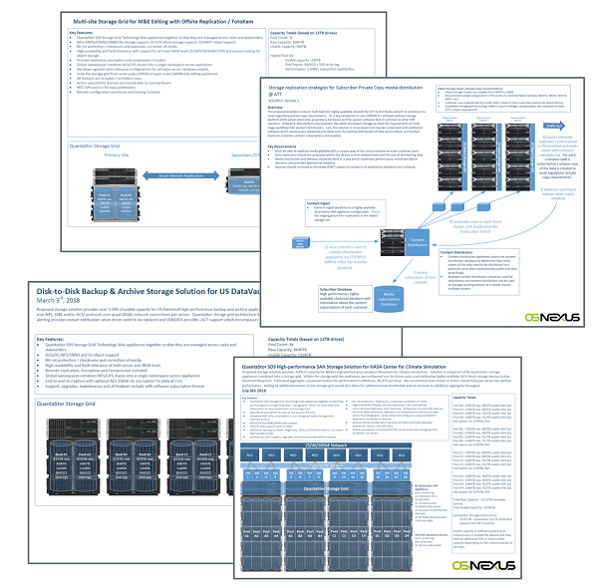
Our old way of designing storage solutions..
Labor intensive Visio diagrams
Common to make miscalculations as the design changes.
Stencils helped, but designs would evolve quickly making the visio hard to maintain
Hard to keep stencils current with hardware compatibility list (HCL)
Difficult to collaborate between end users, architects and VARs.

Slide 3

Got to be a better way..
We needed a tool which:
Enables users and system architects to easily collaborate and share designs
Provides guidance on common use cases
Make it easy to experiment with the impact of RAID levels, vendors, drive capacities, compression, etc.
Provides build-of-materials so one can easily communicate to a SI/distributor the information needed to get a hardware quote.

Slide 4
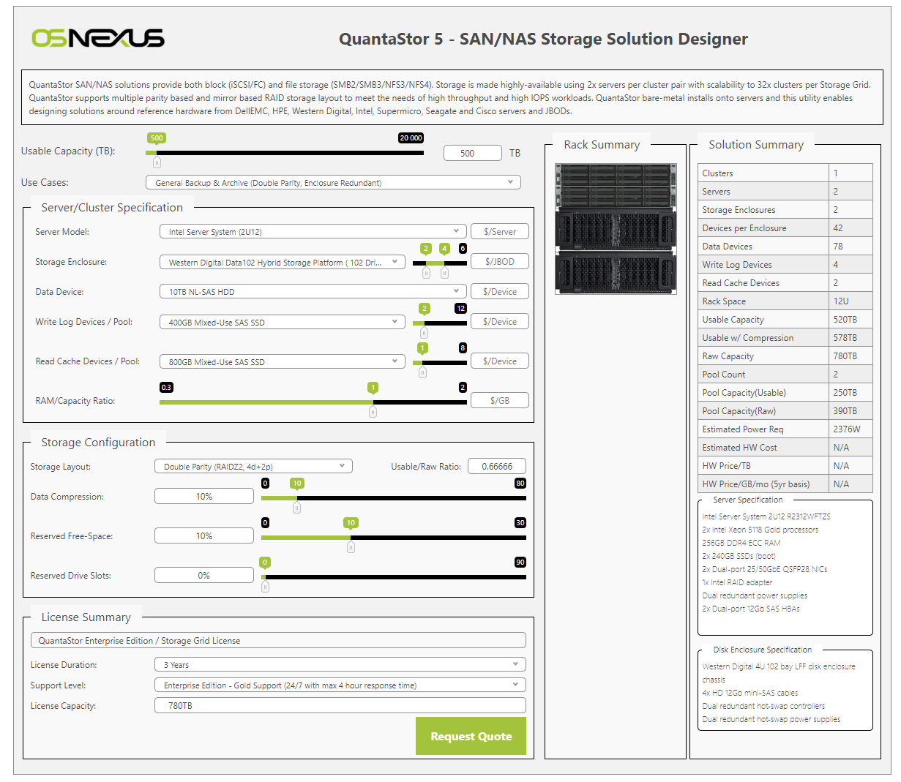
ZFS Solution Designer
Does the math Input capacity and use case and the tool will produce a workable design.
Data driven using JSON & images in AWS S3 HCL of everything we’ve tested maintained in one place Pulls from JSON we store in AWS
Makes collaboration easy Design changes are saved to the URL Attributes in the URL contain all the selected settings so you can easily share the URL to collaborate on designs.
Design tools are all public, no login required.
osnexus.com/zfs-designer

Slide 5
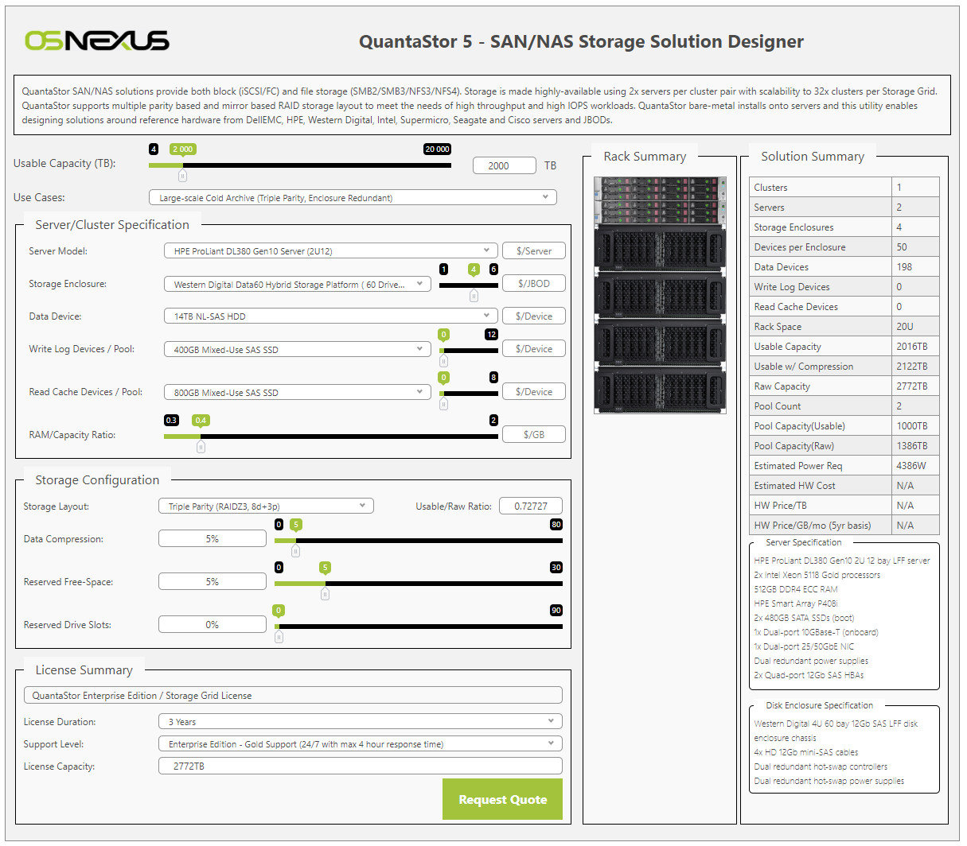
Example Design / Demo
Example requirements:
Backup/archive use case
Requires high level of fault-tolerance
Mostly large files (> 10MB)
User preference for HPE servers
User preference for WD JBOD
Data is minimally compressible (< 5%)
Normal rack depth (but not room enough for 90+ bay JBODs)
2PB usable required
bit.ly/openzfs-osn-demo

Slide 6
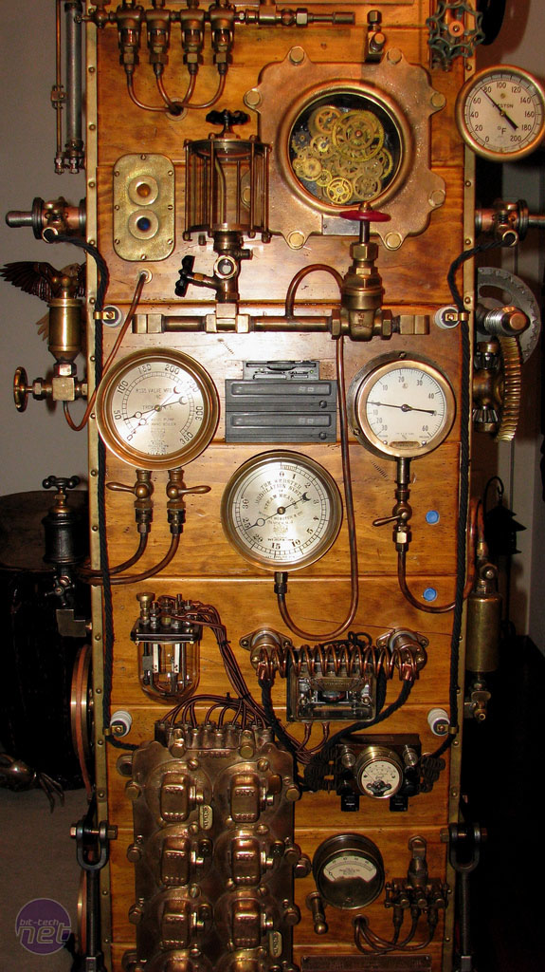
Eliminating Common Design mistakes..
Use Case selection in the tool helps to resolve…
Low vdev/stripe count
Poor RAID type choice for the workload.
Selecting the wrong media for data vdevs (SATA vs SAS)
Selecting the wrong media for ZIL / SLOG (read-intensive SATA).
Selecting a server/mobo which doesn’t have room to expand
Selecting the hardware before designing the solution.
Forgetting to account for reserved capacity
http://bit.ly/frankenrack

Slide 7

Quantifying Performance
Need to help users understand the performance benefits of various design choices like..
ZIL/SLOG
L2ARC
Metadata offload
Deduplication metadata-offload
Increasing VDEV count
etc

Slide 8
Futures / Q&A
Futures
Run benchmarks to produce synthetic performance equations
estimated 8K r/w IOPS performance
estimated 128K/1M r/w sequential performance
Add spares count selection / spares per JBOD
Add synthetic performance estimates
Add a solution summary page
Add a cabling diagram page
Add single server option
Will open-source on GitHub soon
Ideas / suggestions for improvements?
steve (at) osnexus.com

