Slide 1

Virtio/Vhost Status Quo and Near-term Plan
Zhihong Wang <zhihong.wang@intel.com>
Jianfeng Tan <jianfeng.tan@intel.com>

Slide 2
Legal Disclaimers
No license (express or implied, by estoppel or otherwise) to any intellectual property rights is granted by this document.
Intel disclaims all express and implied warranties, including without limitation, the implied warranties of merchantability, fitness for a particular purpose, and non-infringement, as well as any warranty arising from course of performance, course of dealing, or usage in trade.
This document contains information on products, services and/or processes in development. All information provided here is subject to change without notice. Contact your Intel representative to obtain the latest forecast, schedule, specifications and roadmaps.
Intel technologies’ features and benefits depend on system configuration and may require enabled hardware, software or service activation. Performance varies depending on system configuration. No computer system can be absolutely secure. Check with your system manufacturer or retailer or learn more at intel.com.
© 2018 Intel Corporation. Intel, the Intel logo, Intel. Experience What’s Inside, and the Intel. Experience What’s Inside logo are trademarks of Intel. Corporation in the U.S. and/or other countries.
*Other names and brands may be claimed as the property of others.

Slide 3
Agenda
Performance
Packed ring layout (Virtio 1.1)
Dequeue zero-copy (BKC^{[1]})
Efficiency
Vhost interrupt
Avoid memory pre-allocate (BKC)
Scalability
Vhost-pci / Virtio-vhost-user
Diversity
Vhost Data Path Acceleration
Cross backend live migration (How-to)
Availability (HA^{[2]})
Virtio-user server mode
Run-time memory provisioning
[1] BKC: Best known configuration
[2] HA: High availability

Slide 4
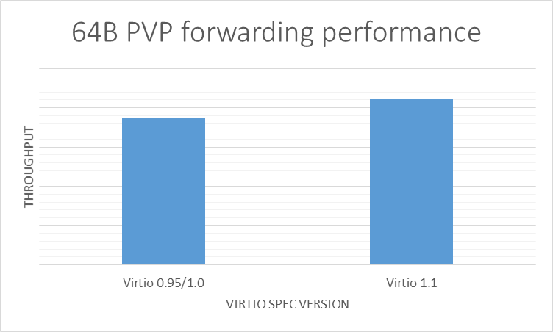
Packed ring layout (Virtio 1.1)
Motivation
Higher ring efficiency
More hardware friendly
Solution
Ring layout evolution
<TODO>
Spec freeze (Target Mar 2018)
Upstream
DPDK (Target 18.05)
Kernel
QEMU
Optimization
Initial code 12% gain, optimization in plan
Reference: http://dpdk.org/ml/archives/dev/2018-January/089417.html

Slide 5
Dequeue zero-copy (BKC)
Motivation
Improve performance for large packets
Gaps
Hard to enable due to lack of BKC
BKC
Set large enough virtio ring size > tx_free_thresh * tx_queue_num
Prefer hugepages for performance: 1GB better than 2MB
<TODO>
Lock the guest memory to avoid DMAR fault (Target 18.05)

Slide 6
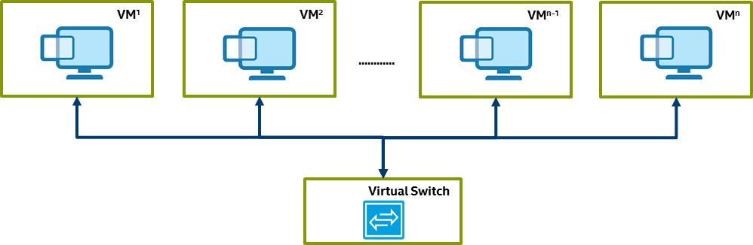
Vhost interrupt
Motivation
Avoid empty polling for low traffic ports for power & performance
Solution
Leverage interrupt mechanism
<TODO>
Support vhost interrupt (Target 18.05)
Even 250 VMs in real world deployments
~60 cycles per empty poll

Slide 7
Avoid memory pre-allocate (BKC)
Motivation
Better memory utilization
BKC
No mandatory memory population in vhost-user lib (Target 18.05)
No -mem-prealloc in QEMU command line
No mlockall in vSwitch

Slide 8
Vhost-pci / Virtio-vhost-user
Motivation
Accelerate Inter VM communication
Solution
Peer to peer virtio/vhost
Better resource efficiency and scalability
Lower latency
<TODO>
Vhost-pci RFC (Stopped)
http://dpdk.org/ml/archives/dev/2017-November/082615.html
http://lists.nongnu.org/archive/html/qemu-devel/2017-12/msg00494.html
Virtio-vhost-user (New direction)
http://dpdk.org/ml/archives/dev/2018-January/088155.html
https://stefanha.github.io/virtio/vhost-user-slave.html#x1-2830007
Peer to peer
Centralized

Slide 9
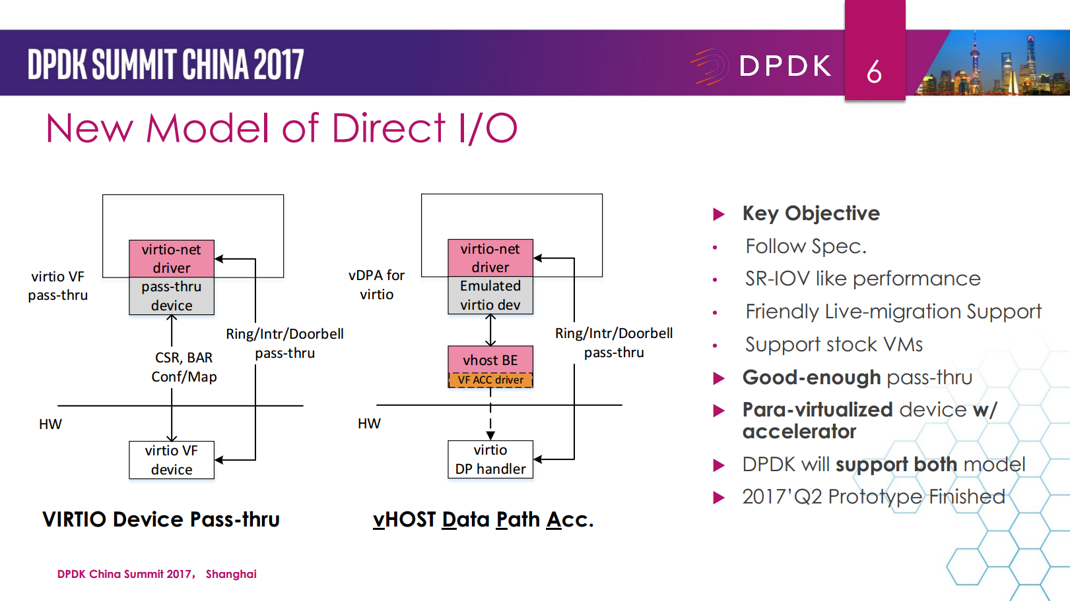
Vhost Data Path Acceleration
Motivation
High performance + Cloud friendly
Gaps
SR-IOV: High performance, vender specific, live-migration unfriendly
Virtio: Stock VM support, live-migration friendly, low performance
Solution
Virtio (Para-virtualization) with data path acceleration
<TODO>
Vhost-user lib support selective datapath (Target 18.05)
A Better Virtio towards NFV Cloud – 2017 China DPDK Summit

Slide 10
Cross backend live migration (How-to)
Motivation
Enable the migration from kernel vSwitch to user space vSwitchs
How-to
Ensure feature parity (Done in 18.02)
Use object QEMU RAM
Adapt OpenStack/libvirt to different command lines
VM
1.1.1.2/24
Live migration
VM’
1.1.1.2/24
vSwitch
virtio
virtio
vhost-user
DPDK0
vhost ko
tap
Destination VM:
$(QEMU) ... -m 8G -numa node,memdev=mem \
-object memory-backend-file,id=mem,size=8G, \
mem-path=/path/to/tmpfs_or_ramfs_or_hugetlbfs,share=on \
-chardev socket,id=char0,path=/tmp/sock0 \
-netdev type=vhost-user,id=mynet1,chardev=char0,vhostforce \
-device virtio-net-pci,netdev=mynet1 \
-incoming tcp:0:4444 ...
vSwitch
eth0
Source VM:
$(QEMU) ... -m 8G -numa node,memdev=mem \
-object memory-backend-file,id=mem,size=8G, \
mem-path=/path/to/tmpfs_or_ramfs_or_hugetlbfs,share=on \
-netdev tap,id=mynet1,vhost=on \
-device virtio-net-pci,netdev=mynet1 ...
NIC
NIC
vhost-kernel
vhost-user

Slide 11
Virtio-user server mode
Motivation
Enable reconnect for containers on both ends
Solution
Server mode for virtio-user just like in QEMU (Target 18.05)
vSwitch reboot: vSwitch to reconnect
VNF reboot: Vhost-user thread keep trying to reconnect
Container
virtio-user
vhost-user
vSwitch

Slide 12
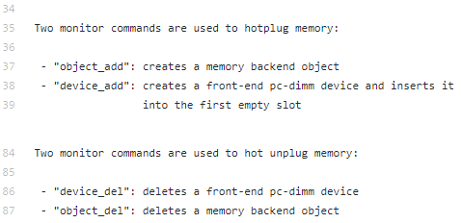
Run-time memory provisioning
Motivation
Support run-time memory provisioning
Gaps
Lack of protection for active rings for memory region change (Fixed in 18.02)
Reference: https://github.com/qemu/qemu/blob/master/docs/memory-hotplug.txt

Slide 13
Questions?

