Slide 1

Project Udyam Digital
Speak, verify, go live: an Indian small business picks the right bundle, clears KYC and gets connected from one phone chat, in its own language.
Team BitStormer · YTL Hackathon 2026 · Enterprise Track A
Watch the 3-minute demo youtu.be/JYg1lNfZmpg
Owner app
airtel-sync.vercel.app
WhatsApp
+91 83184 01662
Staff portal
airtel-sync-staff.vercel.app
Telegram
@UdyamAdvisorBot
Notes:
Team BitStormer, Project Udyam Digital: a digital-first journey for Accel Business to win India's small businesses. Demo video: youtu.be/JYg1lNfZmpg. Owner app: airtel-sync.vercel.app. Staff portal: airtel-sync-staff.vercel.app (one-click demo sign-in). WhatsApp bot: +91 83184 01662 (send Hi). Telegram bot: @UdyamAdvisorBot. Code: github.com/perrysolid/AIRTEL-SYNC.

Slide 2








Try it live: everything in this deck is running today
Watch the 3-minute demo
A Hindi voice note to live in five days, all five key questions, the business case
youtu.be/JYg1lNfZmpg
Owner app (website)
Staff portal
Source code (GitHub)
airtel-sync.vercel.app
airtel-sync-staff.vercel.app
github.com/perrysolid/AIRTEL-SYNC
Ask by voice or text in 10 languages, get a quote, verify, e-sign and track
One-click demo sign-in as area salesman, supervisor or manager
Owner app, staff portal, bots, 180+ automated tests and docs
WhatsApp bot
Telegram bot
Backend
+91 83184 01662
@UdyamAdvisorBot
airtel-sync.onrender.com
Send Hi, or a voice note in Hindi, and order in one tap
Same advisor, same orders, same updates
Free plan: open the site a minute early so it wakes up
Notes:
Everything here is live. Demo video: youtu.be/JYg1lNfZmpg. Owner app: airtel-sync.vercel.app. Staff portal: airtel-sync-staff.vercel.app, with one-click demo sign-in. Code: github.com/perrysolid/AIRTEL-SYNC. WhatsApp: +91 83184 01662, send Hi. Telegram: @UdyamAdvisorBot. The backend is on Render's free plan, so open the site a minute early.

Slide 3

Only 7.4% of SMB leads activate, and most are lost before they accept a quote
17.6
3.0
days from lead to activation
calls per customer chasing status
₹15,053
15.2%
acquisition cost per activation
churn within six months
827 leads dropped because a visit never happened (owner had no time, or sales never scheduled it). A phone journey removes that step.
Steepest drop: needs assessed to quote accepted, only 44% get through.
Notes:
Source: smb_leads.csv. 368 of 5,000 leads activated (7.4%). Activated customers took 17.6 days and chased status 3 times; blended CAC is about ₹15,053; 15.2% churned within six months. 531 dropped because the owner had no time for a visit and 296 because sales never scheduled one: 827 leads lost to the visit itself.

Slide 4
Start with professional offices and micro retail, fully digital; assist multi-site and factories
Q1
# | Segment | Share of leads | Activate today | Median bill | Cost per activation | 6-month churn | Bundle and how we sell it
1 | Professional offices | 25% | 11.1% | ₹6,575 | ₹10,695 | 13.8% | Smart Office from ₹8,620/mo: fibre, backup, email, security. Self-serve.
2 | Micro retail & services | 54% | 4.1% | ₹2,470 | ₹20,007 | 22.7% | Dukaan Starter from ₹4,027/mo (core from ₹1,707). Self-serve only, so cost fits the bill.
3 | Small multi-site | 15% | 11.0% | ₹28,080 | ₹15,614 | 10.8% | Business Group from ₹33,603/mo, 4 sites, one bill. Supervisor closes.
4 | Small manufacturers | 6% | 12.8% | ₹15,910 | ₹15,324 | 8.1% | Factory Floor from ₹18,860/mo: leased line, IoT. Site survey first.
Why this order: offices convert at 11% for the lowest acquisition cost. Micro retail is half the market but loses money today (₹20k to win a ₹2.5k bill, 23% churn), so it goes only through the zero-visit journey. Prices are per month incl. GST on 36 months, with the 5% One Bill discount and no setup fee.
Notes:
Segment numbers computed from smb_leads.csv (activation, median monthly bundle value of activated leads, acquisition cost divided by activations, 6-month churn). Bundle prices are the live curated plans in the prototype (36 months, incl. GST).

Slide 5
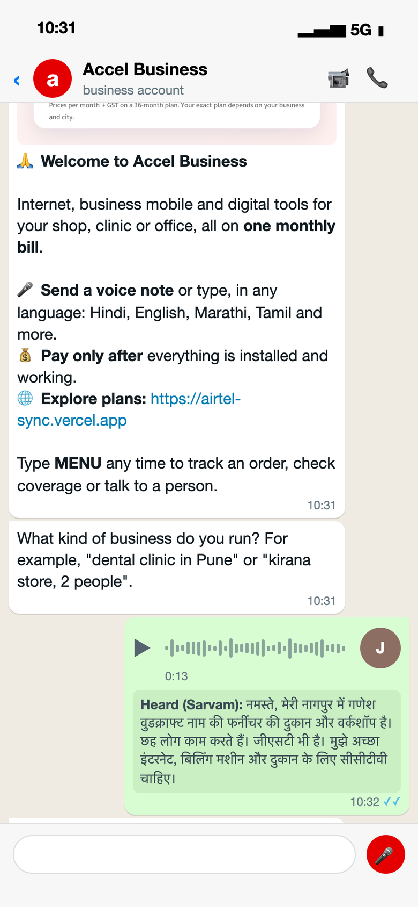
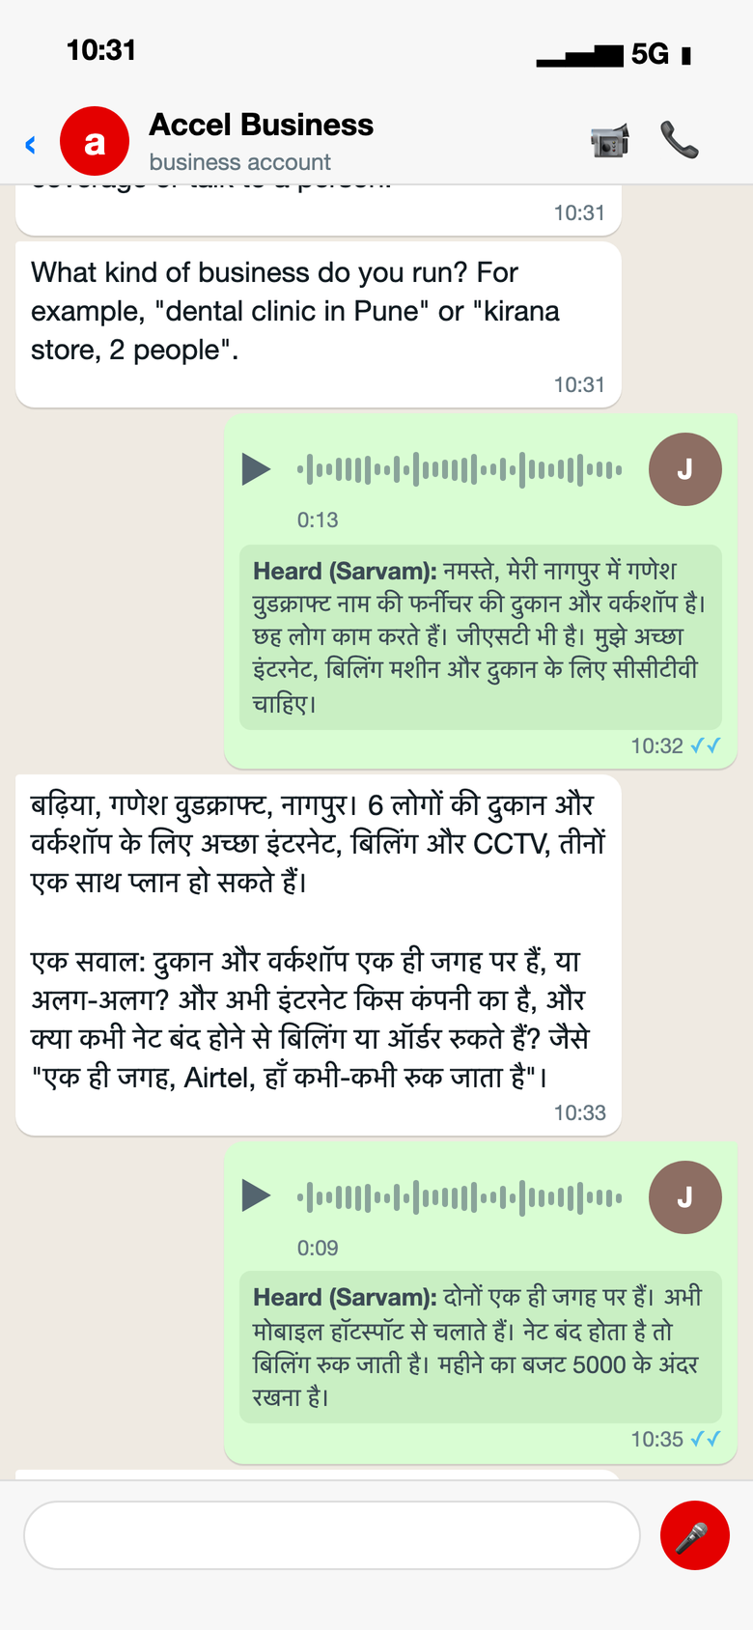
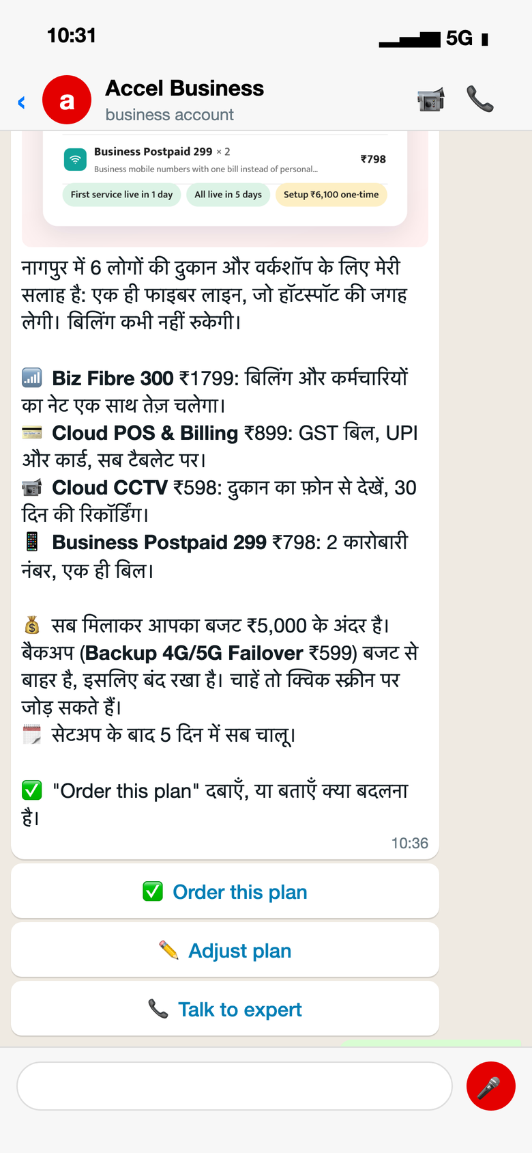
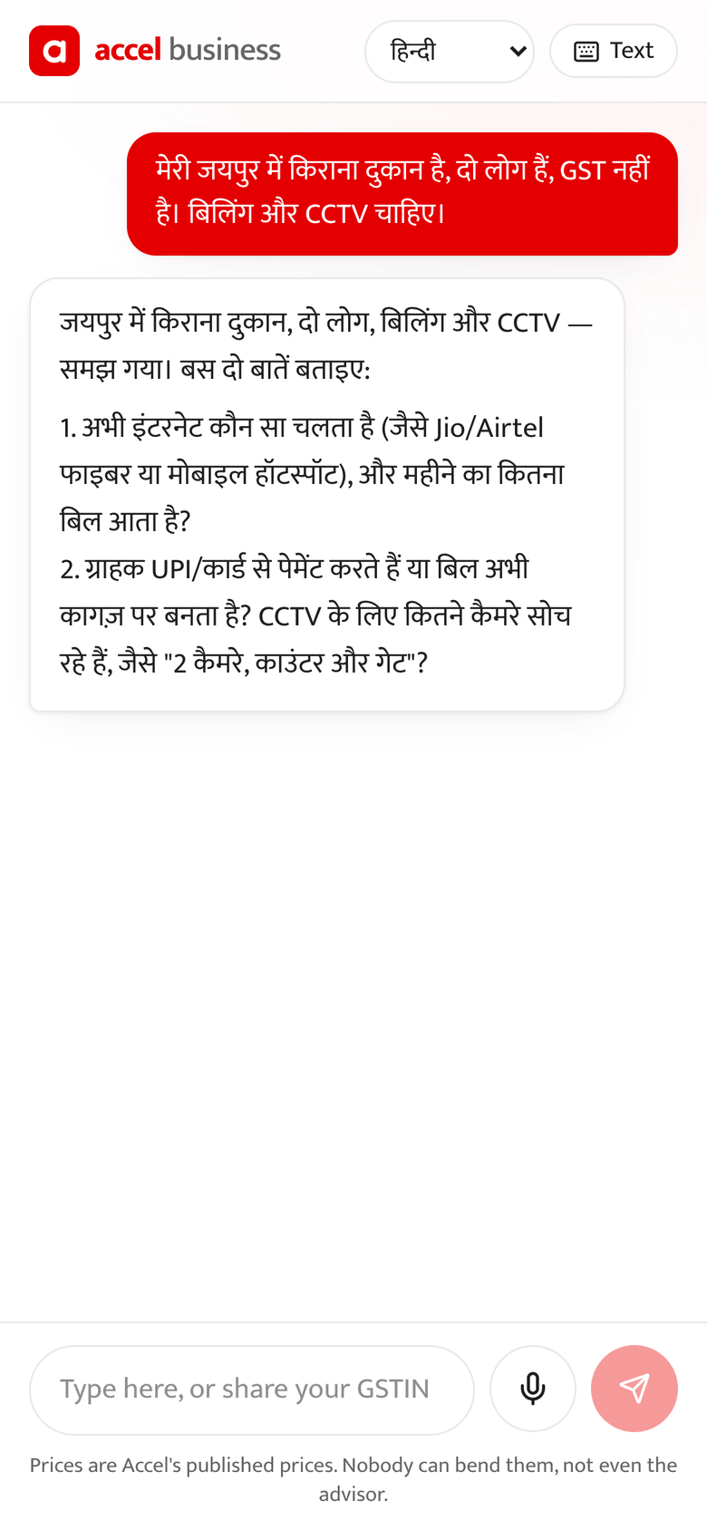
Needs discovery without a salesperson: a voice note in Hindi becomes a priced plan in two replies
Q2
Rules decide, AI explains
Products, eligibility and price come only from the catalogue CSV. The AI cannot invent a product or a price.
Never stuck
If every AI provider is down, a guided bilingual flow takes over mid-chat.
Order in one tap
On WhatsApp the sender's number is the contact: no form.
1 A voice note
2 One or two questions
3 A plan with one price
4 Same brain on the web
Sarvam transcribes Hindi; the advisor knows the trade, city and needs
Same site? What breaks today? Budget? Answered by voice again
Rules pick the products; ₹4,589/month incl. GST, inside the ₹5k budget
Text or mic in 10 languages; also on Telegram
Notes:
Real run of the bot engine: two Hindi voice notes from a Nagpur furniture workshop (Ganesh Woodcraft, the K03 specimen), transcribed by Sarvam, answered by the advisor in Hindi, priced by the catalogue rules (Biz Fibre 300, Cloud POS & Billing, 2× Cloud CCTV, 2× Business Postpaid: ₹4,589/month incl. GST). The quote card is the image the bot actually sends. Fourth phone: the same advisor on the website, in Hindi.

Slide 6
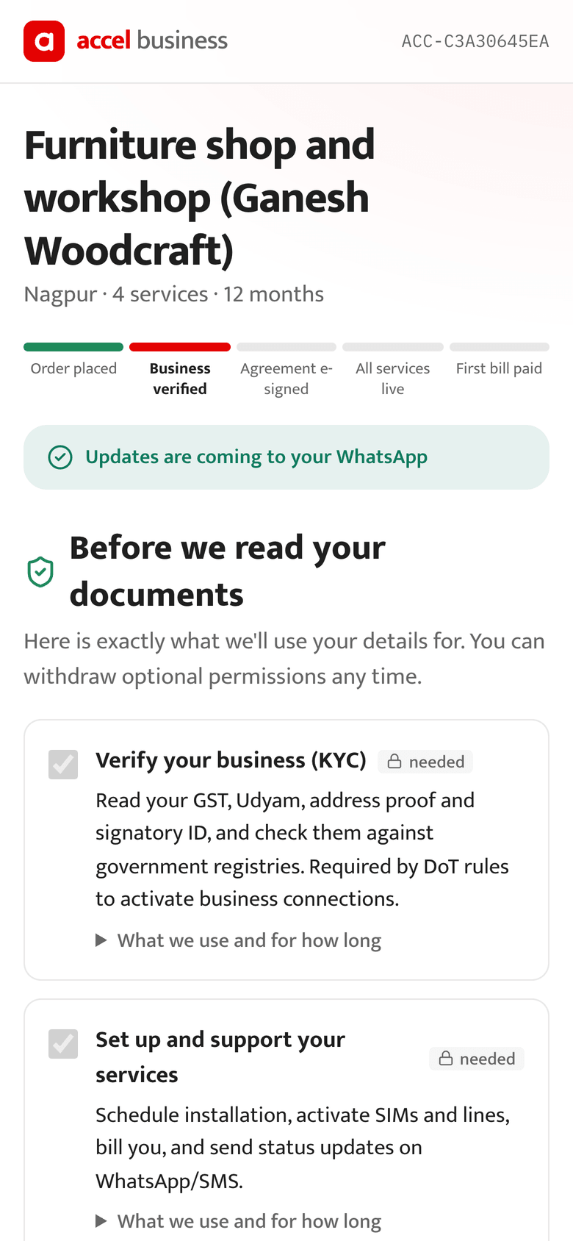
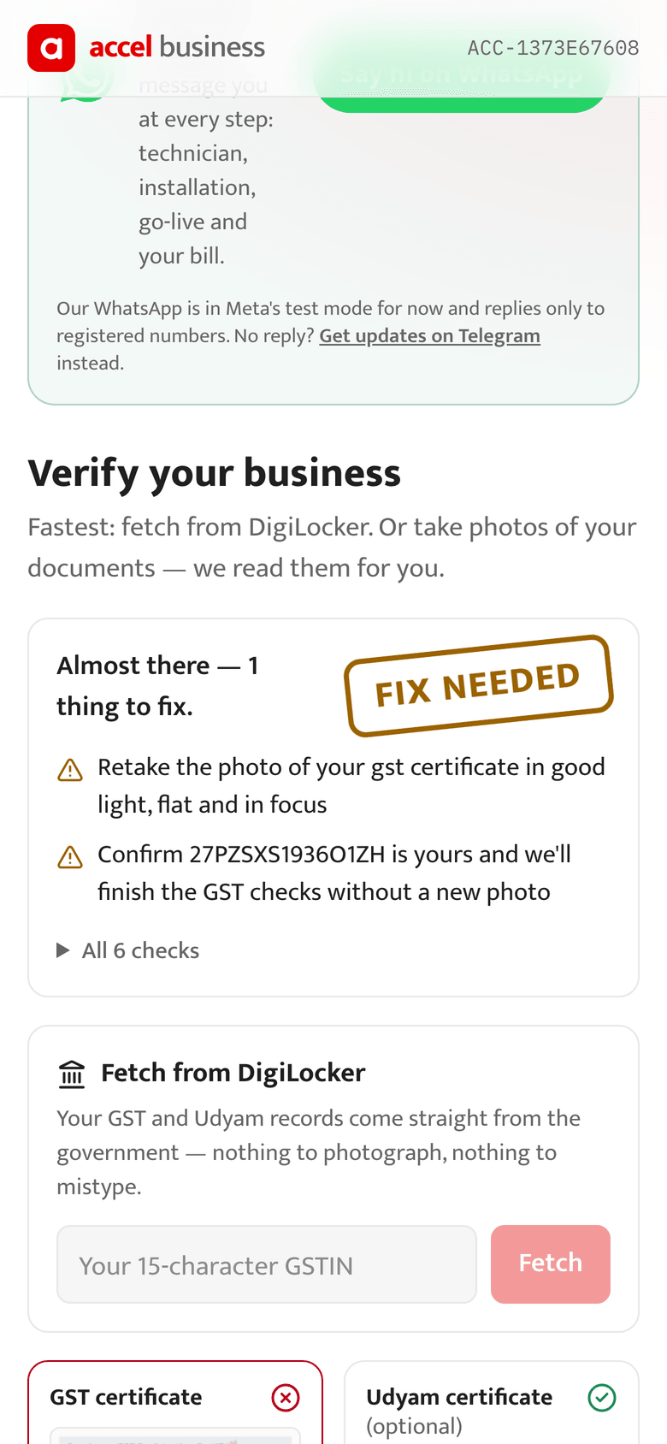
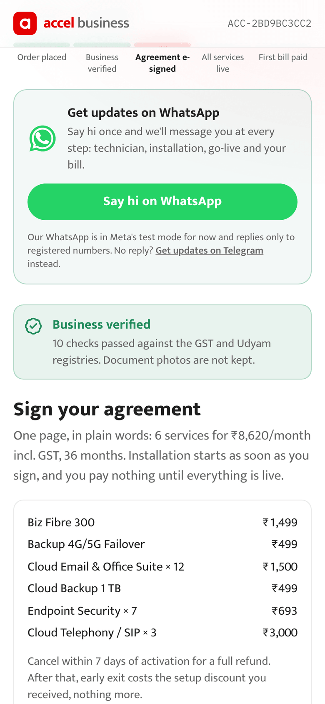
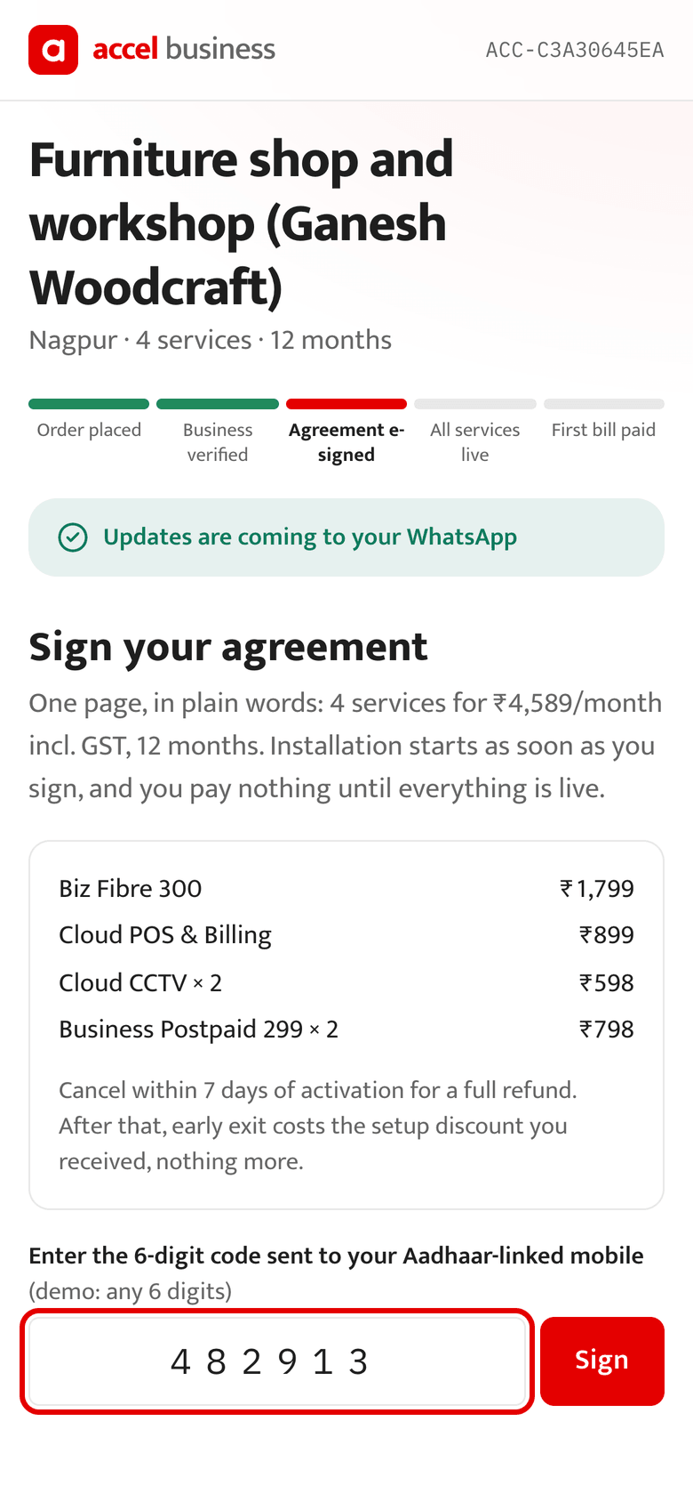
KYC in about two minutes: consent first, photos read by AI, every field checked against the registries
Q3
DPDP Act, 2023
Consent
Per purpose, versioned, hash-chained; withdraw or erase at /privacy
Purpose limitation
Each field has one purpose; staff never see documents
Minimisation
Photos read in memory and discarded (SHA-256 kept); IDs masked
Fair
Hard fails go to a person with the reason, never a silent reject
Consent first
Blurred? Recovered
Verified
E-sign
Itemised per purpose; nothing is read before this
K04's GSTIN found in the registry by name and city
10 checks: checksum, registry, names, address age, signatory
Aadhaar OTP on one plain-language page
Notes:
All 12 specimen applicants (K01–K12) reach the expected verdict. K04's blurred GST certificate is not rejected: the GSTIN is found in the registry from the business name and address and the owner just confirms it. K03 verifies with 10 checks passed. E-sign signs a SHA-256 hash of the agreement; DigiLocker and Aadhaar e-sign through a licensed ASP in production.

Slide 7
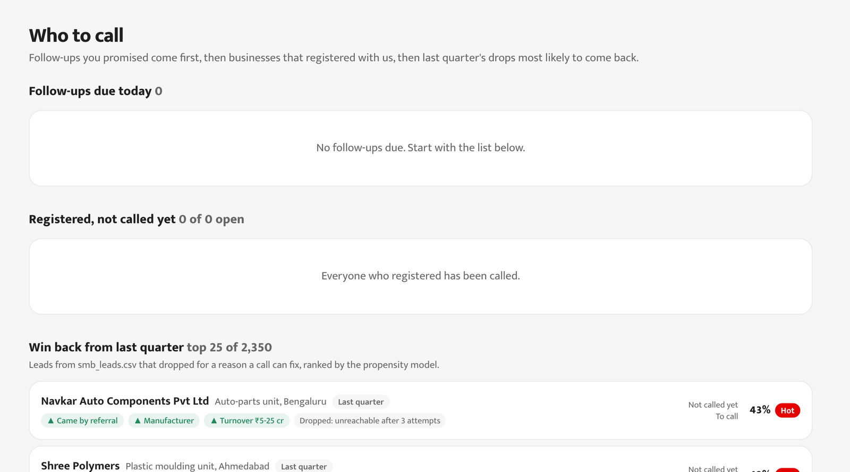
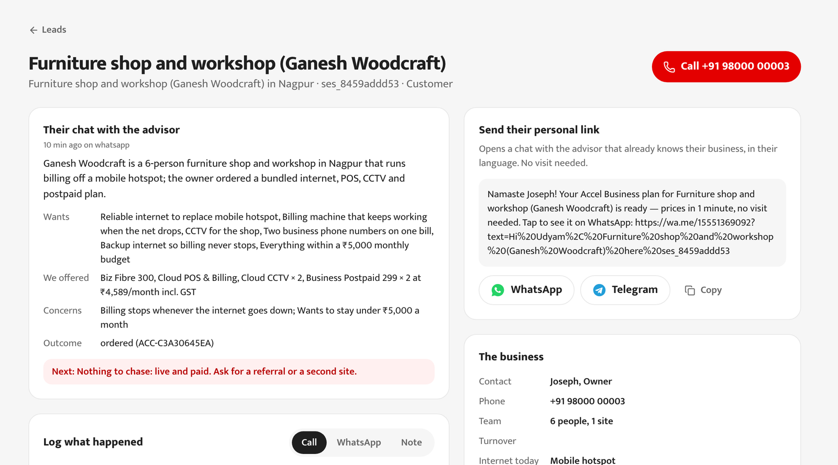



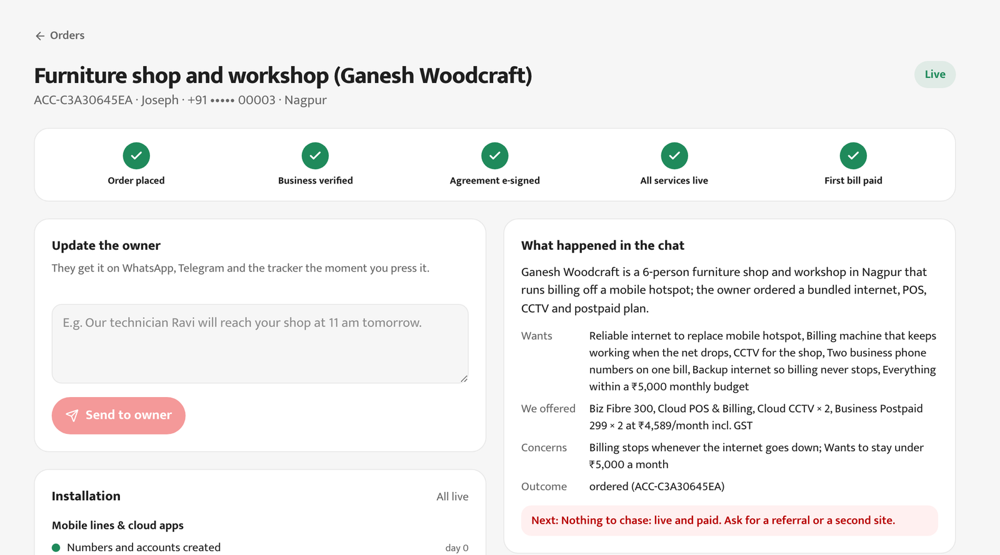
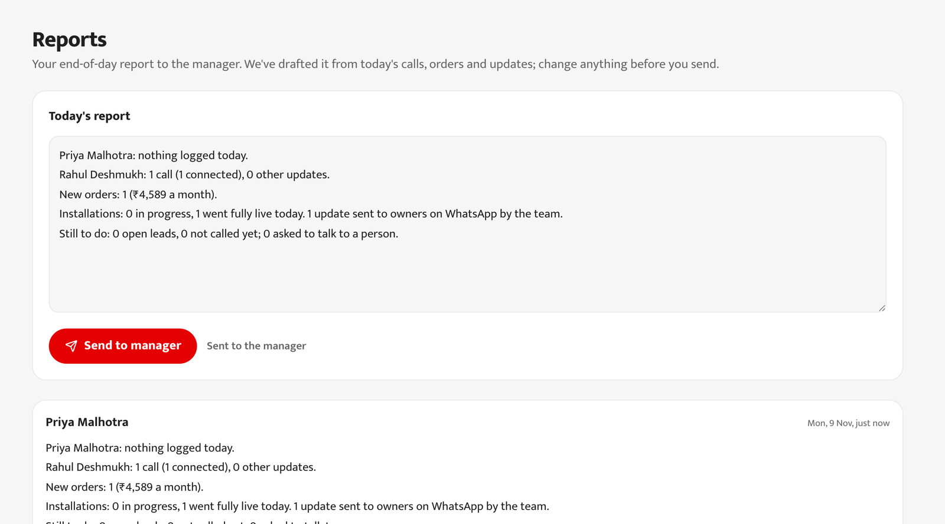
Field force and partners pick up where the chat stops, from the same records, and get credit for digital sales
Q4
Area salesman
Calls every registration, then last quarter's best win-backs (model AUC 0.745). One tap updates the owner on WhatsApp.
Supervisor
Closes multi-site and factory deals, assigns leads, sends the end-of-day report.
Who to call: registrations, then ranked win-backs
The lead: AI chat summary, next step, call log
Manager
Reads reports and the five metrics; sees numbers masked.
Channel partners
Partner code credits digital orders; install locally; hand-offs come with a chat summary.
Update the owner: goes to their WhatsApp
Supervisor's report, drafted from the day
Notes:
Screens from the staff portal running on the same records as the WhatsApp order: the salesman's call list (registrations first, then smb_leads.csv drops ranked by the propensity model), the lead with the AI-written chat summary and a logged call, an update sent to the owner from the order page, and the supervisor's end-of-day report. Referrals activate at 14.8% for ₹4,099 each, against 7.3% at ₹24,335 for field visits.

Slide 8
Five numbers decide success, and the staff portal tracks every one of them live
Q5
Metric | Last quarter | Target | What moves it
Lead to activation | 7.4% | 12–15% | Self-serve quote and KYC; win-back calls
Days to first service | 17.6 | 1 (all live ≤ 21) | Each service goes live on its own track
Cost per activation | ₹15,053 | < ₹6,000 | No visit; people only when asked
Status chases per customer | 3.0 | < 0.5 | A WhatsApp update at every step
Churn within 6 months | 15.2% | < 10% | Fewer chases, one bill, one number
Every chase raises churn: 5.9% after one, 27.9% after five. Updates in their own chat are a retention lever, not a courtesy.
Measured, not estimated: conversations, orders, days to live and updates per order are counted on the Insights page against last quarter's baseline.
Notes:
Baselines from smb_leads.csv. Churn by number of customer follow-up calls among activated leads: 1 call 5.9% (34 customers), 2: 14.3% (84), 3: 11.7% (137), 4: 20.0% (70), 5: 27.9% (43).

Slide 9




One bill the owner trusts, and a customer that costs Accel far less to win
For the owner
For Accel, if activation doubles on the same leads
Pay nothing until everything is live
small businesses a quarter
+370
The first bill comes only when the last service is switched on.
368 activations today become about 740 from the same 5,000 leads.
No setup fee on 36 months
And the lowest monthly price for committing.
₹3.1 Cr
new recurring revenue a year from each quarter's extra customers
5% off for three or more services
370 × the ₹6,900 median monthly bundle × 12.
The One Bill discount, shown line by line on the quote.
₹33 lakh
saved in acquisition cost every quarter
One number, updates in their chat
Technician, installation, go-live and bill, on WhatsApp.
368 activations × (₹15,053 − ₹6,000).
Notes:
Accel numbers are illustrative arithmetic on the case data: median bundle ₹6,900/month (case appendix), today's 368 activations, CAC target under ₹6,000.

Slide 10

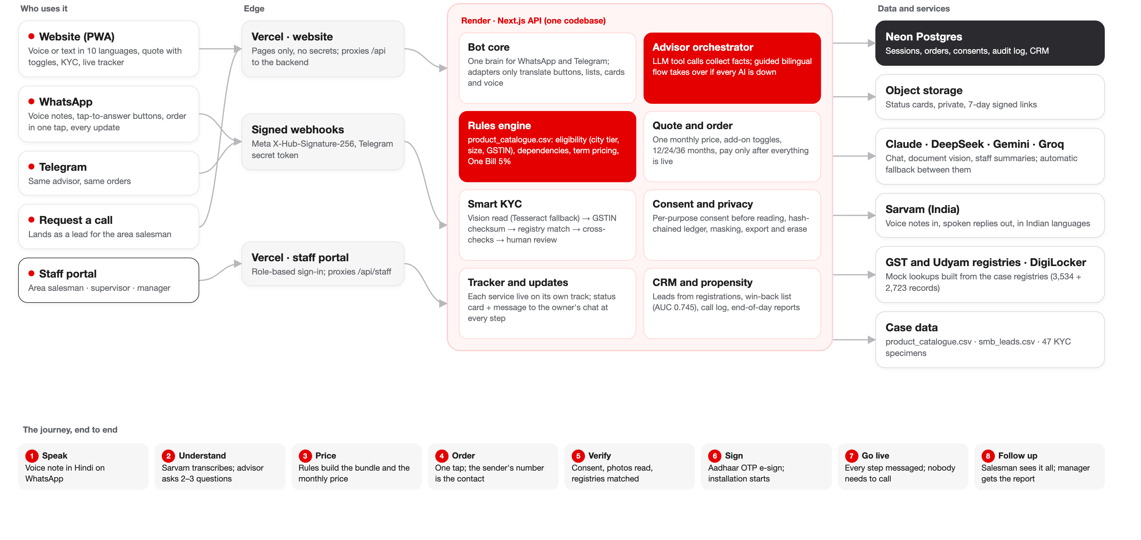
Built and live: one advisor brain behind every channel, rules for every price, an update at every step
Live now
airtel-sync.vercel.app
airtel-sync-staff.vercel.app
WhatsApp and Telegram bots
AI with fallbacks
Claude, DeepSeek, Gemini, Groq; Sarvam for Indian voice; guided flow if all fail
Tested
180+ automated tests, including all 12 KYC specimens
Production next
WhatsApp Business API, DigiLocker, licensed e-sign, India-hosted AI
Notes:
Next.js frontend on Vercel holds no secrets and proxies to the Render backend (API, bots, KYC); data in Neon Postgres; status cards in private object storage behind 7-day signed links. WhatsApp and Telegram webhooks are signature-checked. The full-size diagram is docs/architecture.png in the repository.

Slide 11

Pilot in two cities for six weeks, scale on the numbers, with every risk designed down
Weeks 0–6 · Pilot
Week 6 · Gate
Quarter 2 · Scale
Production
2 tier-2 cities, 20 partners; offices and micro retail; a control group on today's process.
Scale only if activation ≥ 12%, chases < 1 and cost per activation < ₹8,000.
All tier-1 and tier-2 cities; multi-site assisted; factories with a site survey.
WhatsApp Business API, DigiLocker, licensed e-sign, AI hosted in India.
Risk | How the design handles it
The AI recommends the wrong product or price | Rules decide from the catalogue; the AI only explains, and its tool inputs are validated.
KYC passes a bad document or rejects a good one | Checksum and registry match; every hard fail goes to a person with the reason.
Partners and field sales see digital as a threat | Partner codes credit digital orders; leads are assigned, never taken.
Personal data misuse (DPDP Act) | Consent ledger, no stored images, masked IDs, least-access staff roles.
Fibre isn't available at the address | Pincode check before payment; automatic switch to 5G AirFiber.
Notes:
Pilot design mirrors the business case: two tier-2 cities, 20 partners, six weeks, measured against a control group on the same four metrics before scaling.

Slide 12
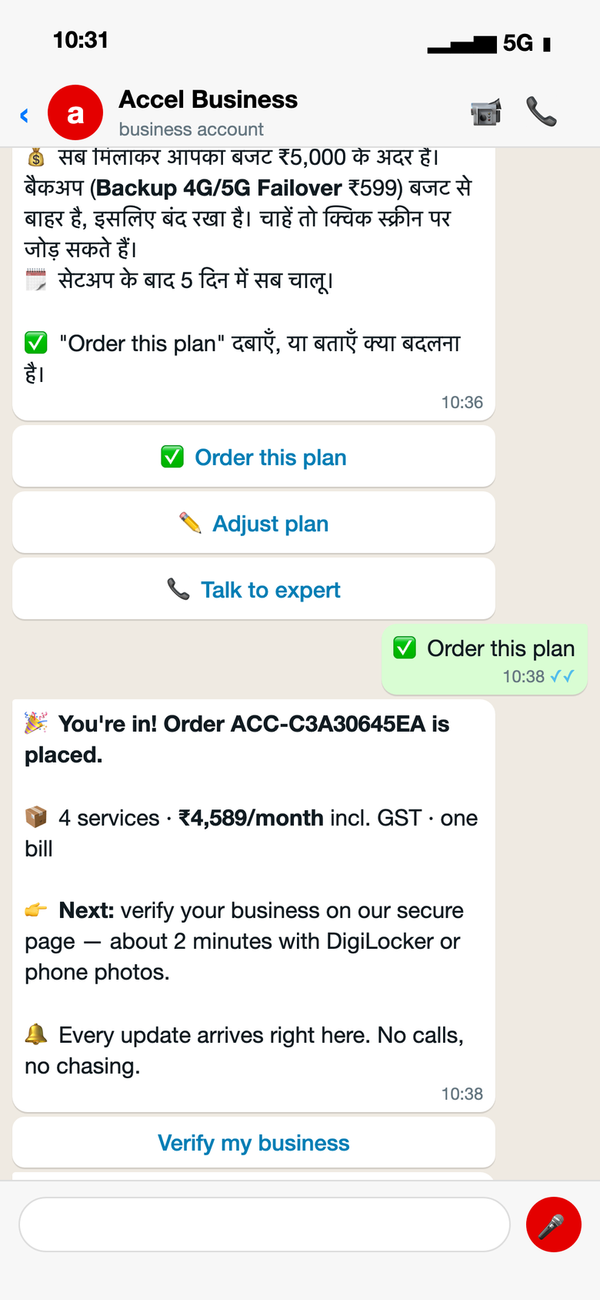
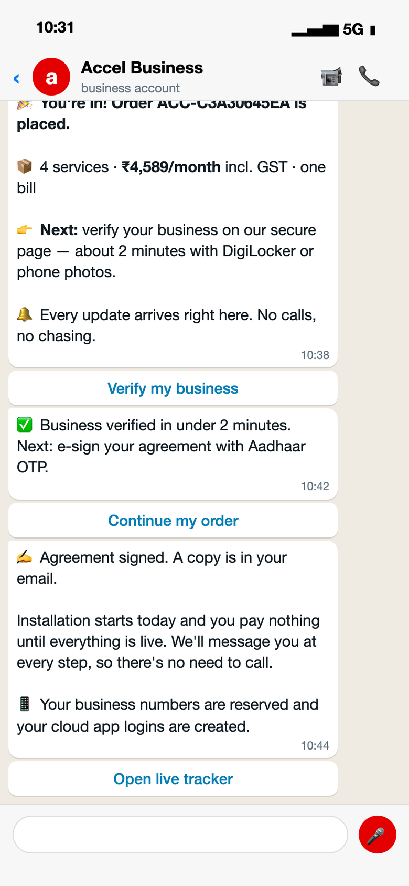
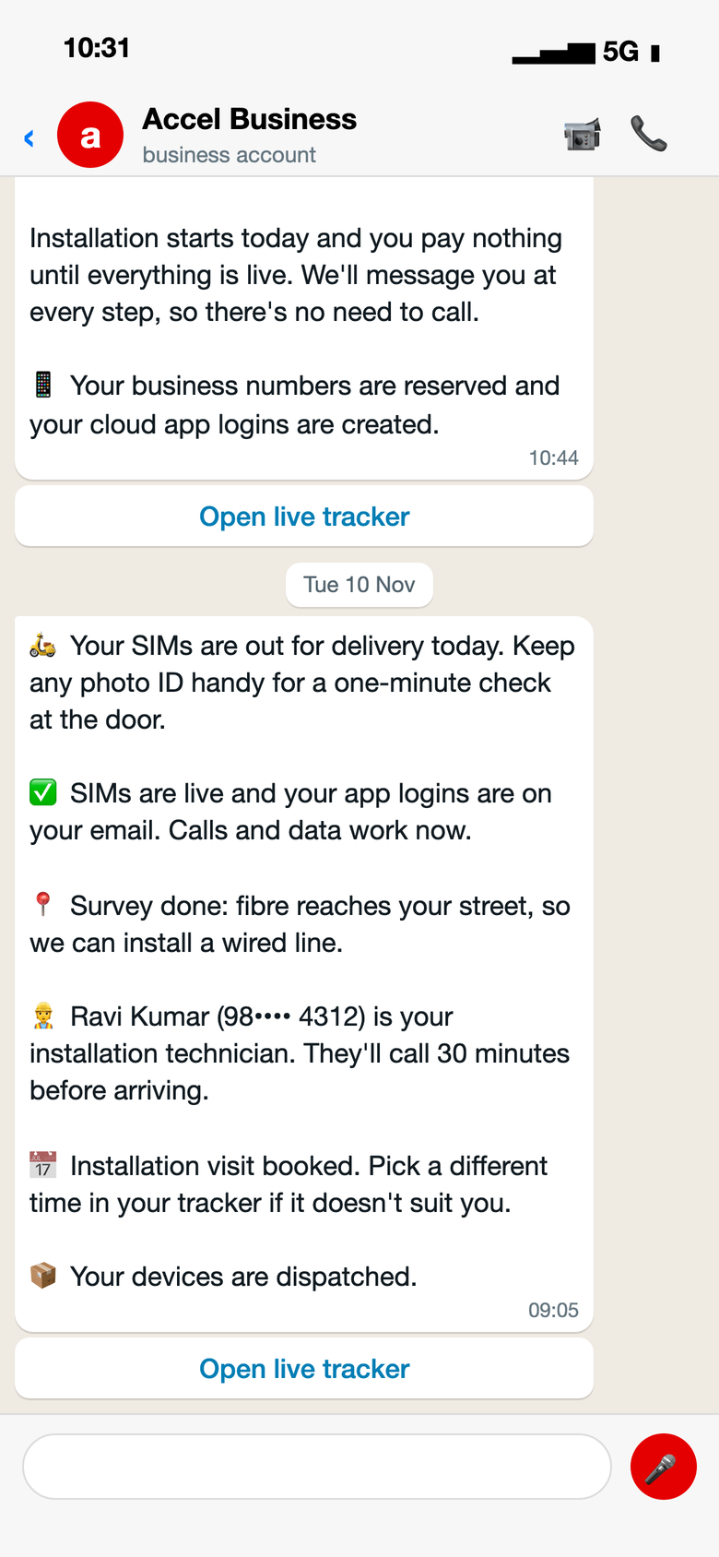
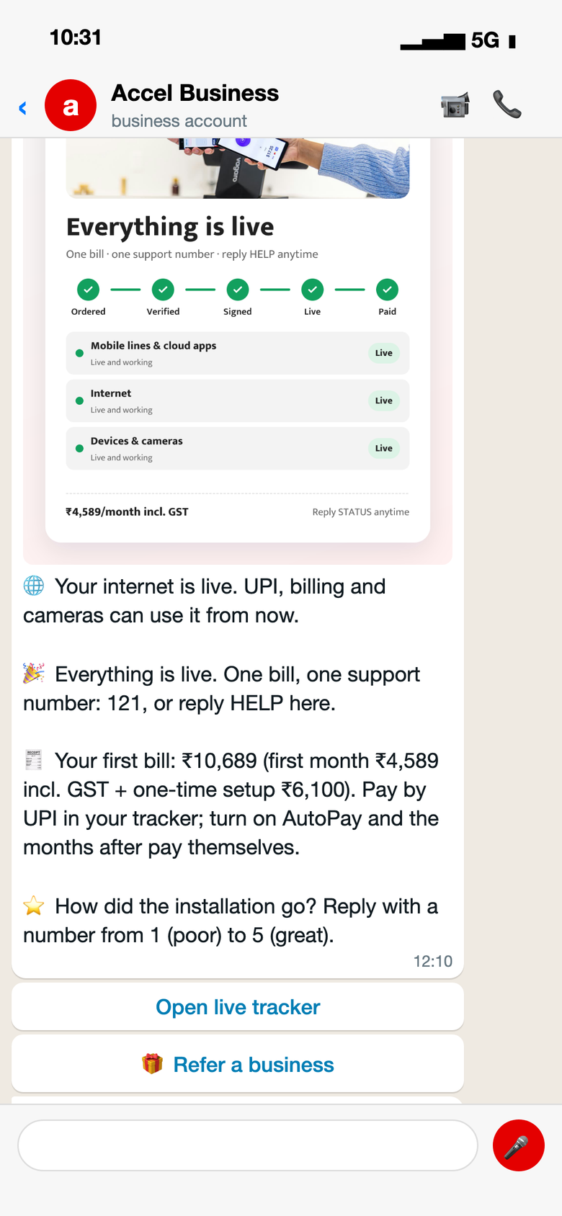
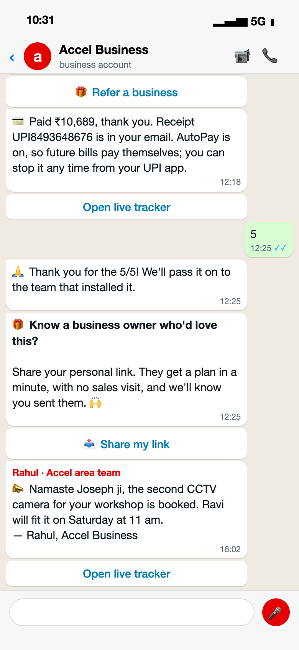
The whole order happens in one WhatsApp chat, from tap to first bill, with no calls
A
Ordered in one tap
Verified, signed
SIMs live, technician named
Everything live
Paid, rated, referred
Order placed; secure link to verify
Installation starts the same day
Numbers, survey, visit booked
Status card, first bill, rating ask
Salesman's update lands here too
Notes:
Real bot messages for order ACC-C3A30645EA, in the order they were sent. Dates follow the tracker's installation days.

Slide 13
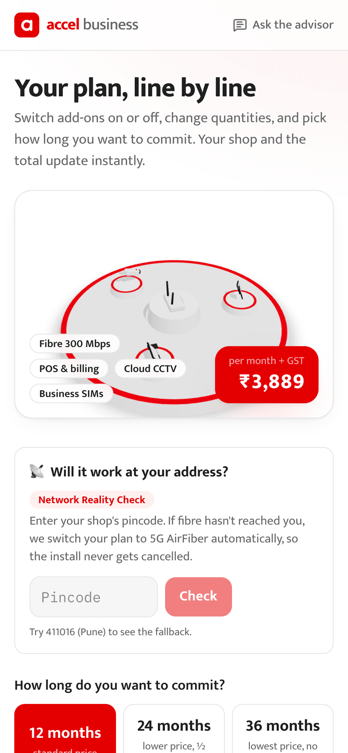
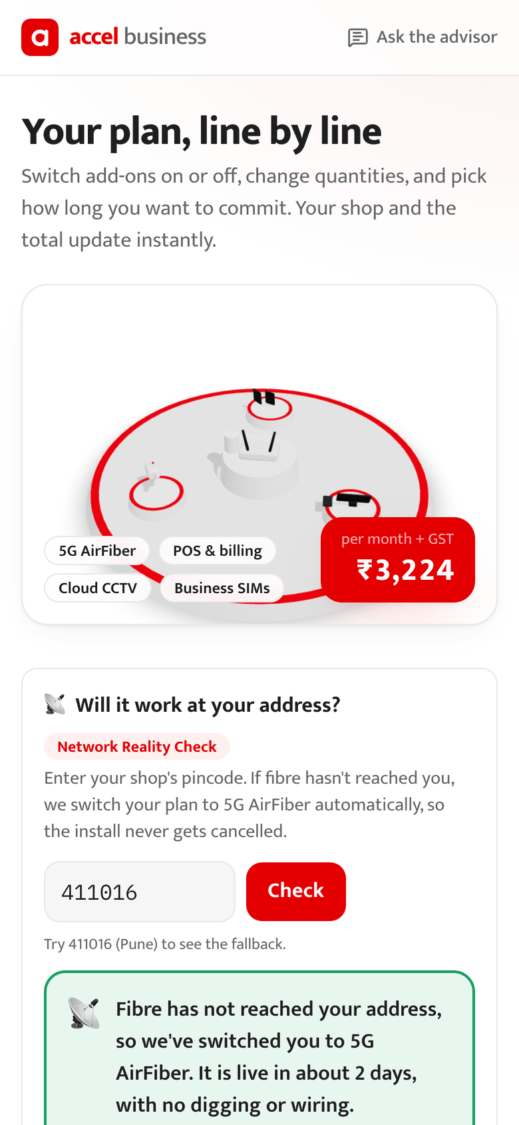
On the web: adjust the plan, check the address, give consent, verify and sign
A
Plan, line by line
Will it work here?
Consent
Fix, not reject
Verified, then sign
Toggles, term, live 3D table
No fibre: AirFiber instead
Per purpose, before reading
Blurred GSTIN recovered
Aadhaar OTP e-sign
Notes:
The same order flow on the website. The pincode check switches to 5G AirFiber where fibre hasn't reached, before the owner pays anything.

Slide 14
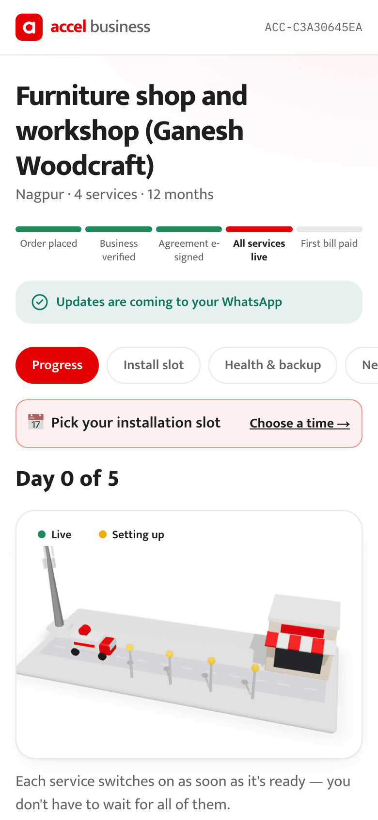
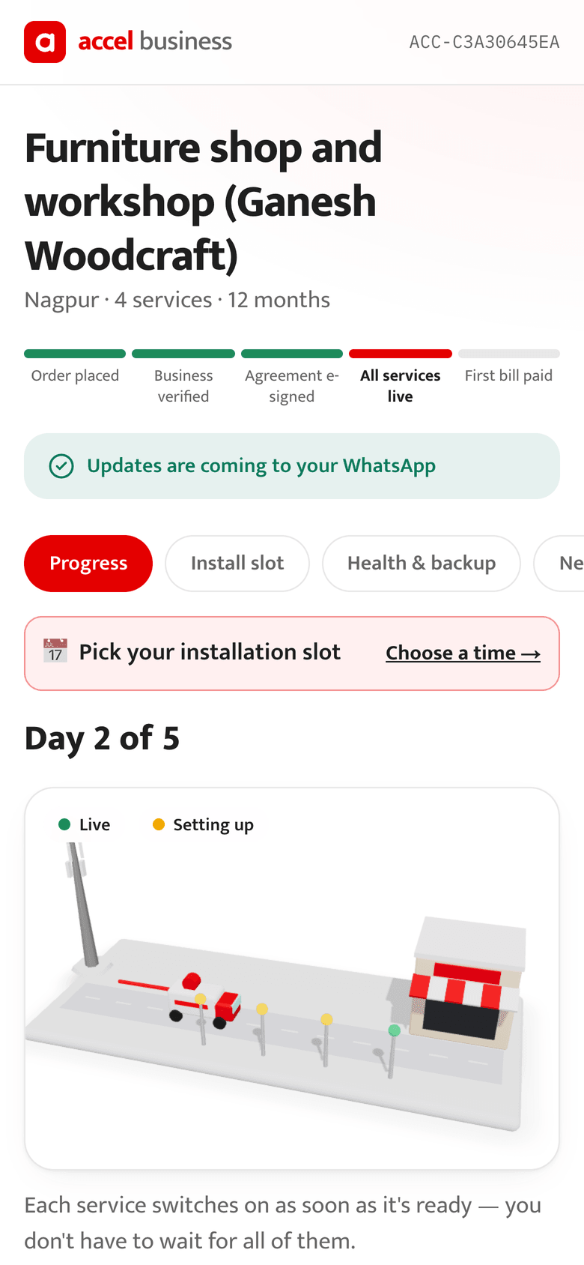
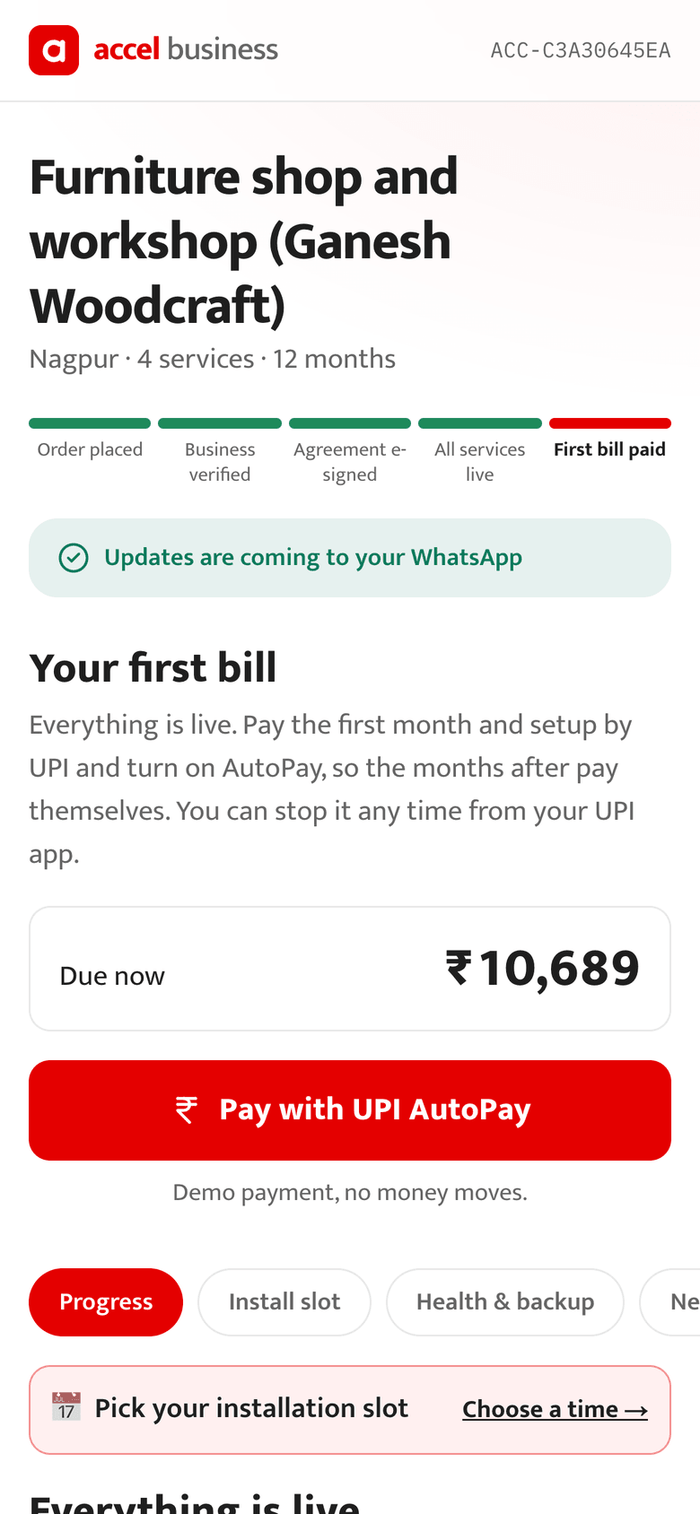
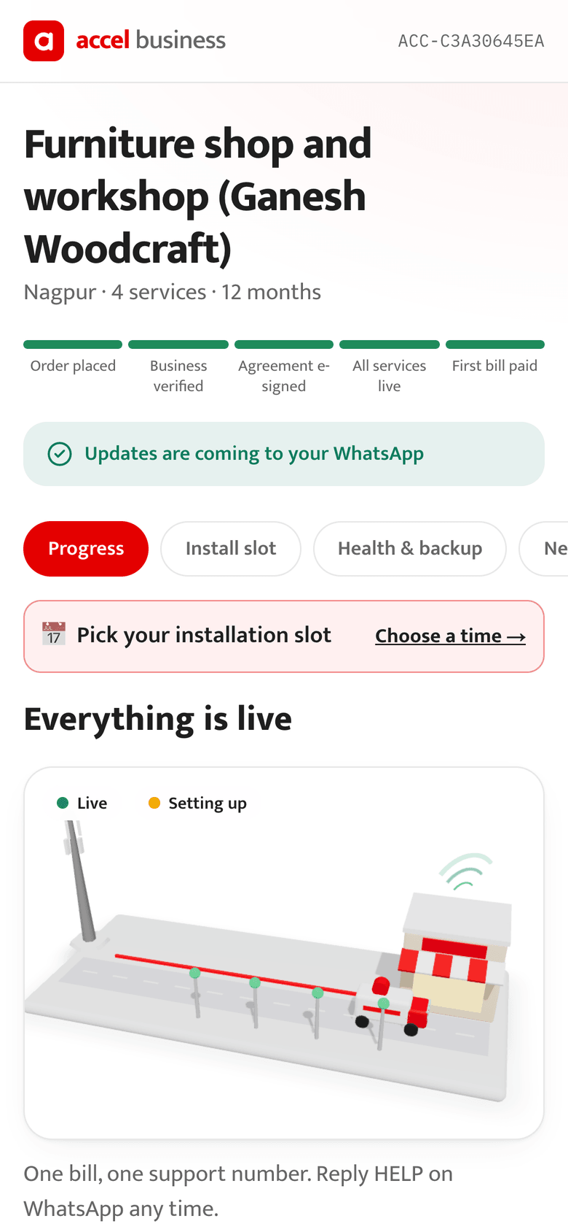
The tracker shows each service going live on its own, and the first bill only when all are live
A
Day 0
Day 2
First bill
Paid
Signed; numbers reserved
SIMs live, technician booked
UPI AutoPay, nothing earlier
One bill, one number
Notes:
Each service type has its own track; the van in the 3D scene lays fibre to the shop as services go live. The owner pays only when everything is working.

Slide 15
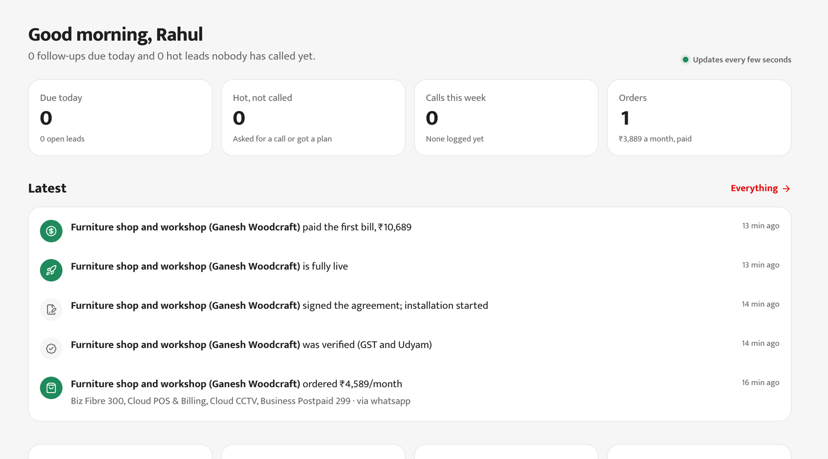
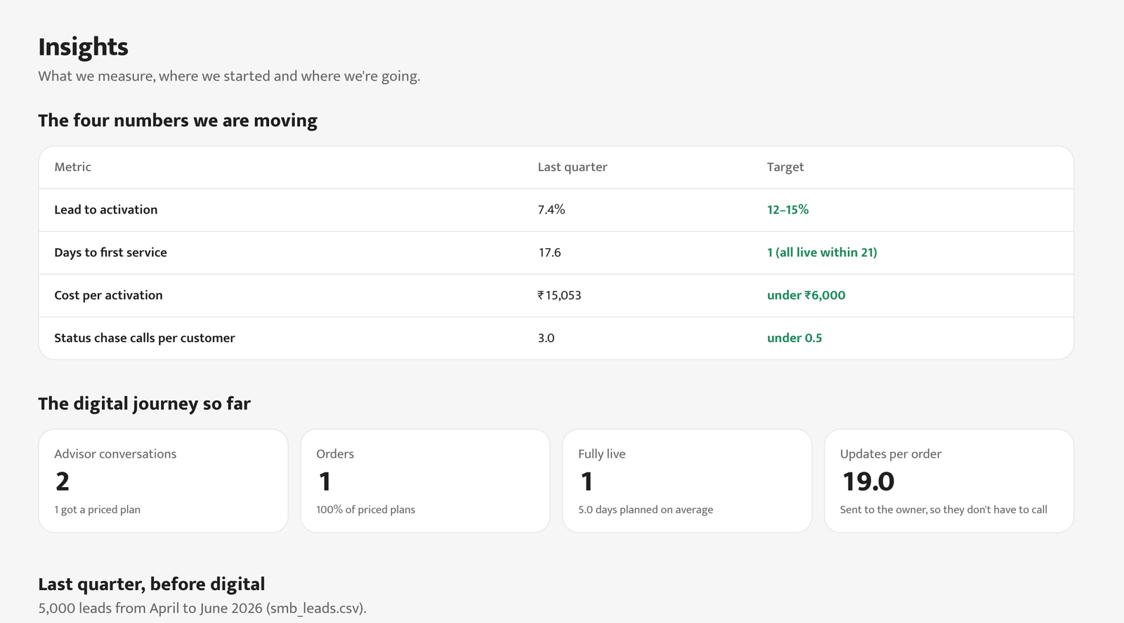
Staff portal: three roles, real registrations only, every action logged
A
Salesman: today
Salesman: who to call
Lead: summary and call log
Order: update the owner
Supervisor: end-of-day report
Insights: the four numbers
Notes:
Area salesman (Rahul), supervisor (Priya) and manager (Kavita). The manager is read-only and sees phone numbers masked.

Slide 16
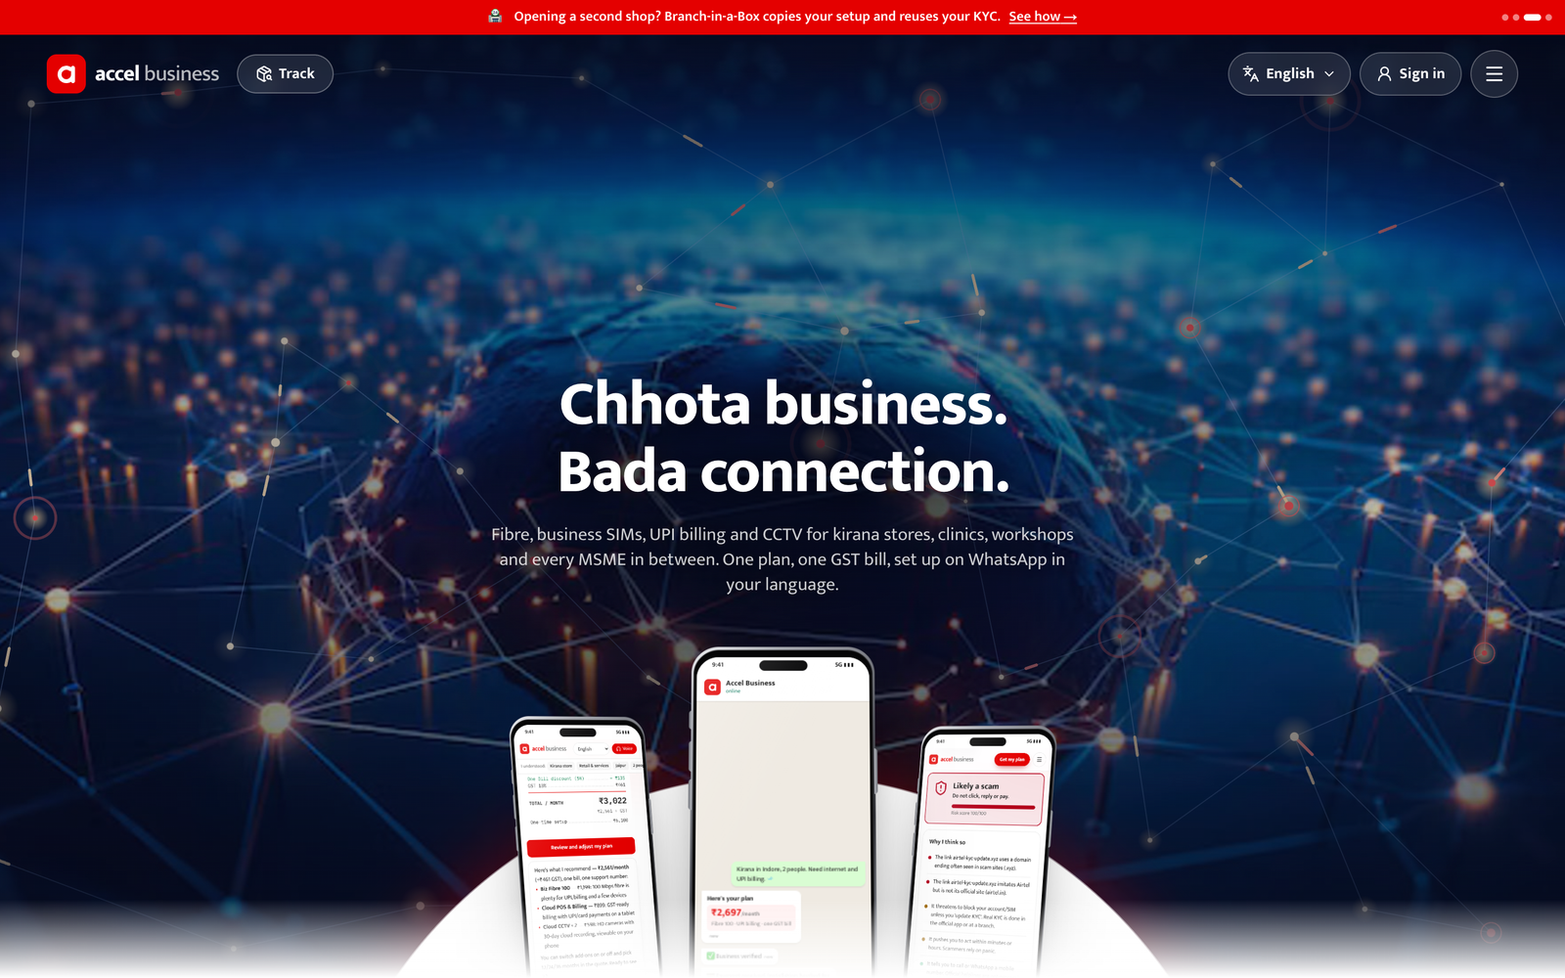
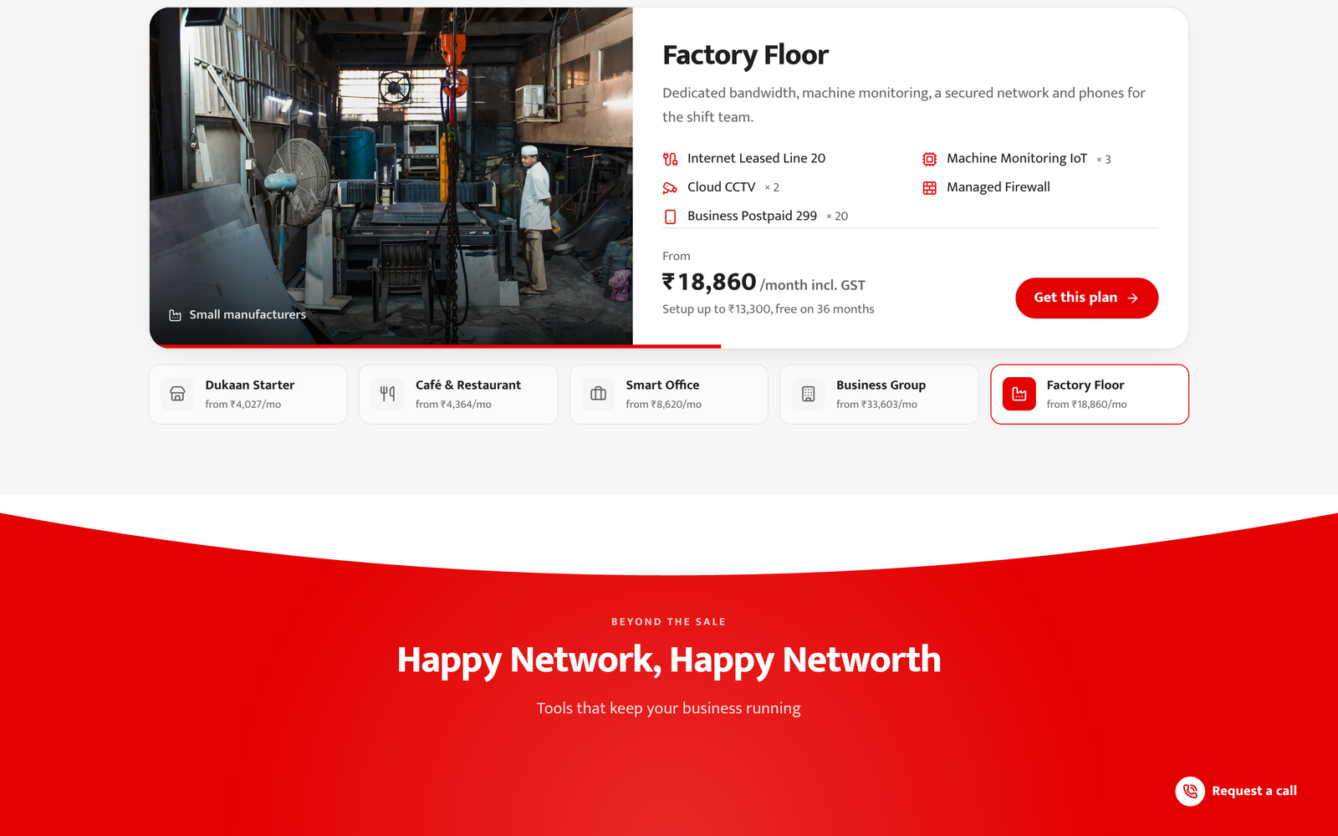
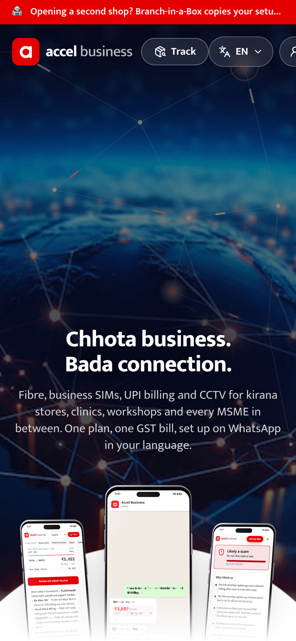
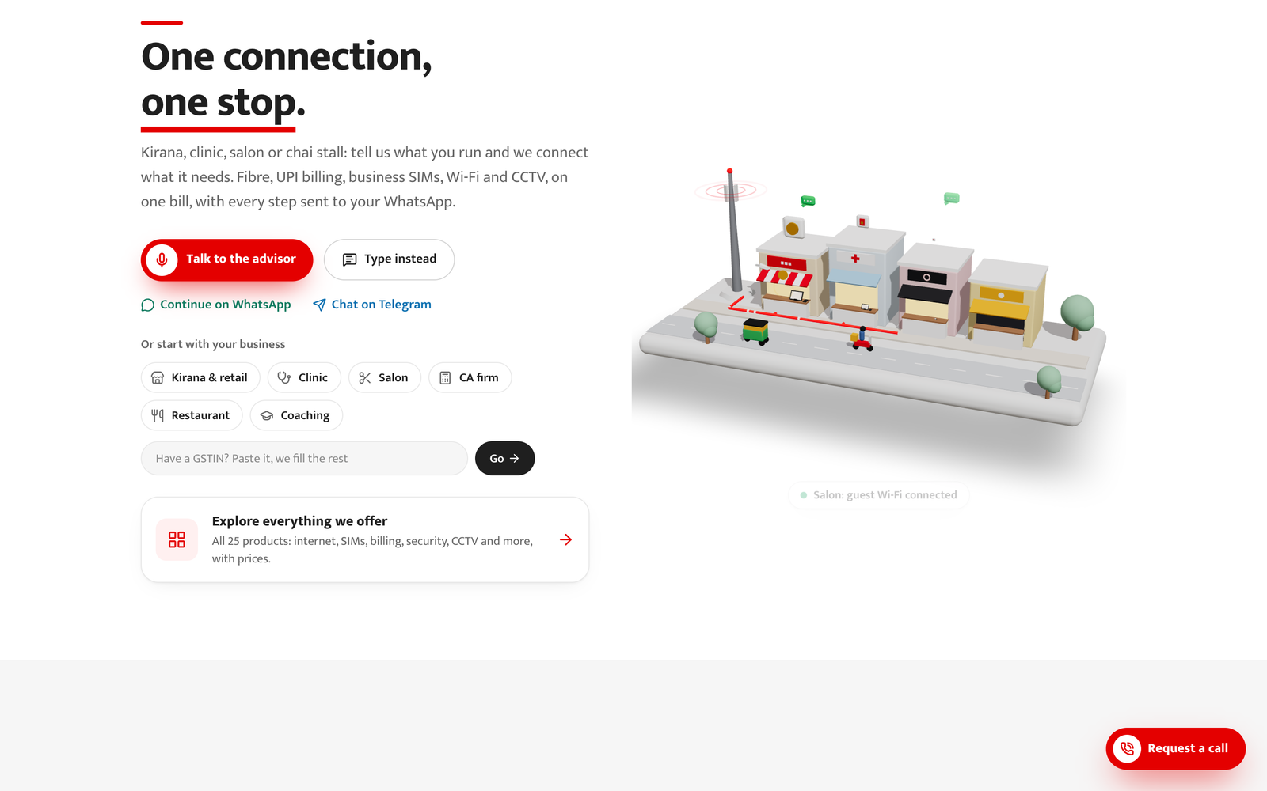
The website: a 3D street of Indian shops, plans by business type, the advisor in your language
A
Home: one plan, one bill, on WhatsApp
Ready plans per segment, priced from the catalogue
Scam Shield, network check, install slots, outage help and Branch-in-a-Box work on the web and in the chat, so the owner keeps one number after go-live.
Pick your business, talk or type
Phone first, 10 languages, voice
Notes:
Landing page with the 3D street (billing POS on every shop, cameras on the kirana and chai stall), plans per segment and the advisor.

