Slide 1
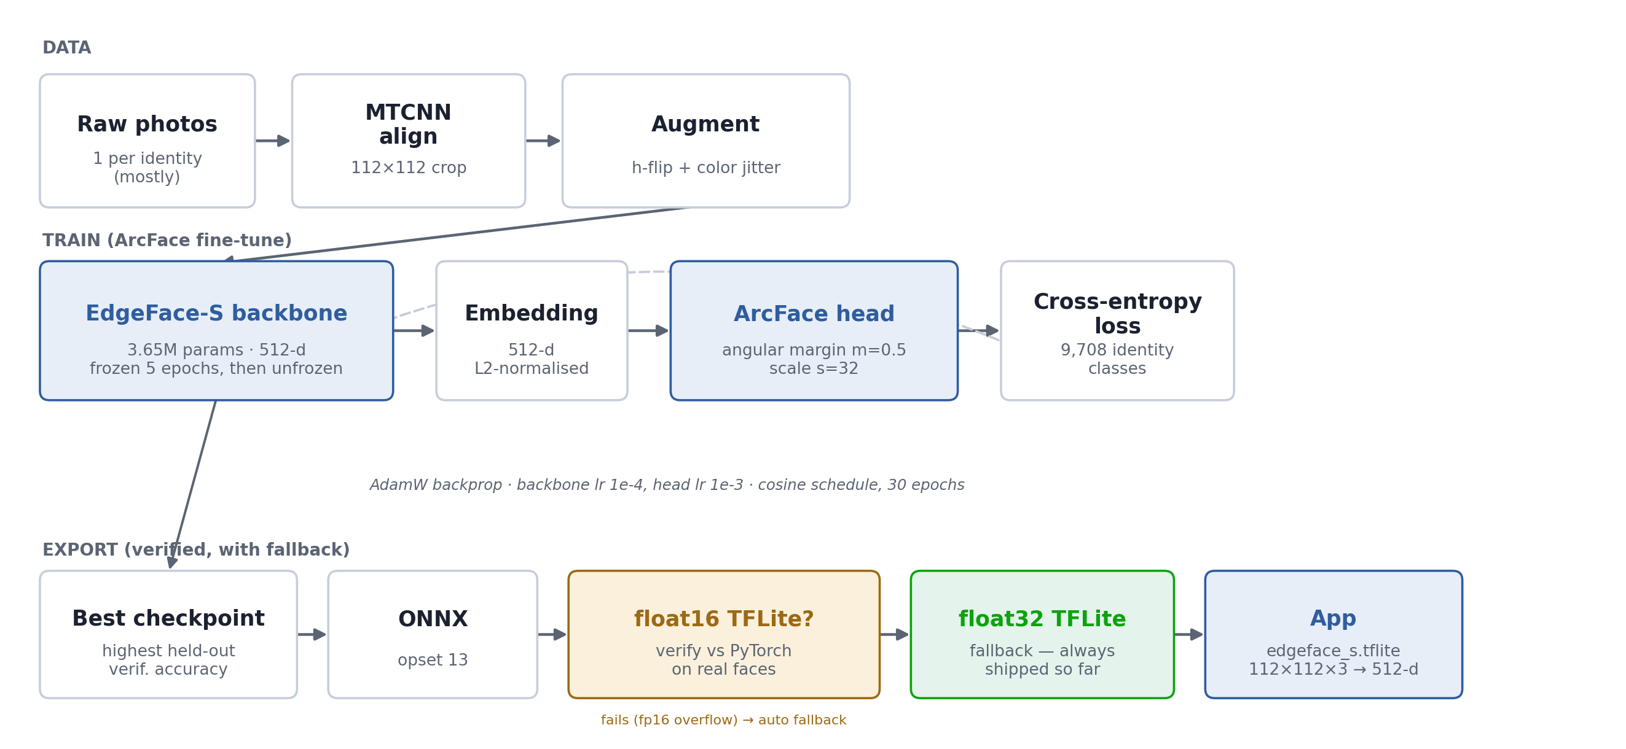
FINE-TUNING ARCHITECTURE
EdgeFace-S + ArcFace, end to end
BACKBONE
EdgeFace-S (edgeface_s_gamma_05)
3.65M params · 512-d output
LOSS
ArcFace angular margin
s=32, m=0.5
SCHEDULE
5 ep. head-only warmup
→ 25 ep. full fine-tune
OPTIMISER
AdamW · backbone lr 1e-4
head lr 1e-3 · cosine decay
INPUT / OUTPUT
112×112×3 float32
mean/std 0.5 → 512-d
EXPORT
ONNX opset13 → TFLite
fp16 verified, fp32 fallback
Same 112×112×3 in / 512-d out / mean-std-0.5 contract as the app's config.ts — drop-in, no app changes.

Slide 2







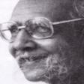



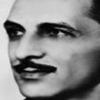
DATASET
9,708 identities of Indian faces, real photos
Wikidata/Wikimedia Commons extraction of named Indian public figures — person, state, gender, portrait photo.
27,364
9,708
9,900
36
source CSV rows
training identities
training images
states & UTs covered
SAMPLE FACES FROM THE DATASET
Sapna Bhavnani
Biswajit Roy Chowdhury
Sangram Singh
Venu Thottempudi
Shaktisinh Gohil
Santosh Lad
Sulochana Latkar
Jambuvijaya
Ishita Malaviya
Sunirmal Basu
Shirine Boukli
J R D Tata
outputs/eval_report/ · data/build_identity_dataset.py · real held-out portrait photos, not synthetic

Slide 3
BENCHMARK
Verification accuracy, held-out identities
Same/different-person verification on identities never seen during training — real photo pairs, evaluated on the shipped TFLite model.
VERIFICATION ACCURACY
85.71%
42 genuine + 42 impostor pairs · ROC-AUC 0.88
outputs/edgeface_s.tflite · float32, cosine parity 1.0 vs PyTorch · evaluate_tflite.py

