Slide 1
Analysis of human Language
Vicki Ziwei zheng

Slide 2
NLP
Natural language processing (NLP)
a subfield of computer science, information engineering, and artificial intelligence concerned with the interactions between computers and human (natural) languages, in particular how to program computers to process and analyze large amounts of natural language data.

Slide 3
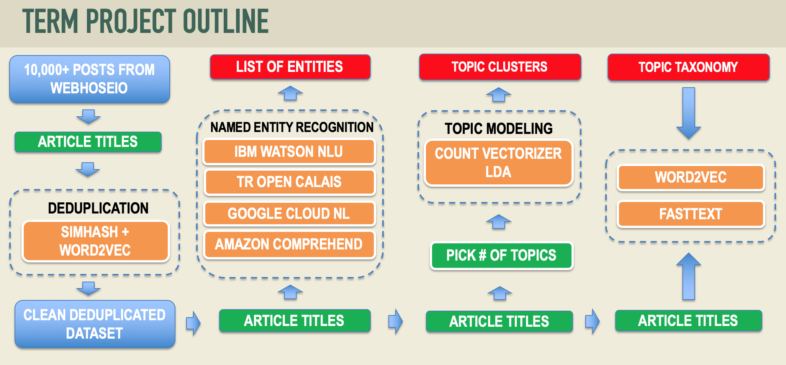

Slide 4

Get 10,000 posts
The Webhose.io API provides easy to integrate, high quality data and meta-data, from hundreds of thousands of global online sources like message boards, blogs, reviews, news and more. Available either by query based API
Crawled 10,000 posts from webhoseio using filters:
organization: google
Language: English
Date: 08/01/2018 – 12/01/2018
Got 8019 posts
Save as .json file
Result:
Still found other language articles – Need more filter processing
https://webhose.io/web-content-api

Slide 5
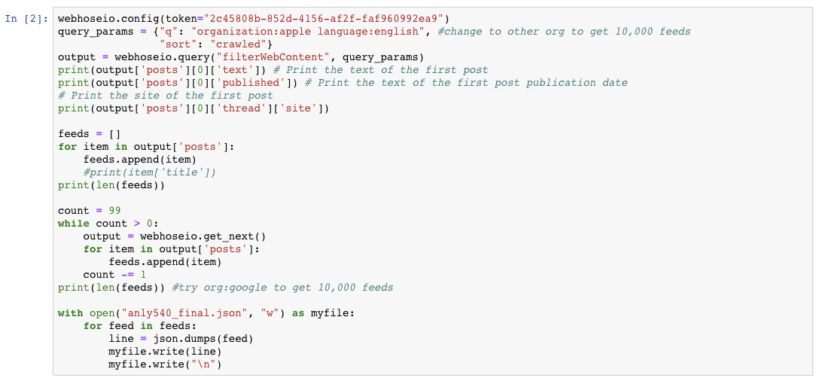
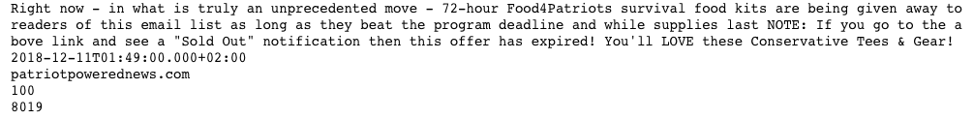

Slide 6


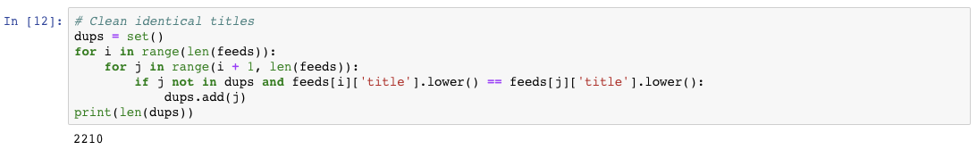
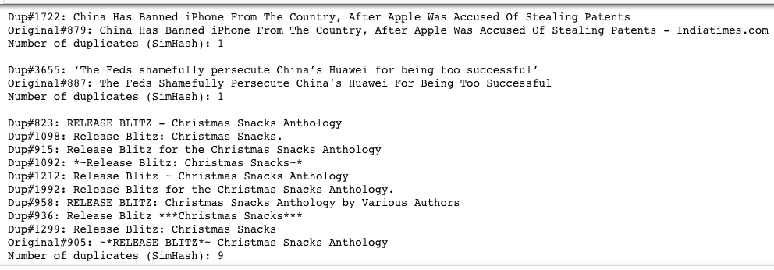
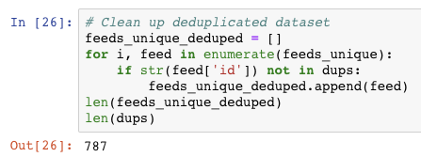
deduplication
Clean Dataset
1. clean 2210 identical titles
2. get unique titles
3. further clean using
Simhash
Wordvector
Distance = 8
4. Get 787 more similar titles cleaned

Slide 7
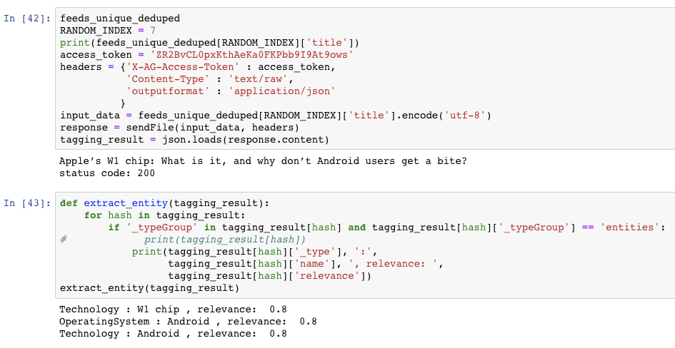
Named entity recognition
Tagging
Extract entity
Get relevance value

Slide 8
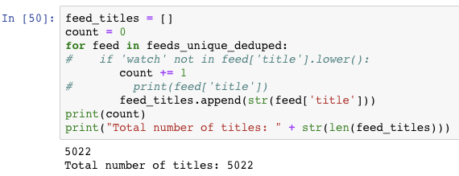
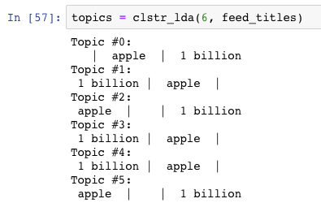
Topic modeling
Total number of titles from clean dataset: 5022
Topic Clustering
Result is not
so good.

Slide 9
Topic taxonomy
topic_taxonomy = {
"Business":
{
"Trading and Investing": "stock trade sale dow market invest acquire merge purchase subsidiary",
"Company Corporation and Competition": "compete partnership rivalry win lose deal giveup",
“Policy Change”: “operation change organizational policy support transfer BAN"
},
"Technology":
{
"Laptop": "microsoft mac pro air surface lenovo dell alienware asus apple",
“Smart Phone”: “iphone android pixel nexus huawei xiaomi text message",
"Intelligent Home Appliance": "alexa home mini ipod ipad amazon"
}
}
What these revealed:
Apple shares keep falling in last three months
Apple watch wins more favorites
Apple is facing difficulties on expanding Chinese market
Testing and Finding:
How would below articles classified into Company Corporation and Competition：
‘China Bans Sale Of Multiple iPhone Models But Apple Is Not Giving Up Just Yet’ - Policy Change
‘Apple iPhone to Google Pixel 3: How to transfer contacts, messages, calendars and media‘, - Smart Phone
’Apple Shares Drop to Lowest in Over 3 Months on iPhone Suppliers‘ Warnings’ - Trading and Investing

Slide 10
Future improvement
Analyze on optimizing deduplication process time
Analyze on alternative algorithm for similarity calculation
Improve LDA model to get better cluster
Build better taxonomy
Use nltk to analyze entities

