Slide 1
Analysis of human Language
Ziwei zheng

Slide 2

Get 10,000 posts
Crawled 10,000 posts from webhoseio using filters:
organization: google
Language: English
Date: 08/01/2018 – 12/01/2018
Got 8019 posts
Save as .json file
Result:
Still found other language articles

Slide 3
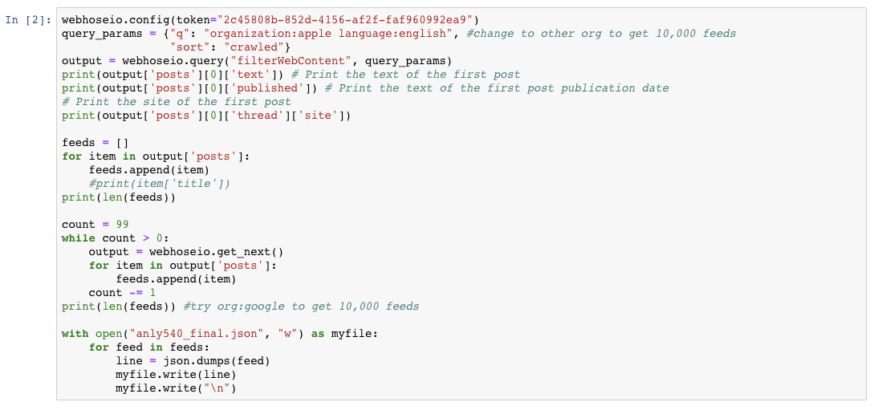
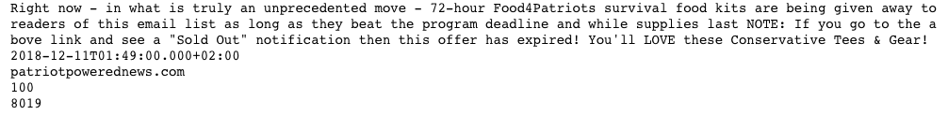

Slide 4


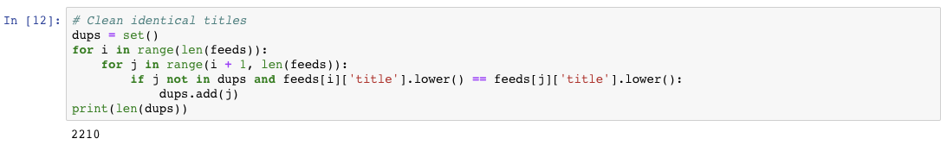
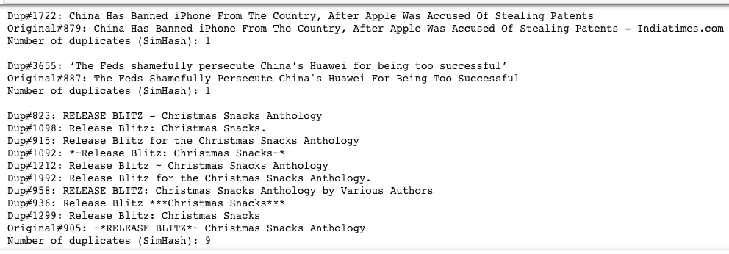
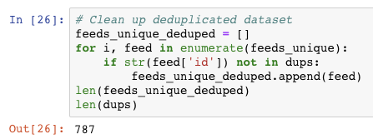
deduplication
Clean Dataset
1. clean 2210 identical titles
2. get unique titles
3. further clean using
Simhash
Wordvector
Distance = 8
4. Get 787 more similar titles cleaned

Slide 5
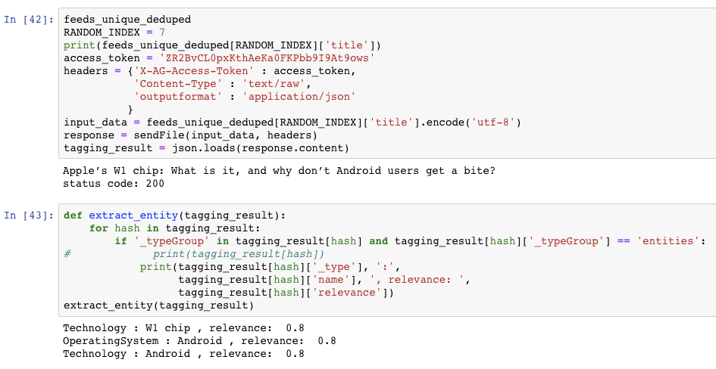
Named entity recognition
Tagging
Extract entity
Get relevance value

Slide 6
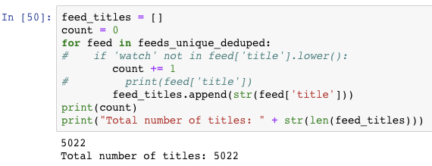
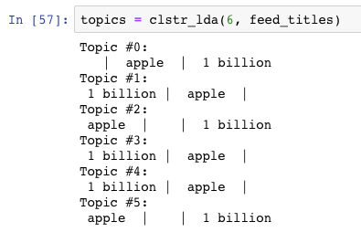
Topic modeling
Total number of titles from clean dataset: 5022
Topic Clustering
Result is not
so good.

Slide 7
Topic taxonomy
topic_taxonomy = {
"Business":
{
"Trading and Investing": "stock trade sale dow market invest acquire merge purchase subsidiary",
"Company Corporation and Competition": "compete partnership rivalry win lose deal giveup",
“Policy Change”: “operation change organizational policy support transfer BAN"
},
"Technology":
{
"Laptop": "microsoft mac pro air surface lenovo dell alienware asus apple",
“Smart Phone”: “iphone android pixel nexus huawei xiaomi text message",
"Intelligent Home Appliance": "alexa home mini ipod ipad amazon"
}
}
What these revealed:
Apple shares keep falling in last three months
Apple watch wins more favorites
Apple is facing difficulties on expanding Chinese market
Testing and Finding:
How would below articles classified into Company Corporation and Competition：
‘China Bans Sale Of Multiple iPhone Models But Apple Is Not Giving Up Just Yet’ - Policy Change
‘Apple iPhone to Google Pixel 3: How to transfer contacts, messages, calendars and media‘, - Smart Phone
’Apple Shares Drop to Lowest in Over 3 Months on iPhone Suppliers‘ Warnings’ - Trading and Investing

Slide 8
Future improvement
Analyze on optimizing deduplication process time
Analyze on alternative algorithm for similarity calculation
Improve LDA model to get better cluster
Build better taxonomy
Use nltk to analyze entities

