Slide 1
PREDICTION ASSURANCE HARNESS (PAH)
Dock Harness
Does this prediction support the claim?
1/15
Notes:
The harness decides whether a co-folding or docking result can support a declared claim. Example system throughout: bovine trypsin, PDB 3PTB, with benzamidine.

Slide 2
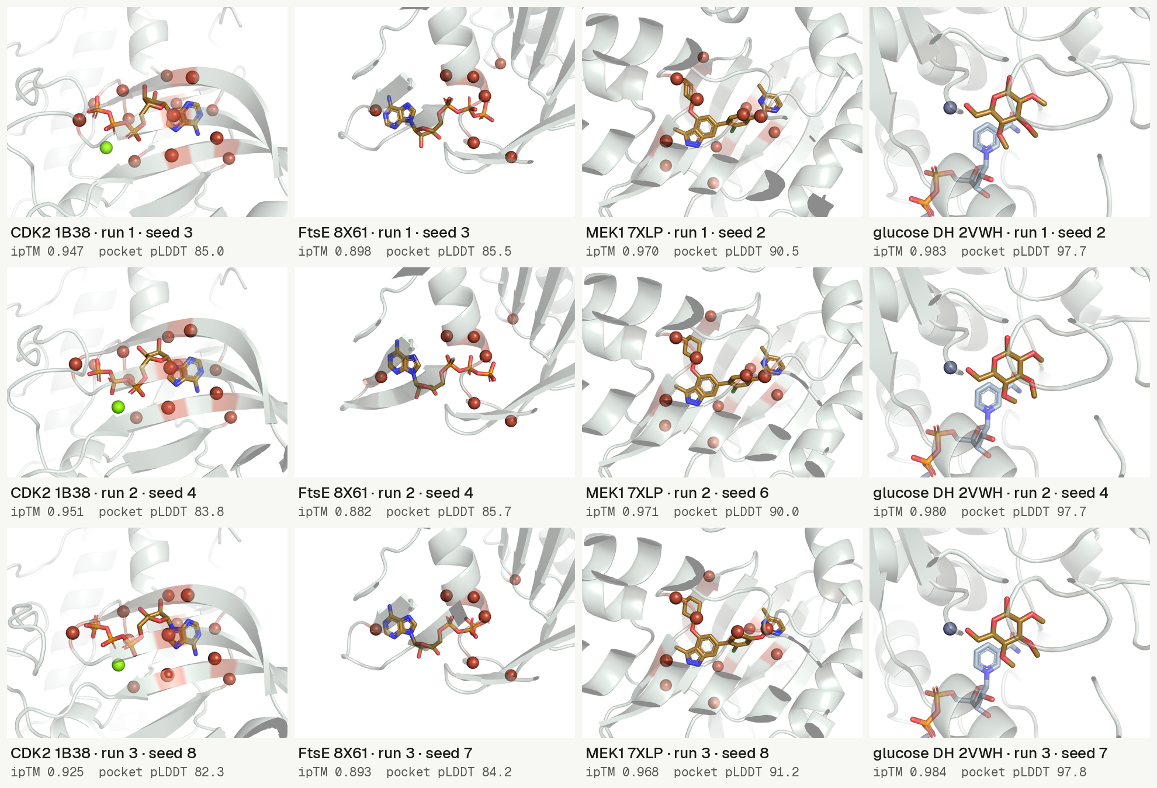
12 perturbed poses: valid on confidence,
rejected with the harness
Without the harness: valid
Agent given ligand ipTM and
pocket pLDDT called 12 of
12 valid
With the harness: rejected
Same agent given the fact
file rejected 12 of 12
Boltz-2, pocket removed; PyMOL renders [R16]. Best published confidence ROC AUC: 0.756 for poses within 2 Å [R2].
S1: media/figures/twelve/twelve.json; bench/runs/*/report.md. S2: Kim et al. 2026 [R2]. Refs: R4, R16, R23–R26 · Sources: S1; S2
2/15
Notes:
Columns: CDK2 1B38, FtsE 8X61, MEK1 7XLP, glucose dehydrogenase 2VWH. Rows: runs 1 to 3. Red spheres mark pocket residues cut to glycine; glucose dehydrogenase has its ligand hydroxyls methylated instead. Without the harness means the agent saw only ligand ipTM and pocket pLDDT; with the harness it saw the fact file. Published AUC: AlphaFold3 ligand pLDDT, 489 Mac1 complexes.

Slide 3
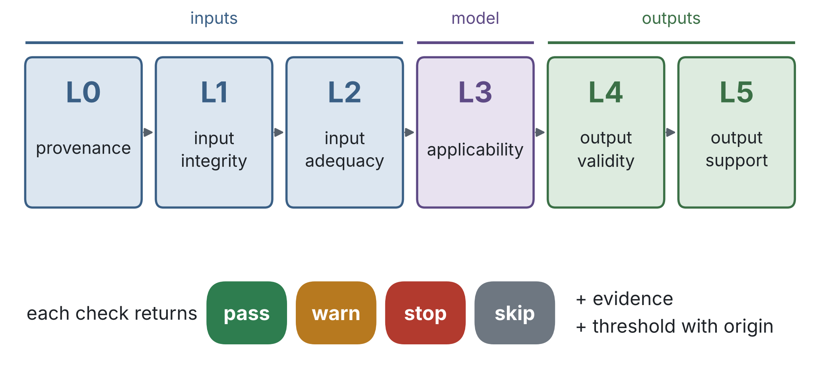
Six layers; each check carries evidence
A
S1: docs/SPECIFICATION.md; README.md. Diagram: media/deck/make_layers.py · Sources: S1
3/15
Notes:
Thresholds come from the specification and configs/, each recorded with its origin.

Slide 4
Models it runs and checks
TABLE INDEX
5 rows | Models | Harness role
Models | Harness role
Boltz-1, Boltz-2, Chai-1, Protenix, ColabFold (AlphaFold2), OpenFold3 | Runs on Modal A100 GPUs, then checks
DiffDock-L, Gnina | Runs on Modal A100 GPUs, then checks
AutoDock Vina | Runs on CPU, then checks
AlphaFold3 | Checks outputs supplied by the user
HADDOCK3, pyDock (protein–protein) | Checks outputs supplied by the user
Executor input and output contracts: docs/EXECUTORS.md.
S1: README.md; configs/executors.yaml; configs/runtimes.yaml. Refs: R3–R13, R18–R20 · Sources: S1
4/15
Notes:
OpenFold3 runs as the openfold3 runtime (configs/runtimes.yaml). AlphaFold3 weights are issued on request, so its outputs are checked, not produced.

Slide 5
Check tools, sources and interfaces
Checks
Sources
PoseBusters [R1], RDKit [R15], PLIP
[R14], OpenMM [R17], PyMOL [R16],
gemmi, FreeSASA
UniProt, RCSB PDB [R21], PDBe and
SIFTS, CCD, PubChem, AlphaFold DB,
ChEMBL, BindingDB
Interfaces
MCP server and HTTP API for agents; web UI with an
Agent view
S1: README.md; configs/sources.yaml. Refs: see References · Sources: S1
5/15

Slide 6
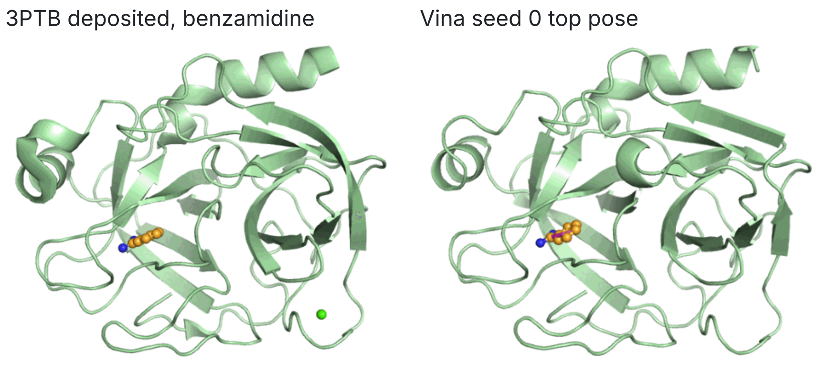
3PTB: Vina passes, Boltz-2 stops
Vina, 5 seeds: pass with warnings
PoseBusters 20/20; medoid
0.38 Å from crystal;
redocking 0.42 Å
Boltz-2: stop
ipTM 0.962; pocket pLDDT
98.6; no redocking control;
314 pre-cutoff benzamidine
entries
Trypsin (P00760) with benzamidine (CCD BEN). PyMOL renders [R16] of PDB 3PTB [R22].
S1: README.md, Results on real targets (examples/3ptb_vina, examples/3ptb_boltz2). Refs: R1, R4, R12, R16, R22 · Sources: S1
6/15

Slide 7
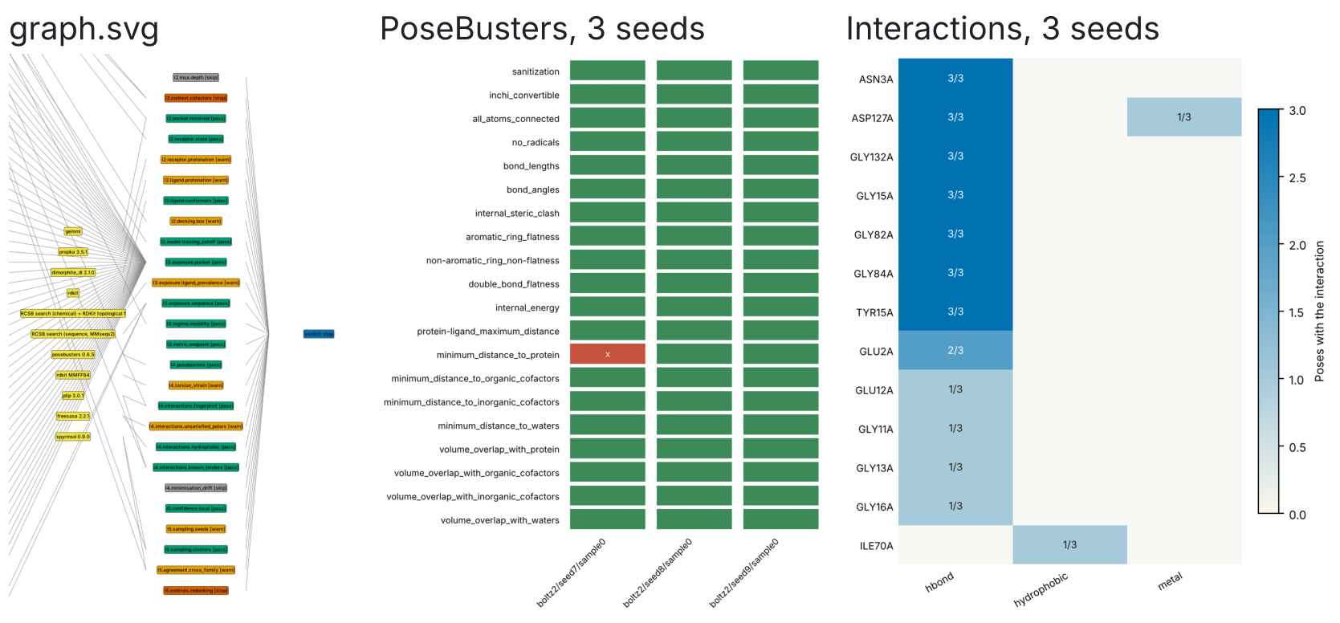
Each run writes a report, graph and figures
A
Also written: report.html, report.md, record.json, provenance.json.
S1: bench/runs/2026-10-17T1859Z-849c856/harness/cdk2_pert_boltz2/run/. Boltz-2 [R4], PoseBusters [R1], PLIP [R14] · Sources: S1
7/15

Slide 8
Benchmark: remove the pocket, ask an agent
1
2
3
4
Perturb
Predict
Check
Judge
Pocket to
glycine, or
glucose
hydroxyls
methylated
Boltz-2,
DiffDock-L;
3 seeds
Fact file per
prediction
GLM-4.6 agent:
score only, or
fact file
FtsE 8X61, CDK2 1B38, MEK1 7XLP, glucose DH 2VWH; 16 predictions per run, 3 runs. Perturbed counts as invalid.
S1: bench/README.md; bench/runs/2026-10-17T1859Z-849c856/report.md. Refs: R4, R10; PDB entries R23–R26 · Sources: S1
8/15
Notes:
Wild type is valid when the medoid pose lies within 2.0 Å of the deposited ligand.

Slide 9
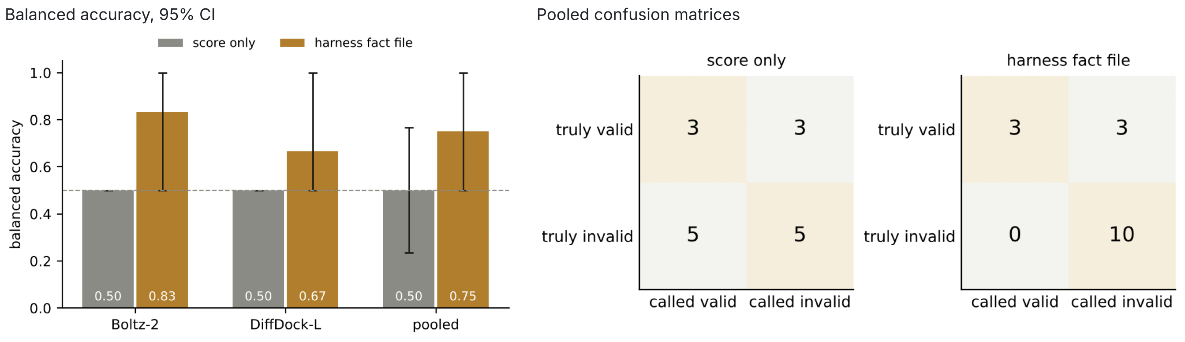
Run 3 balanced accuracy: 0.50 score only,
0.75 fact file
A
Fact file 95% CI 0.50 to 1.0, p = 0.125. Runs 1, 2: 0.53, 0.58.
S1: bench/runs/2026-10-17T1859Z-849c856/report.md; README.md, Perturbation benchmark · Sources: S1
9/15
Notes:
Run 3 values: balanced_accuracy.csv and report.md line 67 (McNemar exact p 0.125). Runs 1 and 2 fact-file balanced accuracy 0.533 and 0.583 (their report.md line 67). FtsE fact-file values in all three runs predate the superposition fix (commit de35af7).

Slide 10
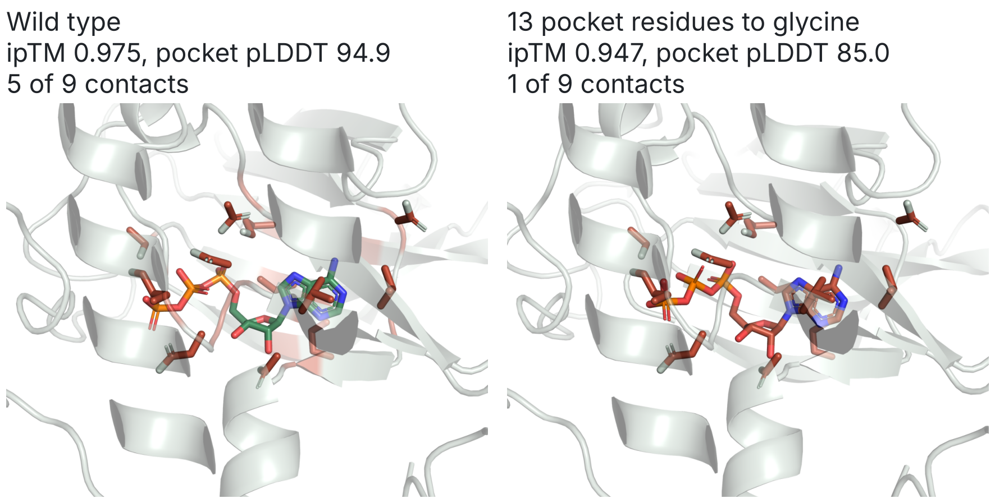
CDK2: confidence holds without the pocket
A
Perturbed: PoseBusters 20/20, RMSD 2.39 Å. Fact file: invalid.
S1: bench/finding/values.csv, panels/; bench/runs/2026-10-17T1611Z-426bfe9/report.md. Refs: R4, R16, R23 · Sources: S1
10/15
Notes:
CDK2 1B38 chain A, ATP, run 2026-10-17T1611Z-426bfe9. RMSD is the perturbed medoid to the deposited ATP (report.md line 17). Proteins superposed by CA, one camera; red marks residues cut to glycine.

Slide 11
Tests and interfaces
394
Python test functions
225
Web UI tests
162 Vitest, 63 Playwright
No network; recorded source responses
7
Of 7 planted input faults stopped
70
Registered checks, L0 to L5
examples/3ptb_faulty_inputs
Each threshold with an origin
S1: README.md; tests/ (def test_); web: vitest list, playwright test --list; pah checks · Sources: S1
11/15

Slide 12
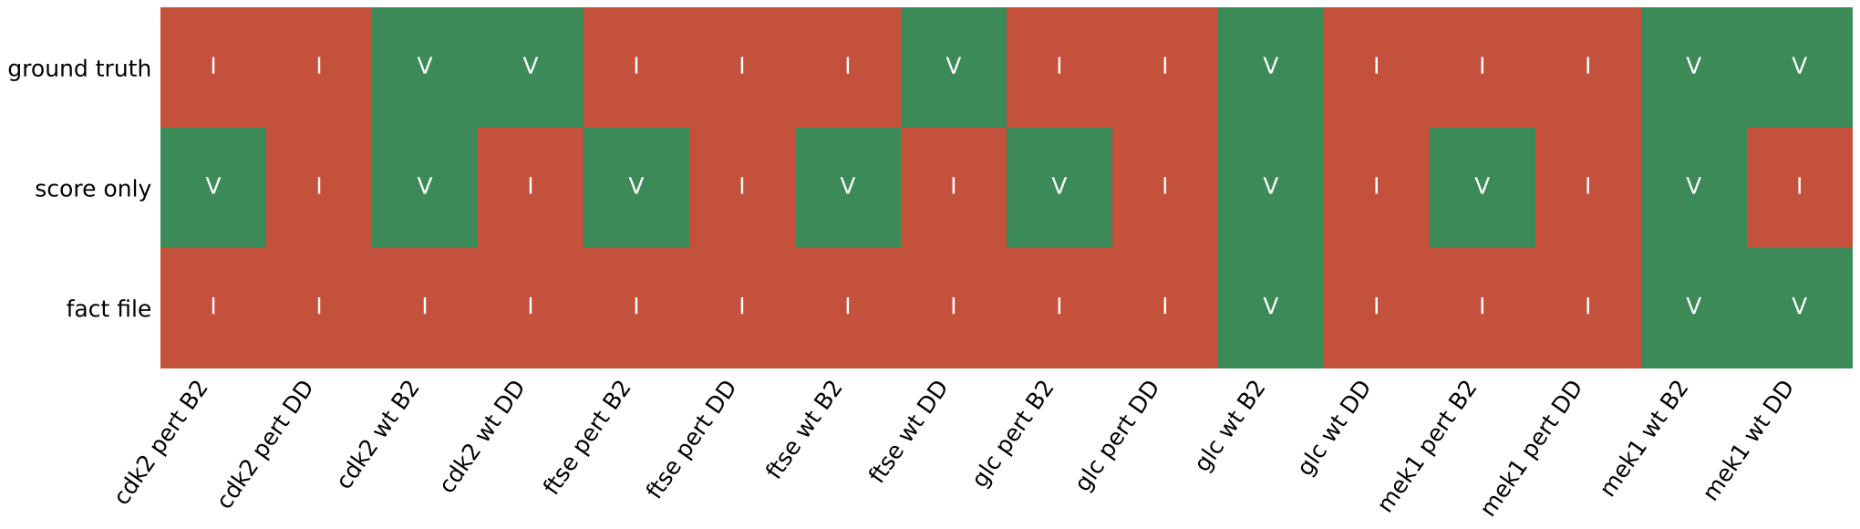
Each number traces to a check and a source
A
Limits: 16 predictions per run; read as a demonstration, since no interval
excludes 0.5.
S1: bench/runs/2026-10-17T1859Z-849c856/results/figures/decisions.csv. Boltz-2 [R4], DiffDock-L [R10] · Sources: S1
12/15

Slide 13
References: models and benchmarks
Buttenschoen M, Morris GM, Deane CM. PoseBusters. Chem Sci 2024;15:3130. doi:10.1039/d3sc04185a
Chai Discovery, Boitreaud J, et al. Chai-1. bioRxiv 2024. doi:10.1101/2024.10.10.615955
R1
R5
Kim J, …, Fraser JS. Co-folding on Mac1–ligand complexes. eLife 2026;15. doi:10.7554/eLife.110475
ByteDance AML AI4Science Team, et al. Protenix. bioRxiv 2025. doi:10.1101/2025.01.08.631967
R2
R6
Wohlwend J, Corso G, Passaro S, et al. Boltz-1. bioRxiv 2024. doi:10.1101/2024.11.19.624167
Mirdita M, et al. ColabFold. Nat Methods 2022;19:679. doi:10.1038/s41592-022-01488-1
R3
R7
Passaro S, Corso G, Wohlwend J, et al. Boltz-2. bioRxiv 2025. doi:10.1101/2025.06.14.659707
Abramson J, et al. AlphaFold 3. Nature 2024;630:493. doi:10.1038/s41586-024-07487-w
R4
R8
Full titles and verification: media/deck/FIGURES.md · Sources: Europe PMC records
13/15

Slide 14
References: docking and analysis
Corso G, Stärk H, Jing B, Barzilay R, Jaakkola T. DiffDock. arXiv:2210.01776 (2022)
Eberhardt J, et al. AutoDock Vina 1.2.0. J Chem Inf Model 2021;61:3891. doi:10.1021/acs.jcim.1c00203
R9
R13
Corso G, Deng A, Fry B, et al. DiffDock-L. ICLR 2024. arXiv:2402.18396
PLIP: Salentin S, et al. 2015, doi:10.1093/nar/gkv315; Adasme MF, et al. 2021, doi:10.1093/nar/gkab294
R10
R14
McNutt AT, et al. GNINA 1.0. J Cheminform 2021;13:43. doi:10.1186/s13321-021-00522-2
Eastman P, et al. OpenMM 8. J Phys Chem B 2024;128:109. doi:10.1021/acs.jpcb.3c06662
R11
R17
Trott O, Olson AJ. AutoDock Vina. J Comput Chem 2010;31:455. doi:10.1002/jcc.21334
Giulini M, et al. HADDOCK3. J Chem Inf Model 2025;65:7315. doi:10.1021/acs.jcim.5c00969
R12
R18
Full titles and verification: media/deck/FIGURES.md · Sources: Europe PMC; arXiv
14/15

Slide 15
References: software and data
Software
pyDock [R19]
R15 RDKit 2026.9.1,
doi:10.5281/zenodo.591637. R16 PyMOL
open-source 3.2.0, Schrödinger. R20
OpenFold3 0.4.1 (software)
Cheng TM, Blundell TL,
Fernandez-Recio J. Proteins
2007;68:503.
doi:10.1002/prot.21419
Structures
R21 Berman HM, et al. Nucleic Acids Res 2000;28:235.
doi:10.1093/nar/28.1.235. R22–R26 PDB 3PTB, 1B38, 8X61,
7XLP, 2VWH (primary citations in FIGURES.md)
Full titles and verification: media/deck/FIGURES.md · Sources: Europe PMC; RCSB PDB; rdkit.org
15/15

