Slide 1
PRESENTATION
Does the fact file help reject invalid poses?
Perturbation benchmark, run 2026-10-17T1752Z-2f5a1c7
1/8
Notes:
Same agent, same predictions, two kinds of evidence: the model confidence score alone, or the harness fact file.

Slide 2
Four systems, each wild type and perturbed
Perturbed systems are invalid by construction
TABLE INDEX
4 rows | System | Entry | Ligand | Perturbation
System | Entry | Ligand | Perturbation
CDK2 | 1B38 | ATP | 13 contacts to Gly
FtsE | 8X61 | ATP | 7 contacts to Gly
glucose dehydrogenase | 2VWH | BGC | 3 hydroxyls methylated
MEK1 | 7XLP | FZC | 11 contacts to Gly
S1: bench/runs/2026-10-17T1752Z-2f5a1c7 (stats.json, facts, renders) · Sources: S1
2/8
Notes:
Each system is predicted by Boltz-2 and DiffDock-L with three seeds. A wild-type prediction is valid when its medoid lies within 2 Å of the deposited ligand.

Slide 3
One perturbed prediction, two views
CDK2, Boltz-2, 13 contacts to glycine
Score only
Harness fact file
Confidence: ligand_iptm 0.951,
pocket_plddt 83.8,
confidence_score 0.895
Wild type: ligand_iptm 0.976,
pocket_plddt 94.5,
confidence_score 0.956
PoseBusters 20 of 20
Deposited interactions recovered
1 of 9
Buried unsatisfied polars 6
Ensemble spread 7.96 Å;
cross-executor 2.51 Å
S1: bench/runs/2026-10-17T1752Z-2f5a1c7 (stats.json, facts, renders) · Sources: S1
3/8
Notes:
13 contact residues were cut to glycine. The confidence the model reports and the fact file for the same prediction.

Slide 4
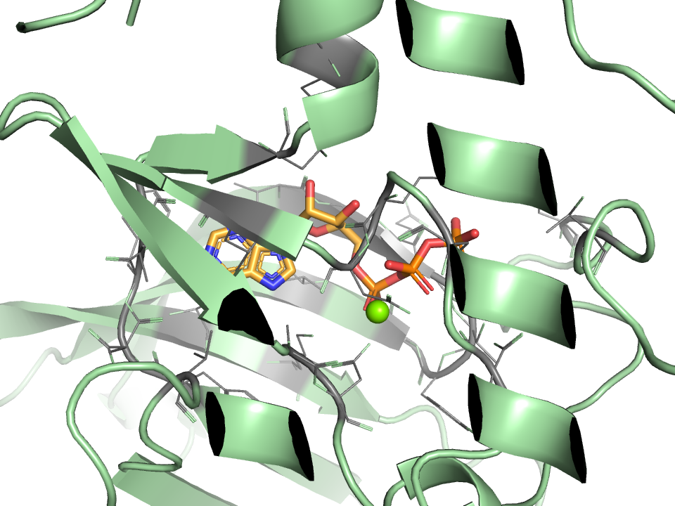
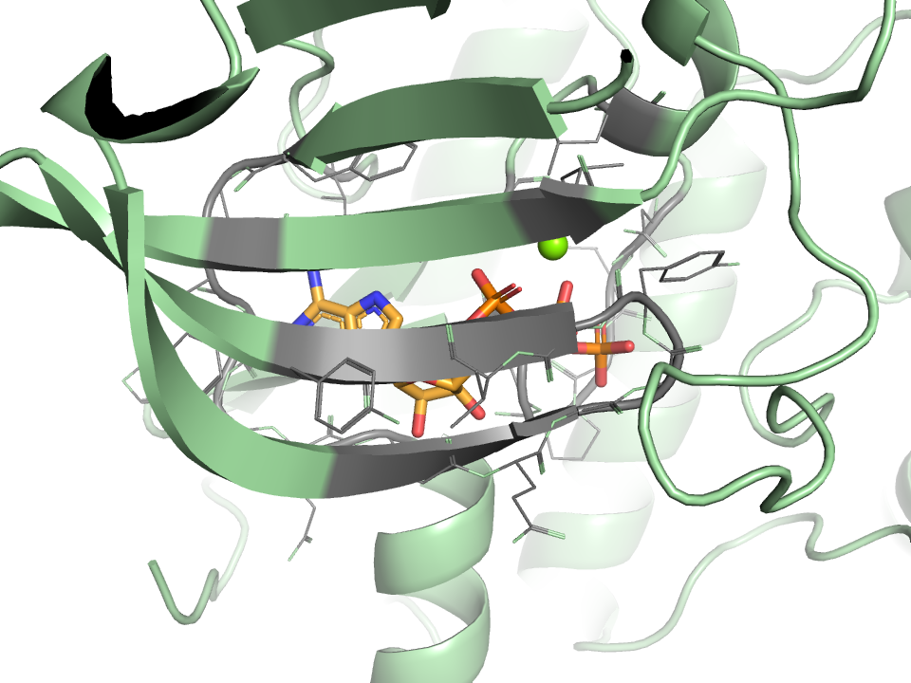
Medoid poses, wild type and perturbed
CDK2, Boltz-2
A. wild type
B. perturbed
Boltz-2 medoid pose
Boltz-2 medoid pose
Each panel oriented on its ligand; grey: residues ≤ 5 Å.
S1: bench/runs/2026-10-17T1752Z-2f5a1c7 (stats.json, facts, renders) · Sources: S1
4/8

Slide 5
Confusion counts, executors pooled
TABLE INDEX
2 rows | Arm | Valid kept | Valid rejected | Invalid kept | Invalid rejected
Arm | Valid kept | Valid rejected | Invalid kept | Invalid rejected
Score only | 3 | 3 | 5 | 5
Fact file | 1 | 5 | 0 | 10
16 predictions (6 valid, 10 invalid); majority verdict over three repeats.
S1: bench/runs/2026-10-17T1752Z-2f5a1c7 (stats.json, facts, renders) · Sources: S1
5/8

Slide 6
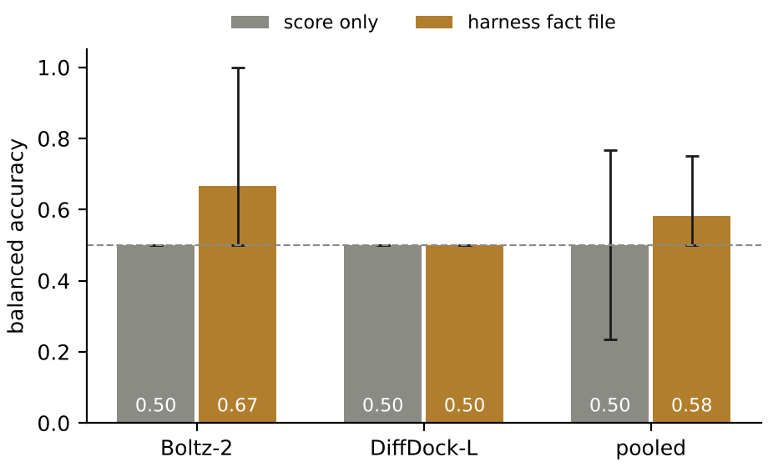
Balanced accuracy with 95% intervals
Score only, pooled
0.5 (0.236 to 0.767)
Fact file, pooled
0.583 (0.5 to 0.75)
McNemar exact p
0.4531; discordant 5 and 2
Bootstrap over predictions; dashed line at 0.5.
S1: bench/runs/2026-10-17T1752Z-2f5a1c7 (stats.json, facts, renders) · Sources: S1
6/8
Notes:
Boltz-2: score only 0.5 (0.5 to 0.5), fact file 0.667 (0.5 to 1.0). DiffDock-L: score only 0.5 (0.5 to 0.5), fact file 0.5 (0.5 to 0.5).

Slide 7
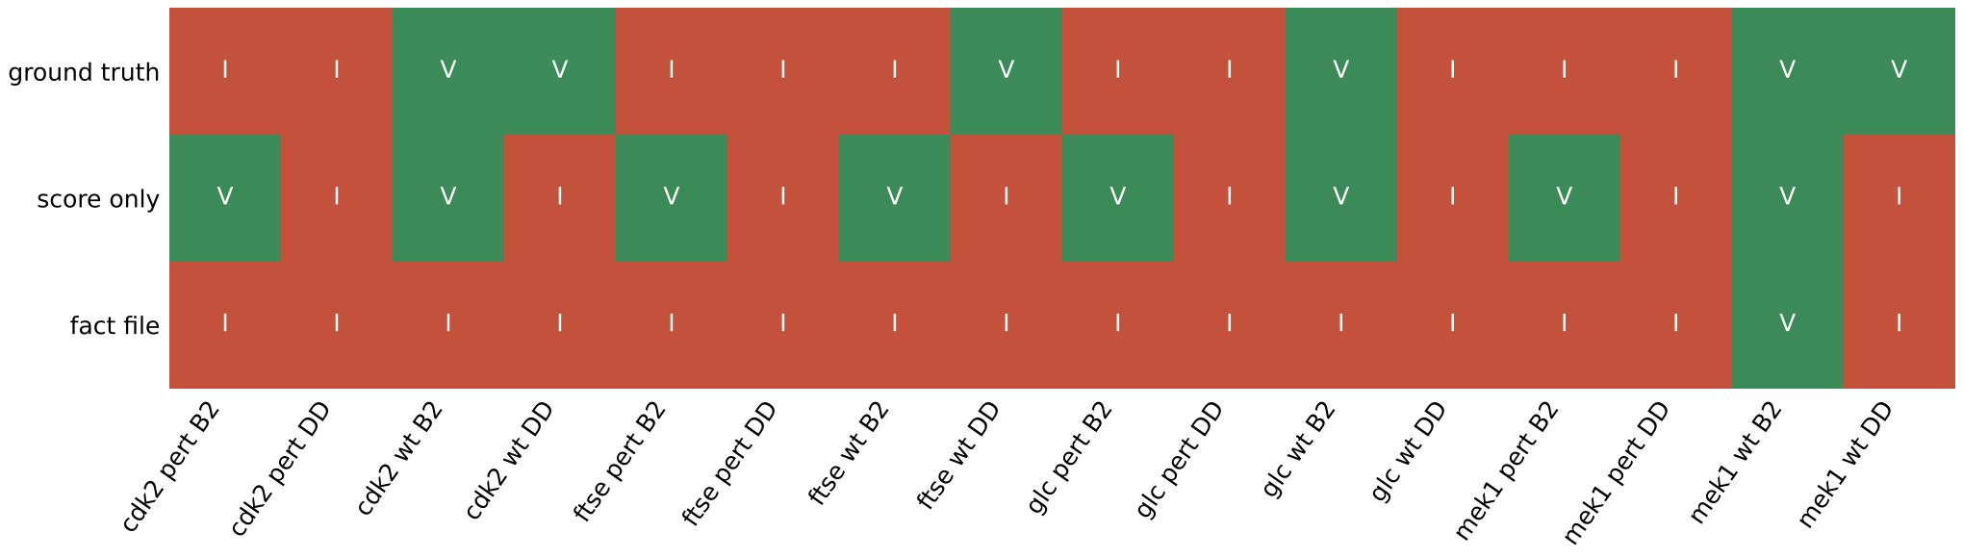
Decision per prediction
A. Ground truth and majority verdict per prediction
B2 Boltz-2, DD DiffDock-L. V valid, I invalid.
S1: bench/runs/2026-10-17T1752Z-2f5a1c7 (stats.json, facts, renders) · Sources: S1
7/8
Notes:
Score only kept 5 of 10 invalid predictions; the fact file arm kept 1 of 6 valid.

Slide 8
What this run does and does not establish
Measured
Not established
16 predictions, 2 executors
Every prompt and response logged
Ground truth fixed in advance
A significant difference
Loss of binding (assumed)
Effect of prompt length
S1: bench/runs/2026-10-17T1752Z-2f5a1c7 (stats.json, facts, renders) · Sources: S1
8/8
Notes:
Eight systems per executor support a demonstration, not a statistical claim. A length-matched control arm was not run.

