Slide 1
PRESENTATION
Does the fact file help reject invalid poses?
Perturbation benchmark, run 2026-10-17T1611Z-426bfe9
1/8
Notes:
Same agent, same predictions, two kinds of evidence: the model confidence score alone, or the harness fact file.

Slide 2
Four systems, each wild type and perturbed
Perturbed systems are invalid by construction
TABLE INDEX
4 rows | System | Entry | Ligand | Perturbation
System | Entry | Ligand | Perturbation
CDK2 | 1B38 | ATP | 13 contacts to Gly
FtsE | 8X61 | ATP | 7 contacts to Gly
glucose dehydrogenase | 2VWH | BGC | 3 hydroxyls methylated
MEK1 | 7XLP | FZC | 11 contacts to Gly
S1: bench/runs/2026-10-17T1611Z-426bfe9 (stats.json, facts, renders) · Sources: S1
2/8
Notes:
Each system is predicted by Boltz-2 and DiffDock-L with three seeds. A wild-type prediction is valid when its medoid lies within 2 Å of the deposited ligand.

Slide 3
One perturbed prediction, two views
CDK2, Boltz-2, 13 contacts to glycine
Score only
Harness fact file
Confidence: ligand_iptm 0.947,
pocket_plddt 85,
confidence_score 0.894
Wild type: ligand_iptm 0.975,
pocket_plddt 94.9,
confidence_score 0.958
PoseBusters 20 of 20
Deposited interactions recovered
1 of 9
Buried unsatisfied polars 5
Ensemble spread 0.894 Å;
cross-executor 2.66 Å
S1: bench/runs/2026-10-17T1611Z-426bfe9 (stats.json, facts, renders) · Sources: S1
3/8
Notes:
13 contact residues were cut to glycine. The confidence the model reports and the fact file for the same prediction.

Slide 4
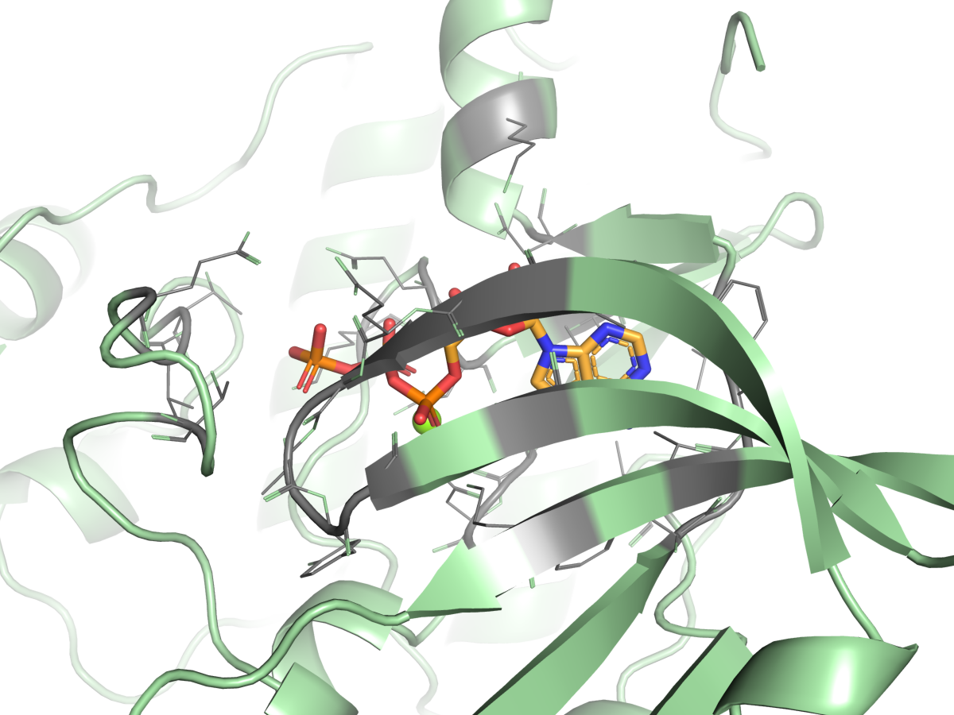
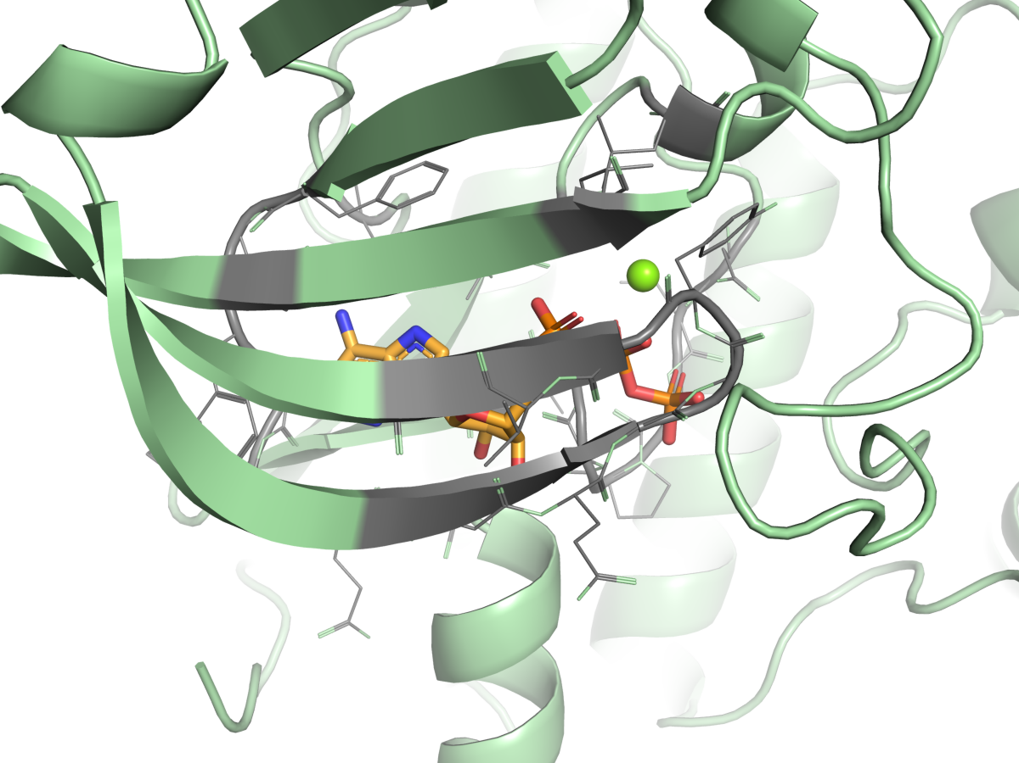
Medoid poses, wild type and perturbed
CDK2, Boltz-2
A. wild type
B. perturbed
Boltz-2 medoid pose
Boltz-2 medoid pose
Each panel oriented on its ligand; grey: residues ≤ 5 Å.
S1: bench/runs/2026-10-17T1611Z-426bfe9 (stats.json, facts, renders) · Sources: S1
4/8

Slide 5
What the perturbation did, by system
Deposited contacts the medoid reproduces, wild type against perturbed
TABLE INDEX
4 rows | System | Wild type contacts | Perturbed contacts | Perturbed medoid (Å)
System | Wild type contacts | Perturbed contacts | Perturbed medoid (Å)
CDK2 | 5 / 9 of 9 | 1 / 0 of 9 | 2.392 / 0.918
FtsE | 9 / 10 of 16 | 0 / 0 of 16 | 15.415 / 17.74
glucose dehydrogenase | 4 / 0 of 6 | 3 / 0 of 6 | n/a / n/a
MEK1 | 2 / 2 of 3 | 0 / 0 of 3 | 3.036 / 1.463
Each cell Boltz-2 / DiffDock-L. Medoid RMSD is to the deposited ligand; n/a where the perturbation modifies the ligand.
S1: bench/runs/2026-10-17T1611Z-426bfe9 (stats.json, facts, renders) · Sources: S1
5/8
Notes:
Contact recovery is the signal that separates the states. Confidence and PoseBusters stay clean on the perturbed poses.

Slide 6
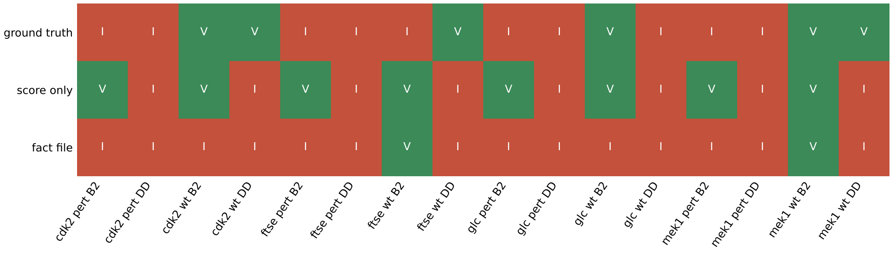
Decision per prediction
A. Ground truth and majority verdict per prediction
B2 Boltz-2, DD DiffDock-L. V valid, I invalid.
S1: bench/runs/2026-10-17T1611Z-426bfe9 (stats.json, facts, renders) · Sources: S1
6/8
Notes:
Score only kept 5 of 10 invalid predictions; the fact file arm kept 1 of 6 valid.

Slide 7
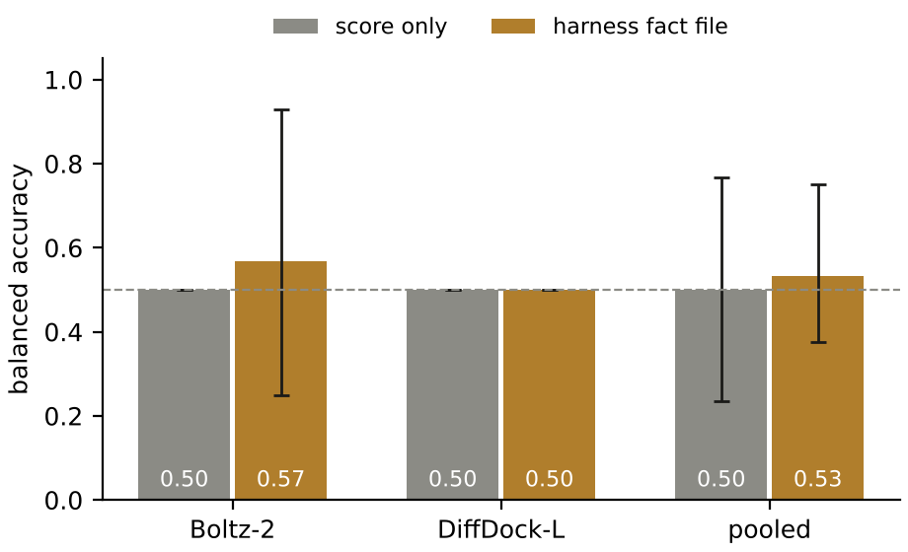
Aggregate over this run
Score only, pooled
0.5 (0.236 to 0.767)
Fact file, pooled
0.533 (0.375 to 0.75)
McNemar exact p
0.6875; discordant 4 and 2
16 predictions; intervals are wide at this size. Invalid kept: score only 5 of 10, fact file 1 of 10. Dashed line at 0.5.
S1: bench/runs/2026-10-17T1611Z-426bfe9 (stats.json, facts, renders) · Sources: S1
7/8
Notes:
Boltz-2: score only 0.5 (0.5 to 0.5), fact file 0.567 (0.25 to 0.929). DiffDock-L: score only 0.5 (0.5 to 0.5), fact file 0.5 (0.5 to 0.5).

Slide 8
What this run does and does not establish
Measured
Not established
16 predictions, 2 executors
Every prompt and response logged
Ground truth fixed in advance
A significant difference
Loss of binding (assumed)
Effect of prompt length
S1: bench/runs/2026-10-17T1611Z-426bfe9 (stats.json, facts, renders) · Sources: S1
8/8
Notes:
Eight systems per executor support a demonstration, not a statistical claim. A length-matched control arm was not run.

