Slide 1
PRESENTATION
Confidence missed every sabotaged pose
The harness caught all 9 of 9
1/8
Notes:
Same predictions, same agent, two kinds of evidence: the model's own confidence score, or the harness fact file.

Slide 2
Three targets, each predicted twice
TABLE INDEX
3 rows | Target | Entry and ligand | Sabotage | Medoid pose
Target | Entry and ligand | Sabotage | Medoid pose
CDK2 | 1B38, ATP | 13 contacts to glycine | boltz2/seed3/sample0
MEK1 | 7XLP, FZC | 11 contacts to glycine | boltz2/seed2/sample0
glucose DH | 2VWH, glucose | 3 hydroxyls methylated | boltz2/seed2/sample0
Boltz-2 2.2.1 on A100, three seeds per prediction, three independent runs. A sabotaged system cannot bind as deposited, so every sabotaged pose should be rejected.
S1: bench/runs (2026-10-17T1611Z-426bfe9, 2026-10-17T1752Z-2f5a1c7, 2026-10-17T1859Z-849c856) · Sources: S1
2/8

Slide 3
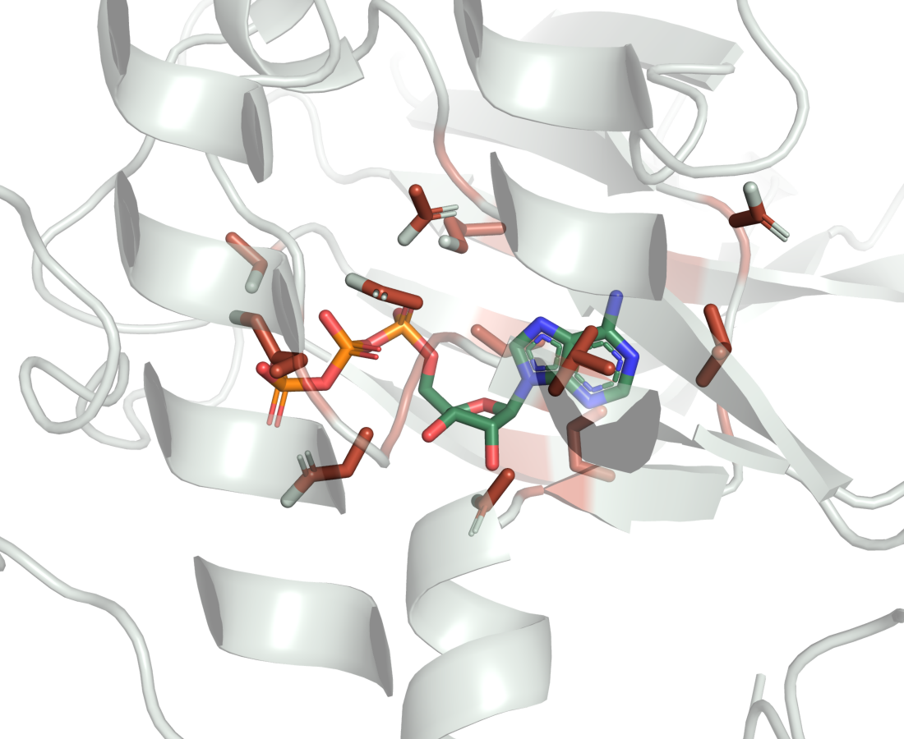
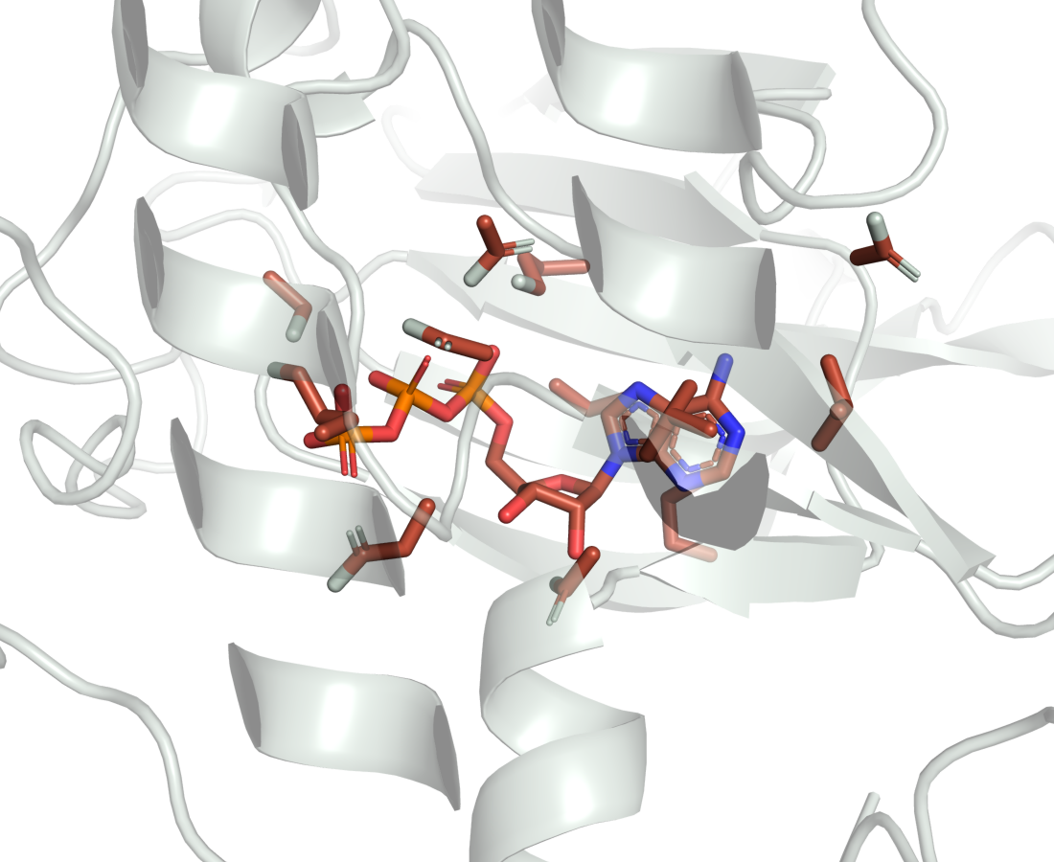
CDK2: the ligand stays, the contacts go
1B38 chain A, Boltz-2 medoid boltz2/seed3/sample0, 13 contacts cut to glycine
A. as deposited
B. pocket cut away
Contacts 5 of 9 then 1 of 9; ipTM 0.975 then 0.947.
S1: bench/runs (2026-10-17T1611Z-426bfe9, 2026-10-17T1752Z-2f5a1c7, 2026-10-17T1859Z-849c856) · Sources: S1
3/8
Notes:
One camera, proteins superposed; red marks the residues cut to glycine. Confidence barely moves (0.975 to 0.947) and PoseBusters still passes 20 of 20. The interactions are what collapse, and that is what the fact file reports.

Slide 4
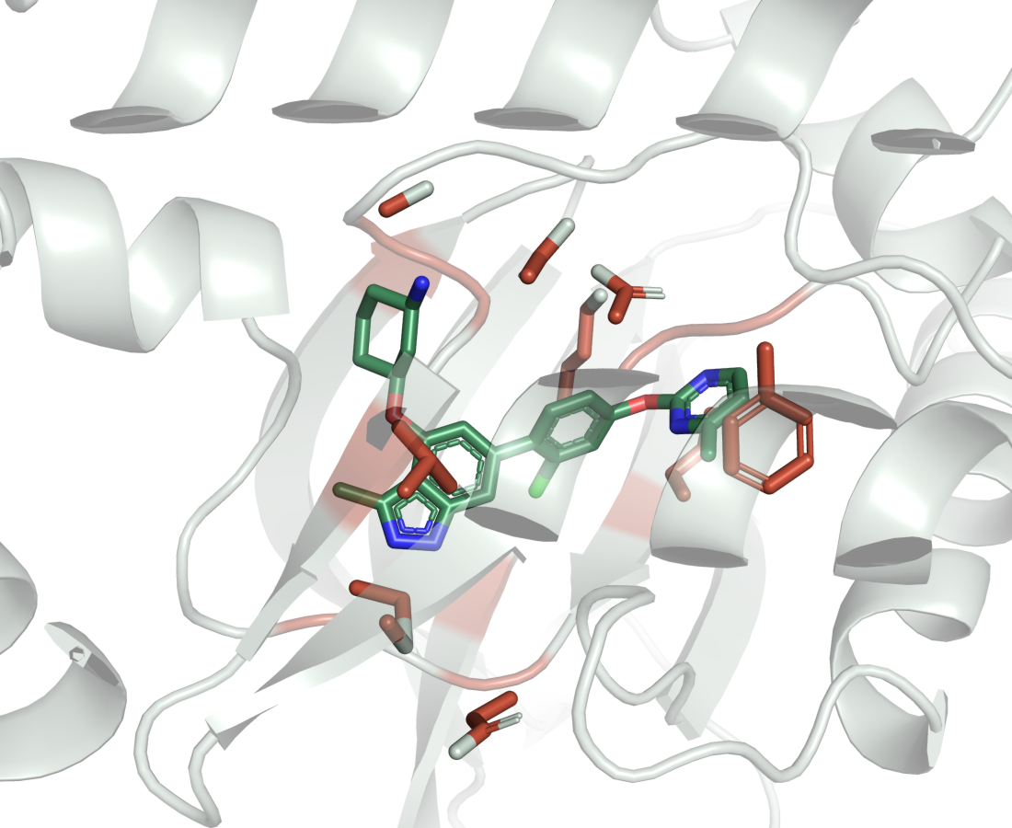
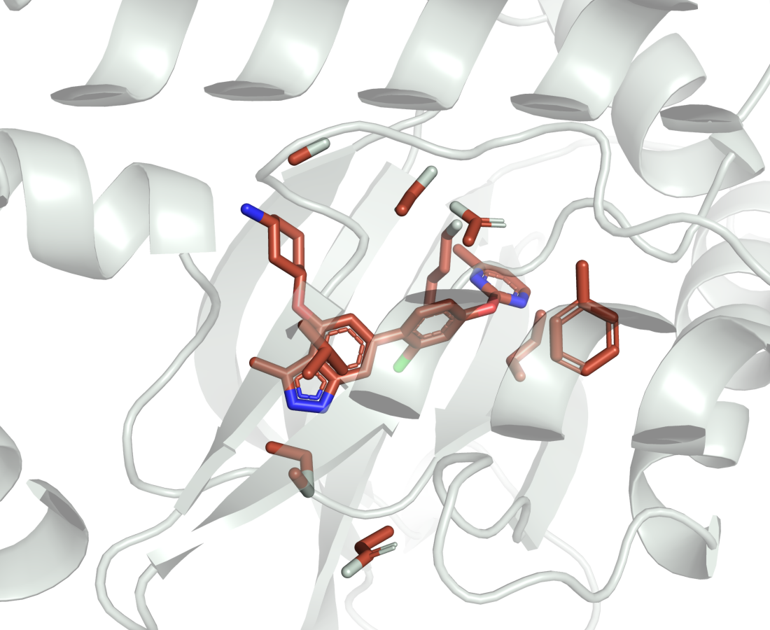
MEK1: the ligand stays, the contacts go
7XLP chain A, Boltz-2 medoid boltz2/seed2/sample0, 11 contacts cut to glycine
A. as deposited
B. pocket cut away
Contacts 2 of 3 then 0 of 3; ipTM 0.988 then 0.97.
S1: bench/runs (2026-10-17T1611Z-426bfe9, 2026-10-17T1752Z-2f5a1c7, 2026-10-17T1859Z-849c856) · Sources: S1
4/8
Notes:
One camera, proteins superposed; red marks the residues cut to glycine. Confidence barely moves (0.988 to 0.97) and PoseBusters still passes 20 of 20. The interactions are what collapse, and that is what the fact file reports.

Slide 5
What the confidence score sees
As deposited / sabotaged, run 2026-10-17T1611Z-426bfe9
TABLE INDEX
3 rows | Target | Ligand ipTM | Pocket pLDDT | PoseBusters
Target | Ligand ipTM | Pocket pLDDT | PoseBusters
CDK2 | 0.975 / 0.947 | 94.9 / 85 | 19/20 / 20/20
MEK1 | 0.988 / 0.97 | 96.5 / 90.5 | 20/20 / 20/20
glucose DH | 0.99 / 0.983 | 97.3 / 97.7 | 20/20 / 19/20
Confidence stays high after the pocket is cut away, and for glucose dehydrogenase the pocket pLDDT rises. PoseBusters passes almost everywhere.
S1: bench/runs (2026-10-17T1611Z-426bfe9, 2026-10-17T1752Z-2f5a1c7, 2026-10-17T1859Z-849c856) · Sources: S1
5/8
Notes:
This is the whole problem. Nothing in these columns tells the agent the pocket is gone.

Slide 6
What the harness sees
As deposited / sabotaged, run 2026-10-17T1611Z-426bfe9
TABLE INDEX
3 rows | Target | Deposited contacts recovered | Cross-executor RMSD (A) | Strain (kcal/mol)
Target | Deposited contacts recovered | Cross-executor RMSD (A) | Strain (kcal/mol)
CDK2 | 5 of 9 / 1 of 9 | 1.665 / 2.656 | 12.31 / 13.6
MEK1 | 2 of 3 / 0 of 3 | 1.452 / 2.974 | 1.59 / 2.15
glucose DH | 4 of 6 / 3 of 6 | 14.38 / 12.345 | 4.26 / 9.58
Contact recovery falls on every target. Cross-executor RMSD rises on CDK2 and MEK1 and falls on glucose dehydrogenase, where both tools were already far apart.
S1: bench/runs (2026-10-17T1611Z-426bfe9, 2026-10-17T1752Z-2f5a1c7, 2026-10-17T1859Z-849c856) · Sources: S1
6/8

Slide 7
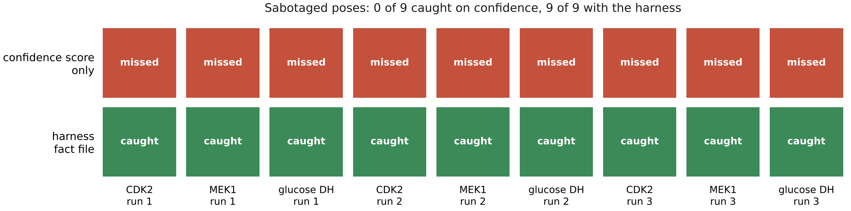
Every sabotaged pose, both ways of judging
A
9 sabotaged predictions: 3 targets by 3 runs.
S1: bench/runs (2026-10-17T1611Z-426bfe9, 2026-10-17T1752Z-2f5a1c7, 2026-10-17T1859Z-849c856) · Sources: S1
7/8
Notes:
Confidence missed 9 of 9; the fact file caught 9.

Slide 8
What it buys and what it costs
Buys
Costs
9 of 9 sabotaged poses rejected
Same answer in three runs
A reason recorded per decision
Good poses rejected too
CDK2 as deposited, all runs
Mostly high strain estimates
S1: bench/runs (2026-10-17T1611Z-426bfe9, 2026-10-17T1752Z-2f5a1c7, 2026-10-17T1859Z-849c856) · Sources: S1
8/8
Notes:
A fourth target, FtsE, is held back: its reference is a homodimer and its values predate a superposition fix.

