Slide 1
Learning Path 10 : Troubleshoot the Windows client operating system and apps
MD-100 Windows Client

Slide 2
Learning Path Agenda
Employ file recovery in Windows client
Explore application troubleshooting
Troubleshoot Windows startup
Troubleshoot operating system service issues

Slide 3
Module 1: Employ file recovery in Windows client

Slide 4
Module 1: Employ file recovery in Windows client
Explain the importance of file recovery
Explain file history
Protect files using Azure Backup
Restore files using Backup and Restore (Windows 7)
Restore files using the Previous Versions tab
Compare file recovery options
Troubleshoot file recovery options

Slide 5
Explain the importance of file recovery
Some of the reasons for
performing backups
Protect against accidental file deletion
Provide recovery from virus infection
Provide previous versions of files and folders
Protect against total computer data loss
Help ensure data availability
Windows features
Folder Redirection, Offline Files
Backup and Restore (Windows 7)
Synchronization with OneDrive
File History
Work Folders
System Image
Wbadmin.exe
Copying files
Azure Backup can be used
with Windows
Notes:
Ask students if they have ever lost important documents because of a hard-disk failure. Ask them how they can prevent such losses. Discuss why it is important to protect data that you store locally on a computer. Point out that when you store data on a file server, it usually is highly available and centrally backed up. Emphasize that many users store data locally, and therefore, it is important to protect local data files so that if a computer fails, no data loss occurs. Based on the responses, continue with the discussion to explain the typical reasons for data loss. Explain which Windows tools and features you can use for protecting, backing up, and recovering data files. Remember that later topics will cover File History, Backup and Restore (Windows 7), and Previous Versions (System Restore).
Question
Does Windows client include a backup tool?
Answer
Yes, Windows client includes two backup tools:
Wbadmin.exe, which is a backup command‑line tool.
Backup and Restore (Windows 7), which you can use to schedule backups of individual folders, users’ libraries, and a complete Windows 10/11–based computer.
Question
What is the simplest way to recover a locally stored document that a user accidentally deleted in Windows?
Answer
After you set it up, File History is the easiest and most user‑friendly way to restore previous versions of files.
Supporting videos for instructor or student use:
Interview: Tell us about your experiences supporting file recovery in Windows? ### Video File: https://youtu.be/54b13nXTroo

Slide 6
Explain file history
File History saves backup copies of user files
You can save backup copies on a local drive, removable drive, or network location
Configure and manage by using Control Panel or the Backup section in the Settings app
File History copies protected files hourly and stores copies indefinitely by default
By default, profile folders and libraries are protected
You can preview and restore backup copies:
You can restore to original or alternate location
You can protect additional folders by:
Adding them to protected libraries
Using the Backup option in the Settings app
Notes:
Explain that Windows 8 introduced File History, which enables you to protect user files stored in user profiles and libraries. Do not forget to mention that you can add additional folders for File History to protect. Remind students where File History can make copies of modified files and explain the default Windows history settings. Do not forget to mention that File History is not enabled by default, and that to use it you must enable it first. Additionally, you should mention that after you enable File History, users can browse and restore modified or deleted files, either by using the Previous Versions tab in File Explorer or from the File History window.
Question
Is File History turned on by default?
Answer
No. Before you can use File History, you must configure it with a local drive, a removable drive, or a network location, and then turn on File History.
Question
Can you protect additional folders by using File History?
Answer
Yes. You can add additional folders to one of the libraries that File History is protecting. Alternatively, you can use the Backup option in the Recovery section in the Settings app. When you do so, File History also protects the folders you add.
Supporting videos for instructor or student use:
Interview: What File Recovery scenarios do you encounter? https://youtu.be/-Na7kjsFvRs
Enable File History https://youtu.be/ik2FX05p8oI
Illustration: File History https://youtu.be/I-lUSA_VdOg

Slide 7
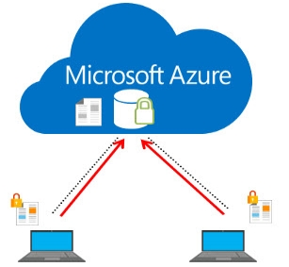
Protect files using Azure Backup
Notes:
Supporting videos for instructor or student use:
Interview: What is your experience supporting Azure backup? Video File: https://youtu.be/DNqSYHes8N4

Slide 8
Restore files using Backup and Restore (Windows 7)
Graphical backup tool in Windows
You can use it for creating system image and system repair disk
Uses Volume Shadow Copy Service for creating backups:
On local disk, external disk, or network location
First backup contains all data, later backups contain changes only
Creates restore points, used by Previous Versions
Can back up folders, libraries, and volumes
Restores data on original or alternate location
Backup is in .vhdx format
Notes:
Explain to students that Backup and Restore (Windows 7) is a graphical backup tool that is part of Windows 10/11. Point out that this tool provides basic backup and restore capabilities, and that you can perform backups on local disks, external disks, or a network location. The initial backup takes longer than subsequent backups.
Mention that the tool stores backup data in the virtual hard disk (.vhdx) format, and you can use its contents without using the Backup and Restore (Windows 7) tool. Also mention that the Backup and Restore (Windows 7) tool creates restore points, which you can find in the Previous Versions tab in File Explorer. The next topic will cover this.
Question
Can you use the Backup and Restore (Windows 7) tool to back up a single file automatically in a folder with multiple documents?
Answer
You can use the Backup and Restore (Windows 7) tool to perform automatic backups, but you can only define which folders to include in the backup, not individual files.
Question
How can you modify the default backup schedule for the Backup and Restore (Windows 7) tool, which performs a backup every Sunday at 7 PM, by default?
Answer
You can use the Backup and Restore (Windows 7) item in Control Panel to configure a simple backup schedule. However, by editing the triggers property for the AutomaticBackup task in Task Scheduler, you can be more specific. For example, you can specify a backup schedule of multiple times per day, or you can provide the precise time to run a backup.
Supporting videos for instructor or student use:
Interview: What have you observed about file recovery in Windows? https://youtu.be/-nyG-s42pu0

Slide 9
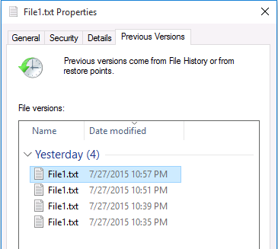


Restore files using the Previous Versions tab
Enables user to view and restore previous versions:
Files, folders, and volumes
Data comes from File History and restore points:
Each time when File History runs
When file is backed up by Backup and Restore (Windows 7)
Notes:
Explain that Windows reintroduces the Previous Versions feature. Point out that previous versions come from File History and restore points. Emphasize that these restore points are from the Backup and Restore (Windows 7) tool, and not System Restore. In addition, emphasize that previous versions come from File History only for files that File History is protecting. Previous versions come from restore points for any content that is on a New Technology File System (NTFS) volume and is included in the backup. Emphasize that you can view and restore all previous versions from the same interface, whether they come from File History or from restore points. You will demonstrate the Previous Versions feature later in this Module.
Question
What must you configure if you want the Previous Versions tab in File Explorer to list previous versions of files?
Answer
Previous versions of the files come from File History or from restore points. If you want the Previous Versions tab in File Explorer to list previous versions of files, you must protect those files by using File History or including them in the backup that the Backup and Restore (Windows 7) tool creates.
Question
When will the Previous Versions tab include the previous versions of a file that the Backup and Restore (Windows 7) tool is backing up?
Answer
As soon as the Backup and Restore (Windows 7) tool creates a backup, the previous version will be available on the Previous Versions tab. The same is true if File History is protecting the file. When File History runs, previous versions of the file become available on the Previous Versions tab.

Slide 10
Compare file recovery options
How often
Types of files
System state
Recovery options

Slide 11
Troubleshoot file recovery options
Is the tool properly configured?
Connectivity dependencies
Target restore device configuration

Slide 12
Knowledge Check

Slide 13
Module 2: Explore application troubleshooting

Slide 14
Module 2: Explore application troubleshooting
Troubleshoot Windows Installer issues
Resolve desktop app deployment issues
Identify issues related to desktop app operations
Resolve issues related to desktop app operations
Resolve issues related to Universal Windows Platform apps
Troubleshoot common Microsoft 365 App issues
Explore the Application Compatibility Toolkit

Slide 15
Troubleshoot Windows Installer issues
1
Verify
5
Re-register Msiexec
2
Msiexec can execute
6
Reboot
3
Installer starts without errors
7
Software conflicts
4
Latest updates
Notes:
Supporting videos for instructor or student use:
Interview: What scenarios do you encounter supporting Windows installer issues? https://youtu.be/9x4VnSiJocw

Slide 16
Resolve desktop app deployment issues
Run as Administrator
Ensure necessary dependencies are installed
Leverage the ACT
Verify AppLocker configuration
Notes:
Supporting videos for instructor or student use:
Interview: What scenarios have you encountered related to app deployment? https://youtu.be/s8J5q6xwYGs
Interview: What scenarios have you encountered related to app deployment? https://youtu.be/FKy4bdgvogc

Slide 17
Identify issues related to desktop app operations
Missing OS or application features
Incorrect app/device/security configuration
Application errors or performance issues
Connectivity to dependencies (i.e. database)
AppLocker blocking

Slide 18
Resolve issues related to desktop app operations
Install required features
Repair/Reinstall the applications
Install application updates/upgrade
Use tools to identify performance issues
Reconfigure AppLocker
Notes:
Supporting videos for instructor or student use:
Interview: What is your approach to troubleshooting desktop apps? https://youtu.be/nfm7A0zcSH8

Slide 19
Resolve issues related to Universal Windows Platform apps
1
UAC settings
5
Clear Microsoft Store cache
2
Security settings
6
Application licensing
3
Group Policy settings
7
Reinstall
4
Latest version

Slide 20
Troubleshoot common Microsoft 365 App issues
Older technologies (i.e. ActiveX, Silverlight, etc.) require Internet Explorer
Favorites are not automatically imported from Internet Explorer
Less commonly used features in Internet Explorer are not always available in Microsoft Edge

Slide 21
Explore the Application Compatibility Toolkit
Use ACT to test and verify your applications:
1
Build a test workstation running Windows 10 and that has all the required apps installed
5
Create a custom database to hold test information
2
Run the apps to see if there are any issues in functionality or behavior
6
Create an application fix, if required
3
Install ACT on the workstation
7
Save the fix to a distributable location or media
4
Open the Compatibility Administrator and run any problematic apps within it
8
Distribute the application fix around your organization
Notes:
Supporting videos for instructor or student use:
Interview: How do you use the Application Compatibility Toolkit? https://youtu.be/Tl493HfSVHw

Slide 22
Knowledge Check

Slide 23
Module 3: Troubleshoot Windows startup

Slide 24
Module 3: Troubleshoot Windows startup
Explore the Windows client startup architecture
Compare device recovery procedures
Use the Windows Recovery Environment
Explore advanced startup options
Use the Reset This PC feature
Examine the System Restore feature
Explore additional recovery tools in Windows Recovery Environment
Explore the Windows client Boot Configuration Data store
Configure the BCD settings

Slide 25
Explore the Windows client startup architecture
Native UEFI or BIOS
Windows OS Loader
Windows core, Kernel, Antimalware
Third-party drivers
Windows logon

Slide 26
Compare device recovery procedures
Operating system is separate from the data:
You can recover, reinstall or upgrade it without affecting data
Device-recovery features in Windows:
Driver Roll Back
System Protection and System Restore
Startup Recovery
Reset this PC
System Image Recovery
Command Prompt
Notes:
Ask students how the device recovery process today is different from what it was several years ago. Explain that in Windows, the operating system is separate from the data, and that you can recover, reinstall, or upgrade it without affecting the data on the device. List the device-recovery features in Windows, but do not go into detail, because the following topics will explain them further.
Question
Why would you use Startup Repair instead of System Image Recovery if the Boot Configuration Data (BCD) store is corrupted on a Windows 10/11–based computer?
Answer
If the BCD store is corrupted, Windows will not start. Both Startup Repair and System Image Recovery can resolve the issue, but Startup Repair is much faster and is a nondestructive operation.
Supporting videos for instructor or student use:
Interview: What are your experiences supporting device recovery for Windows? https://youtu.be/iY2w71ISNq8
Interview: What are your experiences supporting device recovery for Windows? https://youtu.be/P3k9hEyBiUs

Slide 27
Use the Windows Recovery Environment
Tool | Function
Reset this PC | Lets you choose to keep or remove your files and reinstalls Windows
System Restore | Returns your computer to an earlier state
System Image Recovery | A system image created earlier replaces everything on a computer
Startup Repair | Detects and repairs most common startup issues
Command Prompt | Resolves problems with a service or device driver, and runs diagnostic tools
Go back to the previous build | Preserves personal files, but changes to apps and settings are lost
Notes:
Discuss the tools that are available in Windows Recovery Environment (Windows RE). Explain why you would use each tool and provide a scenario in which you would use it. Mention that you will demonstrate some of the tools in the next demonstration and that students will use them in the lab. Use the next two slides to discuss the options available with the Reset this PC tool, and explain how you can create a system image in advance to be able to use it with System Image Recovery.
Be prepared to explain how the Reset this PC option replaces the Refresh your PC and Reset your Computer options that were available in Windows 8 and Windows 8.1.
Use the second slide to discuss options in Reset this PC, and the third slide to explain that you require a system image before you can perform System Image Recovery.
Question
Can you use System Image Recovery without any previous preparation?
Answer
No. System Image Recovery restores a system image on your computer. To be able to use this option, you must first create the system image while Windows is running.
Question
What are the options for the Reset this PC tool?
Answer
If you start the Reset this PC tool, you can first choose between the Keep my files and Remove everything options. If you select Remove everything, you can further choose between the Just remove my files and Fully clean the drive options.

Slide 28
Explore advanced startup options
Enable debugging
Enable Safe Mode with Command Prompt
Enable boot logging
Disable driver signature enforcement
Enable low-resolution video
Disable early launch anti-malware protection
Enable Safe Mode
Disable automatic restart after failure
Enable Safe Mode with Networking
Launch recovery environment
Notes:
Introduce the startup settings options that are available in Windows. Point out how you can access startup settings. Mention that you cannot access startup settings by pressing F8 or any other keyboard shortcut during startup. Explain the different ways to access startup settings, and demonstrate some of them. Discuss each of the startup options and the scenarios in which you would use them. Ensure that students understand the three different safe modes: Safe Mode, Safe Mode with Networking, and Safe Mode with Command Prompt.
Question
Can you access startup settings options by pressing F8 during computer startup?
Answer
No. You cannot use keyboard shortcuts during the Windows startup process, and you cannot access startup settings options by pressing any key during computer startup. You can access startup options by:
Changing advanced startup options in Windows .
Pressing the Shift key while selecting the Restart option.
Restarting the computer by running the shutdown.exe /r /o command.
Question
How can you access the Last Known Good Configuration startup option in Windows?
Answer
The Last Known Good Configuration startup option is not available in Windows 10 and later.
Supporting videos for instructor or student use:
Interview: When do you use advanced startup options in Windows? https://youtu.be/kFxBYTB2zck
Interview: When do you use advanced startup options in Windows? https://youtu.be/KboJSlBzn9A

Slide 29
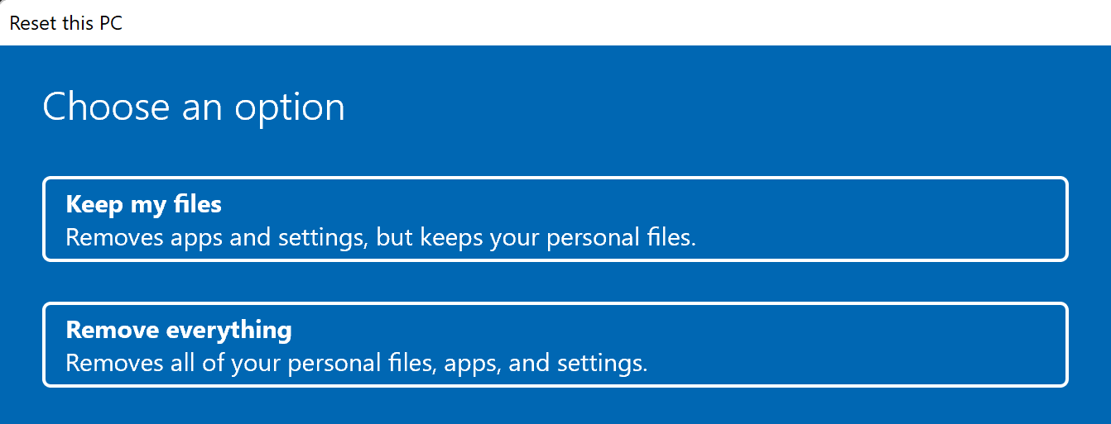
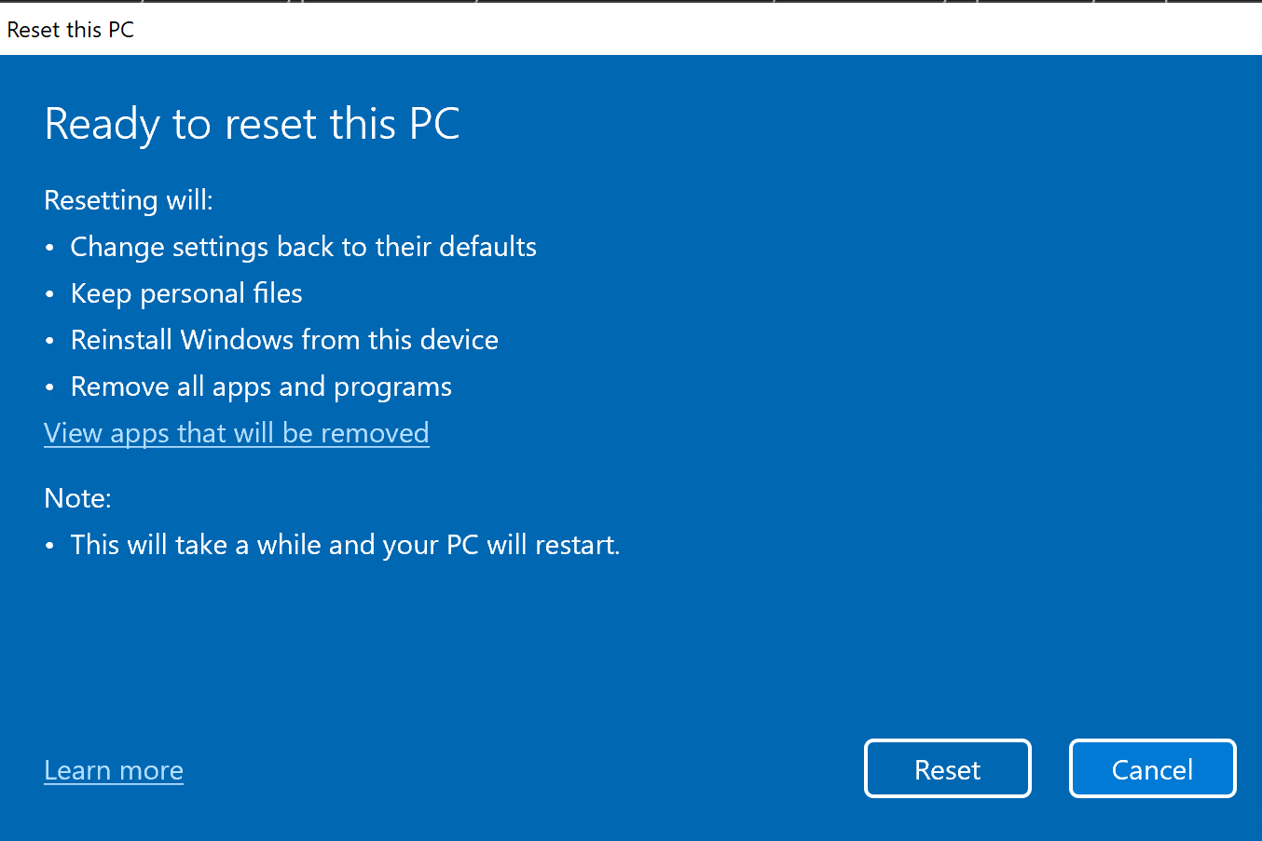
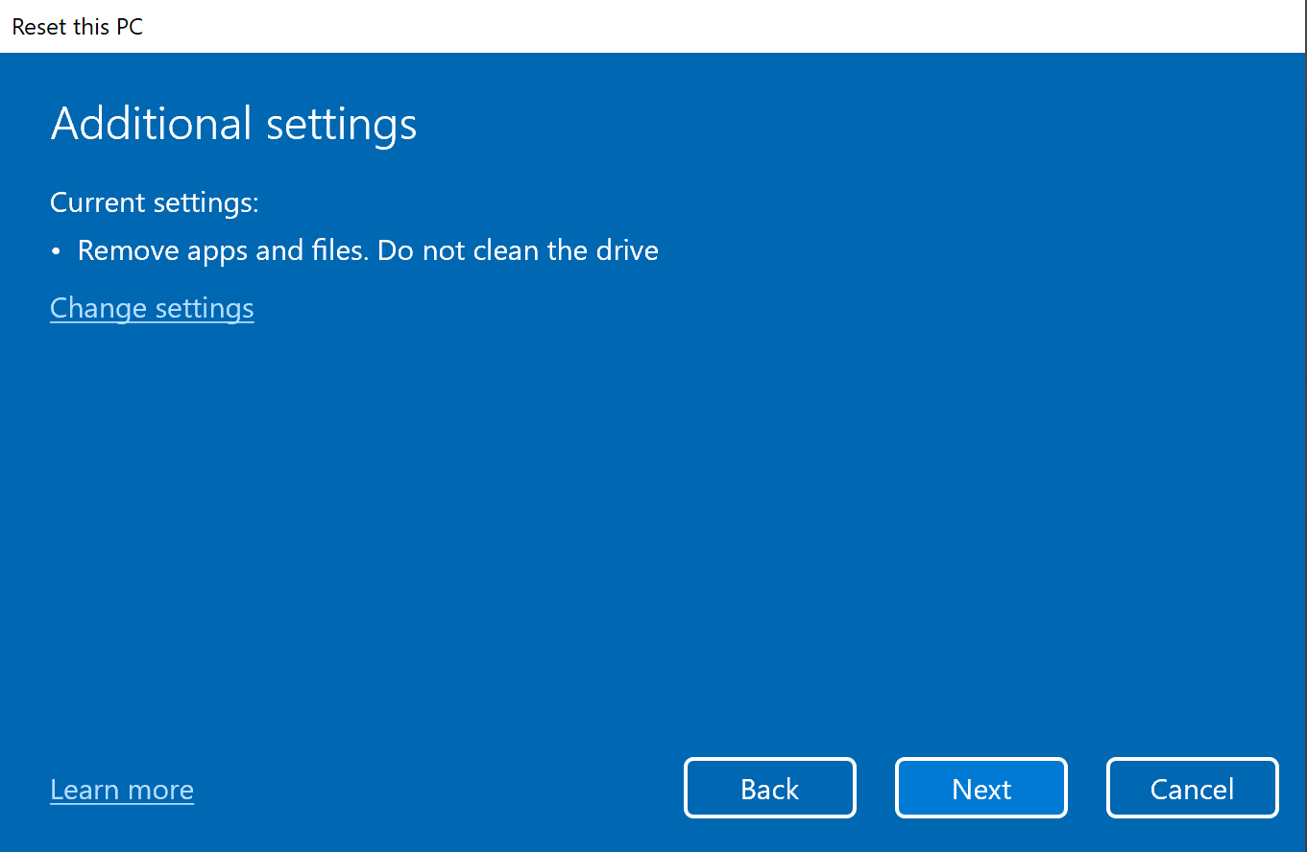
Use the Reset This PC feature
Additional options:
Keep pre-installed apps
Clean drive
Cloud download
Notes:
Besides using this feature for obvious issues, discuss this as an option for troubleshooting intermittent problems. If an organization embraces centralized management, taking advantage of OneDrive for user files, ESR, Edge Sync, and using a tool such as Endpoint Manager to deliver apps and device settings, resetting a PC can have minimal impact to the user, while saving considerable time troubleshooting that are particularly difficult to pinpoint.
Supporting videos for instructor or student use:
Demonstration: Reset this PC https://youtu.be/cBEIJ7fczic

Slide 30
Examine the System Restore feature
Create snapshots of computer configuration:
Snapshots are called restore points
Restore points do not include user data
You can use restore points to:
Perform driver rollbacks
Protect against accidental program deletion
Restore Windows configurations to earlier states
Restore points are created before system changes:
Automatic: app, driver, or Windows updates
Schedule: can be created based on a schedule
Manual: on-demand, before applying restore point
If turned off, all restore points are deleted
Notes:
Introduce the System Restore feature. Students have probably heard of it because the feature was available in older versions of Windows operating systems, starting with Windows XP. Explain that System Restore creates restore points automatically, but you also can create them manually. Point out that restore points include only system settings and not user data. Point out when the creation of restore points occurs. Mention that System Restore automatically manages used space, and that it deletes older restore points automatically when there is not enough space for a new restore point. Mention scenarios in which you would use System Restore. Remember that there is no demonstration for this topic, but students will use it in the lab.
Question
How can you configure Windows to create restore points automatically?
Answer
System Protection creates a scheduled task named SR that can schedule the creation of restore points automatically. You can add a new trigger to the task and configure the frequency for creating restore points.
Question
Can you enable System Protection on an ReFS volume?
Answer
No. You can only turn on System Protection on NTFS volumes. You cannot enable it on FAT or ReFS volumes.

Slide 31
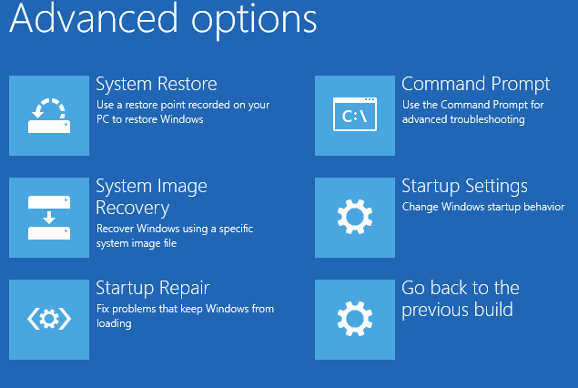
Explore additional recovery tools in Windows Recovery Environment
Notes:
Explain to students that if you want to use System Image Recovery, you must first create a system image while Windows is running. Mention that you can create a system image by using the Backup and Restore (Windows 7) tool.
Supporting videos for instructor or student use:
Interview: What has been your experience using Windows RE? https://youtu.be/pLNmbmx-va4
Interview: What has been your experience using Windows RE? https://youtu.be/4yfO3zjnP5o

Slide 32
Explore the Windows client Boot Configuration Data store
Database that stores information and configuration about the devices boots to an OS.
Reasons to edit the BCD
Adding a new hard disk to your Windows computer and changing the logical drive numbering.
Installing additional operating systems on your Windows computer to create a multiboot configuration.
Deploying Windows to a new computer with a blank hard disk, requiring you to configure the appropriate boot store.
Performing a backup or restoring a corrupted BCD.
Notes:
Supporting videos for instructor or student use:
Interview: What experience do you have supporting BCD Store? https://youtu.be/ZohwuBFLr0s

Slide 33
Configure the BCD settings
Modify with:
Startup and Recovery
MSConfig
BCDEdit
BootRec

Slide 34
Knowledge Check

Slide 35
Module 4: Troubleshoot operating system service issues

Slide 36
Module 4: Troubleshoot operating system service issues
Examine operating system services
Identify failed operating system services
Disable operating system services
Troubleshoot locked accounts in Windows clients
Identify sign-in errors

Slide 37
Examine operating system services
Load and run in the background without user intervention
Support application requests, for example, when an application needs to open a file, it relies on a system service to retrieve that file from the disk
Can make calls to device drivers when a request is sent to a physical device
Notes:
Remind students of the operating system architecture that you discussed in topic 1. If necessary, show them the architectural slide again.

Slide 38
Identify failed operating system services
Windows provides a number of ways of locating service-related problems:
Event Viewer
Log files
Stop codes
Action Center
Notes:
Consider demonstrating Event Viewer. Students have seen or will see the other tools mentioned on the slide.
Supporting videos for instructor or student use:
Interview: What scenarios involve troubleshooting failed services? https://youtu.be/mI-m-hHhu0I
Interview: What scenarios involve troubleshooting failed services? https://youtu.be/8yqsUHkaqSo

Slide 39
Disable operating system services
Depending on the circumstances, you can disable a service in one of the following ways:
Safe mode
Command Prompt
System Configuration tool
Notes:
If time allows, demonstrate one or two of these options with the students. Ensure that students are aware of each tool’s limitations. For example, if the computer cannot load at all, then accessing the Advanced Boot Options menu might be impossible.
Supporting videos for instructor or student use:
Interview: What is your experience supporting BitLocker? https://youtu.be/0IL_fGJZIG0

Slide 40
Troubleshoot locked accounts in Windows clients
Common causes for repeated lockouts:
Cached credentials used by application
Service account passwords
Persistent drive mappings
Notes:
Supporting videos for instructor or student use:
Interview: What is your approach to troubleshooting locked accounts? https://youtu.be/33WO5foq0j8

Slide 41
Identify sign-in errors
Verify sign in error or message
Unlock account in Active Directory
Review event logs

Slide 42
Knowledge Check

Slide 43
Practice Labs
Using File History to Recover Files
Using Windows RE and Advanced Startup to recover from Boot Failures
Troubleshooting Boot Failure with the BCD store
Recovering Windows using Reset This PC

Slide 44
Learning Path Review

Slide 45
Closing slide

