Slide 1
Learning Path 11 : Troubleshoot hardware and drivers
MD-100 Windows Client

Slide 2
Learning Path agenda
Troubleshoot device driver failures
Explore physical hardware troubleshooting
Troubleshoot physical failures on Windows clients

Slide 3
Module 1: Troubleshoot device driver failures

Slide 4
Module 1: Troubleshoot device driver failures
Examine tools for managing and troubleshooting device drivers
Use driver roll back
Manage signed drivers
Stage device drivers
Restrict device installation

Slide 5
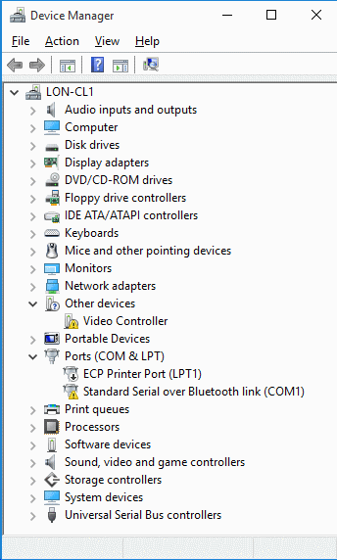
Examine tools for managing and troubleshooting device drivers
Use Device Manager to:
View devices, their drivers, details, settings, and events
Enable and disable devices
Install, update, uninstall, and roll back device drivers
Troubleshoot device issues
Manage devices locally only
Other tools include:
Windows PowerShell
DevCon.exe tool
Remote Desktop or Windows PowerShell remoting
Notes:
Supporting videos for instructor or student use:
Interview: When do you use Device Manager to support Windows 10? https://youtu.be/gD3xR77T4FM
Interview: What are scenarios for using Device Manager? https://youtu.be/3NDxEIectpo
Demonstration: Uninstall a Device Driver https://youtu.be/opiFrC2wLEQ
Interview: What device driver scenarios do you encounter? https://youtu.be/Wxu3xWcgx3I
Managing Device Drivers in Windows 10
https://youtu.be/9Z1BFiS4bz4

Slide 6
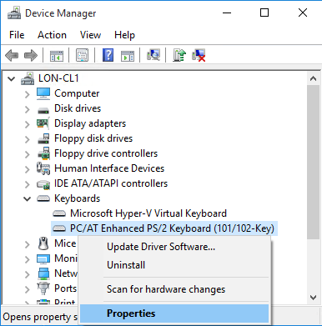
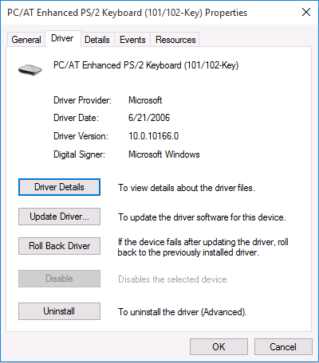
Use driver roll back
Nondestructive operation, but requires restart
Reinstalls previous version of device driver:
Not available if device driver has never been updated
Only active and functional drivers are backed up
Supports one level of rollback:
If you perform a rollback, you cannot roll back again
Driver Roll Back is not available for printers
Multifunction devices are handled on an individual function basis (printer, scanner)
Can be performed from safe mode:
If malfunctioning driver is preventing normal operation
Notes:
Note: This topic has one additional slide.
Introduce Driver Roll Back as a nondestructive option to install a previous version of a device driver. Point out that this option replaces only the device driver, and leaves all other system settings and user data intact. Mention that you can roll back a driver only if a previous version of the driver exists; this option is unavailable if an older version does not exist. Mention that the Roll Back Driver option is available for all devices except printers. You can also mention other options for potentially resolving driver issues, such as System Restore, system image recovery, and Reset PC, but point out that they are more destructive than Driver Roll Back. Mention that you will demonstrate Driver Roll Back in the next topic.
Question
Why is the Roll Back Driver option unavailable for some devices?
Answer
The Roll Back Driver option reverts the device driver to the previously used device driver. If the device is using the first and only version of the device driver, the Roll Back Driver option is unavailable for that device.
Question
Can you roll back device drivers for printers in Device Manager?
Answer
No, Device Manager does not provide an option to roll back device drivers for printers (print queues). This is because you manage Printers in Devices and Printers, not in Device Manager.
Supporting videos for instructor or student use:
Demonstration: Uninstall a Device Driver https://youtu.be/ueVPig_xCWU

Slide 7
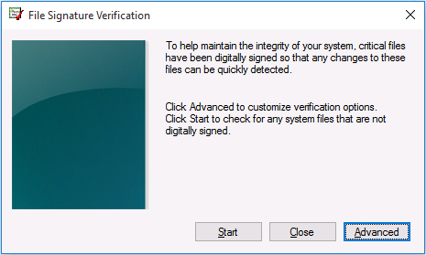
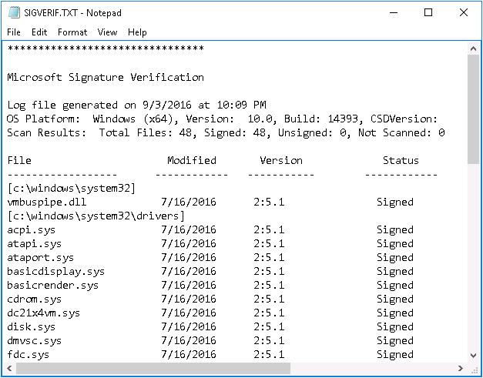
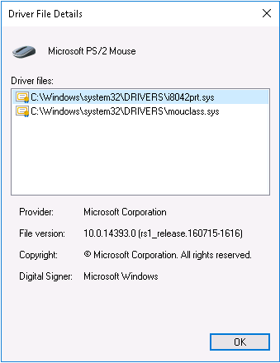
Manage signed drivers
Windows 10:
32-bit warns you if a driver is not signed
64-bit requires signed drivers
Windows 11:
64-bit only, requires signed drivers
Driver signing does not modify driver functionality
Run Sigverif.exe to scan for unsigned drivers.
Notes:
Point out that the 64-bit editions of Windows 10 require that all device drivers be signed digitally by default. With Window 11 being 64-bit only, this is all drivers. Conversely, 32-bit editions of Windows 10 do not enforce such requirements. However, we recommend that you use only signed device drivers. Ask students what driver-signing policies they use and whether those policies modify the device-driver functionality in any way. Point out that you can verify if a device driver is signed in Device Manager, but only on a device-by-device basis. Discuss the Sigverif.exe tool, which can verify the signatures of all device drivers at once, and consider demonstrating it. However, in general, you should not spend too much time on this topic, as 32-bit installations are uncommon now.
Supporting videos for instructor or student use:
Interview: What advice do you have for supporting signed drivers? https://youtu.be/cs8RIB9iuYg

Slide 8
Stage device drivers
Benefits of Staging Driver Packages
Allows only known authorized drivers to run
Improves security
Reduces support costs
Better user experience
Notes:
Supporting videos for instructor or student use:
Interview: What experience do you have supporting driver packages? https://youtu.be/FdsitXL3maU

Slide 9
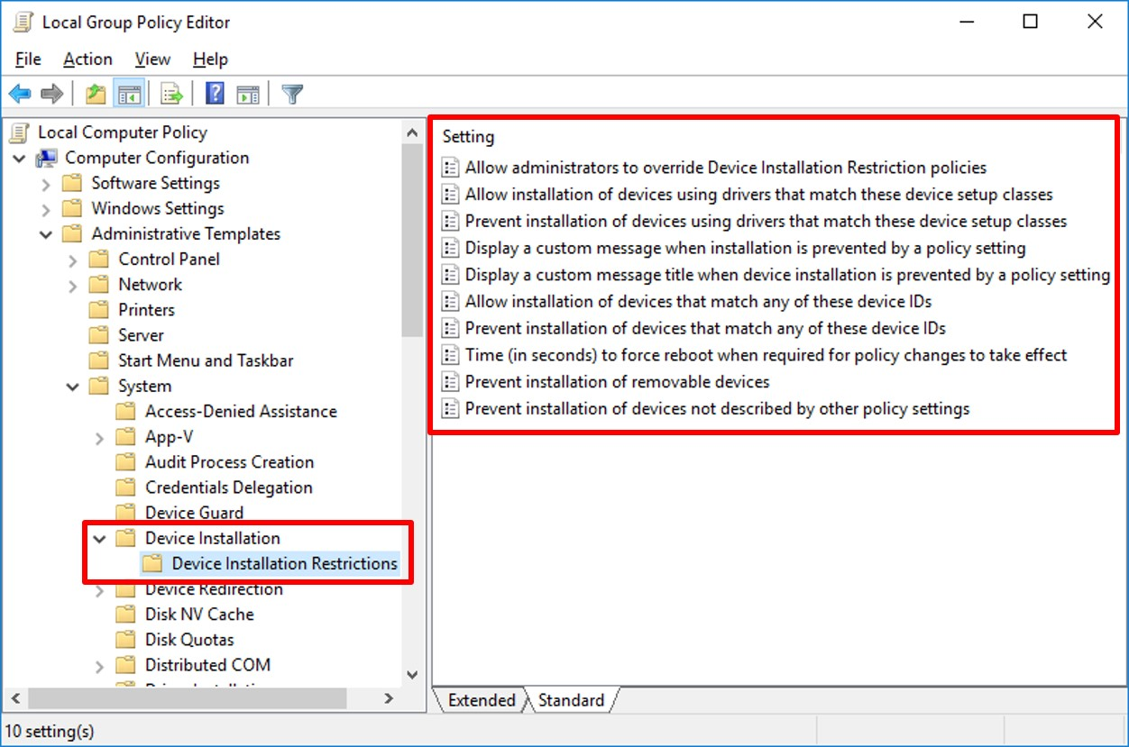
Restrict device installation

Slide 10
Knowledge Check

Slide 11
Module 2: Explore physical hardware troubleshooting

Slide 12
Module 2: Explore physical hardware troubleshooting
Identify hardware-related problems
Troubleshoot USB devices
Troubleshoot wireless devices
Gather hardware information
Use best practices to troubleshoot hardware issues

Slide 13
Identify hardware-related problems
Physical Issue
Moving parts (fans, power supplies, hard disk drives) prone to fail
Excessive dust impairing heat dissipation
Driver Issue
Version incompatibility
Defective driver
Incorrect driver assigned
Notes:
Supporting videos for instructor or student use:
Interview: What are some common hardware related issues you encounter supporting Windows? https://youtu.be/XO2U-0MLCKw

Slide 14
Troubleshoot USB devices
Controlling USB Devices
Prevent users from installing any device.
Allow users to install only devices on an approved list.
Prevent users from installing devices that are on a prohibited list.
Deny read or write access to removable devices or removable media.
Notes:
Supporting videos for instructor or student use:
Interview: What scenarios do you encounter supporting USB devices? https://youtu.be/t2DH-BXbW8Q

Slide 15
Troubleshoot wireless devices
Troubleshooting Wireless Devices
WiFi/Bluetooth Enabled
Airplane mode
Discovery
Pairing
Device proximity
External interference
Notes:
Supporting videos for instructor or student use:
Interview: What scenarios do you encounter supporting Bluetooth devices? https://youtu.be/BWn3m3-90cQ

Slide 16
Gather hardware information
Event Viewer
System Information Tool
Device Manager
Windows Powershell
Windows Memory Diagnostics tool
Central Device Management Inventory

Slide 17
Use best practices to troubleshoot hardware issues
Physical Connection?
Compatible Device?
Review Event Viewer logs
Recent driver change?
Update device firmware/BIOS
Notes:
Supporting videos for instructor or student use:
Interview: What are some of your hardware troubleshooting best practices? https://youtu.be/CR5M9QVICl0

Slide 18
Knowledge Check

Slide 19
Module 3: Troubleshoot physical failures on Windows clients

Slide 20
Module 3: Troubleshoot physical failures on Windows clients
Examine factors when replacing devices
Explore common vulnerabilities on hardware devices
Examine guidelines for replacing hardware
Diagnose Memory Problems
Diagnose and troubleshoot disk problems

Slide 21
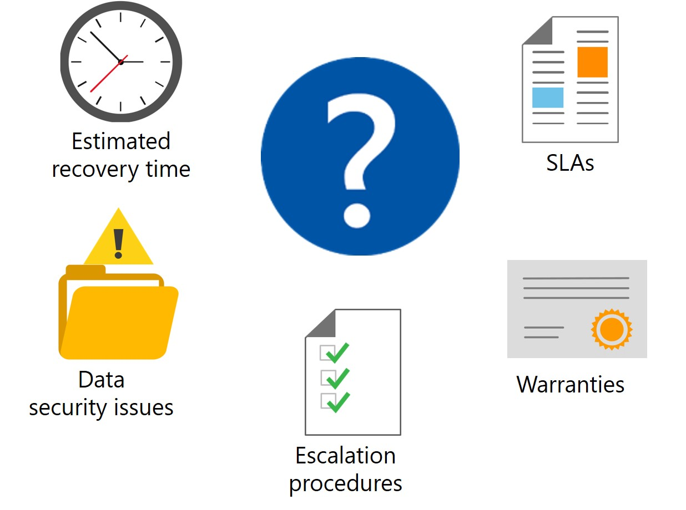
Examine factors when replacing devices

Slide 22
Explore common vulnerabilities on hardware devices
Drives
PSUs
Fans
CPU/GPU
Memory
Battery

Slide 23
Examine guidelines for replacing hardware
Identify root cause
Warranty concerns
Static electricity
User interruption
Notes:
Supporting videos for instructor or student use:
Interview: What is your approach to troubleshooting hardware? https://youtu.be/n817QbRvAW0

Slide 24
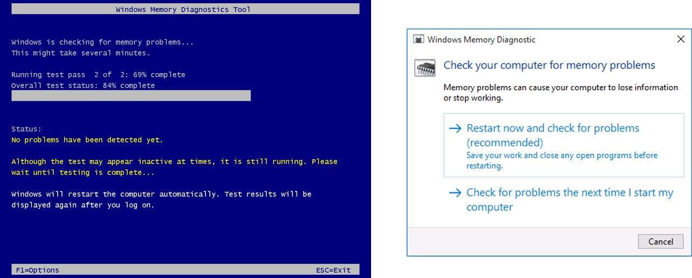
Diagnose Memory Problems
Windows Memory Diagnostics Tool
Notes:
Supporting videos for instructor or student use:
Interview: What is your approach to diagnosing memory issues on a Windows machine? https://youtu.be/cvbuVMLWjdg
Interview: What is your approach to diagnosing memory issues on a Windows machine? https://youtu.be/Ofpe9n0vm3g

Slide 25
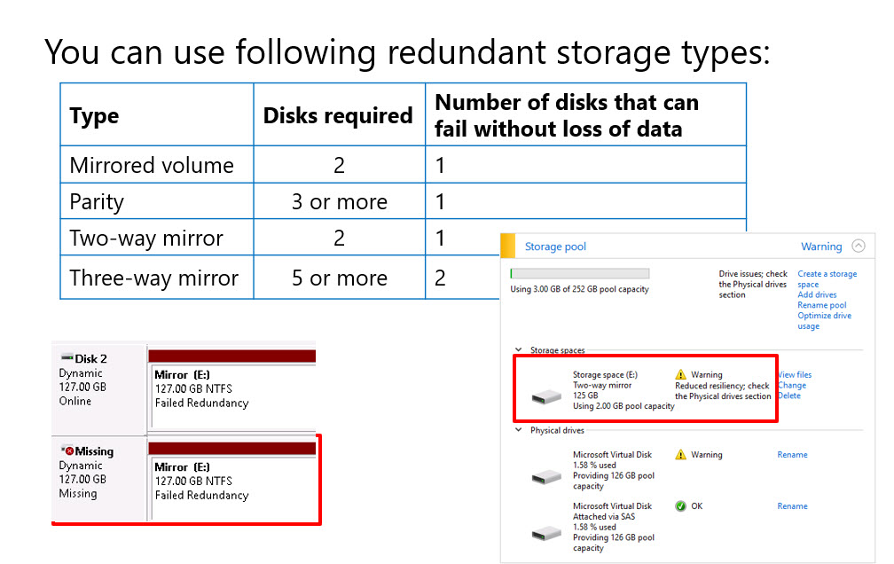
Diagnose and troubleshoot disk problems
Notes:
Supporting videos for instructor or student use:
Interview: What is your approach to troubleshooting disk problems? https://youtu.be/KZ4rl89VYvI
Interview: What is your approach to troubleshooting disk problems? https://youtu.be/TKVCAB4zu08

Slide 26
Knowledge Check

Slide 27
Practice Labs
Recovering Windows by using a Restore Point

Slide 28
Learning Path Review

Slide 29
Closing slide

