Slide 1
SOLID
Design Principles

Slide 2
What is a Design Pattern?

Slide 3
What is a Design Pattern?
From Wikipedia:
  A general, reusable solution to a commonly occurring problem within a given context in Software Design.
  It is not a finished design that can be transformed directly into code.
  It is a description or template for how to solve a problem that can be used in many different situations. Design patterns are formalized best practices that the programmer can use to solve common problems when designing an application or system.

Slide 4
What is a Best Practice?

Slide 5


Slide 6
What goals do we strive at, when we develop software?

Slide 7
Zero Errors
Easy to reuse
Secure
Easy to use
Fast
Easy to extend

Slide 8
What is Quality?

Slide 9
What is Quality?
“it depends…”

Slide 10


Slide 11



Slide 12


Slide 13
What is Quality?

Slide 14
What is Quality?
“words ending with …bility”

Slide 15
Usability
Reliability
Extensibility
Reusability
Maintainability
Portability
…bility

Slide 16
Reusability
Extensibility

Slide 17
How do we achieve…
Reusability
Extensibility

Slide 18
SOLID

Slide 19
Single responsibility
Open/Closed
Liskov Substitution
Interface Segregation
Dedendency Injection

Slide 20
Single Responsibility
Classes should only have one main responsibility
=> classes should only have one reason to change
Keep classes small, focused and abstract

Slide 21
public void ConvertData()
{
// Read data from database
string query = "SELECT * FROM CAR";
SQLServerDBConnection conn = SQLServerDBConnection.Connect("...");
RecordSet records = conn.ExecuteQuery(query);
// Convert data from RecordSet to XML
string XMLData = "";
foreach (var rec in records)
{
string licensePlate = rec.GetFieldAsString("LicensePlate");
int price = rec.GetFieldAsInt("Price");
string XMLelemStart = "<Car>\n";
string XMLelemLp = $" <Licenseplate>{licensePlate}</Licenseplate>\n";
string XMLelemPr = $" <Licenseplate>{price}</Licenseplate>\n";
string XMLelemEnd = "</Car>\n";
XMLData += XMLelemStart + XMLelemLp + XMLelemPr + XMLelemEnd;
}
// Write XML data to text file
FileWriterFAT32 fw32 = new FileWriterFAT32();
fw32.Write("C:\ConverterApp\Data\convData.txt", XMLData);
}

Slide 22
public void ConvertData(
IDBConnection conn,
IXMLConverter xmlConv,
IFileWriter fileWriter,
string query,
string fileTarget)
{
// Read data from database
RecordSet records = conn.ExecuteQuery(query);
// Convert data from RecordSet to XML
string xmlData = xmlConv.ConvertRecordSet(records);
// Write XML data to text file
fileWriter.Write(fileTarget, xmlData);
}

Slide 23
Open/Closed
Software entities should be open for extension, but closed for modification.
Open for extension: behavior can be extended with new behaviors
Closed for modification: Extension does not require change in the source code for the entity

Slide 24
public void ConvertData(
IDBConnection conn,
IXMLConverter xmlConv,
IFileWriter fileWriter,
string query,
string fileTarget)
{
// Read data from database
RecordSet records = conn.ExecuteQuery(query);
// Convert data from RecordSet to XML
string xmlData = xmlConv.ConvertRecordSet(records);
// Write XML data to text file
fileWriter.Write(fileTarget, xmlData);
}

Slide 25
public void ConvertData(
IDBConnection conn,
IRecordSetConverter rcConv,
IFileWriter fileWriter,
string query,
string fileTarget)
{
// Read data from database
RecordSet records = conn.ExecuteQuery(query);
// Convert data from RecordSet to text
string convData = rcConv.ConvertRecordSet(records);
// Write converted data to text file
fileWriter.Write(fileTarget, convData);
}

Slide 26
DB
Convert (to XML)
Text

Slide 27
DB
Convert (to JSON)
Text

Slide 28
// Call to convert to XML format
ConvertData(
new SQLServerDBConnection(),
new RecToXMLConverter(),
new FileWriterFAT32(),
query,
fileTarget);

Slide 29
// Call to convert to JSON format
ConvertData(
new SQLServerDBConnection(),
new RecToJSONConverter(),
new FileWriterFAT32(),
query,
fileTarget);

Slide 30

Liskov Substitution
Principle relating to how to create inheritance hierarchies
Ensures that a client can use subclasses of provided classes without changing the expected behavior
Maybe another time… ☺

Slide 31
Interface Segregation
Interfaces: abstract definitions of behavior
Clients should ”see” objects through interfaces
Smaller interfaces => less dependency between clients and objects
One object may implement many interfaces
Keep interfaces small and focused

Slide 32
ClassABC
MethodA
MethodB
MethodC
Client

Slide 33
public class Client
{
private ClassABC _abc;
public Client()
{
_abc = new ClassABC();
}
public DoUsefulStuff()
{
_abc.MethodB();
}
}

Slide 34
ClassABC
MethodA
MethodB
MethodC
Client

Slide 35
ClassABC
MethodA
MethodB
MethodC
Client
Composition

Slide 36
public class Client
{
private ClassABC _abc;
public Client(ClassABC abc)
{
_abc = abc;
}
public DoUsefulStuff()
{
_abc.MethodB();
}
}

Slide 37
ClassABC
MethodA
MethodB
MethodC
Client

Slide 38
ClassABC
MethodA
MethodB
MethodC
Client
Aggregation

Slide 39
ClassABC
MethodA
MethodB
MethodC
Client

Slide 40
InterfaceA
MethodA
ClassABC
MethodA
MethodB
MethodC
Client
InterfaceB
MethodB
InterfaceC
MethodC

Slide 41
public class Client
{
private InterfaceB _b;
public Client(InterfaceB b)
{
_b = b;
}
public DoUsefulStuff()
{
_b.MethodB();
}
}

Slide 42
Client
InterfaceB
MethodB
Aggregation
ClassABC
MethodA
MethodB
MethodC

Slide 43
InterfaceA
ClassABC
Client
InterfaceB
InterfaceC

Slide 44
InterfaceA
Client
InterfaceB
ClassB
InterfaceC

Slide 45
Client
InterfaceB
ClassB

Slide 46
Dependency Injection
A class should not itself establish (too) tight dependencies to other classes
Dependencies should be injected by a third party, by means of interfaces
Can also be applied at lower levels
Look for places in code where variation can occur, and turn them into extension points
Apply when relevant!

Slide 47
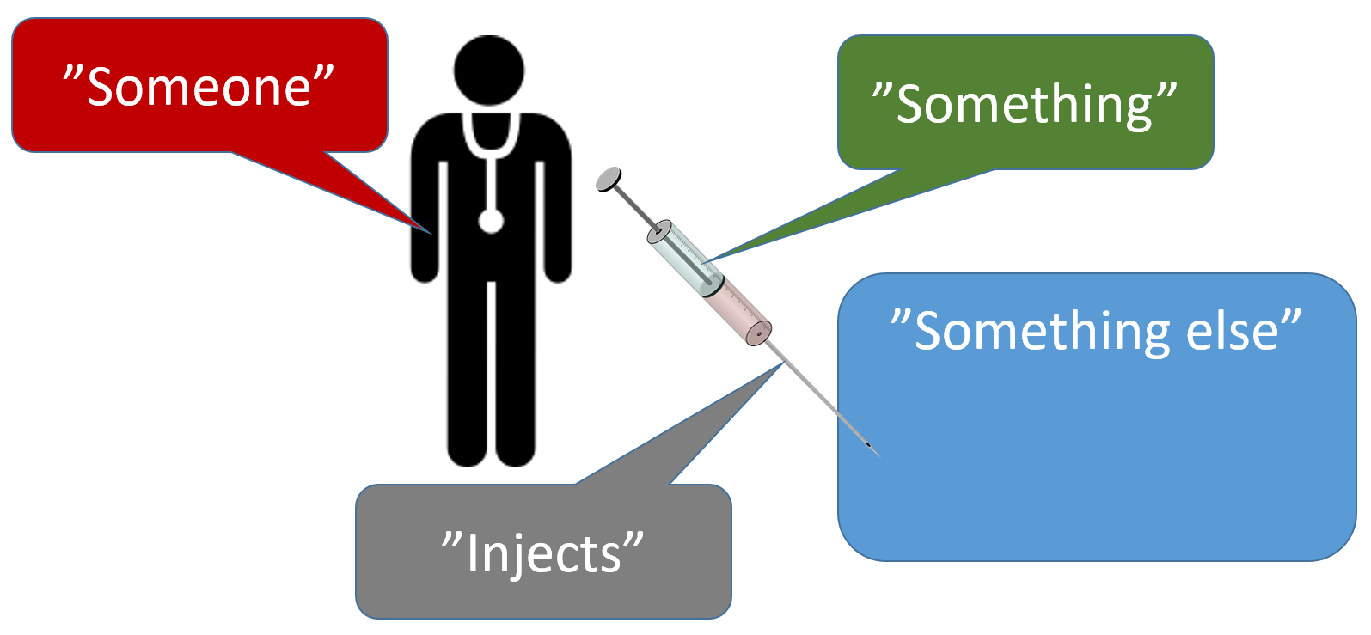

Slide 48


Slide 49
public int SquareOf4()
{
return 4 * 4;
}

Slide 50
public int SquareOf4()
{
return 4 * 4;
}
public int SquareOf6()
{
return 6 * 6;
}

Slide 51

public int Square(int n)
{
return n * n;
}

Slide 52
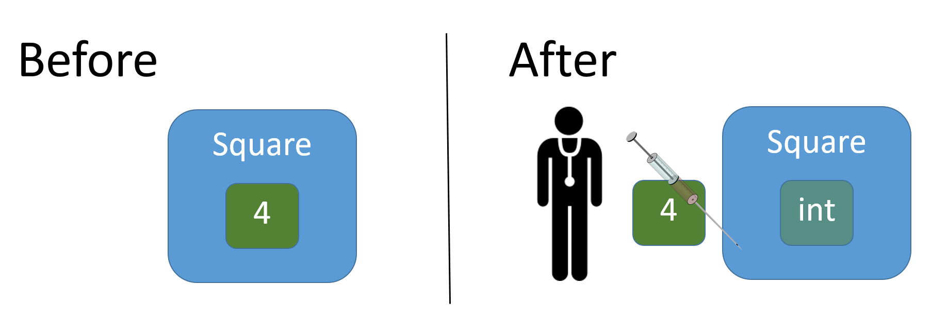

Slide 53
public class Die
{
private int _faceValue;
private static Random _random = new Random();
public Die()
{
Roll();
}
public int FaceValue
{
get { return _faceValue; }
}
public void Roll()
{
_faceValue = _random.Next(0,6) + 1;
}
}

Slide 54

public void Roll()
{
_faceValue = _random.Next(0,6) + 1;
}
public void Roll(int noOfSides)
{
_faceValue = _random.Next(0, noOfSides) + 1;
}

Slide 55
public class Die
{
private int _faceValue;
private int _noOfSides;
private static Random _random = new Random();
public Die(int noOfSides)
{
_noOfSides = noOfSides;
Roll();
}
public int FaceValue
{
get { return _faceValue; }
}
public void Roll()
{
_faceValue = _random.Next(0, _noOfSides) + 1;
}
}

Slide 56
Dependency Injection – filtering values
Given a set of integer values, filter out those values for which a certain condition becomes true.
Condition example: value is less than 12.
12
24
9
10
6
3
45
< 12
9
10
6
3

Slide 57
// Version 1.0
public List<int> FilterValues()
{
List<int> values = new List<int>{ 12, 24, 9, 10, 6, 3, 45 };
List<int> filteredValues = new List<int>();
foreach (int value in values)
{
if (value < 12)
{
filteredValues.Add(value);
}
}
return filteredValues;
}

Slide 58
// Call of Version 1.0
List<int> filteredValues;
FilterV10 fv10 = new FilterV10();
filteredValues = fv10.FilterValues();

Slide 59

// Version 1.0
public List<int> FilterValues()
{
List<int> values = new List<int>
{ 12, 24, 9, 10, 6, 3, 45 };
List<int> filteredValues = new List<int>();
foreach (int value in values)
{
if (value < 12)
{
filteredValues.Add(value);
}
}
return filteredValues;
}
What parts of this filtering process may vary?
How can we manage this variation?
30
25
20
15
10
5

Slide 60
// Version 1.0
public List<int> FilterValues()
{
List<int> values = new List<int>{ 12, 24, 9, 10, 6, 3, 45 };
List<int> filteredValues = new List<int>();
foreach (int value in values)
{
if (value < 12)
{
filteredValues.Add(value);
}
}
return filteredValues;
}

Slide 61
// Version 2.0
public List<int> FilterValues(List<int> values)
{
List<int> filteredValues = new List<int>();
foreach (int value in values)
{
if (value < 12)
{
filteredValues.Add(value);
}
}
return filteredValues;
}

Slide 62
// Call of Version 2.0
List<int> values = new List<int>{…};
List<int> filteredValues;
FilterV20 fv20 = new FilterV20();
filteredValues = fv20.FilterValues(values);

Slide 63
// Version 2.0
public List<int> FilterValues(List<int> values)
{
List<int> filteredValues = new List<int>();
foreach (int value in values)
{
if (value < 12)
{
filteredValues.Add(value);
}
}
return filteredValues;
}

Slide 64
public interface ICondition
{
bool Condition(int value);
}

Slide 65
// Version 3.0
public List<int> FilterValues(List<int> values, ICondition cond)
{
List<int> filteredValues = new List<int>();
foreach (int value in values)
{
if (cond.Condition(value))
{
filteredValues.Add(value);
}
}
return filteredValues;
}

Slide 66
public class ConditionLessThan12 : ICondition
{
public bool Condition(int value)
{
return (value < 12);
}
}

Slide 67
// Call of Version 3.0
List<int> values = new List<int>{…};
List<int> filteredValues;
ICondition condInt = new ConditionLessThan12();
FilterV30 fv30 = new FilterV30();
filteredValues = fv30.FilterValues(values, condInt);

Slide 68
// Version 3.0
public List<int> FilterValues(List<int> values, ICondition cond)
{
List<int> filteredValues = new List<int>();
foreach (int value in values)
{
if (cond.Condition(value))
{
filteredValues.Add(value);
}
}
return filteredValues;
}

Slide 69
public interface ICondition
{
bool Condition(int value);
}

Slide 70
public interface IConditionGeneric<T>
{
bool Condition(T value);
}

Slide 71
// Version 4.0
public List<T> FilterValues<T>(List<T> values, IConditionGeneric<T> cond)
{
List<T> filteredValues = new List<T>();
foreach (T value in values)
{
if (cond.Condition(value))
{
filteredValues.Add(value);
}
}
return filteredValues;
}

Slide 72
public class ConditionContainsS : IConditionGeneric<string>
{
public bool Condition(string value)
{
return value.ToLower().Contains("s");
}
}

Slide 73
// Call of Version 4.0
List<string> valuesStr = new List<string>{…};
List<string> filteredValuesStr;
IConditionGeneric<T> condStr = new ConditionContainsS();
FilterV40<string> fv40 = new FilterV40<string>();
filteredValuesStr = fv40.FilterValues(valuesStr, condStr);

Slide 74
// Version 4.0
public List<T> FilterValues<T>(List<T> values, IConditionGeneric<T> cond)
{
List<T> filteredValues = new List<T>();
foreach (T value in values)
{
if (cond.Condition(value))
{
filteredValues.Add(value);
}
}
return filteredValues;
}

Slide 75
// Version 5.0
public List<T> FilterValues<T>(IEnumerable<T> values, IConditionGeneric<T> cond)
{
List<T> filteredValues = new List<T>();
foreach (T value in values)
{
if (cond.Condition(value))
{
filteredValues.Add(value);
}
}
return filteredValues;
}

Slide 76
// Call of Version 4.0
List<string> valuesStr = new List<string>{…};
List<string> filteredValuesStr;
IConditionGeneric<T> condStr = new ConditionContainsS();
FilterV40<string> fv40 = new FilterV40<string>();
filteredValuesStr = fv40.FilterValues(valuesStr, condStr);

Slide 77
// Call of Version 5.0
LinkedList<string> valuesStr = new LinkedList<string>{…};
List<string> filteredValuesStr;
IConditionGeneric<T> condStr = new ConditionContainsS();
FilterV50<string> fv50 = new FilterV50<string>();
filteredValuesStr = fv50.FilterValues(valuesStr, condStr);

Slide 78

// Version 6.0 (with LINQ)
public List<T> FilterValues<T>(IEnumerable<T> values, IConditionGeneric<T> cond)
{
return values.Where(cond.Condition).ToList();
}
// Version 6.1 (with LINQ)
public List<T> FilterValues<T>(IEnumerable<T> values, Func<T, bool> condFunc)
{
return values.Where(condFunc).ToList();
}

Slide 79
// Call of Version 6.1
LinkedList<string> valuesStr = new LinkedList<string>{…};
List<string> filteredValuesStr;
FilterV61<string> fv61 = new FilterV61<string>();
filteredValuesStr = fv61.FilterValues(
valuesStr,
str => str.ToLower().Contains("s"));

Slide 80
Client

Slide 81
Client
ClassABC

Slide 82
public class Client
{
private ClassABC _abc;
public Client()
{
_abc = new ClassABC();
}
public DoUsefulStuff()
{
_abc.MethodB();
}
}

Slide 83
Client c = new Client();
c.DoUseufulStuff();

Slide 84
Client

Slide 85
Client
ClassABC

Slide 86
public class Client
{
private ClassABC _abc;
public Client(ClassABC abc)
{
_abc = abc;
}
public DoUsefulStuff()
{
_abc.MethodB();
}
}

Slide 87
ClassABC abc = new ClassABC();
Client c = new Client(abc);
c.DoUseufulStuff();

Slide 88
InterfaceB
Client
ClassABC

Slide 89
public class Client
{
private InterfaceB _b;
public Client(InterfaceB b)
{
_b = b;
}
public DoUsefulStuff()
{
_b.MethodB();
}
}

Slide 90
// Create object that implements InterfaceB
InterfaceB b = new …();
Client c = new Client(b);
c.DoUseufulStuff();

Slide 91
Client

Slide 92
Client
ClassABC

Slide 93
Injector

Slide 94
Injector
new ClassABC();
ClassABC

Slide 95
Injector
InterfaceB b = new ClassABC();
InterfaceB
ClassABC

Slide 96
Injector
InterfaceB b = new ClassABC();
Client c = new Client(…);
Client
InterfaceB
ClassABC

Slide 97
Injector
InterfaceB b = new ClassABC();
Client c = new Client(b);
Client
InterfaceB
ClassABC

Slide 98
Who is the Injector?

