Slide 1
Razor Pages
An Overview

Slide 2
Your PC
HTTP Request
Web Server
Brow
ser
Web
Web App
HTTP Response

Slide 3
Your PC
HTTP Request
Web Server
Brow
ser
Web App
HTTP Response

Slide 4
HTTP Request
GET: Essentially a URL
POST: A URL and some data

Slide 5
HTTP Response
Status code (200, 404,…)
HTML (which the browser then renders)

Slide 6
Web App
App receives HTTP Requests (GET/POST plus URL)
App invokes controller matching the URL
Controller ”calculates” the HTML which should be shown in the browser (the page matching the URL)
App sends the HTML – and possibly also CSS – back to the browser, in the form of HTTP Responses

Slide 7
Razor Pages Web App
Handles HTTP Requests/Responses
Is page-centric: matches a URL with a page (i.e. a Razor Page)
We write
Page layout code
Page controller code
Assisting services code

Slide 8
Razor Pages Web App
Example: A page named ViewMessage
Layout code
Written in ViewMessage.cshtml
A mix of HTML, C# and ASP ”helper tags”
Often referred to as page layout code
Controller code
Written in ViewMessage.cshtml.cs
Pure C# (!)
Often referred to as page model code

Slide 9


Slide 10
Razor Pages Web App
NB: ALWAYS add pages under the Pages folder!
We will often define and use subfolders under Pages

Slide 11
Razor Pages Web App
What is a ”service”…?
Pure C# classes containing needed logic (business, persistence, …)
Not written as part of the page itself
Written as stand-alone classes that can be injected into page controller code
Usually style is a interface plus (at least) one class implementing the interface
Must be registered in Program.cs, as a ”singleton” service or a ”transient” service.

Slide 12
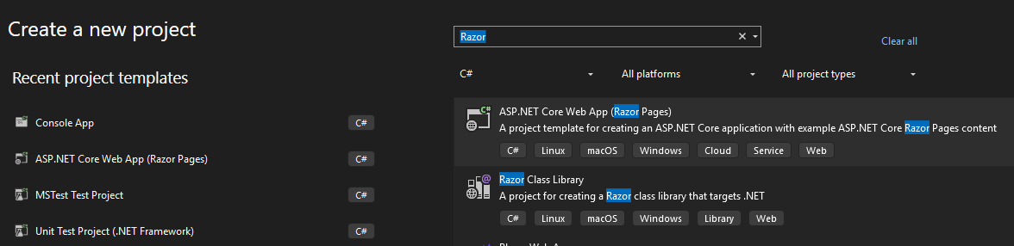

Slide 13
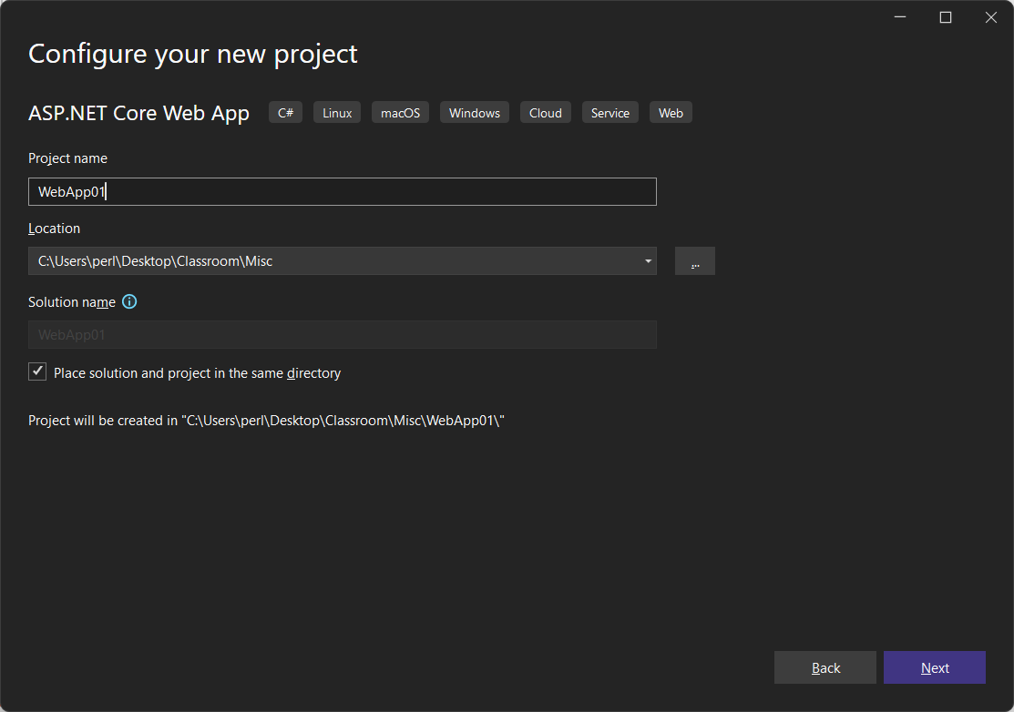

Slide 14
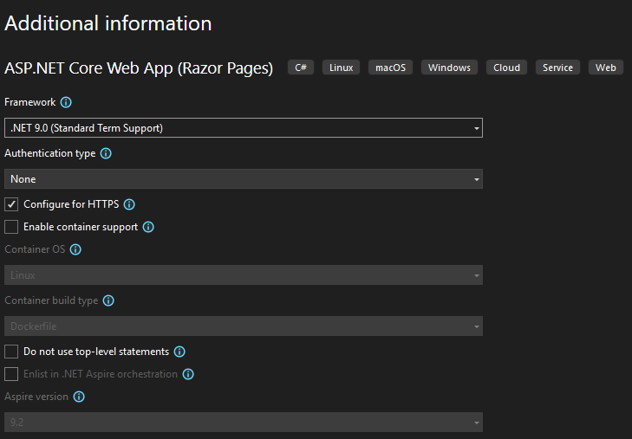

Slide 15
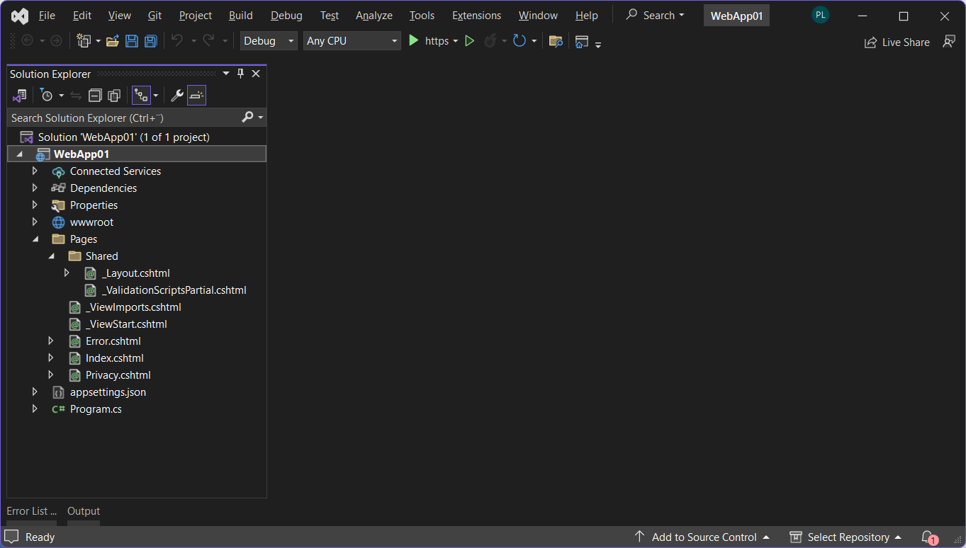

Slide 16
Page
Layout
(ViewMsg)

Slide 17
Page
Layout
(ViewMsg)
@page
@model ViewMsgModel
@{
}

Slide 18
Page
Layout
(ViewMsg)
@page
@model ViewMsgModel
@{
}
<h1>Hi World</h1>

Slide 19
_Layout.cshtml
…
<li class="nav-item">
<a … asp-page="/ViewMsg">View Message</a>
</li>
…

Slide 20
Page
Layout
(ViewMsg)
@page
@model ViewMsgModel
@{
}
<h1>Hi World, it is @DateTime.Now</h1>

Slide 21
Page
Model

Slide 22
Page
Model
public class ViewMsgModel : PageModel
{
}

Slide 23
Page
Model
public class ViewMsgModel : PageModel
{
public string Message { get; }
}

Slide 24
Page
@page
@model ViewMsgModel
@{
}
<h1>@Model.Message</h1>

Slide 25
@page
@model ViewMsgModel
@{
}
<h1>@Model.Message</h1>
public class ViewMsgModel : PageModel
{
public string Message { get; }
}

Slide 26
Service
public interface IMsgService
{
}

Slide 27
Service
public interface IMsgService
{
string GetMessage();
}

Slide 28
Service
public class MsgService : IMsgService
{
public string GetMessage()
{
…
}
}

Slide 29
Page
Model
public class ViewMsgModel : PageModel
{
private IMsgService _msgService;
}

Slide 30
@page
@model ViewMsgModel
@{
}
public class ViewMsgModel : PageModel
{
private IMsgService _msgService;
}
public class MsgService : IMsgService
{
}

Slide 31
Page
@page
@model ViewMsgModel
@{
}
<h1>@Model.Message</h1>

Slide 32
Page
Model
public class ViewMsgModel : PageModel
{
private IMsgService _msgService;
public string Message { get; }
}

Slide 33
@page
@model ViewMsgModel
@{
}
<h1>@Model.Message</h1>
public class ViewMsgModel : PageModel
{
private IMsgService _msgService;
public string Message { get; }
}

Slide 34
Page
Model
public class ViewMsgModel : PageModel
{
private IMsgService _msgService;
public ViewMsgModel(IMsgService msgSrv)
{
_msgService = msgSrv;
}
public string Message { get; }
}

Slide 35
Page
Model
public class ViewMsgModel : PageModel
{
private IMsgService _msgService;
public ViewMsgModel(IMsgService msgSrv)
{
_msgService = msgSrv;
}
public string Message { get; private set;}
public void OnGet()
{
Message = _msgService.GetMessage();
}
}

Slide 36
Service
public class MsgService : IMsgService
{
public string GetMessage()
{
…
}
}

Slide 37
public class ViewMsgModel : PageModel
{
private IMsgService _msgService;
public ViewMsgModel(IMsgService msgSrv)
{
_msgService = msgSrv;
}
public string Message { get; }
public void OnGet()
{
Message = _msgService.GetMessage();
}
}
public class MsgService : IMsgService
{
public string GetMessage() { … }
}

Slide 39
Program.cs
…
builder.Services.AddRazorPages(); // already there
builder.Services.AddSingleton<IMsgService,MsgService>();
…

Slide 40
Page (SetMsg)
@page
@model SetMsgModel
@{
}
<form method="post">
<div class="form-group">
<label asp-for="@Model.Message" class="control-label"></label>
<input asp-for="@Model.Message" class="form-control" />
</div>
<input type="submit" value="Save" class="btn btn-primary mt-3" />
</form>

Slide 41
Page
Model
public class SetMsgModel : PageModel
{
private IMsgService _msgService;
public string Message { get; private set; }
public SetMsgModel(IMsgService msgSrv)
{
_msgService = msgSrv;
}
public void OnGet()
{
Message = _msgService.GetMessage();
}
public void OnPost()
{
_msgService.SetMessage(Message);
}
}

Slide 42
Service
public interface IMsgService
{
string GetMessage();
void SetMessage(string message);
}

Slide 43
Service
public class MsgService : IMsgService
{
private string _theMessage;
public MsgService()
{
_theMessage = "Hi World";
}
public string GetMessage()
{
return _theMessage;
}
public void SetMessage(string message)
{
_theMessage = message;
}
}

Slide 44
_Layout.cs
…
<li class="nav-item">
<a … asp-page="/ViewMsg">View Message</a>
</li>
<li class="nav-item">
<a … asp-page="/SetMsg">Set Message</a>
</li>
…

Slide 46
Page
Model
public class SetMsgModel : PageModel
{
private IMsgService _msgService;
[BindProperty] // NB!!!
public string Message { get; set; } // NB!!!
public SetMsgModel(IMsgService msgSrv)
{
_msgService = msgSrv;
}
public void OnGet()
{
Message = _msgService.GetMessage();
}
public void OnPost()
{
_msgService.SetMessage(Message);
}
}

Slide 47
Web App with Domain Class
We want to be able to ”manage” several instances of a domain class
Domain class like e.g. Item, Movie, Customer, etc..
Typically need functionality for
CRUD operations
View all instances
Domain-specific operations

Slide 48
Web App with Domain class
Create a top-level folder named Models.
In the Models folder, add a class Movie.

Slide 49
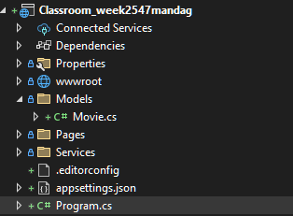

Slide 50
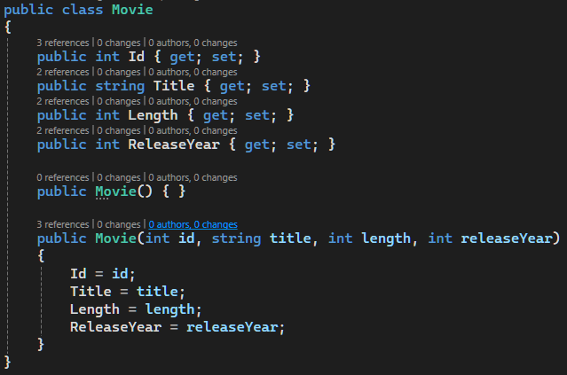

Slide 51
Web App with Domain class
Create a top-level folder named Services.
In the Services folder, add an interface IMovieRepository.
In the Services folder, add a class MovieRepository.

Slide 52
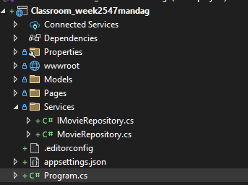

Slide 53
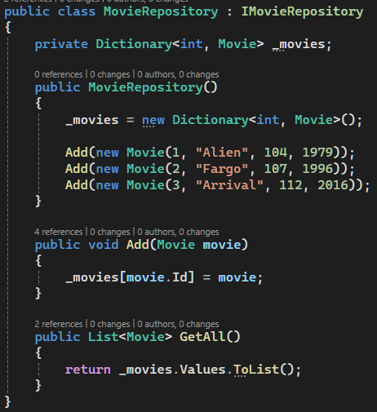
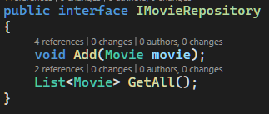

Slide 54
Web App with Domain class
Register IMovieRepository/MovieRepository as a service in Program.cs

Slide 55


Slide 56
Web App with Domain class
In the Pages folder, create a subfolder named Movies (remember the ”plural s”).
In the Movies folder, create a new Razor Page named ShowAll

Slide 57
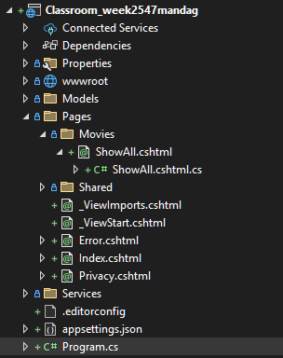

Slide 58
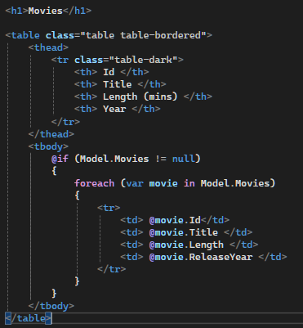
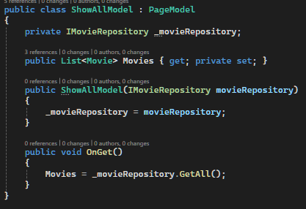

Slide 59
Web App with Domain class
In the Pages/Shared folder, open the _Layout.cshtml file and add a new <li> tag under the existing <li> tags, in order to add a new item to the navigation bar.

Slide 60
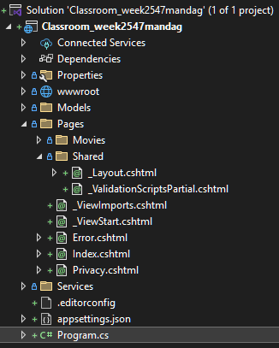

Slide 61
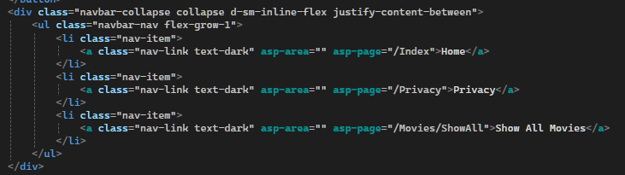

Slide 62
Web App with Domain Class
Recommendations
Add top-level folder Models to project
Add domain class definitions to this folder
NB: All domain classes must have a default constructor (i.e. no parameters)
Under the Pages folder, add one subfolder for each domain class
Give each subfolder the same name as the domain class plus a ”plural s”, i.e. for a class Product make a folder named Products.
Add all Pages relating to this domain class to this subfolder
Add top-level folder Services to project
Add all service interfaces/classes to this folder (add subfolders if needed)
Register all services in Program.cs
NB: Be aware of namespaces!

