Slide 1
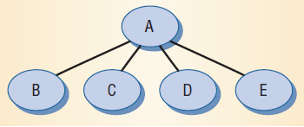
Leveraging Social Networks to Fight Spam
P. Boykin and V. Roychowdhury, Computer (April 2005).
A particular scenario: For an individual user, create her contacts’ interaction network.
Star subnetwork per email: Subgraph represents e-mail interaction generated by a message sent from A to B and C and cc’d to D and E. These networks are then aggregated.
Notes:
1. there's this little harmless looking insect called a locust, but, outbreaks of locust swarms are big threats to our food security;
2. (state the data source of the plot); from the plot, we see that locust outbreak is very bursty (we see a devastating outbreak every ... years approximately)
3. a locust outbreak is similar in concept fundamentally to any other outbreak we observe in life, such as outbreaks of flu; basically, each locust has x number of offsprings, or each flu-infected person can pass the flu onto x number of other individuals; if x surpasses one, epidemic outbreaks are likely;
4. now, for the locust, rainfall is important: heavy rains -> locust eggs absorb moisture and hatch (i.e. greatly increase number of offsprings per locust) -> Locust Plague!

Slide 2
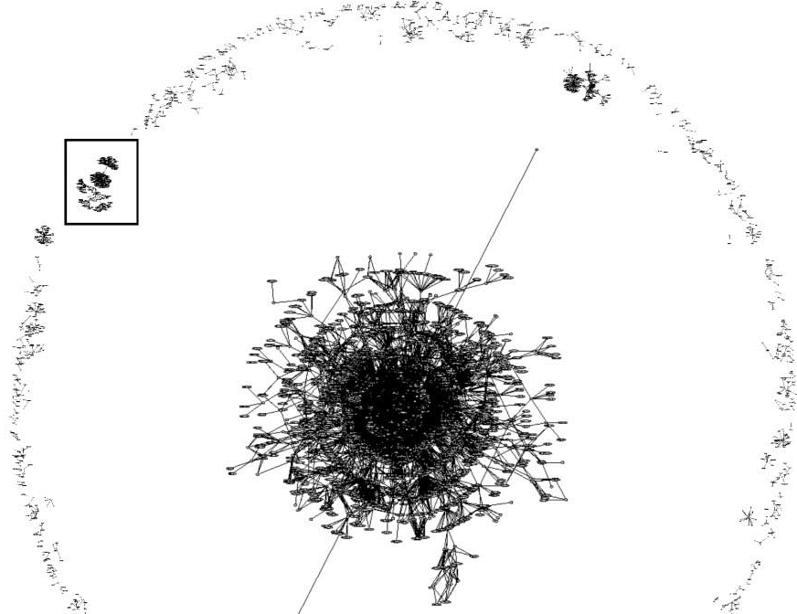
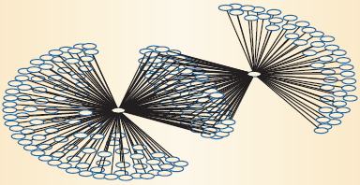
Structure of the Network
A Subgraph of the giant connected component: no node shares a neighbor with any of its neighbors.
What is happening? Two
spammers share many co-recipients
(middle nodes).
Notes:
1. there's this little harmless looking insect called a locust, but, outbreaks of locust swarms are big threats to our food security;
2. (state the data source of the plot); from the plot, we see that locust outbreak is very bursty (we see a devastating outbreak every ... years approximately)
3. a locust outbreak is similar in concept fundamentally to any other outbreak we observe in life, such as outbreaks of flu; basically, each locust has x number of offsprings, or each flu-infected person can pass the flu onto x number of other individuals; if x surpasses one, epidemic outbreaks are likely;
4. now, for the locust, rainfall is important: heavy rains -> locust eggs absorb moisture and hatch (i.e. greatly increase number of offsprings per locust) -> Locust Plague!

Slide 3
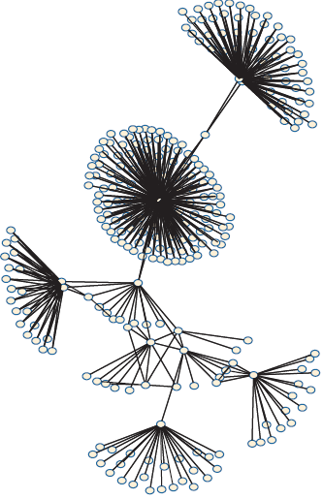
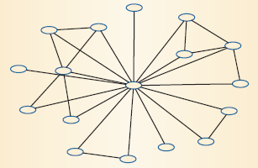
Friends’ subnetworks
Subgraph of a nonspam component: Shows a higher incidence of triangle structures (neighbors sharing neighbors) than the spam subgraph. In this component, around 67 percent of the nodes are connected to each other.
Notes:
1. there's this little harmless looking insect called a locust, but, outbreaks of locust swarms are big threats to our food security;
2. (state the data source of the plot); from the plot, we see that locust outbreak is very bursty (we see a devastating outbreak every ... years approximately)
3. a locust outbreak is similar in concept fundamentally to any other outbreak we observe in life, such as outbreaks of flu; basically, each locust has x number of offsprings, or each flu-infected person can pass the flu onto x number of other individuals; if x surpasses one, epidemic outbreaks are likely;
4. now, for the locust, rainfall is important: heavy rains -> locust eggs absorb moisture and hatch (i.e. greatly increase number of offsprings per locust) -> Locust Plague!

Slide 4

Putting Structure to Work

Slide 5
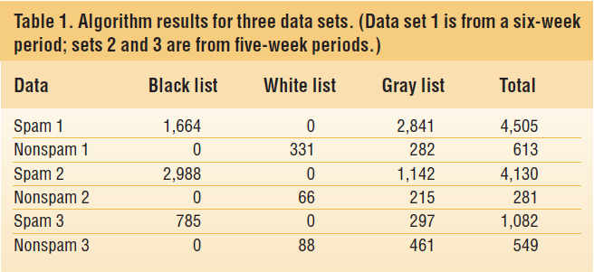
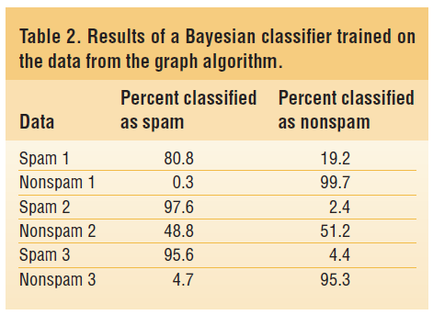
Sorting Email Friends from Foes
We break the complete network into components and then use a number of metrics including, clustering coefficient, degree distribution, and classify nodes as in (i) White List, (ii) Black List, or (iii) Gray list.
Notes:
1. there's this little harmless looking insect called a locust, but, outbreaks of locust swarms are big threats to our food security;
2. (state the data source of the plot); from the plot, we see that locust outbreak is very bursty (we see a devastating outbreak every ... years approximately)
3. a locust outbreak is similar in concept fundamentally to any other outbreak we observe in life, such as outbreaks of flu; basically, each locust has x number of offsprings, or each flu-infected person can pass the flu onto x number of other individuals; if x surpasses one, epidemic outbreaks are likely;
4. now, for the locust, rainfall is important: heavy rains -> locust eggs absorb moisture and hatch (i.e. greatly increase number of offsprings per locust) -> Locust Plague!

