Slide 1
Two-photon Imaging Through a Multimode Fiber
Edgar E. Morales-Delgado, Demetri Psaltis, and Christophe Moser
Presenter: Hongda Wang
Edgar E. Morales-Delgado, Demetri Psaltis, and Christophe Moser, "Two-photon imaging through a multimode fiber," Opt. Express23, 32158-32170 (2015)

Slide 2
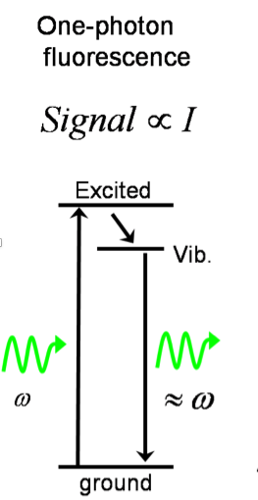
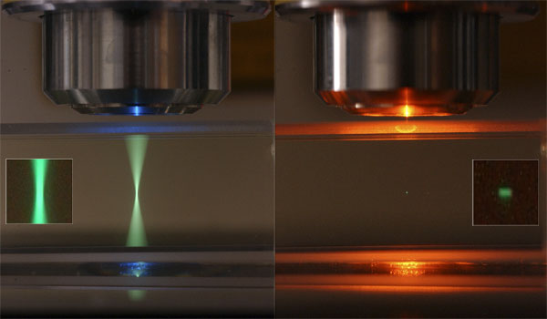
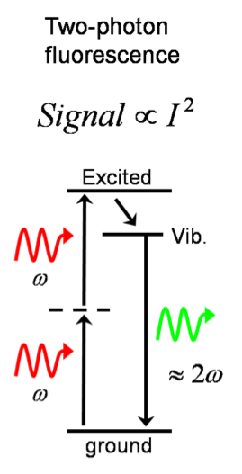
Two-photon Excited Fluorescence Signal
Advantages of two-photon excited fluorescence imaging:
Increased penetration depth (up to 1000 µm in living brains);
Suppressed background signal;
Reduced phototoxicity.

Slide 3
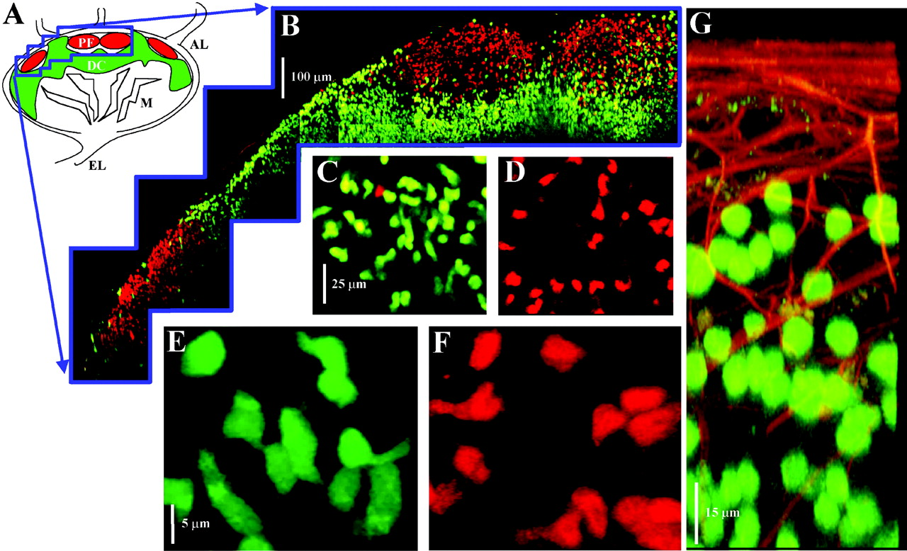
Two-photon excitation Imaging Example
Two-photon imaging of living T and B lymphocytes deep within an intact isolated lymph node.
Science 07 Jun 2002:
Vol. 296, Issue 5574, pp. 1869-1873
DOI: 10.1126/science.1070051

Slide 4
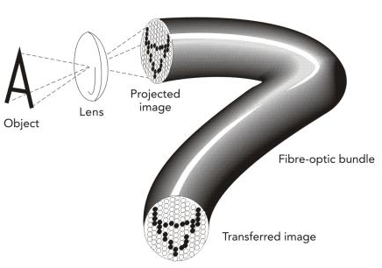
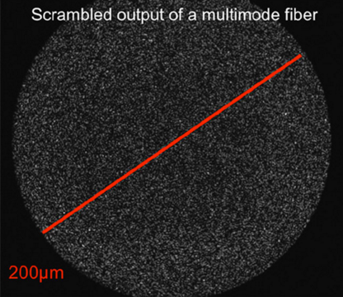
Background of Fiber Endoscopy
Traditional Fiber Endoscope:
Visualization of the interior of organs or cavities inside of the body.
Most widely used type in medical service: multi-core fibers in medical diagnosing.
Suffers from pixilation and bulky size.
An alternative: multimode fiber
Challenges: mode scrambling.

Slide 5
Focusing Pulses Through the Multimode Fiber
3 Steps Procedure:
Calibration of Point Transfer Function;
Digital scanning of pulsed light;
Group Velocity Dispersion (GVD) compensation.

Slide 6
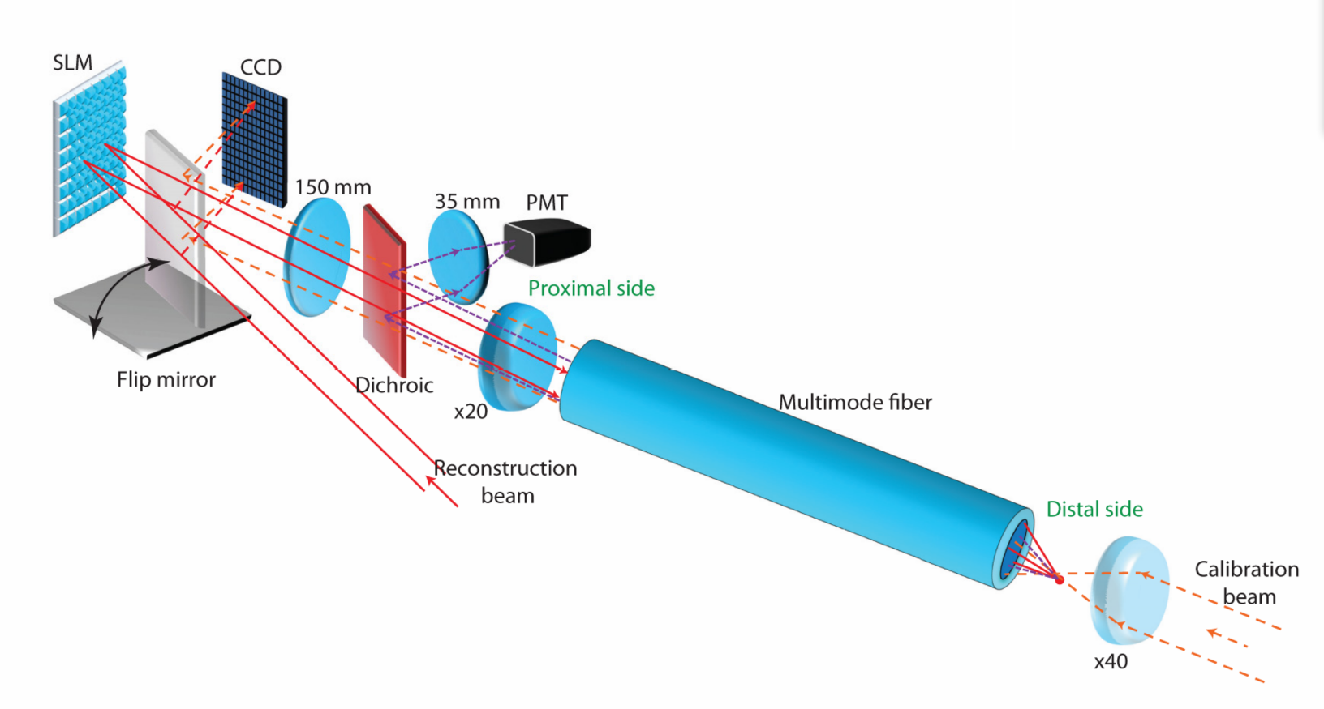
Step1: Calibration of Point Transfer Function
③time-gated off-axis holography
②20 cm length graded index fiber
①GVD compensated laser pulse

Slide 7
Step2: Digital Scanning of Pulsed Light
②conjugated phase
③temporally and spatially sharp focused spot
①same reference beam

Slide 8
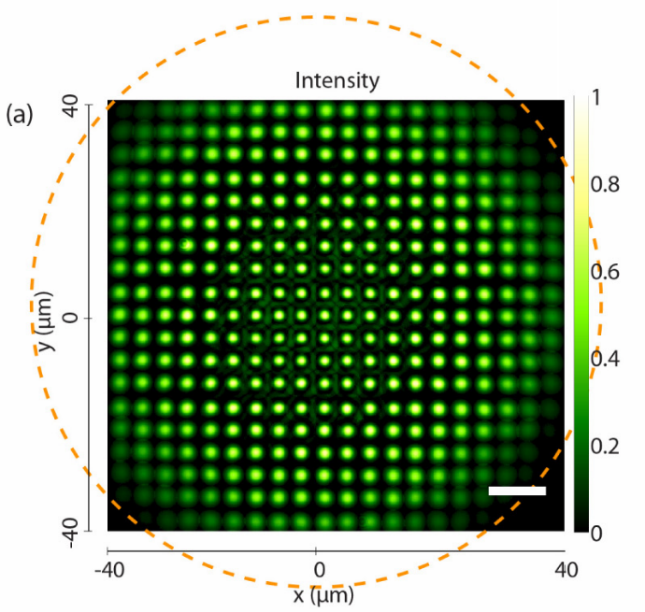
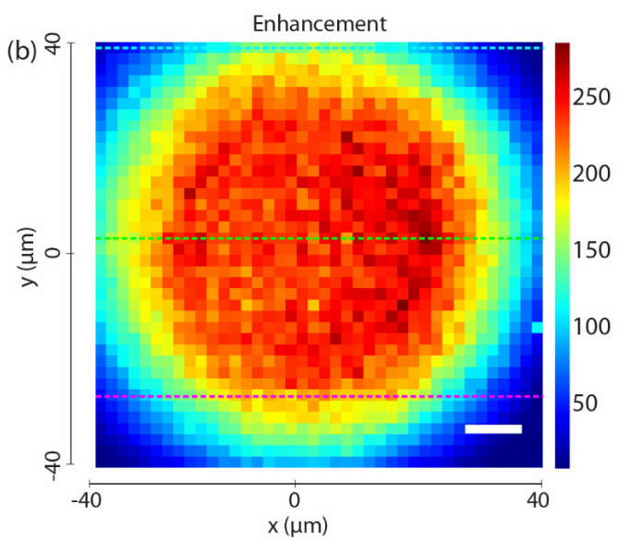
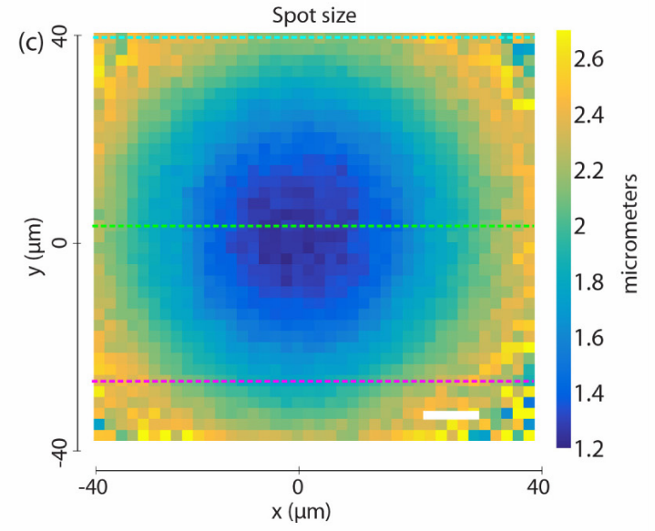
Step2: Digital Scanning of Pulsed Light
Intensity enhancement of the focused pulse as a function of scanning position.
FWHM size of the focused pulses as a function of scanning position.
An example array of sharp focused spot
(Scale bars are 10 µm)

Slide 9
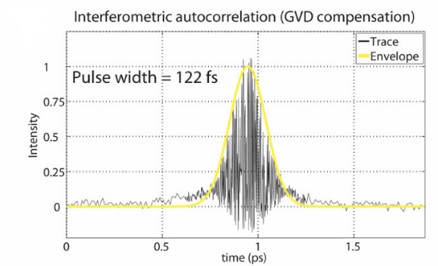
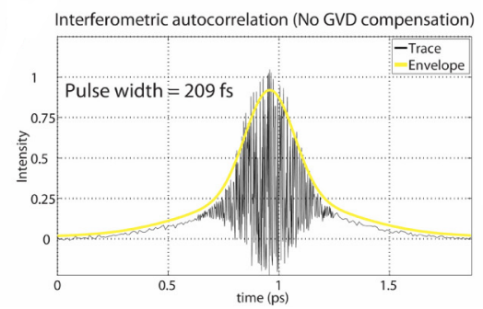
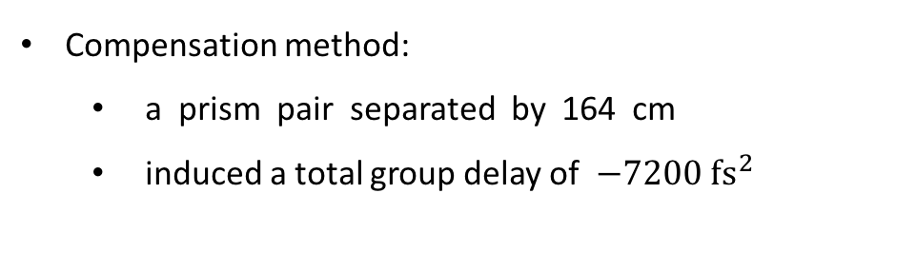
Step3: GVD Compensation
At calibration step:
enhances the visibility of the fringes.
At reconstruction step:
allows the reconstruction of a 120 fs pulse when used, close to the initial 100 fs.
Compensation method:
a prism pair separated by 164 cm
induced a total group delay of $−7200 fs^{2}$

Slide 10
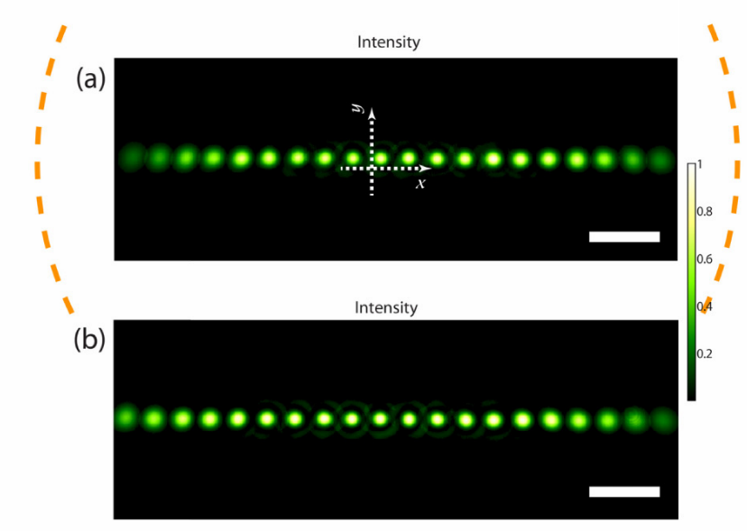
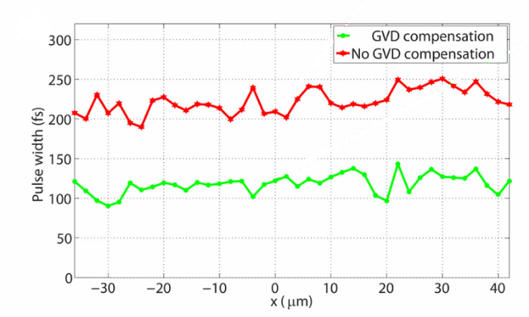


Step3: GVD Compensation
Pulse width vs position.
Intensity of the generated focused pulses at 800 nm without (a) and with (b) GVD compensation. Scale bars are 10 µm
(Scale bars are 10 µm.)
wo\
w\
GVD compensation

Slide 11
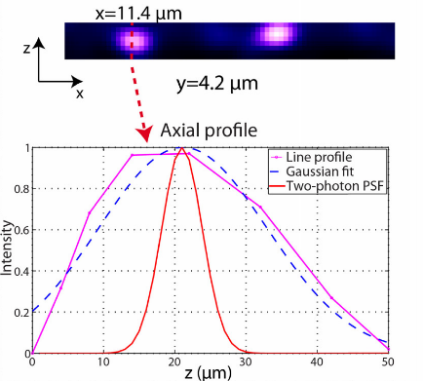
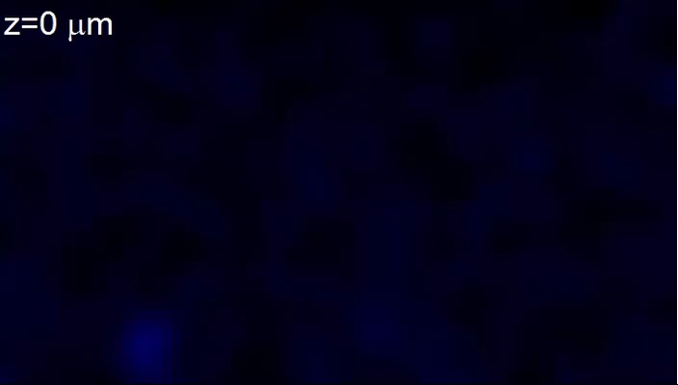
Two-photon Imaging Through the Multimode Fiber
1-5 µm fluorescent red microspheres.
Scan the focused pulse every 700 nm in a grid of 40x70 points (28x49 µm FOV).
Scan the planes from 0 to 50 µm inside the sample.
(Scale bar is 10 µm.)
Near the optical axis, single photon axial resolution is 15 µm and the two-photon axial resolution 10 µm.

Slide 12
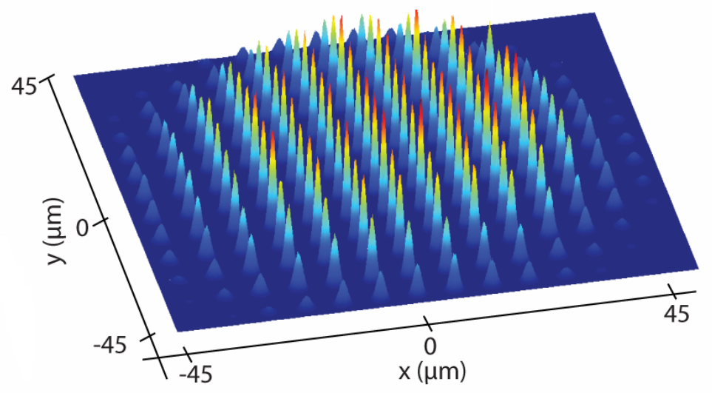
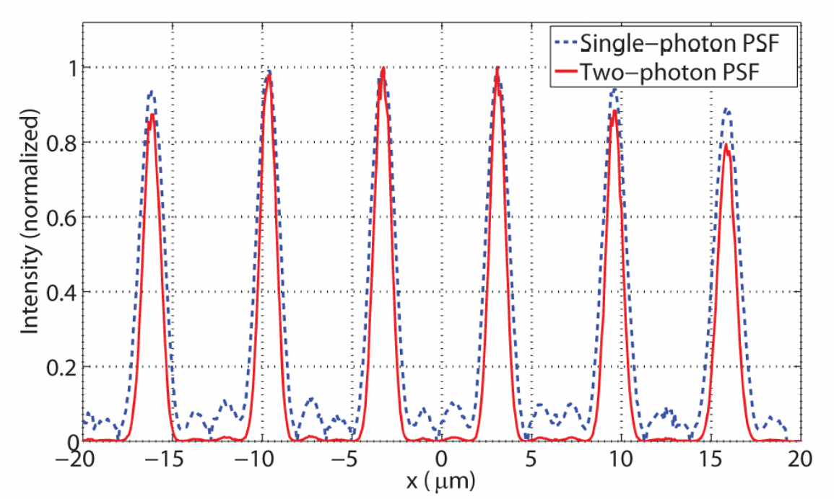
Two-photon Imaging PSF and Resolution
Lateral resolution smaller than 1.05 µm within a 40 µm diameter circle
Lateral resolution smaller than 1.4 µm in a 60 µm diameter FOV
The two-photon axial resolution 10 µm ( comparing to 15 µm in single photon imaging).

Slide 13
Conclusion
Demonstrated the first implementation of a multimode fiber two-photon endoscope.
Implemented time-gated phase conjugation of a pre-GVD compensated beam.
Generated an ultrashort pulse of 120 fs duration outside of the fiber.
Drawbacks
Limited field of view: ~40 µm by 40 µm
Required recalibration if the fiber was bent.
Scanning mechanism: not real time imaging.

Slide 14
Thank you!

Slide 15
