Slide 1


Slide 2

Course Outline
Business Cultures and Protocol
Business Law
Business Policy & Strategy
Financial Management
Fundamentals of Accounting
Entrepreneurship
Fundamentals of Marketing
HR Management
International Business & Trade
Management & Business
Management Information System
Micro- & Macroeconomics
Presentation & Communication
Purchasing & Supply Chain Management
Sales Management & Consumer Behaviour

Slide 3


Slide 4
Course Outline
Presentation & Communication
Management & Business
Entrepreneurship
Key concepts in Algebra
Elementary Statistics
Operating Systems: UNIX / Linux
Operating Systems: Windows Server
Networking Basics
Systems Design and Analysis
Introduction to Electronic Commerce
IT Security Essentials I
IT Security Essentials II
Advanced Network Security
Security Policy Design and Administration
Computer Forensics

Slide 5
Accelerated Bachelor of Business Administration and IT
Minimum 8 Month Course
Maximum 2 and a Half years
Accredited by SMC University
Fully Online
Able to go straight into the MBA from SMC

Slide 6


Slide 7
Master of Business Administration
Fully Accredited by ACBSP and ECBE
Full MBA program
2 years Minimum
5 years Maximum
Focus on developing Business skills at a Masters level

Slide 8
MBA Core Courses
Management
Marketing Management
Managerial Finance & Accounting
Business Research
Managerial Economics
Human Resources Management
International Business and Trade
Business Development Management
Case Studies – The F1 Art of Leadership

Slide 9

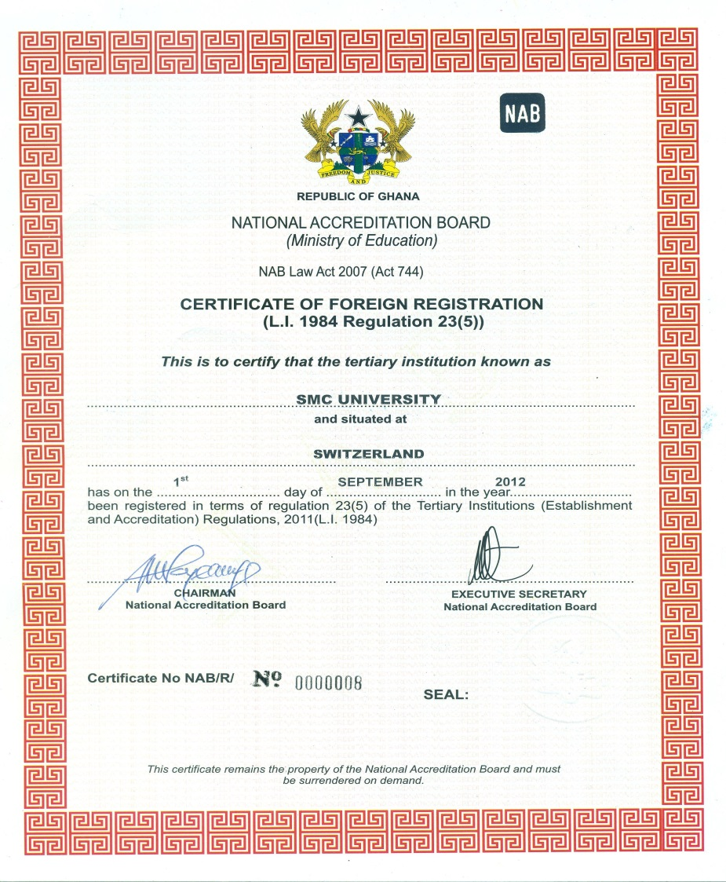

Accreditations

Slide 10


