Slide 1
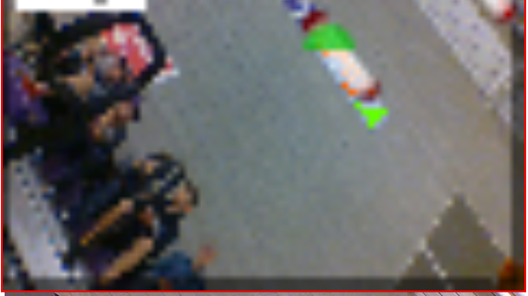
Computer Vision and OpenCV
Team 5827

Slide 2
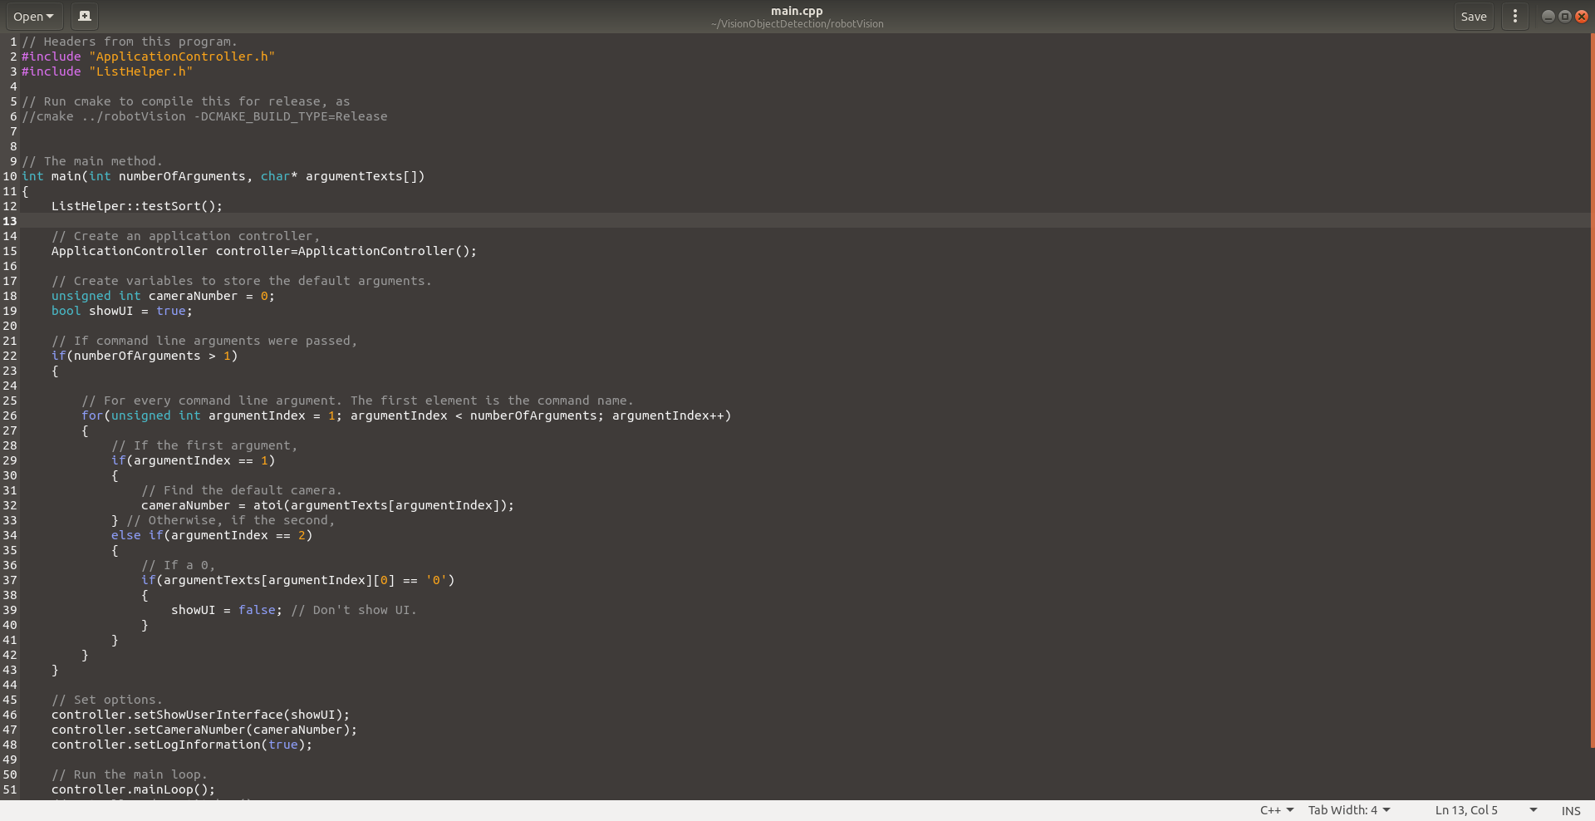
C++
Very similar to Java.
Most C code will compile as C++.

Slide 3
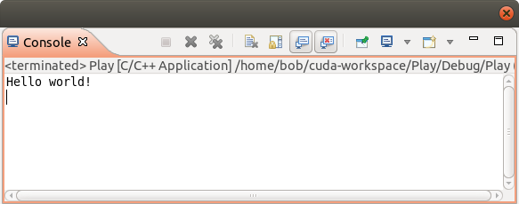
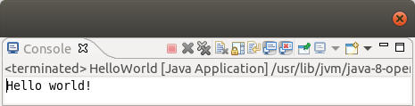
// C++
// Import a library for input/output streams.
#include <iostream>
int main()
{
std::cout << "Hello world!" << std::endl; // Print "Hello world!" followed by a new-line.
return 0; // Exit status.
}
// Java
// Package here.
public class HelloWorld
{
// A method that can be accessed from outside the class and package (public).
// A method that receives args as its initial parameters.
// A HelloWorld object does not need to be created to call this method (static).
// It returns nothing (void).
public static void main(String[] args)
{
System.out.println("Hello world!");
}
}

Slide 4
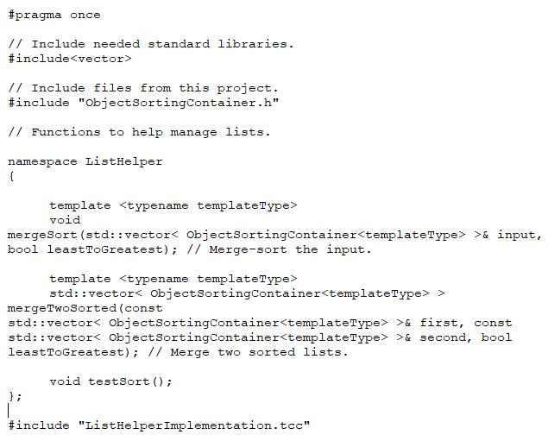
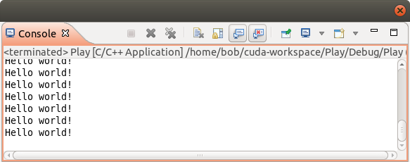
C++
// Import a library for input/output streams.
#include <iostream>
namespace MessagePrinters
{
void printHelloWorld()
{
std::cout << "Hello world!" << std::endl; // Print "Hello world!" followed by a new-line.
}
}
int main()
{
// This for-loop syntax is the same as Java.
for(int i = 0; // Create a variable i, set it to zero. BEFORE THE LOOP.
i < 1000; //Repeat the code inside the curly brackets WHILE i < 1000.
i++) // At the end of each run of the code inside the curly brackets, increase i by 1.
{
MessagePrinters::printHelloWorld();
}
return 0; // Exit status.
}
Differences
Namespaces
Classes/objects
Enums
Templates
Compiling
Much more.

Slide 5
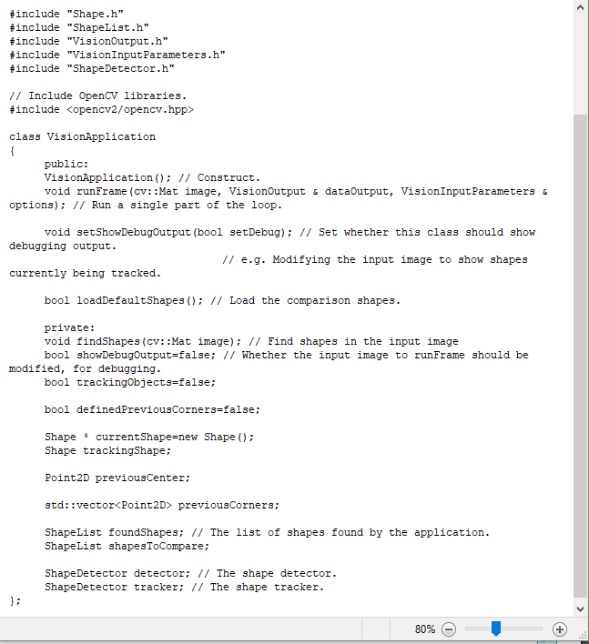
C++
VisionApplication * app = new VisionApplication();
app->setShowDebugOutput(false);
Differences
Namespaces
Classes/objects
Enums
Templates
Compiling
Much more.
VisionApplication& app = VisionApplication();
app.setShowDebugOutput(false);
VisionApplication app = VisionApplication();
app.setShowDebugOutput(false);

Slide 6
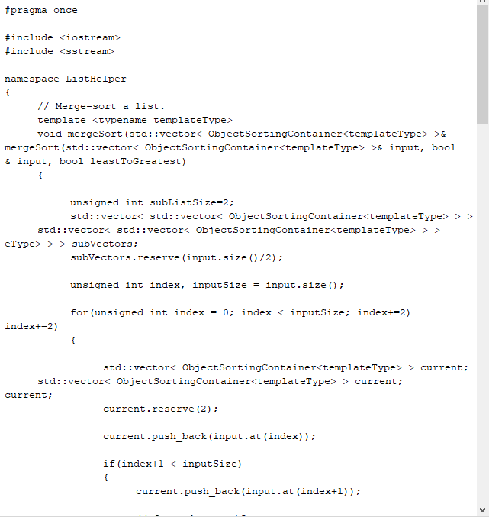
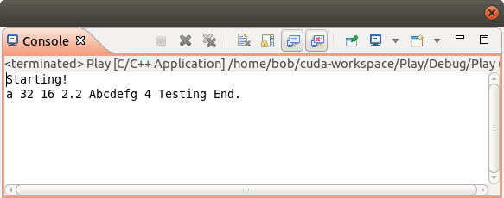
C++
#include <iostream>
// Templates can even provide recursion!
void f() { } // Base case: Do nothing.
template <typename T>
void g(T argument)
{
std::cout << argument << " ";
}
// The "..." indicates multiple arguments -- "the rest of a list."
template <typename T, typename... Tail>
void f(T head, Tail... tail)
{
g(head); // Output head.
f(tail...); // RECURSION.
}
int main()
{
std::cout << "Starting!" << std::endl;
f('a', 32, 16, 2.2, "Abcdefg", 4, "Testing");
std::cout << "End." << std::endl;
}
Example taken from page 66 of A Tour of C++ by Bjarne Stroustrup.
Differences
Namespaces
Classes/objects
Enums
Templates
Compiling
Much more.

Slide 7
Compiling and Linking
Compiler
OBJ files
Headers
Linker
Compiler
OBJ files
Your Source
Library Source Code
Executable

Slide 8
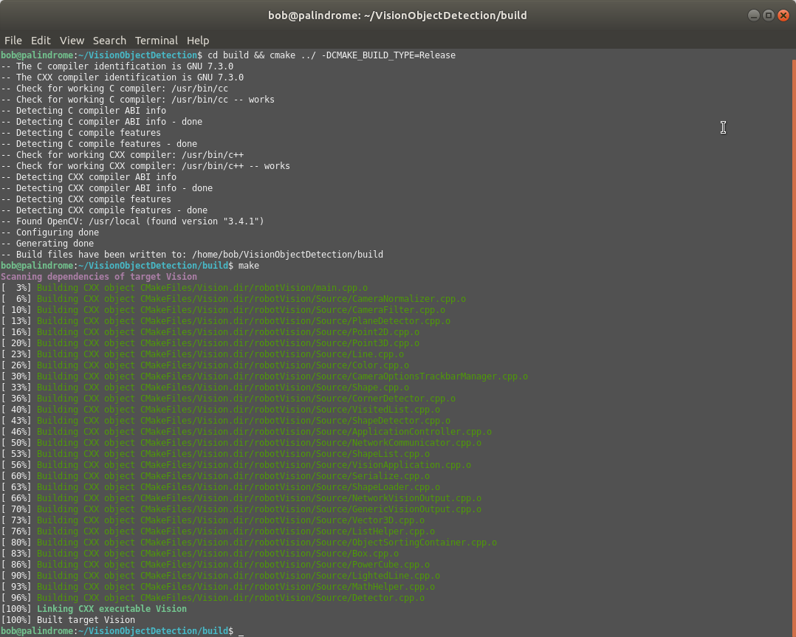
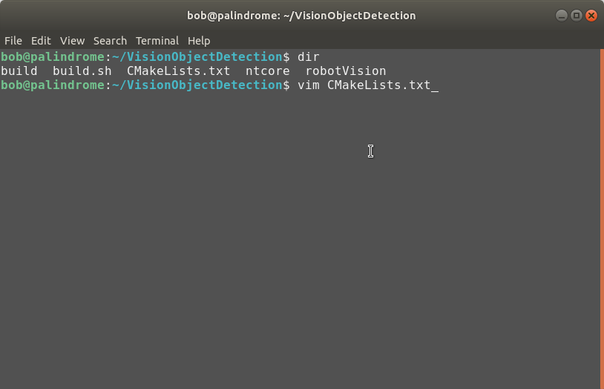
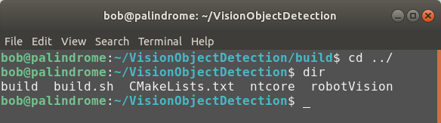
Compiling and Linking
CMake

Slide 9
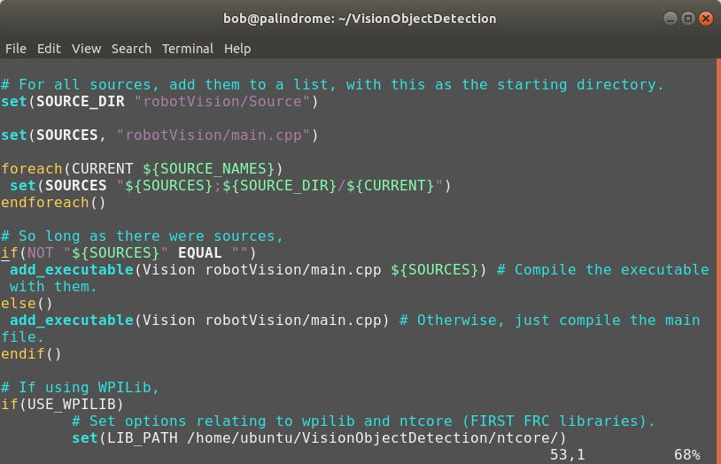
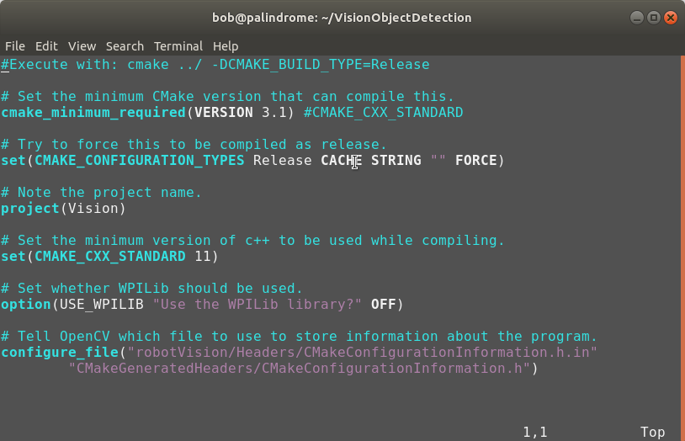
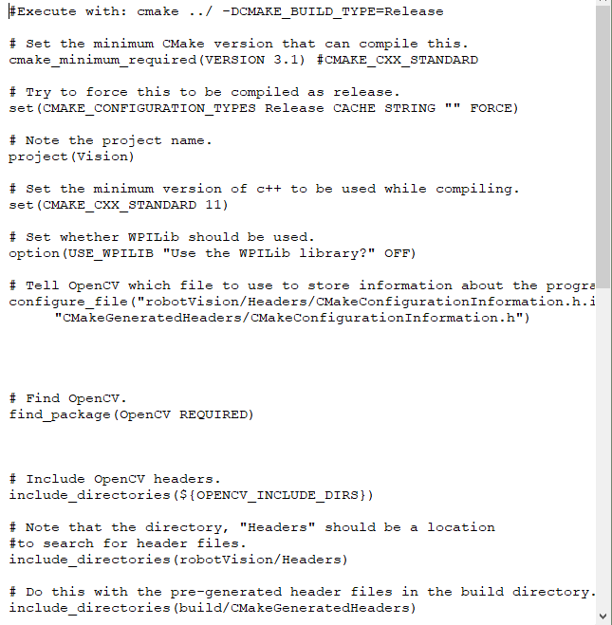
Compiling and Linking
CMake

Slide 10
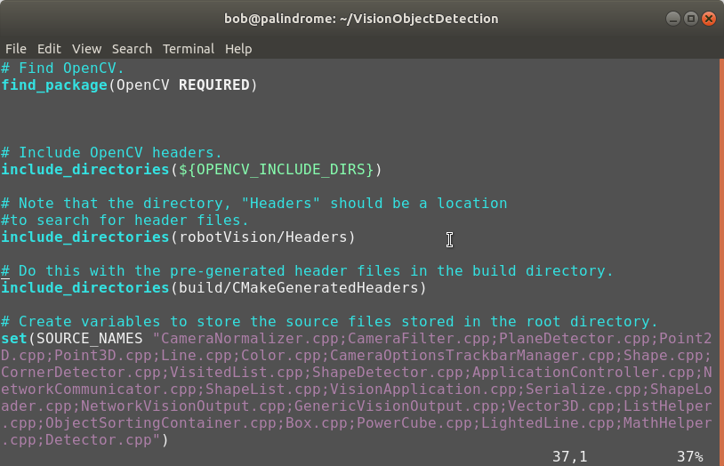
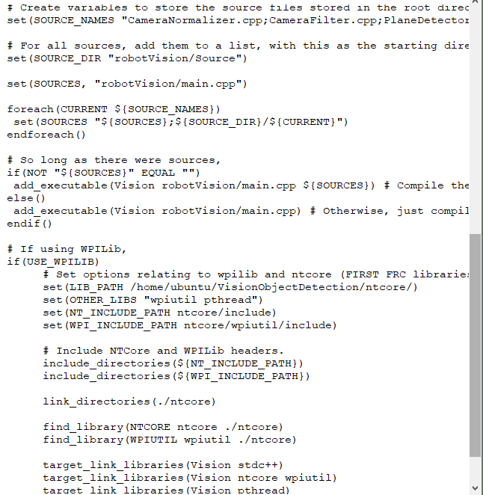
Compiling and Linking
CMake

Slide 11
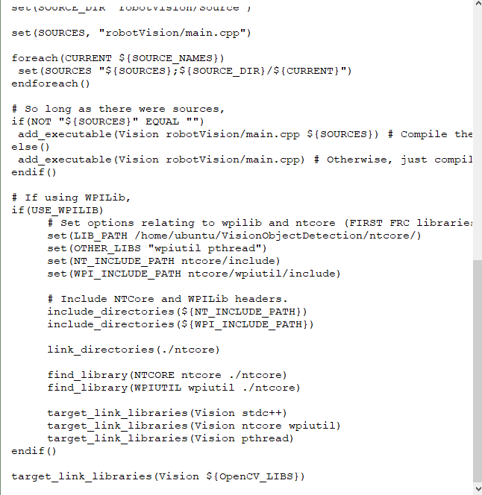
Compiling and Linking
CMake

Slide 12
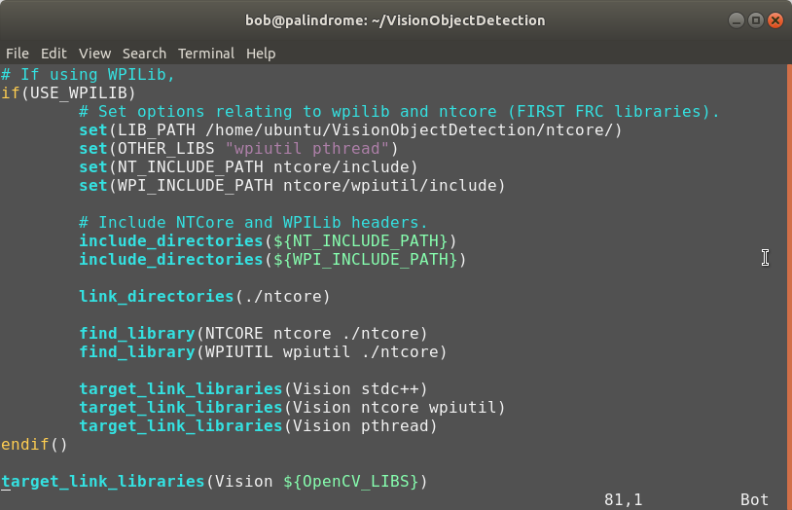
Compiling and Linking
CMake

Slide 13
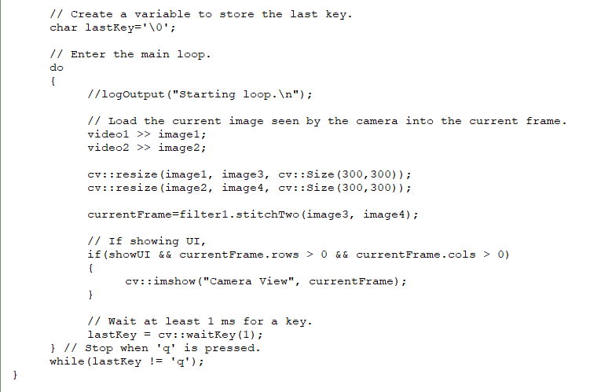
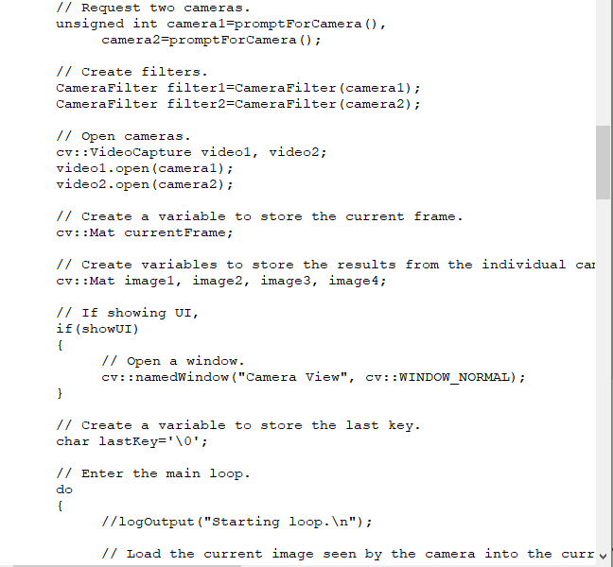


OpenCV
Opening a camera.

Slide 14
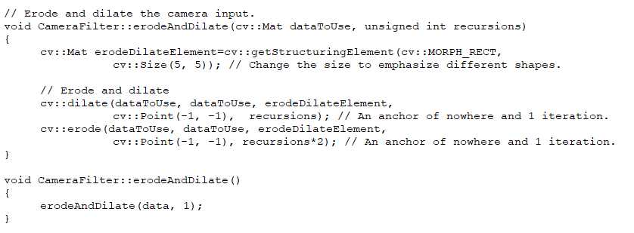
OpenCV – Other Functions

Slide 15
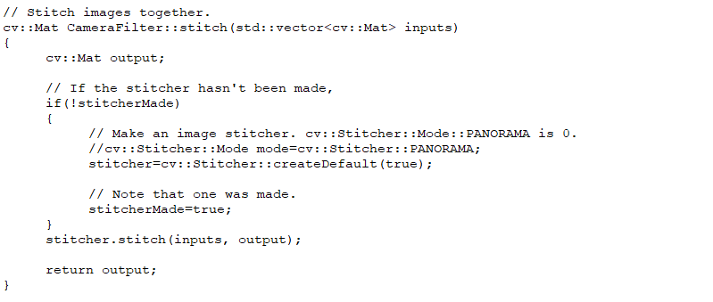
OpenCV – Other Functions

Slide 16
OpenCV – Other Functions
// Run an HSL (HSV) filter on the data.
void CameraFilter::hslFilter(unsigned short minH, unsigned short maxH, bool filterHue, unsigned short minS, unsigned short maxS, bool filterSaturation, unsigned int minL, unsigned int maxL, bool filterLuminance)
{
// Create an image to put the HSV data in.
cv::Mat hsvImage;
// Change the color-space.
cv::cvtColor(data, hsvImage, cv::COLOR_BGR2HSV);
unsigned short currentH, currentS, currentV;
// For every pixel.
unsigned int x, y;
unsigned char * ptr;
for(y=0; y < data.rows; y++)
{
ptr=hsvImage.ptr<unsigned char>(y);
for(x=0; x < data.cols; x++)
{
// Find the hue, saturation, ...
currentH = ptr[x*3];
currentS = ptr[x*3 + 1];
currentV = ptr[x*3 + 2];
// Operate on them.
if((minH > currentH || maxH < currentH) && filterHue
|| filterSaturation && (minS > currentS || maxS < currentS)
|| filterLuminance && (minL > currentV || maxL < currentV))
{
currentH = 0;
currentS = 0;
currentV = 0;
}
// Update the values.
ptr[x*3] = currentH;
ptr[x*3 + 1] = currentS;
ptr[x*3 + 2] = currentV;
}
}
// Change the colorspace back.
cv::cvtColor(hsvImage, data, cv::COLOR_HSV2BGR);
}

Slide 17
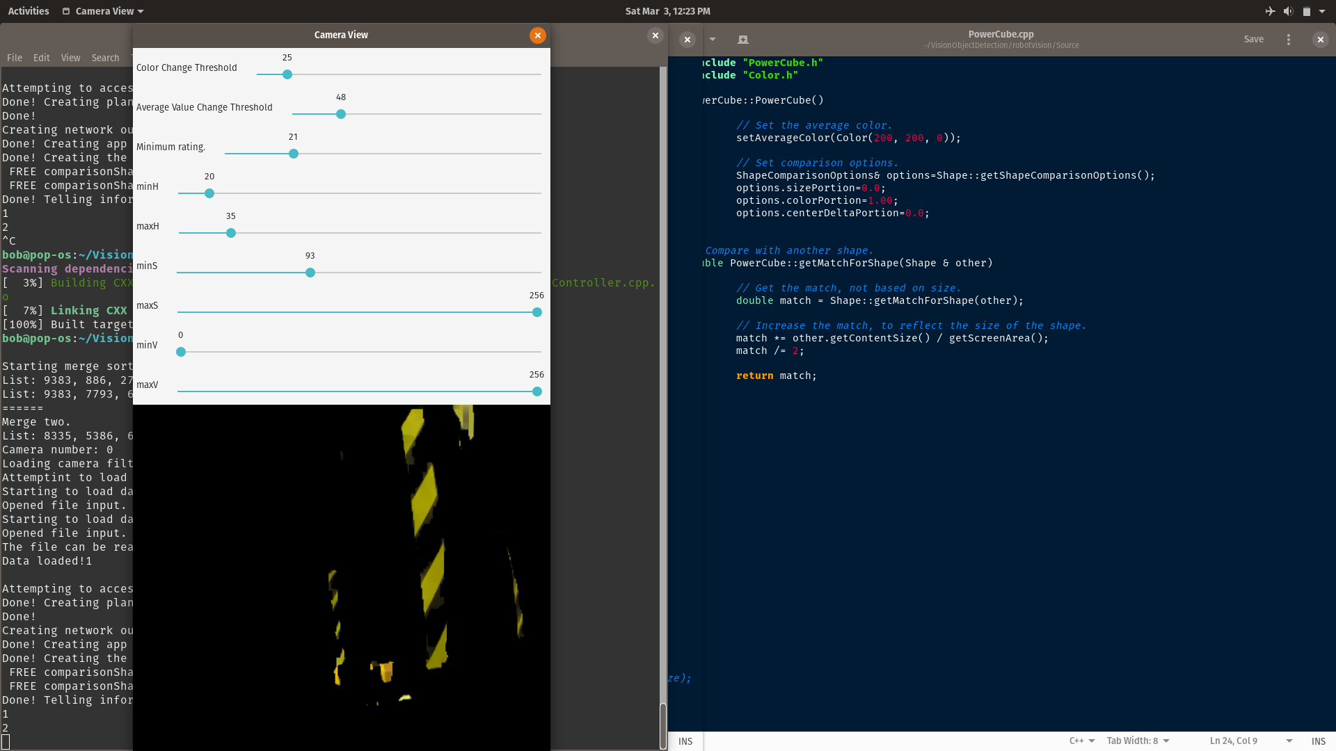

Slide 18
Edge and Shape Detection
Breadth-first search.
Create a queue of pixels.
If the pixel is visitable (based on current pixel and last pixel colors, color averages, and the number of explored pixels),
  Add the current pixel to the beginning of the queue.
  Add the current pixel to a list of explored pixels.
Otherwise
  Add the current pixel to the list of edges.
Set the current pixel to that at the end of the queue. Terminate if there are no pixels in the queue.
Jump to step 2.

Slide 20
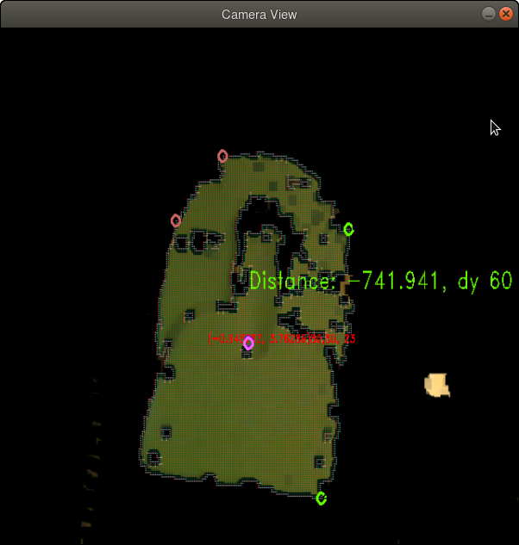












Corner Detection

Slide 21
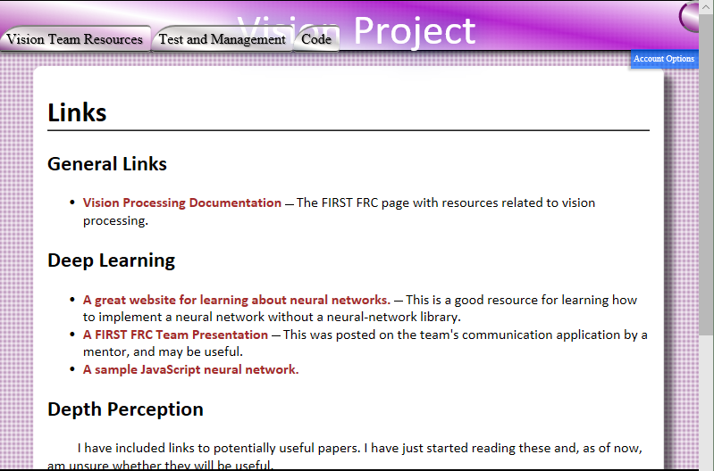
More Information
https://lwrobotvis.firebaseapp.com/

Slide 22
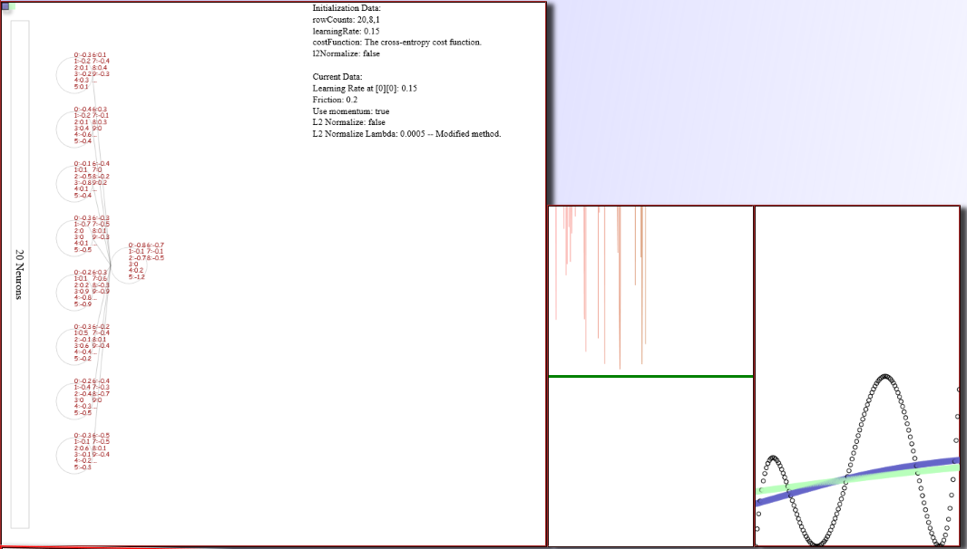
Neural Networks

Slide 24

Backpropagation

