Slide 1
Consent Form
The purpose of this study is to evaluate and compare collaborative behaviors for robots in order to design natural and efficient collaborative behaviors.
You will be asked to do a collaborative task with a robot by choosing actions through a GUI interface. You will then be asked to answer questions regarding the task.
You must be between the ages of 18 and 65 to participate.
The risks and discomfort associated with the participation in this study are no greater than those ordinarily encountered in daily life.
Your participation is voluntary. You are free to stop your participation at any point.

Slide 2
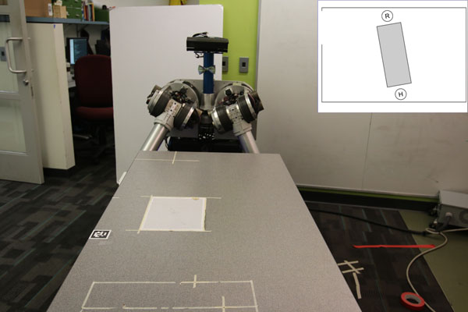


You will train with HERB, our Home Exploring Robot Butler, to reorient a big table and move it through a door and out of our lab. You can choose among 2 actions: clockwise rotate or counterclockwise rotate. HERB has the same two actions.
At each step, if you and HERB manage to coordinate your actions (i.e., both perform clockwise rotate or both perform counterclockwise rotate), then the table turns 20 degrees. Otherwise, the table does not turn.
Door
Top view of the room showing the table, the robot position R and your position H.
Click to choose
clockwise
rotate action
Click to choose
counterclockwise
rotate action

Slide 3
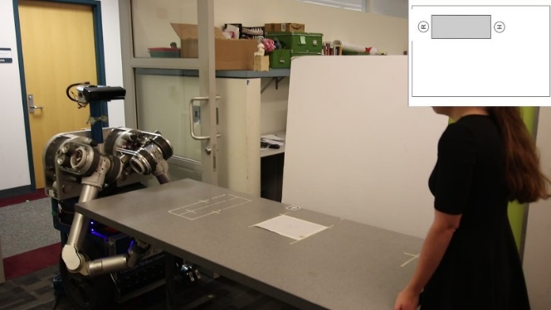
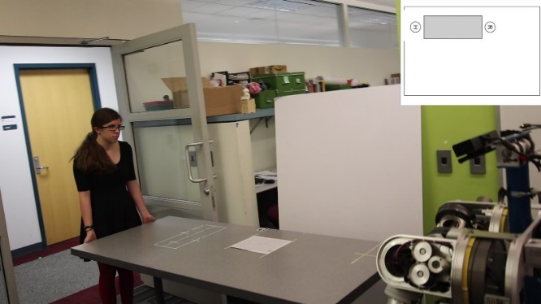
To complete the task, you need to bring the table to a horizontal position, so that it fits through the door. You can move the table outside either:
by doing a sequence of counterclockwise rotations, so that you end up facing the door
by doing a sequence of clockwise rotations, so that you end up facing the room

Slide 4
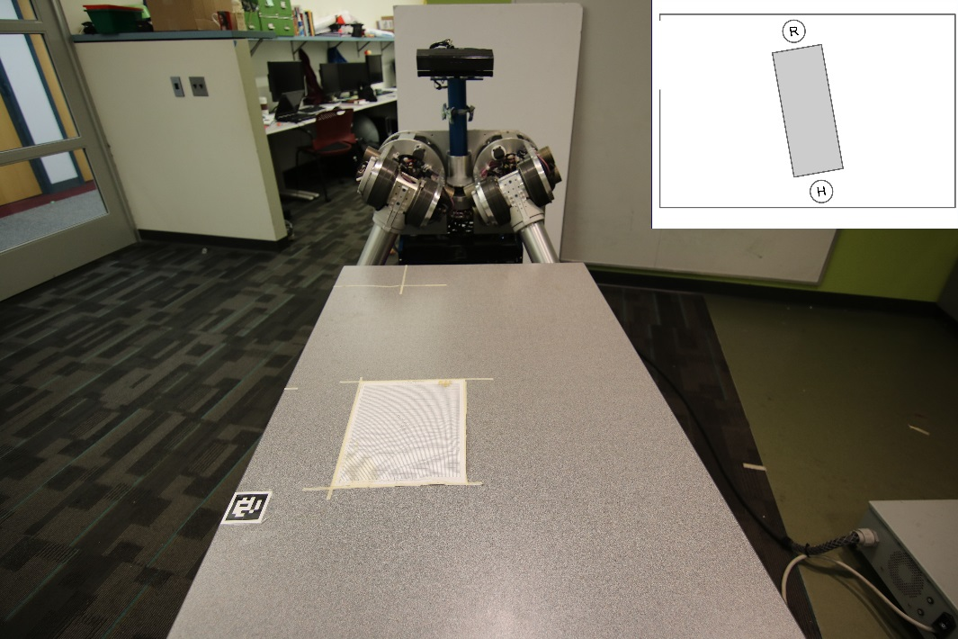
This will be the starting position of you and HERB.
Please choose how you would like to rotate the table. Note that you can change your opinion during the task. Your goal is to move the table through the door on the left as quickly as possible. HERB may also change his actions based on your actions.

Slide 5
Press START when you are ready to start the task.

Slide 6
Let’s do the task again one final time!

Slide 7
You and HERB tried to turn the table in opposite directions.
The table did not turn.

Slide 8
Questionnaire:
1. What was the color of the robot head?
Green b. Red c. Yellow d. Black e. Purple
2. What is your Gender
Male b. Female
3. What was your initial preference for doing the task:
Move the table outside so that I am facing the door
Move the table outside so that I am facing the room
No Preference.
4. Did you switch preferences during the task?
Yes b) No
Explain your answer below
5. Were the instructions clear? Add any additional comments on the experiment in the text below.

Slide 9
Questionnaire:
Rate your agreement to the following statements:
(Scale 1 to 7)
HERB is trustworthy
I trusted HERB to do the right thing at the right time.
HERB is intelligent
HERB made me change my mind during the task
I was satisfied with HERB and my performance
HERB perceived accurately what my goals are
HERB and I worked towards mutually agreed upon goals
HERB and I collaborated well together.
HERB’s actions were reasonable
HERB and I collaborated well together

Slide 10
To complete the task, you need to bring the table to a horizontal position, so that it fits through the door. You can move the table outside either:
by doing a sequence of counterclockwise rotations, so that you end up facing the door
by doing a sequence of clockwise rotations, so that you end up facing the room
You can choose your preferred way of moving the table outside. Note that you can change your opinion during the task. HERB may also change his actions based on your actions. Your goal is to complete the task as quickly as possible.

