Slide 1
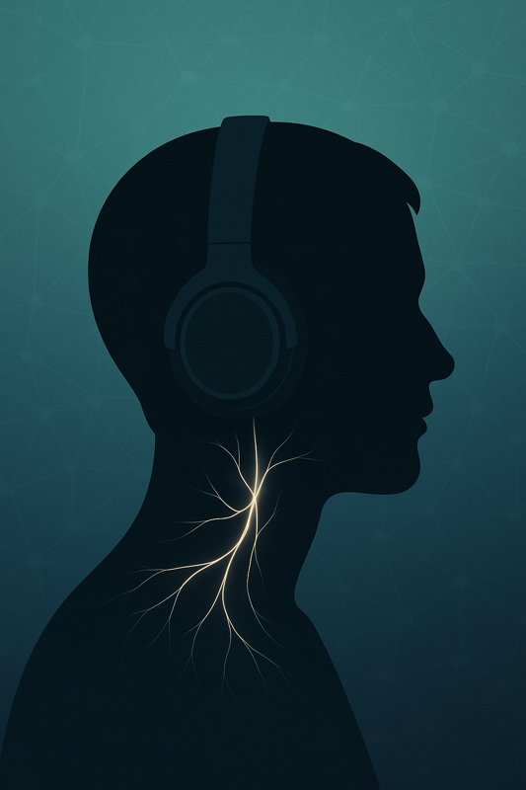
The Vagus Advantage
The Science of Red Light Therapy and Retinal Imaging
Dr. Ray Zhang, MD
and Richard Sprague

Slide 2
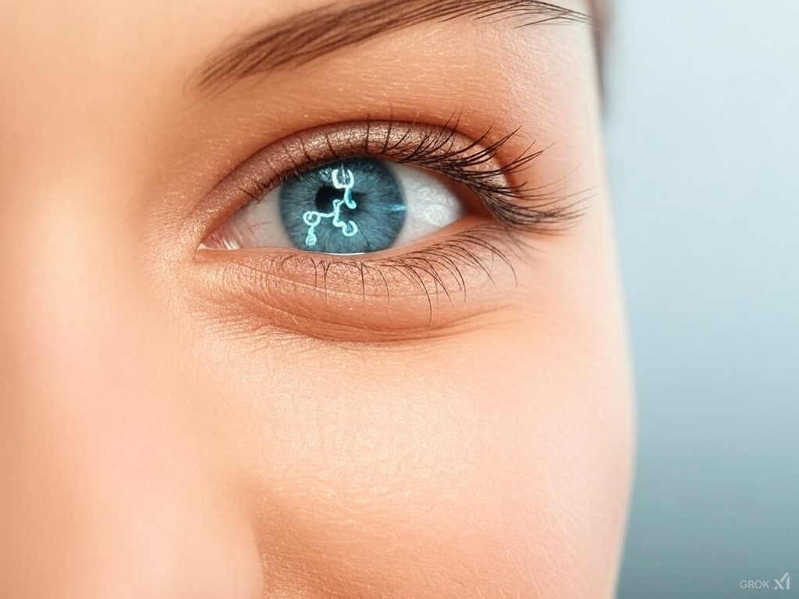
2D Opticare AI
The Red Light Miracle

