Slide 1

[Stock price trend app]
Group Number:20
Project Guide: Prof. Shweta Sharma
Group members:
Vipul Bhavar(08)
Vishakha Borkar(11)
Pranv Dave(18)
Atharva college of Engineering

Slide 2
Introduction/Problem statement
To create a web app to get stock price of listed companies and predicting their future growth on the basis of past performance

Slide 3
Proposed Solution
We have created an web app where you can not only view the exact value of stock price, but also do a technical analysis of the company on the basis of its value over a period of time and also a fundamental analysis wherein given the company business model, sector and its future in the industry.

Slide 4
Methodology/Tech stack
Programming languages
Python
Modules used
yfinance
numpy
pandas
cufflinks
streamlit
Environment used
Conda

Slide 5
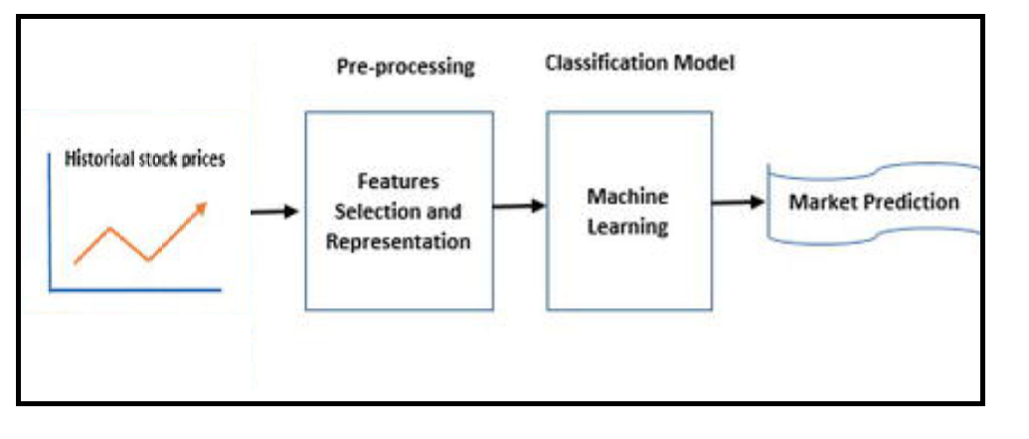
Flowchart/Dataflow

Slide 6
Future/Scope
Use better algorithms like LTSM
Modelling and time forecasting of stock date to get accurate prediction
Addition of cryptocurrencies to the platform
Deploy website on any hosting platform.
We want to add sentiment analysis for better analysis

Slide 7
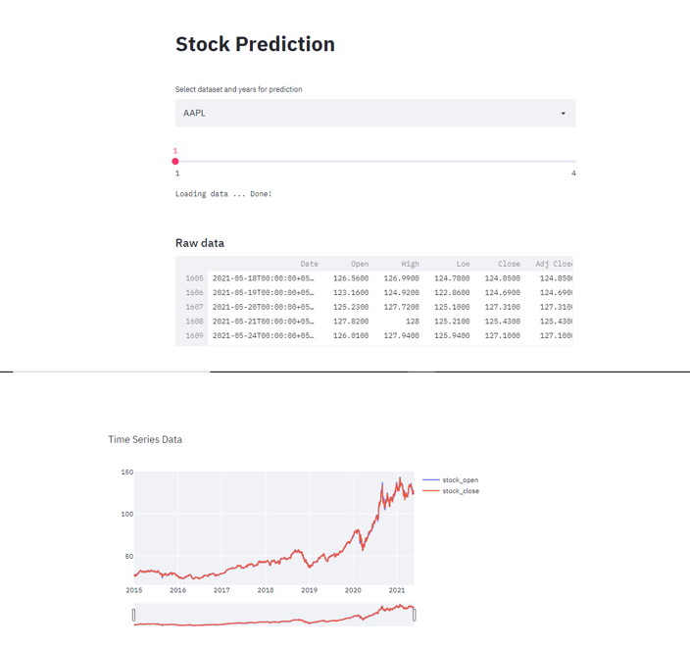
Screenshot/prototype

Slide 8
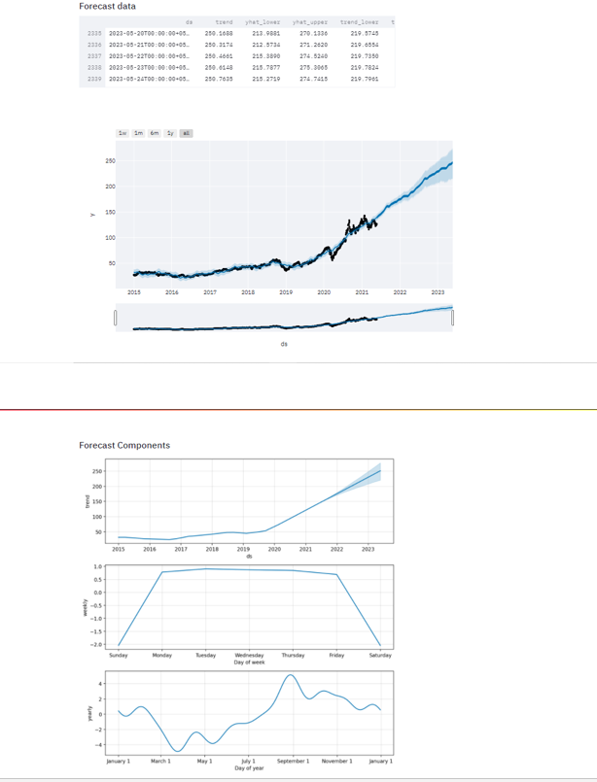

Slide 9
References
https://www.tensorflow.org/tutorials/structured_data/time_series
https://support.google.com/docs/answer/3093281?hl=en
https://streamlit.io/
https://www.yahoofinanceapi.com/
https://www.analyticsvidhya.com/blog/2018/10/predicting-stock-price-machine-learningnd-deep-learning-techniques-python/
https://ieeexplore.ieee.org/document/8703332
https://ieeexplore.ieee.org/document/9526491

