Slide 1

Email Campaign Analysis
2010030009- Amrutha Varshini 2010030104-Sravani Chowdary Guide: 2010030485-Mounika Reddy Dr.K.Sreenivasa Rao

Slide 2
TABLE OF CONTENTS
Problem Statement
Introduction
Literature Survey
Flow Chart
Work Progress
Alpha Testing
GitHub Setup
Conclusion

Slide 3
PROBLEM STATEMENT
Analyzing the data to track the emails that are been ignored, read, and acknowledged by the reader

Slide 4
INTRODUCTION
Most small to medium business owners are using Gmail-based Email Marketing Strategies for offline targeting of converting their prospective customers into leads so that they stay with them in Business. Nowadays email marketing is considered a cost-effective marketing tool for different organizations to market their products or services. Despite the rise of the latest online communication tools such as social media, email marketing remains one of the most credible and profitable digital marketing tools.

Slide 5
LITERATURE SURVEY
SNO | TITLE | AUTHOR | PUBLISHING | TECHNIQUES &DATASETS | PROS | CONS
1) | Automating the Collection and Analysis of Campaign Emails | Maia Hamin | Independent Work Report Fall 2018 | Crawler | The crawler’s integration with a full data pipeline also offers increased performance with decreased effort. | In the Proposed Model integration with MySQL database is time-consuming

Slide 6
SNO | TITLE | AUTHOR | PUBLISHING | TECHNIQUES &DATASETS | PROS | CONS
2) | Email Marketing: A Paradigm Shift To Marketing | Prof K. Venugopal Dr.Vishnu Murthy | International Journal of Advanced Research in Management and Social Sciences | Cost analysis, Risk analysis, data analysis. | An effective way to reach a target audience around the world. | email marketing is to issue emails that are likely to be construed to be spam.

Slide 7
SNO | TITLE | AUTHOR | PUBLISHING | TECHNIQUES &DATASETS | PROS | CONS
3) | Email Marketing Campaign for Selected Company | Bc. Natalia Vataman | Tomas Bata University In Zlin | Dataset: Purcari company dataset Techniques: Smith and Taylor offered the simplest framework | Improves communication with its customers and increase brand awareness and maintain current customer base. | Cost is fixed

Slide 8
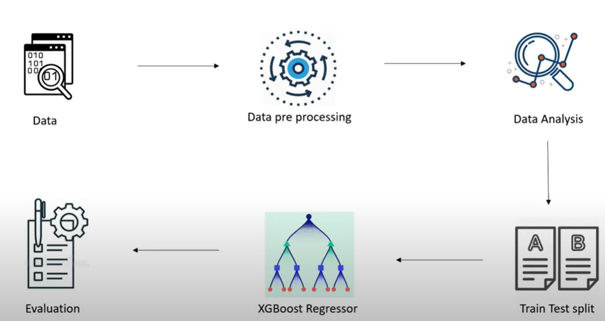
FLOW CHART

Slide 10
ALPHA TESTING

Slide 11
GITHUB SETUP

Slide 12
RESULTS
Imbalanced Class Handling techniques such as Under sampling and SMOTE were done after the train-test split only on the training data, to make sure that the model doesn't catch up to the test set at all and it remains unknown which somewhat reduced our results. It is observed that SMOTE worked considerably better than Random Under sampling, which may have led to the loss of information.The decision Tree Model is overfitting. It is working great on train data and worse on test data.
XGBoost Algorithm worked in the best way possible with such imbalanced data with outliers with an F1 Score of 0.77 on the test set.

Slide 13
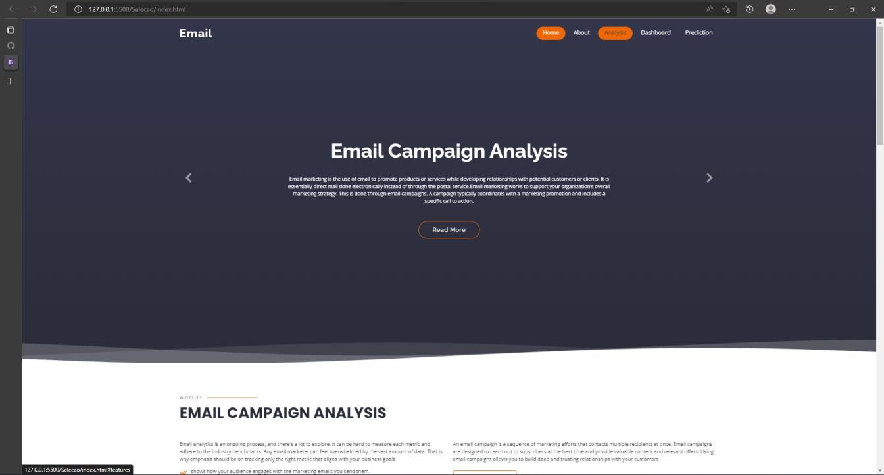
OUTPUT SCREENSHOTS

Slide 14
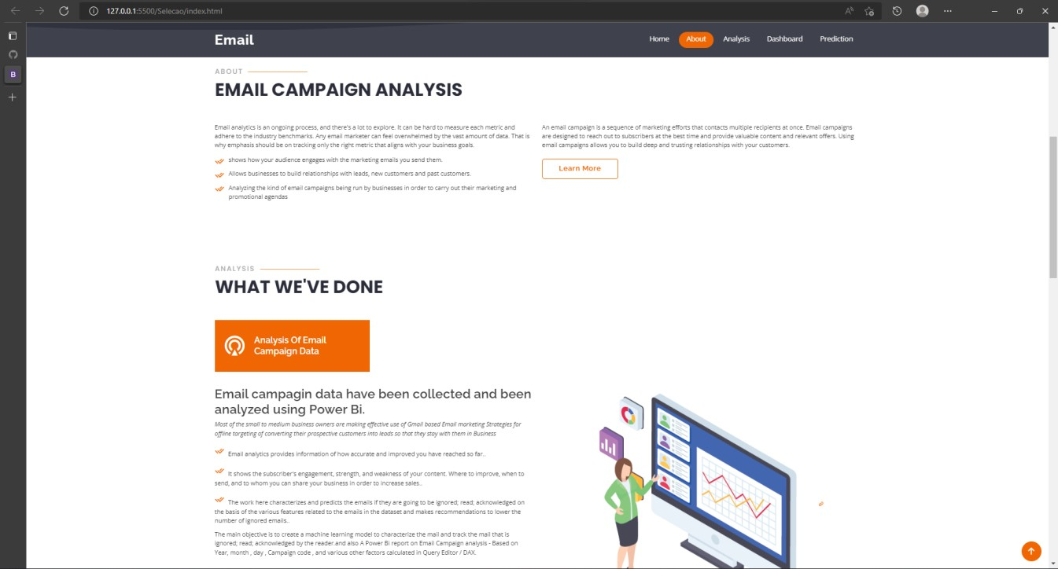

Slide 15
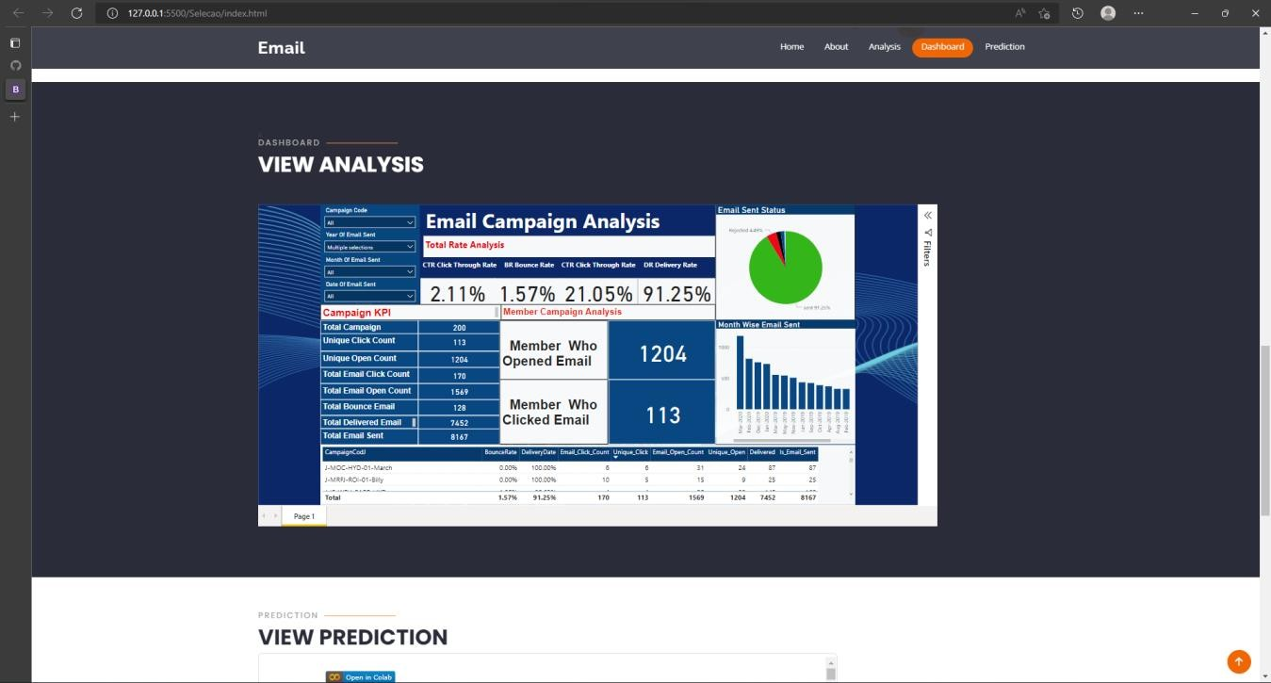

Slide 16
CONCLUSION
An email campaign is a sequence of marketing efforts that contacts multiple recipients at once. Email campaigns are designed to reach out to subscribers at the best time and provide valuable content and relevant offers. Using email campaigns allows you to build deep and trusting relationships with your customers. The main objective is to create an interactive dashboard in order to improve email marketing strategy skills and characterize the mail and track the mail that is ignored; read; or acknowledged by the reader.

