Slide 1

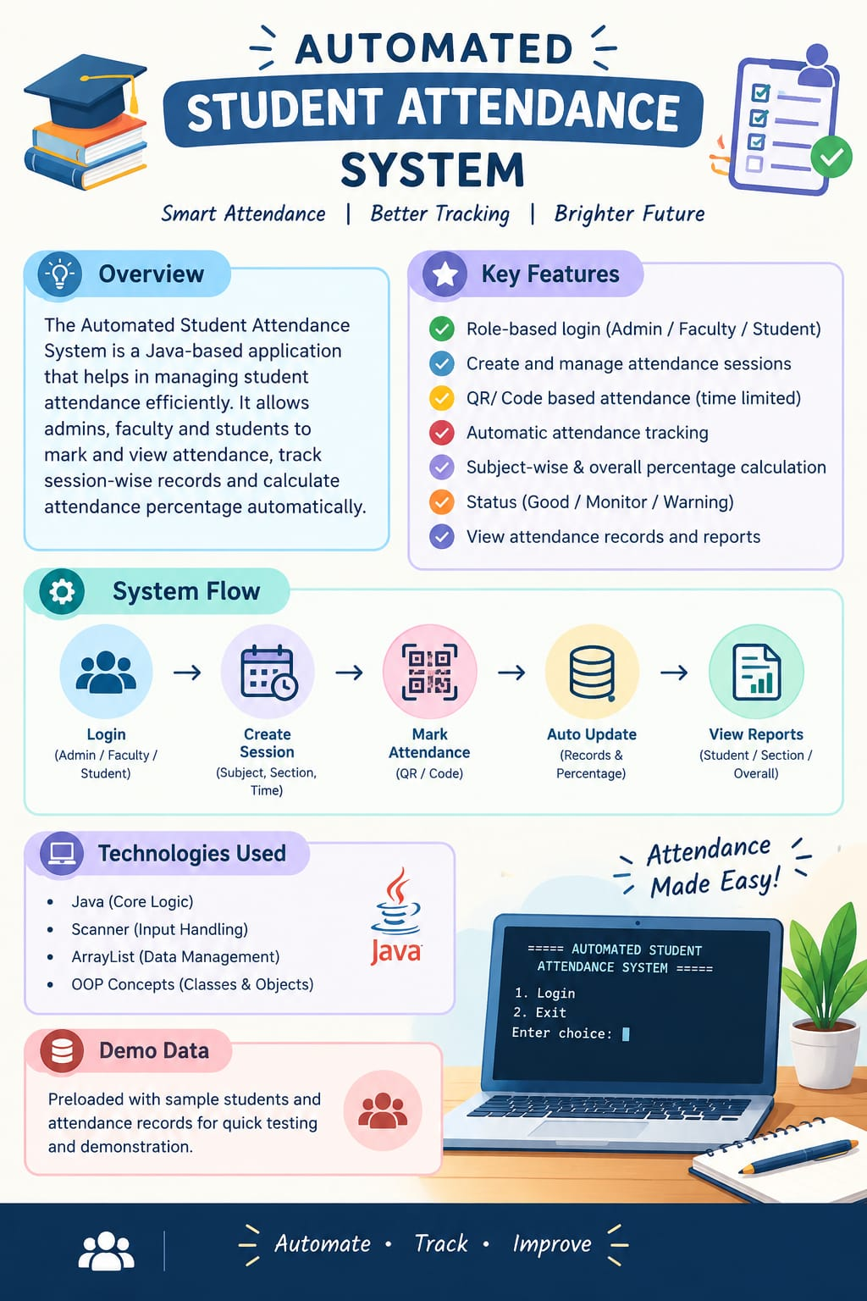

Slide 2



Automated Student Attendance Monitoring & Analytics System for Colleges
Design Thinking for innovation & Entrepreneurship (DTIE)
Section : 9
Project Batch-A

Slide 3
Team Members
PD
DS
CY
PS
P. Sri Divya
D. Bhavya Sree
C. Yasaswini
P. Sneha
2620090130
2620080023
2620030206
2620030603
Under the Guidance of
Dr. G. Sudhakar
Associate Professor, Department of CSE
Project Batch: A Section: 9

Slide 4


Vision and Mission
Our Vision
Simple, accurate and transparent attendance management using modern technology.
Teachers mark attendance easily; students track theirs anytime.
Our Mission
Save teachers' time
Replace paper registers
Reduce errors and proxy attendance
Alert students about low attendance
Our Goal: A smart attendance system that keeps students, teachers and management informed.

Slide 5






Problem Statement
1. Time-Consuming
Roll calls waste class time.
2. Human Errors
Manual records cause mistakes.
3. Proxy Attendance
Students mark for absent friends.
4. Late Updates
Students learn of shortages too late.
5. Manual Reports
Percentages are calculated by hand.
6. No Early Warning
Low attendance is spotted late.
Problem Statement
How can we build a simple, automated attendance system that saves time, reduces errors and prevents proxy attendance?

Slide 6



Research / Facts / Market & Industry Study
1. Manual
Roll calls in registers
Hand calculations
2. Biometric
Needs special hardware
High maintenance cost
3. RFID
Needs card readers
Cards can be shared
4. QR-Based
Uses students' smartphones
No extra hardware
Our Observation
A QR-based system is simple, affordable and easy to connect with an analytics dashboard.
Based on a study of existing methods; not a completed market survey.

Slide 7




Target User - Customer
Students
Faculty
HODs & Admin
Parents
Check attendance anytime
See subject-wise %
Get low-attendance alerts
Mark attendance via QR
No paper registers
Auto-generated reports
Monitor all classes
Spot shortages early
Plan using data
Get low-attendance updates
Stay informed
Primary customers: Colleges and universities

Slide 8
Competitors / Benchmarks
Features | Manual | Biometric | Our System
Attendance marking | Manual | Automated | Automated
Hardware | Register | Biometric device | Smartphone
Low attendance alerts | Usually manual | Depends on software | Yes
Reports | Manual | Depends on software | Automatic
Setup cost | Low | Can be high | Expected to be low
What makes our idea different?
Dynamic QR attendance
Real-time tracking
Shortage alerts
Reports & analytics

Slide 9
Risks and Gap
Risk | Proposed solution
Proxy attendance | Dynamic QR codes that expire quickly
Poor internet | Offline mode that syncs later
Data privacy | Secure login and role-based access
No smartphone | Teacher can mark attendance manually
Note: Dynamic QR codes reduce proxy attendance but cannot fully prevent it.

Slide 10


Concept/Idea/Prototype/Product/Solution
Teachers generate a time-limited QR code; students scan it; attendance is saved and analysed automatically.
Step 1
Step 2
Step 3
Step 4
Step 5
Login
QR Code
Scan
Verify & Store
Analyse & Alert
Teacher selects class
Time-limited code
Students scan it
Identity checked, saved
Reports and alerts
Key Features
Technology
Frontend: React / Flutter
Backend: Node.js
Database: Secure DB
Dynamic QR codes
Real-time attendance %
Low attendance alerts
Reports & dashboards

Slide 11
Images/Storyboard/Architecture
Student Identity
QR Scan
Verification
Secure Database
Dashboard & Alerts
Main Components
Student: log in, scan, view attendance
Faculty: create sessions and QR codes
Admin: monitor all classes
Database: stores all records
Attendance Calculation
Attendance % = Attended ÷ Total Classes × 100
Good: 85% and above
Monitor: 75% - 84%
Warning: below 75%

Slide 12
Prototype Screens (Concept)
Attendance App
CSE-A · Data Structures
Period 3 · 10:00 AM
Hi, Student
82%
Overall Attendance
Low Attendance Alert
Roll Number
DS
90%
Your attendance in CN is 70%, below the 75% requirement. Attend upcoming classes.
Password
DBMS
78%
Login
Expires in 00:45
CN
70%
Student | Faculty | Admin
End Session
View Details
1. Secure Login
2. QR Generation
3. Attendance Dashboard
4. Low Attendance Alert
Concept screens to explain the idea; the final app design may differ.

Slide 13
Lean Canvas Model
PROBLEM
Manual attendance is slow and error-prone.
SOLUTION
Dynamic QR attendance with reports and alerts.
UNIQUE VALUE PROPOSITION
A simple, affordable attendance system with real-time analytics.
UNFAIR ADVANTAGE
Marking, alerts and analytics in one system.
CUSTOMER SEGMENTS
Colleges
Students and faculty
Administrators
KEY METRICS
Marking time, accuracy, active users.
CHANNELS
College demos and partnerships.
COST STRUCTURE
Development, hosting, maintenance, support.
REVENUE STREAMS
College subscriptions and annual licenses.
Proposed business model; not an existing business.

Slide 14
Capital (Financial)
Requirement | Estimated Cost
Design & development tools | ₹0
QR code generation | ₹0
Free-tier cloud hosting | ₹0
Testing & miscellaneous | ₹1,000
Optional deployment | ₹1,500
Total Estimated Budget | ₹2,500
Keep costs low
Free, open-source tools
Smartphones, not devices
Start with a basic prototype
Illustrative planning estimates, not verified prices.
₹2,500
Total estimated budget
Financial Goal
An affordable solution that can grow in the future.

Slide 15
Roadmap/Timeline
First working prototype in about 6 to 8 weeks.
Phase 1
Week 1
Phase 2
Week 2
Phase 3
Weeks 3-4
Phase 4
Weeks 5-6
Phase 5
Week 7
Phase 6
Week 8
Problem Study
Study current system
Finalize requirements
Design
Select features
Design screens
Development
Login and QR scan
Connect database
Analytics
Percentage calculation
Dashboards, alerts
Testing
Test and fix errors
Collect feedback
Final Prototype
Complete prototype
Demonstration
Future Scope
Face recognition
LMS integration
Attendance predictions
Expected Outcome
A working app that records attendance and reports percentages automatically.

Slide 16
PROTOTYPE LINK
ASAMS - Attendance Monitoring & Analytics

Slide 17


Conclusion & Thank You
Conclusion
Our QR-based system replaces manual registers with fast attendance, automatic percentages and early low-attendance alerts.
Saves Time
Faster attendance, no manual work.
Accurate & Transparent
Fewer errors; students see their status.
Smarter Decisions
Alerts help everyone act early.
Thank You
Questions are welcome

