Slide 1

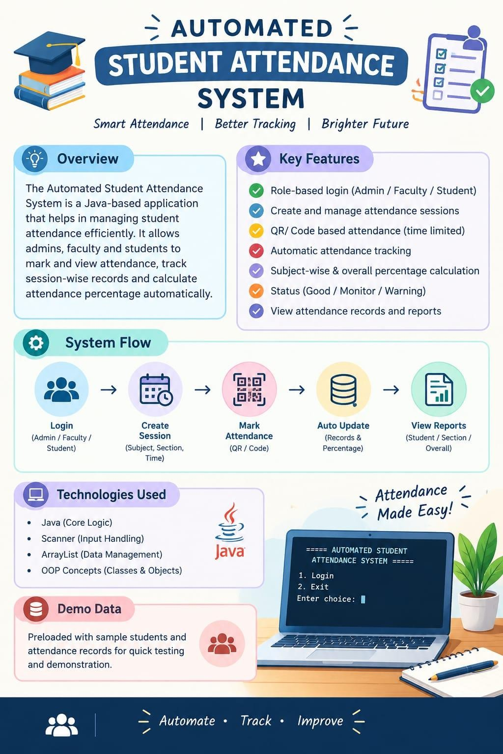

Slide 2



Automated Student Attendance Monitoring & Analytics System for Colleges
Design Thinking for innovation & Entrepreneurship (DTIE)
Section : 9
Project Batch-A

Slide 3
Team Members
PD
DS
CY
PS
P. Sri Divya
2620090130
D. Bhavya Sree
2620080023
C. Yasaswini
2620030206
P. Sneha
2620030603
Under the Guidance of
Dr. G. Sudhakar
Associate Professor, Department of CSE
Project Batch: A Section: 9
|

Slide 4


Vision and Mission
Our Vision
Simple, accurate and transparent attendance management using modern technology.
Teachers mark attendance easily; students track theirs anytime.
Our Mission
Save teachers' time
Replace paper registers
Reduce errors and proxy attendance
Alert students about low attendance
Our Goal: A smart attendance system that keeps students, teachers and management informed.
|

Slide 5






Problem Statement
1. Time-Consuming
Roll calls waste class time.
2. Human Errors Manual records cause mistakes.
3. Proxy Attendance Students mark for absent friends.
4. Late Updates
Students learn of shortages too late.
5. Manual Reports Percentages are calculated by hand.
6. No Early Warning Low attendance is spotted late.
Problem Statement
How can we build a simple, automated attendance system that saves time, reduces errors and prevents proxy attendance?
|

Slide 6



Research / Facts / Market & Industry Study
Manual
  Roll calls in registers
  Hand calculations
Biometric
  Needs special hardware
  High maintenance cost
RFID
  Needs card readers
  Cards can be shared
QR-Based
  Uses students' smartphones
  No extra hardware
Our Observation
A QR-based system is simple, affordable and easy to connect with an analytics dashboard.
Based on a study of existing methods; not a completed market survey.
|

Slide 7




Target User - Customer
Students
Faculty
HODs & Admin
Parents
Check attendance anytime
See subject-wise %
Get low-attendance alerts
Mark attendance via QR
No paper registers
Auto-generated reports
Monitor all classes
Spot shortages early
Plan using data
Get low-attendance updates
Stay informed
Primary customers: Colleges and universities
|

Slide 8
Competitors / Benchmarks
Features | Manual | Biometric | Our System
Attendance marking | Manual | Automated | Automated
Hardware | Register | Biometric device | Smartphone
Low attendance alerts | Usually manual | Depends on software | Yes
Reports | Manual | Depends on software | Automatic
Setup cost | Low | Can be high | Expected to be low
What makes our idea different?
Dynamic QR attendance
Real-time tracking
Shortage alerts
Reports & analytics
|

Slide 9
Risks and Gap
Risk | Proposed solution
Proxy attendance | Dynamic QR codes that expire quickly
Poor internet | Offline mode that syncs later
Data privacy | Secure login and role-based access
No smartphone | Teacher can mark attendance manually
Note: Dynamic QR codes reduce proxy attendance but cannot fully prevent it.
|

Slide 10


Concept/Idea/Prototype/Product/Solution
Teachers generate a time-limited QR code; students scan it; attendance is saved and analysed automatically.
Step 1
Step 2
Step 3
Step 4
Step 5
Login
Teacher selects class
QR Code
Time-limited code
Scan
Students scan it
Verify & Store
Identity checked, saved
Analyse & Alert
Reports and alerts
Key Features
Dynamic QR codes
Real-time attendance %
Technology
Frontend: React / Flutter Backend: Node.js Database: Secure DB
Low attendance alerts
Reports & dashboards
|

Slide 11
Images/Storyboard/Architecture
Dashboard & Alerts
Student Identity
QR Scan
Verification
Secure Database
Main Components
Student: log in, scan, view attendance
Faculty: create sessions and QR codes
Admin: monitor all classes
Database: stores all records
Attendance Calculation
Attendance % = Attended ÷ Total Classes × 100
Good: 85% and above
Monitor: 75% - 84%
Warning: below 75%
|

Slide 12

Prototype Screens (Concept)
Attendance App
CSE-A · Data Structures
Period 3 · 10:00 AM
Hi, Student
82%
Overall Attendance
Low Attendance Alert
Roll Number
DS
90%
Your attendance in CN is 70%, below the 75% requirement. Attend upcoming classes.
Password
DBMS
78%
Login
Expires in 00:45
CN
70%
Student | Faculty | Admin
End Session
View Details
1. Secure Login 2. QR Generation
Concept screens to explain the idea; the final app design may differ.
3. Attendance Dashboard
4. Low Attendance Alert
|

Slide 13
Lean Canvas Model
PROBLEM
Manual attendance is slow and error-prone.
SOLUTION
Dynamic QR attendance with reports and alerts.
UNIQUE VALUE PROPOSITION
A simple, affordable attendance system with real-time analytics.
UNFAIR ADVANTAGE
Marking, alerts and analytics in one system.
CUSTOMER SEGMENTS
Colleges
Students and faculty Administrators
KEY METRICS
Marking time, accuracy, active users.
CHANNELS
College demos and partnerships.
COST STRUCTURE
Development, hosting, maintenance, support.
REVENUE STREAMS
College subscriptions and annual licenses.
Proposed business model; not an existing business.
|

Slide 14
Capital (Financial)
Requirement | Estimated Cost
Design & development tools | ₹0
QR code generation | ₹0
Free-tier cloud hosting | ₹0
Testing & miscellaneous | ₹1,000
Optional deployment | ₹1,500
Total Estimated Budget | ₹2,500
Keep costs low
Free, open-source tools
Smartphones, not devices
Start with a basic prototype
Illustrative planning estimates, not verified prices.
₹2,500
Total estimated budget
Financial Goal
An affordable solution that can grow in the future.
|

Slide 15
Roadmap/Timeline
First working prototype in about 6 to 8 weeks.
Phase 1
Week 1
Phase 2
Week 2
Phase 3
Weeks 3-4
Phase 4
Weeks 5-6
Phase 5
Week 7
Phase 6
Week 8
Problem Study
Study current
system
Finalize requirements
Design
Select features
Design screens
Development
Login and QR
scan
Connect database
Analytics
Percentage
calculation
Dashboards, alerts
Testing
Test and fix
errors
Collect feedback
Final Prototype
Complete
prototype
Demonstration
Future Scope
Face recognition
LMS integration
Attendance predictions
Expected Outcome
A working app that records attendance and reports percentages automatically.
|

Slide 16
PROTOTYPE LINK
ASAMS - Attendance Monitoring & Analytics
|

Slide 17


Conclusion & Thank You
Conclusion
Our QR-based system replaces manual registers with fast attendance, automatic percentages and early low-attendance alerts.
Saves Time
Faster attendance, no manual work.
Accurate & Transparent
Fewer errors; students see their status.
Smarter Decisions
Alerts help everyone act early.
Thank You
Questions are welcome
|

