Slide 1



Automated Student Attendance Monitoring & Analytics System For Colleges
A smart, data-driven solution for colleges
Presented By
P. Sri Divya — Roll No: 2620090130
D. Bhavya Sree — Roll No: 2620080023
C. Yasaswini — Roll No: 2620030206
P. Sneha — Roll No: 2620030603
Under the Supervisor
Dr. G. Sudhakar
Assoc. Professor, Dept-CSE
Subject: DTIE-Projects

Slide 2

1
Problem
2
Empathy
00
Contents
3
Define
4
Idea Generation
5
Multi Voting
6
Rapid Estimation & Solution Concept
7
Rough Prototype
8
Demonstration

Slide 3


Attendance marking during class is time-consuming.
Paper registers cause errors and allow proxy attendance
Faculty calculate attendance percentages by
hand
Students and parents learn about shortages too late.
Students with low attendance are not identified on time.
01
Problem

Slide 4


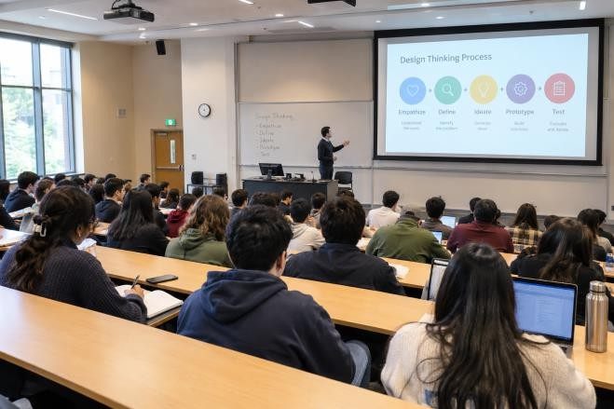

Students
Fear unfair marking, want to see their own attendance, dread shortage detention
02
Empathy
Faculty
Lose teaching time, cannot catch proxies in large classes, repeat paperwork
HOD / Admin
Need timely, accurate reports for eligibility and
accreditation

Slide 5

03
Define
How might we record and analyse attendance accurately, with minimal effort, and give every stakeholder timely insight?
Users: students, faculty, HODs, administrators
Needs: fast capture, proxy prevention, live percentages, alerts
Goal: attendance in under 1 minute; flag at-risk students early

Slide 6





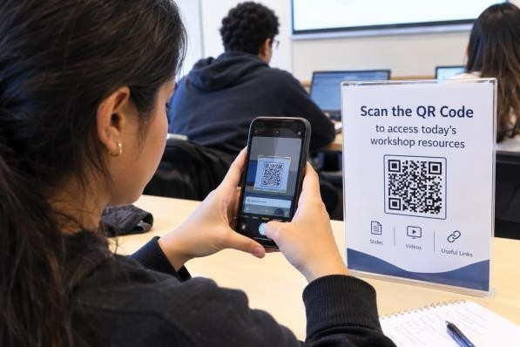


04
Idea Generation
Dynamic QR
Face recognition
RFID / NFC cards
Biometric
GPS geofencing
Auto SMS alerts

Slide 7


Votes per idea (illustrative)
Dynamic QR + app
14
Face recognition
9
05
Multi Voting
RFID / NFC
6
Biometric
4
GPS geofencing
3
Winner: Dynamic QR + mobile app. Replace with your team's real votes.

Slide 8


6–8 wks
Low
Cost with open-source and free-tier cloud
4
Modules: login, QR, logs, analytics
Time to working prototype
06
Rapid Estimation & Solution Concept
Concept: dynamic-QR attendance app plus cloud
analytics dashboard
Stack: React / Flutter front end, Node.js and database back end
Risk: proxy scans and poor network, handled by time-limited codes and offline sync

Slide 9
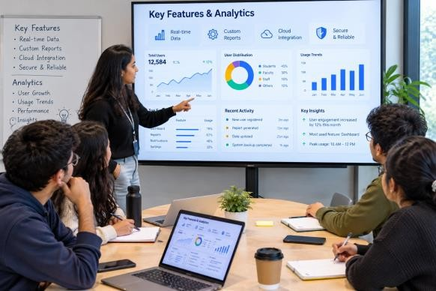
Live attendance percentage per student, subject and class
Automatic alerts when attendance falls below 75%
Trend charts and defaulter lists for faculty and HODs
One-click reports for exams, parents and accreditation
Secure role-based access for students, faculty and admin
07
Key Features & Analytics

Slide 10



08
Rough Prototype
Faculty starts session
QR code shown
Students scan
Saved to database
Dashboard & alerts
Add your screen sketches here.

Slide 11












Attendance Analytics
Turning Attendance Data into Useful Insights
System Architecture / Working Flow
Student Identification
Individual Attendance
Attendance Percentage =
Classes Attended ÷ Classes Conducted × 100
Attendance Capture
Attendance Verification
Secure Database
Subject-Wise Analysis
Trend Analysis
Attendance Processing
Compare attendance across different subjects.
Track weekly or monthly attendance patterns.
Analytics Dashboard
Reports & Alerts
Attendance Status
Admin
Faculty
Students
Good
85% and above
Monitor
75% – 84%
Warning
Below 75%
Users:
Users of the System

Slide 12

1. Faculty logs in and opens a class session
2. A time-limited QR code is generated
3. Student scans it and is marked present instantly
4. Dashboard shows live percentage and flags
students below 75%
5. Report and alert are sent to HOD and parents
09
Demonstration

Slide 13
Saves class time and removes manual errors
Prevents proxy attendance with rotating QR codes
Gives real-time analytics for early intervention
Future: face recognition, LMS integration,
predictive dropout alerts
Thank you
10
Conclusion & Future Scope

Slide 14
THANK YOU

