Slide 1
Employee Management System

Slide 2
Introduction
The Employee Management System is developed to efficiently manage employee records, departments, roles, and payroll information.
It helps organizations track employee details, monitor performance, and manage work assignments.
The system simulates a mini employee database with interconnected entities like employees, jobdepartments, leaves,payroll,salary_bonus,and qualification.
Using SQL, users can extract, transform, and analyze employee data to generate actionable insights for decision-making.
The system enables tracking of employee performance, departmental productivity, and workforce distribution. data, gaining valuable business insights.
The project aims to optimize HR workflows, improve resource allocation, and enhance overall organizational effectiveness.

Slide 3
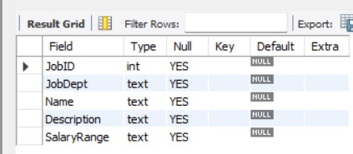
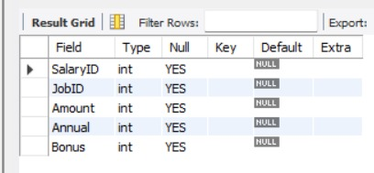
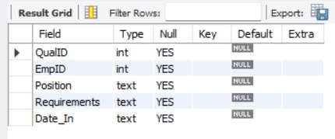
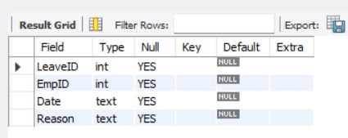
TABLES
Jobdepartment Salary
Leaves Qualification

Slide 4
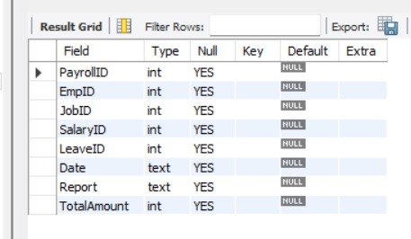
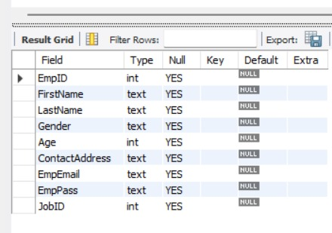
Payroll Employee

Slide 5
Problem Statement
The objective of this project is to design and implement an Employee Management System that efficiently stores and manages employee-related data within an organization. The system needs to track various aspects of employee information, including personal details, job roles, salary structures, qualifications, leave records, and payroll data. The system should ensure the integrity and consistency of data by using relational tables with appropriate foreign keys and cascading actions.
The system should allow for easy management and querying of employee data, providing insights such as payroll calculation, leave tracking, and department-specific job roles. The goal is to streamline HR operations, ensuring that all relevant employee data is accessible and accurately updated across different modules.

Slide 6
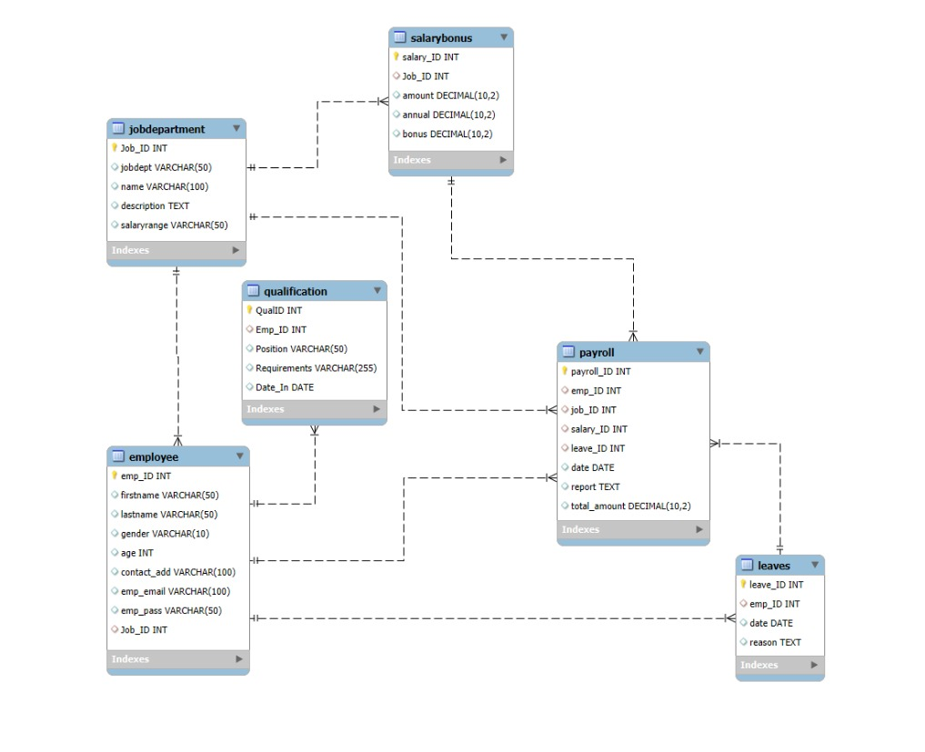
ER Diagram

Slide 7
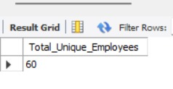
1. How many unique employees are currently in the system?
SELECT COUNT(DISTINCT EmpID) AS Total_Unique_Employees FROM Employee;

Slide 8
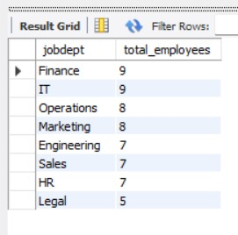
2.Which departments have the highest number of employees?
SELECT j.jobdept, COUNT(*) AS total_employeesFROM Employee eJOIN JobDepartment j ON e.jobid = j.JobID GROUP BY j.jobdeptORDER BY total_employees DESC;

Slide 9
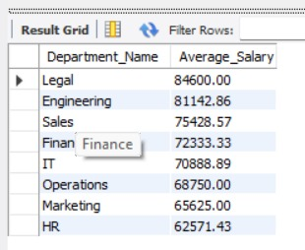
3.What is the average salary per department?
SELECT j.jobdept AS Department_Name,ROUND
(AVG(s.amount), 2) AS Average_SalaryFROM JobDepartment j JOIN Salary_Bonus s ON j.JobID = s.JobID GROUP BY j.jobdept ORDER BY Average_Salary DESC;

Slide 10
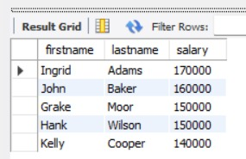
4.Who are the top 5 highest-paid employees?
SELECT firstname, lastname, amount AS salaryFROM Employee e JOIN Salary_Bonus s ON
e.JobID= s.JobI DORDER BY salary DESC LIMIT 5;

Slide 11
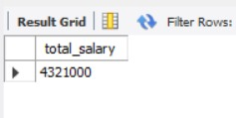
5.What is the total salary expenditure across the company?
SELECT SUM(amount) AS total_salary FROM Salary_Bonus;

Slide 12
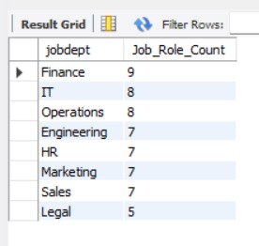
6.How many different job roles exist in each department?
SELECT jobdept , COUNT(DISTINCT name) AS Job_Role_CountFROM JobDepartmentGROUP BY jobdeptORDER BY Job_Role_Count DESC;

Slide 13
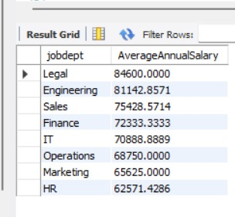
7.What is the average salary range per department?
SELECT JD.jobdept, AVG(SB.amount) AS AverageAnnualSalary FROM Salary_Bonus SB JOIN JobDepartment JD ON SB.JobID = JD.JobID GROUP BY JD.jobdept ORDER BY AverageAnnualSalary DESC;

Slide 14
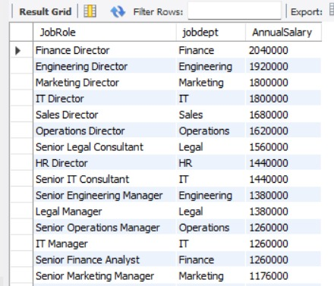
8.Which job roles offer the highest salary?
SELECT JD.name AS JobRole, JD.jobdept, SB.annual AS AnnualSalary FROM JobDepartment JD JOIN Salary_Bonus SB ON JD.JobID = SB.JobID ORDER BY SB.annual DESC;

Slide 15
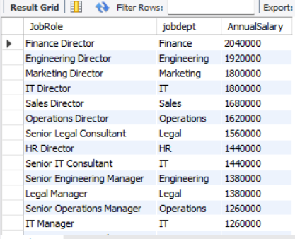
9.Which departments have the highest total salary allocation?
SELECT JD.name AS JobRole, JD.jobdept, SB.annual AS AnnualSalary FROM JobDepartment JD JOIN SalaryBonus SB ON JD.Job_ID = SB.Job_ID ORDER BY SB.annual DESC;

Slide 16

10.How many employees have at least one qualification listed?
SELECT COUNT(DISTINCT EmpID) AS Employees_With_Qualifications FROM Qualification;

Slide 17
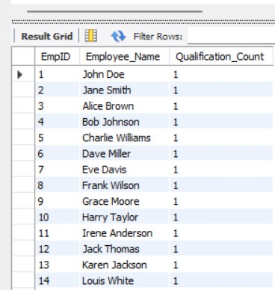
11.Which positions require the most qualifications?
SELECT q.EmpID,CONCAT(e.FirstName, ' ', e.LastName) AS Employee_Name,COUNT(q.QualID) AS Qualification_Count FROM Qualification q LEFT JOIN Employee e ON
q.EmpID = e.EmpID GROUP BY q.EmpID, Employee_Name ORDER BY Qualification_Count DESC;

Slide 18
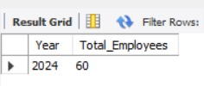
13. Which year had the most employees taking leaves?
SELECT YEAR(Date) AS Year, COUNT(DISTINCT EmpID) AS Total_EmployeesFROM Leaves GROUP BY YEAR(Date) ORDER BY Total_Employees DESC LIMIT 1;

Slide 19
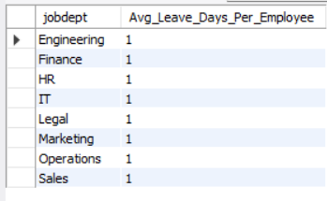
14. What is the average number of leave days taken by its employees per department?
SELECT JD.jobdept,
CAST(COUNT(L.leaveID) AS REAL) / COUNT(DISTINCT E.empID) AS Avg_Leave_Days_Per_EmployeeFROM Employee E INNER JOIN JobDepartment JD ON E.JobID = JD.JobIDLEFT JOIN Leaves L ON E.empID = L.empID GROUP BY JD.jobdept ORDER BY Avg_Leave_Days_Per_Employee DESC;

Slide 20
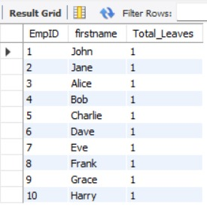
15. Which employees have taken the most leaves?
SELECT e.EmpID, e.firstname, COUNT(l.leaveID) AS Total_Leaves FROM Leaves l JOIN Employee e ON l.EmpID = e.EmpID GROUP BY e.EmpID, e.firstname ORDER BY Total_Leaves DESCLIMIT 10;

Slide 21
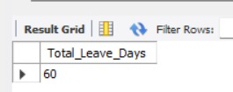
16.What is the total number of leave days taken company-wide?
SELECT COUNT(Leave ID) AS Total _ Leave_Days FROM Leaves;

Slide 22
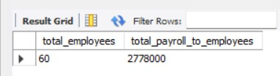
17.What is the total monthly payroll processed?
select count(EmpId) as total_employees,sum(totalamount) as total_payroll_to_employees
from payroll;

Slide 23
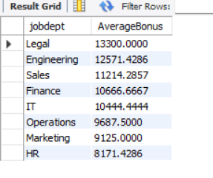
18 .What is the average bonus given per department?
SELECT JD.jobdept, AVG(SB.bonus) AS AverageBonus FROM JobDepartment JD JOIN SalaryBonus SB ON JD.Job_ID = SB.Job_ID GROUP BY JD.jobdept ORDER BY AverageBonus DESC;

Slide 24
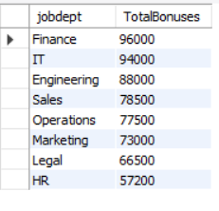
19 .Which department receives the highest total bonuses?
SELECT JD.jobdept, SUM(SB.bonus) AS TotalBonuses FROM Employee E JOIN JobDepartment JD ON E.JobID = JD.JobID JOIN Salary_Bonus SB ON
E.JobID = SB.JobID GROUP BY JD.jobdept ORDER BY TotalBonuses DESC;

Slide 25
Insights
The highest-paid employee is the Finance Director.
All employees share the distinction of taking the "most" leaves with 1 day each.
The average midpoint salary range is highest in Legal.
2024 is the only year represented, with all 60 employees having a leave entry.
Finance receives the highest total bonus allocation across all employees in that department.
All employees share the distinction of taking the most leaves with 1 day each.

Slide 26
THANK YOU

