Slide 1
EEG-based Mind Reading IV. SSVEP BCI Data Analysis
Yijun Wang, PhD
Institute of Semiconductors, Chinese Academy of Sciences
wangyj@semi.ac.cn
2018 IEEE EMBS International Summer School, August 13-17, 2018 Beijing, China

Slide 2
Data and Scripts
Data files:
S1.mat, S2.mat, … , S10.mat
Matlab Scripts:
AMP_SNR_demo.m
FBCCA_demo.m
FFT_demo.m
ITCCA_demo.m
itr.m
ITR_demo.m
STDCCA_demo.m
Combination_demo.m
References:
CCA_JNE09.pdf
Combination_PNAS15.pdf
Dataset_IEEETNSRE17.pdf
FBCCA_JNE15.pdf
ITCCA_PONE15.pdf
ITR
Amplitude Spectrum and SNR
FFT-based SSVEP detection
CCA-based SSVEP detection
FBCCA-based SSVEP detection
ITCCA-based SSVEP detection
Combination method?

Slide 3
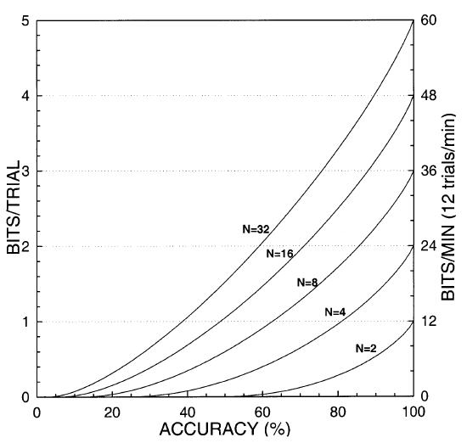
Information transfer rate (ITR)
Bits/min
N: number of classes
P: accuracy
T: selection time (seconds/selection)
Open: itr.m
% function [ itr ] = itr(n, p, t)
%
% Input:
% n : # of targets
% p : Target identification accuracy (0 <= p <= 1)
% t : Averaged time for a selection [s]
Walpaw et al. 2002

Slide 4
Information transfer rate (ITR)
Run: ITR_demo.m
% Examples of ITR calculation
t=2;%time per selection
p=0:0.1:1;%accuracy
for k=1:length(p)
itr32(k)=itr(32,p(k),t);
itr16(k)=itr(16,p(k),t);
itr4(k)=itr(4,p(k),t);
end
figure;
plot(p*100,itr32,'b');
hold on
plot(p*100,itr16,'k');
plot(p*100,itr4,'r');
xlabel('Accuracy (%)')
ylabel('ITR (bpm)')

Slide 5

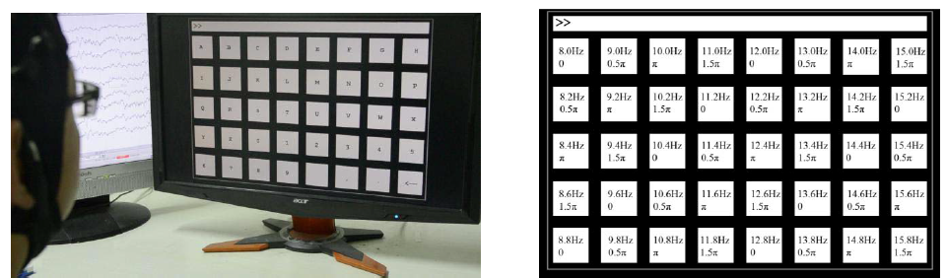
Data description
https://pan.baidu.com/s/1qYhyLtE

Slide 6
Data description
An offline BCI experiment with cue-guided target selection
The experiment consisted of 6 blocks, each containing 40 trials corresponding to all 40 characters indicated in a random order. Each trial lasted 6 s in total.
(1) Each trial started with a 0.5-s target cue (a red square at the target location, the same size as the stimulus).
(2) Subjects were asked to shift their gaze to the target as soon as possible.
(3) After the cue, all stimuli started to flicker on the screen concurrently for 5 s.
(4) The screen was blank for 0.5 s before the next trial began.

Slide 7
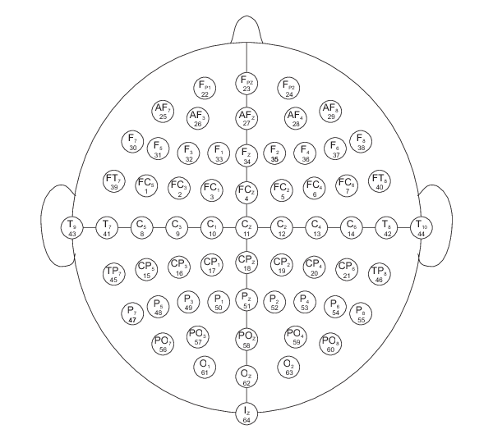
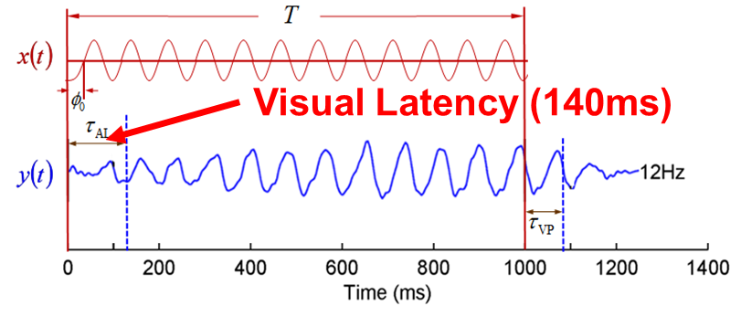
Data description
freq = [8:1:15 8.2:1:15.2 8.4:1:15.4 8.6:1:15.6 8.8:1:15.8];
nCondition = 40;
channels = [1:9];% Pz, PO5, PO3, POz, PO4, PO6, O1, Oz, and O2
nChannel = length(channels);
rfs = 250;% sampling rate
dataLength = 6*rfs;% [-0.5 5.5s]
nBlock = 6;% six blocks
latencyDelay = 0.5*rfs+35;% 140ms delay
0.5s
5s
0.5s
Stimulus Onset
Stimulus Offset

Slide 8
Data description
Data for 10 subjects (*.mat files)
S1, S2, S3, S4, S5, S6, S7, S8, S9, S10
>>load S1.mat
>>size(data)
ans =
9 1500 40 6
>>plot([1:1500]/250,data(8,:,1,1))
>> xlabel('Time (s)')
>> ylabel('Amplitude (uV)')
Time points
Trials
Channels
Classes

Slide 9
Data description
Extract vep epoch (Oz, 10Hz, trial 1)
>> vep=data(8,128+35+1:128+35+250*5,3,1);
>> amp=abs(fft(vep))/(length(vep)/2);
>> plot(([1:5*250]-1)/5,amp)
>> xlim([0 50])
>> xlabel(‘Frequency (Hz)')
>> ylabel(‘Amplitude (uV)')
FFT:
Data length = 5 seconds;
Frequency resolution = 1/5=0.2Hz.

Slide 10
Amplitude Spectrum and SNR
Run: AMP_SNR_demo.m
Line 19-24: bandpass filter
% predefined bandpass filter
fs = rfs/2;
Wp=[6/fs 90/fs];%6-90Hz
Ws=[4/fs 100/fs];%
[k,Wn]=cheb1ord(Wp,Ws,3,40);
[B,A] = cheby1(k,0.5,Wn);

Slide 11

Amplitude Spectrum and SNR
Run: AMP_SNR_demo.m
Line 47-52: SNR calculation
n=5;%width of background neighbours [-1 +1]Hz
vepSnr=zeros(length(vepAmp));
f1=6;%SNR starts from f1 Hz
for k=f1*sTime+1:length(vepAmp)-n
vepSnr(k)=20*log10(vepAmp(k)/mean(vepAmp([k-n:k-1 k+1:k+n])));%SNR
end

Slide 12
Amplitude Spectrum and SNR
Run: AMP_SNR_demo.m
Line 29: iTarget=8; (15Hz)
Line 36: for sub=[1] (subject 1)

Slide 13
FFT-based target identification
Run: FFT_demo.m
Line 11: channel selection
……
Block 6 - Target 36: estimated as 11
Block 6 - Target 37: estimated as 4
Block 6 - Target 38: estimated as 38
Block 6 - Target 39: estimated as 27
Block 6 - Target 40: estimated as 19
Accuracy = 51.25%
ITR = 19.04 bpm
iChannel = [8];% Oz for FFT
Line 16: data length
stimTime = 5;% stimulation time (up to 5s)
Line 34-41: FFT and target identification
% FFT
vepFFT=abs(fft(testData,5*rfs));%5*rfs-point FFT, zero-padding
for kk = 1:nCondition
amp(kk)=mean(vepFFT(freq(kk)*5*[1:5]+1));% mean of fundamental and harmonics
end
% target identification
pLabels(ii,jj) = find(amp==max(amp));

Slide 14
FFT-based target identification
Run: FFT_demo.m
Line 11: channel selection
iChannel = [8];% Oz for FFT
8-Oz
7-O1
9-O2
Accuracy = 51.25%
ITR = 19.04 bpm
Accuracy = 52.08%
ITR = 19.53 bpm
Accuracy = 67.08%
ITR = 29.11 bpm
Line 11: Oz(8), Line 16: data length
stimTime = 5;% stimulation time (up to 5s)
5s
4s
2s
Accuracy = 51.25%
ITR = 19.04 bpm
Accuracy = 47.50%
ITR = 20.65 bpm
Accuracy = 32.50%
ITR = 20.27 bpm

Slide 15
FFT-based target identification
Run: FFT_demo.m
Line 16: 5 seconds; Line 37: number of harmonics ([1:5])
amp(kk)=mean(vepFFT(freq(kk)*5*[1:5]+1));% mean of fundamental and harmonics
1:5
1:4
1:3
Accuracy = 51.25%
ITR = 19.04 bpm
Accuracy = 50.83%
ITR = 18.80 bpm
Accuracy = 48.75%
ITR = 17.60 bpm
1:2
1:1
Accuracy = 39.17%
ITR = 12.44 bpm
Accuracy = 17.92%
ITR = 3.33 bpm

Slide 16
FFT-based target identification
Run: FFT_demo.m
Line 37: [1:5], Line 22: subject index
load(['S1.mat']);
S1
S2
Accuracy = 51.25%
ITR = 19.04 bpm
Accuracy = 71.25%
ITR = 32.04 bpm
S3
S10
Accuracy = 99.17%
ITR = 56.82 bpm
…
Accuracy = 93.75%
ITR = 50.77 bpm

Slide 17
CCA-based target identification
Run: STDCCA_demo.m
Line 19-36: sinusoidal reference signals
10Hz
% reference signals for CCA
for ii = 1:length(freq);
s1 = sin(2*pi*freq(ii)*t);
s2 = cos(2*pi*freq(ii)*t);
…
s9 = sin(2*pi*5*freq(ii)*t);
s10 = cos(2*pi*5*freq(ii)*t);
refData(:,:,ii) = cat(2,s1',s2',s3',s4',s5',s6',s7',s8',s9',s10');
end
figure;
for i=1:10
subplot(10,1,i);plot(t,refData(:,i,3));
end

Slide 18
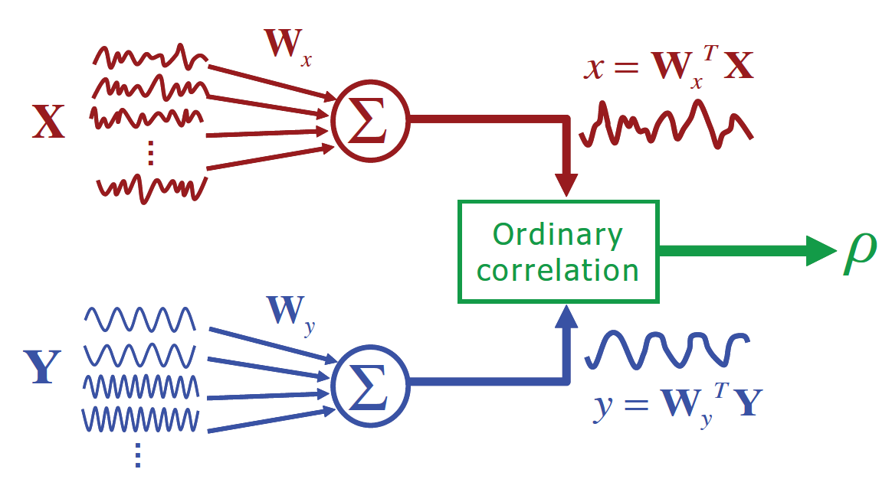
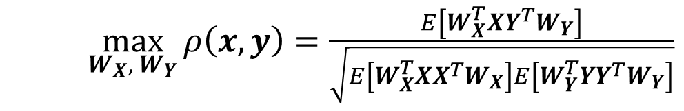
CCA-based target identification
Run: STDCCA_demo.m
Line 65-72: CCA and target identification
% CCA
for kk = 1:nCondition
[~,~,D] = canoncorr(testData, refData(:,:,kk));
cc(kk)=D(1);
end
% target identification
pLabels(ii,jj) = find(cc==max(cc));
$\max_{W_{X},{ W}_{Y}}{ρ\left(x,y\right)=\frac{E\left[W_{X}^{T}XY^{T}W_{Y}\right]}{\sqrt{E\left[W_{X}^{T}XX^{T}W_{X}\right]E\left[W_{Y}^{T}YY^{T}W_{Y}\right]}}}$

Slide 19
CCA-based target identification
Run: STDCCA_demo.m
Line 48: subject index
load(['S1.mat']);
S1
S2
FFT
Accuracy = 51.25%
ITR = 19.04 bpm
Accuracy = 71.25%
ITR = 32.04 bpm
CCA
Accuracy = 93.75%
ITR = 50.77 bpm
Accuracy = 100.00%
ITR = 58.06 bpm
S3
S10
FFT
Accuracy = 99.17%
ITR = 56.82 bpm
…
Accuracy = 93.75%
ITR = 50.77 bpm
CCA
Accuracy = 100.00%
ITR = 58.06 bpm
Accuracy = 99.58%
ITR = 57.39 bpm

Slide 20
CCA-based target identification
Run: STDCCA_demo.m
Line 48: subject index (‘S1’)
Line 37: number of harmonics
nHarmonics=5;
5
3
1
5s
Accuracy = 93.75%
ITR = 50.77 bpm
Accuracy = 93.75%
ITR = 50.77 bpm
Accuracy = 90.83%
ITR = 47.95 bpm
Line 15: data length
stimTime = 5;% stimulation time (up to 5s)
5
3
1
2s
Accuracy = 71.25%
ITR = 70.49 bpm
Accuracy = 69.58%
ITR = 67.87 bpm
Accuracy = 57.50%
ITR = 50.21 bpm

Slide 21
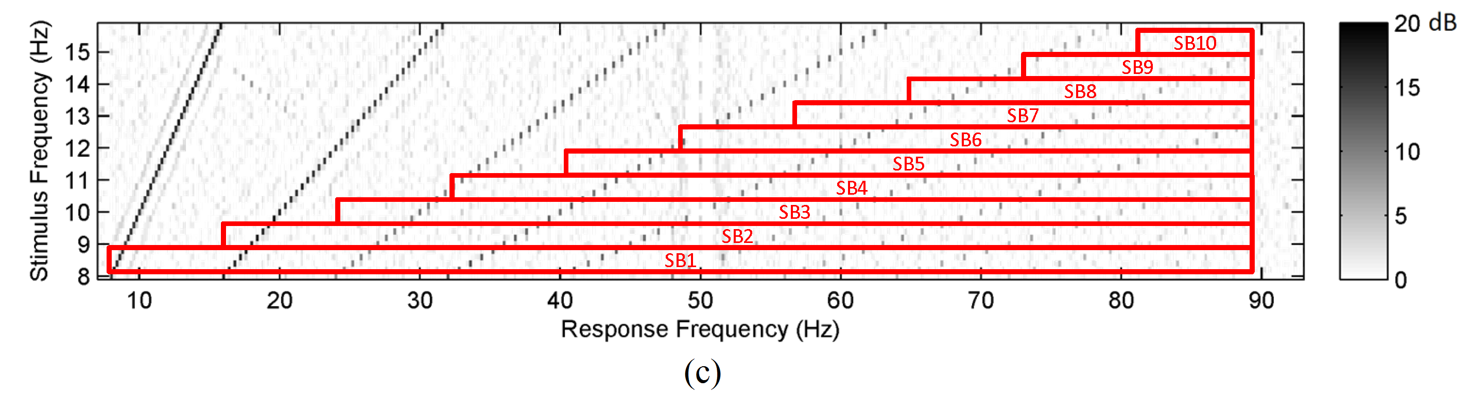
FBCCA-based target identification
Run: FBCCA_demo.m
Line 36-79: filter bank
% predefined bandpass filters for a filter bank
fs = rfs/2;
%h1
fls1(1) = [6]; fls2(1) = [4];
fhs1(1) = [90]; fhs2(1) = [100];
…
%h7
fls1(7) = [54]; fls2(7) = [48];
fhs1(7) = [90]; fhs2(7) = [100];
for nFB=1:7
Wp=[fls1(nFB)/fs fhs1(nFB)/fs];%
Ws=[fls2(nFB)/fs fhs2(nFB)/fs];%
[k,Wn]=cheb1ord(Wp,Ws,3,40);
[B{nFB},A{nFB}] = cheby1(k,0.5,Wn);
end
Sub Band | Lower Freq (Hz) | Upper Freq (Hz)
1 | 6 | 90
2 | 14 | 90
3 | 22 | 90
4 | 30 | 90
5 | 38 | 90
6 | 46 | 90
7 | 54 | 90

Slide 22
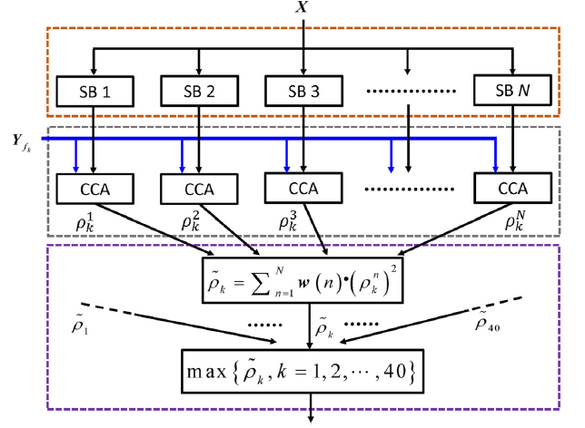
FBCCA-based target identification
Run: FBCCA_demo.m
Line 111-133: FBCCA and target identification
% standard CCA for all sub-bands
for kk = 1:nCondition
[~,~,D] = canoncorr(testDatah1, refData(:,:,kk));
cc(1,kk)=D(1);
……
[~,~,D] = canoncorr(testDatah7, refData(:,:,kk));
cc(7,kk)=D(1);
end
% weighted sum
rrr = weights(1:nSubband)*cc(1:nSubband,:).^2;
% target identification
pLabels(ii,jj) = find(rrr==max(rrr));
Line 15: weights
weights = [1:7].^(-1.25)+0.25;

Slide 23
FBCCA-based target identification
Run: FBCCA_demo.m
Line 16: data length
stimTime = 5;% stimulation time (up to 5s)
5s
2s
1s
FFT
Accuracy = 51.25%
ITR = 19.04 bpm
Accuracy = 32.50%
ITR = 20.27 bpm
Accuracy = 20.83%
ITR = 15.97 bpm
CCA
Accuracy = 93.75%
ITR = 50.77 bpm
Accuracy = 71.25%
ITR = 70.49 bpm
Accuracy = 42.50%
ITR = 51.96 bpm
FBCCA
Accuracy = 99.58%
ITR = 57.39 bpm
Accuracy = 92.50%
ITR = 108.99 bpm
Accuracy = 65.42%
ITR = 102.55 bpm

Slide 24
FBCCA-based target identification
Run: FBCCA_demo.m
Line 19: number of subbands
nSubband = 7;% number of subbands
7
6
5
Accuracy = 92.50%
ITR = 108.99 bpm
Accuracy = 92.92%
ITR = 109.88 bpm
Accuracy = 91.25%
ITR = 106.35 bpm
4
3
2
2s
Accuracy = 91.25%
ITR = 106.35 bpm
Accuracy = 85.42%
ITR = 94.84 bpm
Accuracy = 79.58%
ITR = 84.30 bpm
1
Accuracy = 71.25%
ITR = 70.49 bpm
CCA

Slide 25
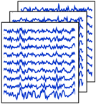

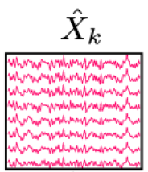
ITCCA-based target identification
Run: ITCCA_demo.m
Line 71-86: individual template
% leave-one-out training data
rawData1=rawData;
rawData1(:,:,:,ii)=[];
trainData(:,:,:)=mean(rawData1,4);
for jj=1:nCondition
for chan = 1:nChannel
refData(chan,:,jj) = trainData(chan,1:N+latencyDelay,jj);
refDatah1(chan,:,jj) = filtfilt(B{1},A{1},refData(chan,:,jj));
…….
refDatah7(chan,:,jj) = filtfilt(B{7},A{7},refData(chan,:,jj));
end
end
Y: SSVEP templates

Slide 26
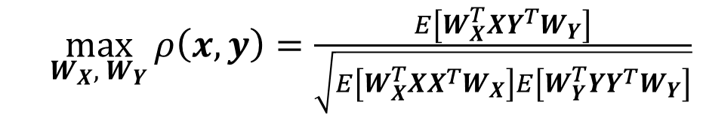
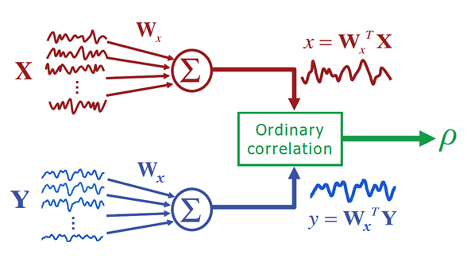
ITCCA-based target identification
Run: ITCCA_demo.m
Line 112-148: ITCCA and target identification
% IT-CCA for all sub-bands
for kk = 1:nCondition
refTmph1 = refDatah1(:,1+latencyDelay:N+latencyDelay,kk)';
[SFA,SFB,D] = canoncorr(testDatah1,refTmph1);
cc(1,kk)=corr2(testDatah1*SFA(:,1),refTmph1*SFA(:,1));
……
refTmph7 = refDatah7(:,1+latencyDelay:N+latencyDelay,kk)';
[SFA,SFB,D] = canoncorr(testDatah7,refTmph7);
cc(7,kk)=corr2(testDatah7*SFA(:,1),refTmph7*SFA(:,1));
end
% weighted sum
rrr = weights*(sign(cc).*cc.^2);
% target identification
pLabels(ii,jj) = find(rrr==max(rrr));

Slide 27
ITCCA-based target identification
Run: ITCCA_demo.m
Line 16: data length
stimTime = 5;% stimulation time (up to 5s)
5s
2s
1s
FFT
Accuracy = 51.25%
ITR = 19.04 bpm
Accuracy = 32.50%
ITR = 20.27 bpm
Accuracy = 20.83%
ITR = 15.97 bpm
CCA
Accuracy = 93.75%
ITR = 50.77 bpm
Accuracy = 71.25%
ITR = 70.49 bpm
Accuracy = 42.50%
ITR = 51.96 bpm
FBCCA
Accuracy = 99.58%
ITR = 57.39 bpm
Accuracy = 92.50%
ITR = 108.99 bpm
Accuracy = 65.42%
ITR = 102.55 bpm
ITCCA
Accuracy = 98.33%
ITR = 55.76 bpm
Accuracy = 99.58%
ITR = 126.26 bpm
Accuracy = 95.83%
ITR = 194.07 bpm

Slide 28
ITCCA-based target identification
Run: ITCCA_demo.m
Line 16: 1 second; Line 13: number of training trials (nBlock-1)
nBlock = 6;% six blocks
6
5
4
Accuracy = 95.83%
ITR = 194.07 bpm
Accuracy = 94.00%
ITR = 187.09 bpm
Accuracy = 92.50%
ITR = 181.65 bpm
1s
3
2
Accuracy = 85.00%
ITR = 156.77 bpm
Accuracy = 55.00%
ITR = 78.03 bpm

Slide 29
Summary
Subject S1 (data length: 1 s)
 | Year | Number of channels | Number of harmonics | Number of sub-bands | Number of training trials | Accuracy (%) | ITR (bpm)
FFT | 2002 | 1 | 5 | 1 | 0 | 20.83% | 15.97
CCA | 2007 | 9 | 5 | 1 | 0 | 42.50% | 51.96
FBCCA | 2015 | 9 | 5 | 7 | 0 | 65.42% | 102.55
ITCCA | 2014 | 9 | - | 7 | 5 | 95.83% | 194.07

Slide 30
Homework
How to combine the FBCCA method and the IT-CCA method to further improve SSVEP detection?
Use linear combination of correlation coefficients from CCA and IT-CCA to improve the detection (weights?);
For different data lengths (e.g., from 0.5s to 1s with an interval of 0.1s), calculate average accuracy and ITR (mean ± standard deviation) cross 10 subjects for FBCCA, ITCCA, and the combination method.

Slide 31
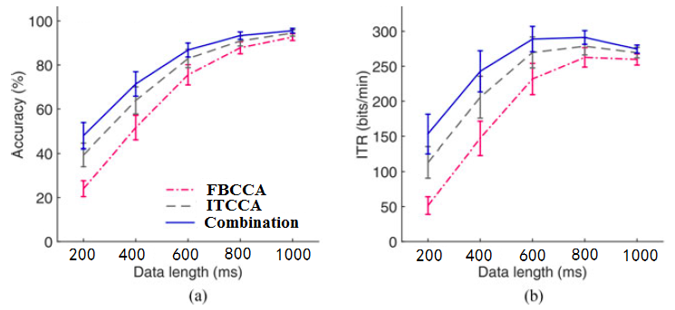
Homework
How to combine the FBCCA method and the IT-CCA method to further improve SSVEP detection?
Submit to: wangyj@semi.ac.cn

Slide 32
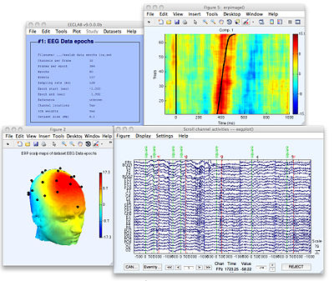
EEGLAB (https://sccn.ucsd.edu/eeglab/)
EEGLAB is an interactive Matlab toolbox for processing continuous and event-related EEG, MEG and other electrophysiological data incorporating ICA, time/frequency analysis, artifact rejection, event-related statistics, and visualization of the averaged and single-trial data.

Slide 33
Thanks for your attention!

