Slide 1

COURSE PROJECT REVIEW · NODE-TO-SELF
PromptGFM-Bio
Prompt-Conditioned Graph Foundation Model for Rare-Disease Gene Mapping
Bhaskarjyoti Das
Yash Verma
Interdisciplinary Deep Learning on Graphs
PES1UG23AM910

Slide 2
OVERVIEW
PromptGFM-Bio: What & Why
THE PROBLEM
🎯
0.9626
Rare diseases affect 300M+ people worldwide — yet most have no effective treatment. The core bottleneck is gene discovery : only 1–5 causal genes are known for most diseases, making this a severe long-tail learning problem.
AUROC (best model)
🔬
55.7%
True gene in Top 50 / 19,576
PromptGFM-Bio frames gene discovery as a link prediction problem on a large heterogeneous biomedical knowledge graph (19,576 genes · 16,841 diseases · 1.85M PPI edges). A GraphSAGE backbone is paired with a frozen PubMedBERT prompt encoder, connected via FiLM conditioning — so a disease's natural language description dynamically modulates GNN message passing at every layer.
⚡
392×
Enrichment over random chance
🌐
Zero-Shot
Generalizes to unseen disease associations
INTERDISCIPLINARY DEEP LEARNING ON GRAPHS
PROMPTGFM-BIO
NODE-TO-SELF

Slide 3
NOVELTY
What Makes This Project Unique?
01 / 07
02 / 07
03 / 07
FiLM-Conditioned Message Passing
Free-Text Disease Queries
Disease-Adaptive Graph Traversal
Disease text dynamically modulates GNN feature transformations at every layer via learned scale (γ) and shift (β) parameters. The language signal enters inside graph reasoning — not as static input features or at the prediction head. No prior work does this for gene prioritization.
Unlike SHEPHERD (requires structured HPO codes) or traditional KGE methods (need disease IDs), PromptGFM-Bio accepts arbitrary natural-language disease descriptions via frozen PubMedBERT, enabling zero-shot generalization to diseases never seen during training.
The same PPI network produces different gene representations for different disease prompts — the model learns to "look at the graph differently" depending on which disease is being queried. Prior GNN methods (Mantis-ML 2.0, SHEPHERD, KDGene) generate disease-agnostic gene embeddings.
γ, β = MLP(p) · h′ = γ ⊙ h + β
vs. SHEPHERD · KGE · Mantis-ML 2.0
Same graph · Different conditioning
INTERDISCIPLINARY DEEP LEARNING ON GRAPHS
PROMPTGFM-BIO
NODE-TO-SELF

Slide 4
NOVELTY
What Makes This Project Unique?
04 / 07
05 / 07
06–07 / 07
Full-Vocabulary Gene Ranking
Heterogeneous Biomedical Knowledge Graph
117 Zero-Shot Diseases & Combined Ranking Loss
Evaluation ranks all ~19,576 candidate genes per disease query — not a small candidate set (SHEPHERD: 13–244 genes) or a few negatives. This is rare in the literature and provides an honest assessment of clinical utility.
Integrates STRING PPI (1.85M edges), DisGeNET, HPO phenotype bridges, and Orphanet into a single heterogeneous graph with 19,576 genes, 16,841 diseases, and 11,794 phenotypes.
117 rare diseases with zero training edges for evaluating true generalization. Combined BCE + pairwise margin ranking + ListNet losses jointly optimize gene ranking quality — not just classification accuracy.
19,576 genes ranked per query
Multi-source · 48M+ parameters
BCE · Margin · ListNet
INTERDISCIPLINARY DEEP LEARNING ON GRAPHS
PROMPTGFM-BIO
NODE-TO-SELF

Slide 5
DATA
Dataset & Graph Statistics
DATA SOURCES
GRAPH STATISTICS
STRING v12
PPI NETWORK
Human protein–protein interactions (score ≥ 9606)
Gene nodes
19,576
Experimentally validated interactions
Disease nodes
16,841
BioGRID 4.4.224
PPI NETWORK
Phenotype nodes
11,794
DisGeNET
GENE–DISEASE
Curated gene–disease associations
Gene ↔ Gene edges (STRING PPI ≥ 700)
1,854,012
HPO
PHENOTYPE
Gene–phenotype mappings, disease ontology
Gene → Disease edges
9,741,610
Orphanet
RARE DISEASE
Rare disease gene associations
Disease → Gene edges (reverse)
9,741,610
INTERDISCIPLINARY DEEP LEARNING ON GRAPHS
PROMPTGFM-BIO
NODE-TO-SELF

Slide 6
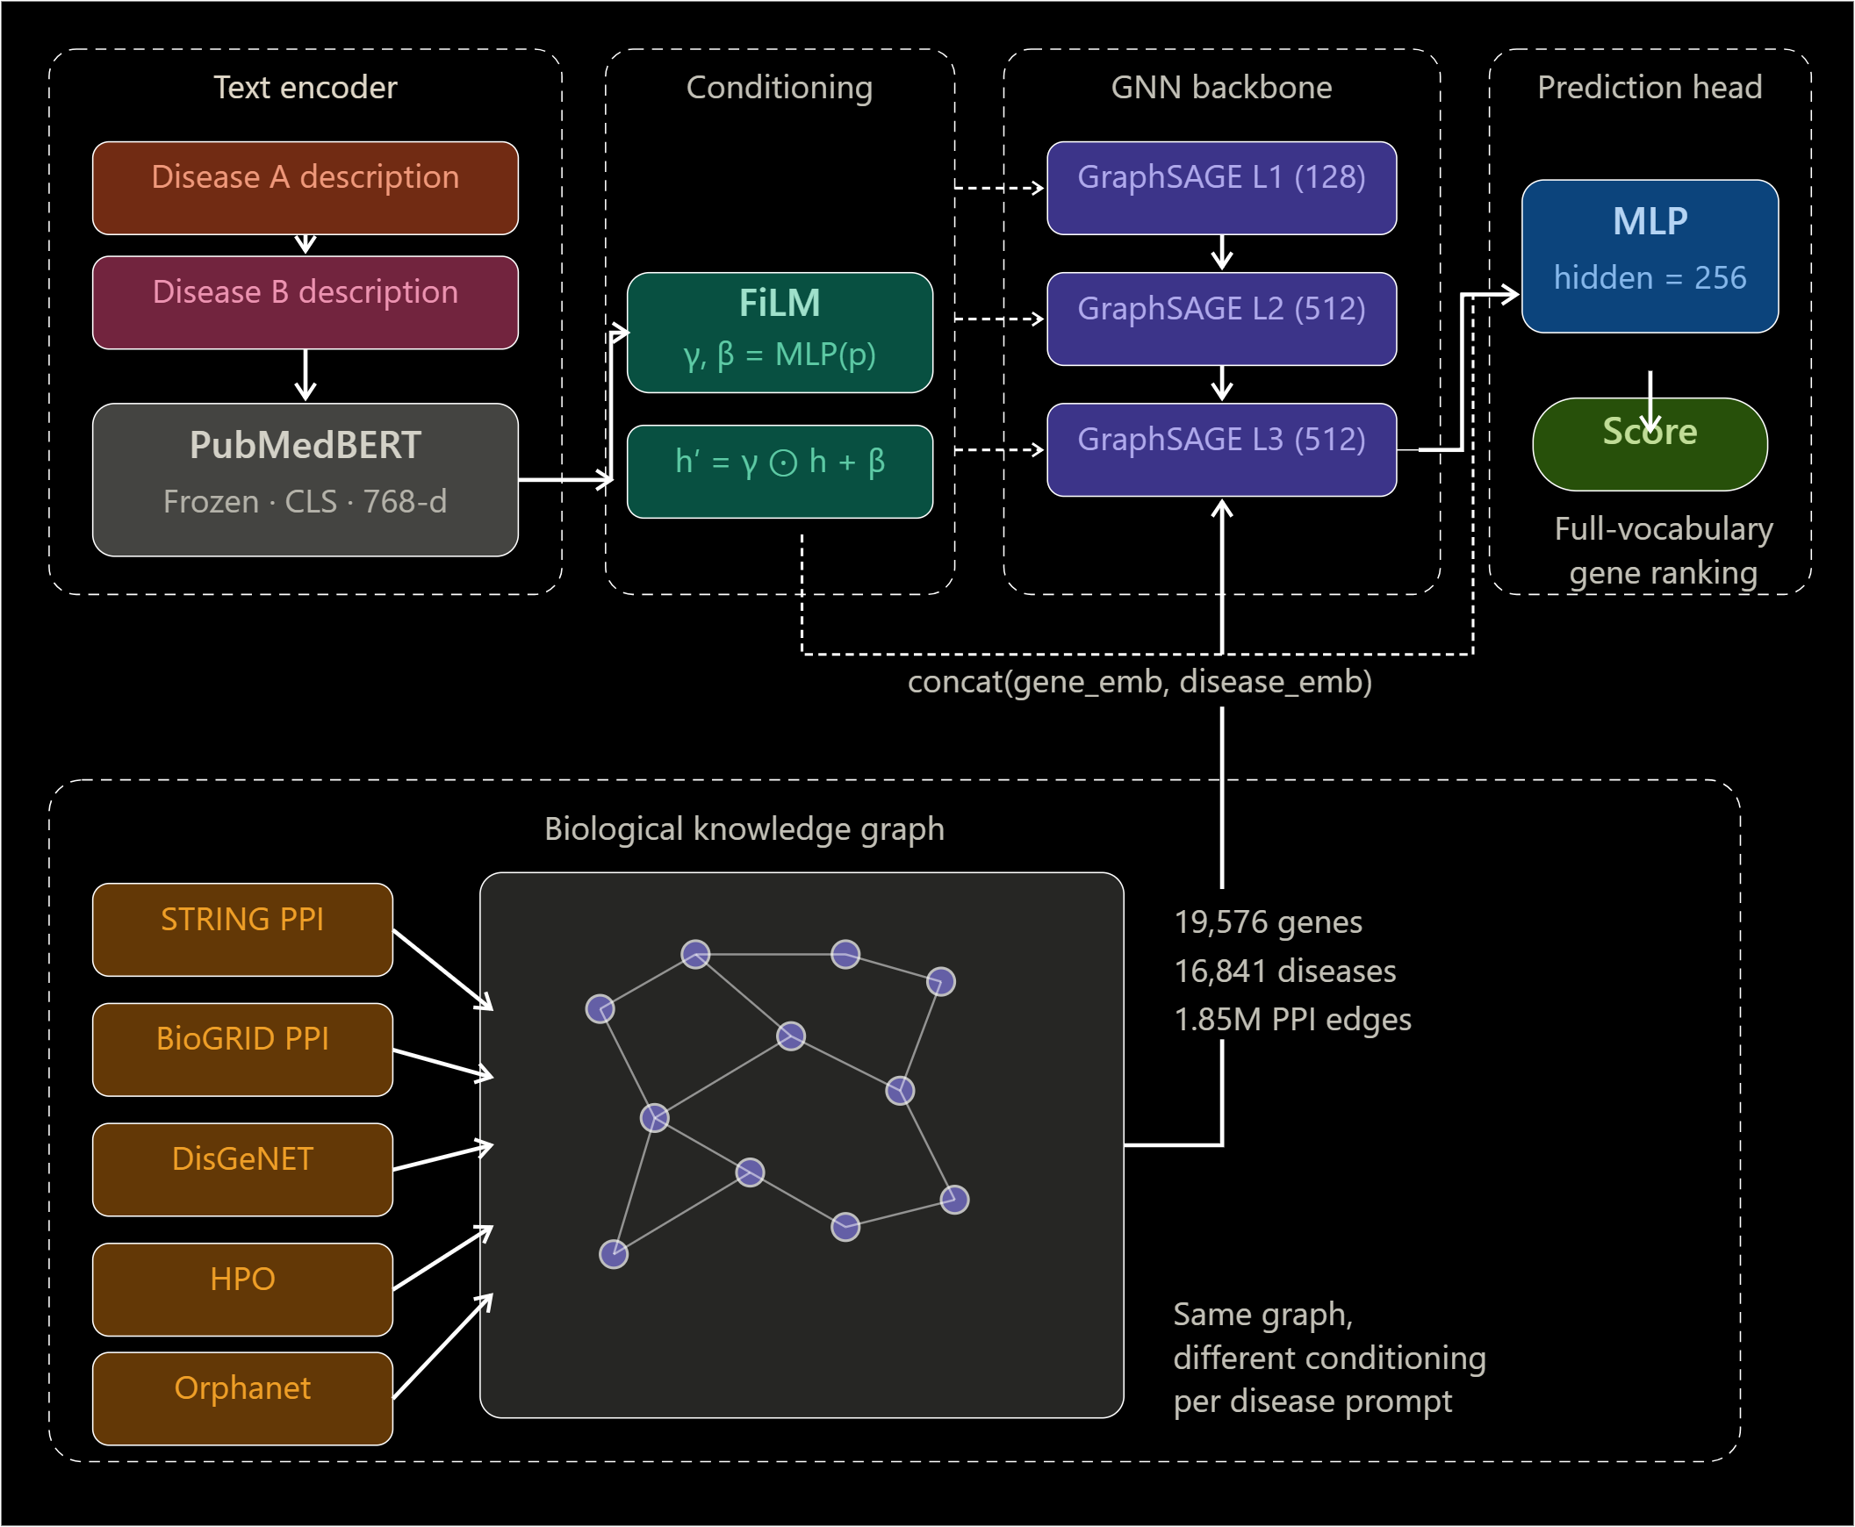
MODEL
Architecture
INTERDISCIPLINARY DEEP LEARNING ON GRAPHS
PROMPTGFM-BIO
NODE-TO-SELF

Slide 7
RESULTS
Ablation Study: Zero-Shot Rare Disease Results 117 diseases · 3 seeds · Full-vocabulary evaluation
VARIANT
GNN
CONDITIONING
AUROC
HIT@50
MRR
DESCRIPTION
MLP only (Baseline)
✗
✗
0.916 ±0.007
0.168 ±0.030
0.026 ±0.008
Raw node embeddings → MLP. No message passing, no prompt conditioning.
Prompt only
✗
✓
0.926 ±0.001
0.185 ±0.022
0.042 ±0.017
FiLM active, but no PPI edges. Prompt signal at prediction only.
GNN only
✓
✗
0.925 ±0.000
0.174 ±0.005
0.035 ±0.020
PPI message passing active, no FiLM. GraphSAGE without language guidance.
Full PromptGFM-Bio ★ Best
✓
✓
0.941 ±0.006
0.219 ±0.018
0.047 ±0.012
Full model with prompt-conditioned message passing over PPI graph.
INTERDISCIPLINARY DEEP LEARNING ON GRAPHS
PROMPTGFM-BIO
NODE-TO-SELF

Slide 8
STATUS
Project Progress So Far
1
Large-Scale Knowledge Graph
✓
2
Multi-Source Dataset Integration
✓
3
Prompt-Conditioned GNN Architecture
✓
19,576 genes · 16,841 diseases · 1.85M+ PPI edges (STRING + BioGRID)
DisGeNET · HPO · Orphanet → unified gene–disease supervision ( ~1.17M edges)
GraphSAGE backbone + FiLM conditioning · Frozen PubMedBERT for disease text embeddings
4
Disease-Specific Message Passing
✓
5
Full-Vocabulary Evaluation
✓
6
Strong Performance Achieved
✓
Same graph produces different gene embeddings per disease query
Rank all ~19.5k genes per disease — realistic, publication-grade setup
AUROC: 0.9606 · Hit@50: 54.9% · MRR: 0.159
7
Ablation Framework
✓
8
117 Zero-Shot Rare Diseases
✓
9
Optimized Training Pipeline
✓
4 variants × 3 seeds — isolates contribution of GNN vs prompt conditioning
Evaluation of generalization to unseen diseases with no training edges
Mixed precision (AMP) · Stable training · ~2.6h per run on RTX 4090
INTERDISCIPLINARY DEEP LEARNING ON GRAPHS
PROMPTGFM-BIO
NODE-TO-SELF

Slide 9
NODE-TO-SELF · COURSE PROJECT REVIEW
Thank You
Bhaskarjyoti Das
Department of Computer Science and Engineering in AI & ML
bhaskarjyoti01@gmail.com

