Slide 1
PRANA-NET
VayuDrishti
Hyperlocal pollution evidence
and operator review
Working MVP and technical roadmap
PRANA-NET / VayuDrishti
01
Notes:
Project presentation as of 30 September 2026. VayuSetu is the repository and original hosting name. PRANA-NET / VayuDrishti is the current product identity.
Source: current project source, README.md, dist/index.html, dist/features.js, server/worker.mjs and db/schema.ts. Repository: https://github.com/pesanish5-bot/vayusetu. Product captures show the local working demo with synthetic data. Original PRD supplies the broader vision only, not verified implementation or performance claims.

Slide 2
The problem: local spikes need local evidence
78
168 µg/m³
Scenario citywide AQI
Scenario local PM2.5
A city summary can hide local variation.
Our hypothesis: local baselines and corroborating evidence can help operators decide what deserves verification.
PRANA-NET / VayuDrishti
02
Notes:
Product hypothesis from the PRD. This deck does not assert a national monitoring-station density or a quantified health impact. The AQI and PM2.5 examples are synthetic values with different units.
Source: current project source, README.md, dist/index.html, dist/features.js, server/worker.mjs and db/schema.ts. Repository: https://github.com/pesanish5-bot/vayusetu. Product captures show the local working demo with synthetic data. Original PRD supplies the broader vision only, not verified implementation or performance claims.

Slide 3
Users and decisions
Residents
Describe a local observation and add an optional photo.
Pollution operators
Review signals and evidence before escalating a case.
Pilot researchers
Import labelled readings and compare detection rules.
Municipal partnerships and field participation remain future work.
PRANA-NET / VayuDrishti
03
Notes:
Source: current project source, README.md, dist/index.html, dist/features.js, server/worker.mjs and db/schema.ts. Repository: https://github.com/pesanish5-bot/vayusetu. Product captures show the local working demo with synthetic data. Original PRD supplies the broader vision only, not verified implementation or performance claims.

Slide 4
The MVP: a complete review loop
01
Choose a city
02
Import readings
Open the relevant corridor
Validate JSON or CSV data
03
Review evidence
04
Save a case
Inspect the local anomaly rule
Record reports and incident data
05
Record progress
06
Export evidence
Resume review stages from history
Prepare a dossier for review
PRANA-NET / VayuDrishti
04
Notes:
Source: current project source, README.md, dist/index.html, dist/features.js, server/worker.mjs and db/schema.ts. Repository: https://github.com/pesanish5-bot/vayusetu. Product captures show the local working demo with synthetic data. Original PRD supplies the broader vision only, not verified implementation or performance claims.

Slide 5
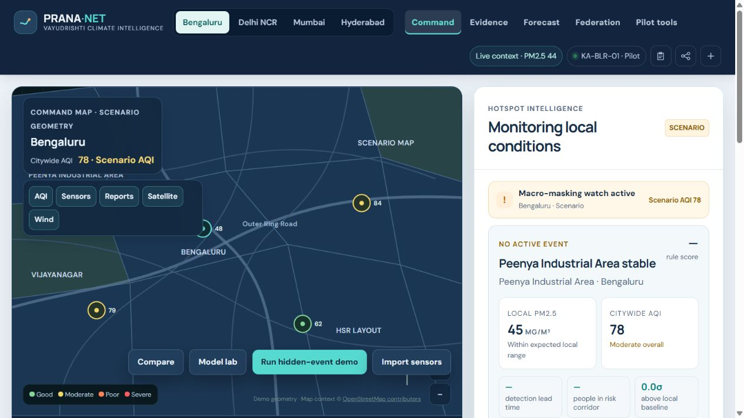
The command dashboard
A local review workspace
City controls, regional context and scenario signals share one view. The map labels its illustrative geometry.
Local demonstration using synthetic evidence
PRANA-NET / VayuDrishti
05
Notes:
Open-Meteo/CAMS context does not replace hardware measurements. The command map uses a scenario drawing rather than real GIS plume modelling.
Source: current project source, README.md, dist/index.html, dist/features.js, server/worker.mjs and db/schema.ts. Repository: https://github.com/pesanish5-bot/vayusetu. Product captures show the local working demo with synthetic data. Original PRD supplies the broader vision only, not verified implementation or performance claims.

Slide 6
Four contexts, with room to expand
City context | Pilot corridor | Node
Bengaluru | Peenya Industrial Area | KA-BLR-01
Delhi NCR | Bawana / Narela | DL-NCR-01
Mumbai MMR | Taloja Industrial Area | MH-MMR-01
Hyderabad | Patancheru Industrial Area | TS-HYD-01
These are configured city contexts. Four views do not mean four deployed municipal systems.
PRANA-NET / VayuDrishti
06
Notes:
Source: current project source, README.md, dist/index.html, dist/features.js, server/worker.mjs and db/schema.ts. Repository: https://github.com/pesanish5-bot/vayusetu. Product captures show the local working demo with synthetic data. Original PRD supplies the broader vision only, not verified implementation or performance claims.

Slide 7
Evidence sources and their current status
Evidence | Working today | Boundary
Local readings | User-supplied JSON / CSV | Hardware feed planned
Citizen observations | Saved text and optional photos | Human verification required
Satellite cues | Operator-supplied evidence flag | Live ingestion planned
Weather and regional PM | Open-Meteo / CAMS context | Regional model context
PRANA-NET / VayuDrishti
07
Notes:
Source: current project source, README.md, dist/index.html, dist/features.js, server/worker.mjs and db/schema.ts. Repository: https://github.com/pesanish5-bot/vayusetu. Product captures show the local working demo with synthetic data. Original PRD supplies the broader vision only, not verified implementation or performance claims.

Slide 8
The current detector is an explainable rule
z = (PM2.5 − local baseline) / σ
Local deviation
A candidate spike crosses z ≥ 2.5.
Corroboration
At least one report or satellite flag supports review.
Review threshold
The rule score reaches 65 out of 100.
A rule score does not establish emission source or probability.
PRANA-NET / VayuDrishti
08
Notes:
Exact implementation: z = max(0,(pm-baseline)/max(1,sigma)). sensor = z >= 2.5. corroborators = reports + satellite. Score = clamp(round(26 + min(z,6)*6 + reports*15 + satellite*12 + (wind>=4?5:0)),18,95), except z<0.5 with no corroborators gives 18. Alert = sensor and corroborators>=1 and score>=65. This is an experimental score, not a calibrated probability or trained attribution model.
Source: current project source, README.md, dist/index.html, dist/features.js, server/worker.mjs and db/schema.ts. Repository: https://github.com/pesanish5-bot/vayusetu. Product captures show the local working demo with synthetic data. Original PRD supplies the broader vision only, not verified implementation or performance claims.

Slide 9
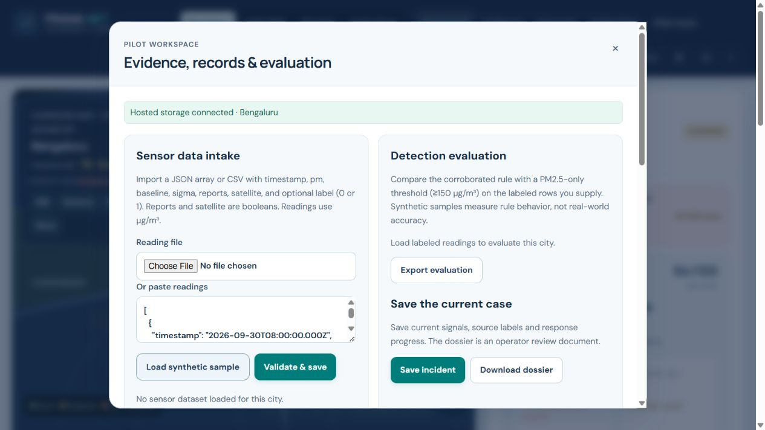
Sensor intake and validation
Bring your own readings
Up to 500 rows and 200 KB. Required fields include time, PM2.5, baseline, σ and evidence flags. An optional label enables evaluation.
Local demonstration using synthetic evidence
PRANA-NET / VayuDrishti
09
Notes:
Fields: timestamp, pm, baseline, sigma, reports, satellite and optional label. PM units µg/m³. CSV supports simple unquoted rows. A saved dataset can later reload from history.
Source: current project source, README.md, dist/index.html, dist/features.js, server/worker.mjs and db/schema.ts. Repository: https://github.com/pesanish5-bot/vayusetu. Product captures show the local working demo with synthetic data. Original PRD supplies the broader vision only, not verified implementation or performance claims.

Slide 10
Synthetic evaluation shows the comparison
Metric | Corroborated rule | PM2.5 ≥ 150
True / false positives | 2 / 0 | 2 / 1
False negatives / true negatives | 0 / 4 | 0 / 3
Precision | 100% | 66.7%
Recall | 100% | 100%
False positive rate | 0% | 25%
Six synthetic labelled rows. These results test rule behaviour, not field accuracy or detection latency.
PRANA-NET / VayuDrishti
10
Notes:
Source: six-row synthetic sample from dist/features.js, reproduced in the working demo. Corroborated rule: TP=2, FP=0, FN=0, TN=4. Threshold >=150: TP=2, FP=1, FN=0, TN=3. Precision 2/2=100% vs 2/3=66.7%. Recall 2/2=100% for both. False positive rate 0/4=0% vs1/4=25%. Small synthetic sample results cannot establish real-world performance.
Source: current project source, README.md, dist/index.html, dist/features.js, server/worker.mjs and db/schema.ts. Repository: https://github.com/pesanish5-bot/vayusetu. Product captures show the local working demo with synthetic data. Original PRD supplies the broader vision only, not verified implementation or performance claims.

Slide 11
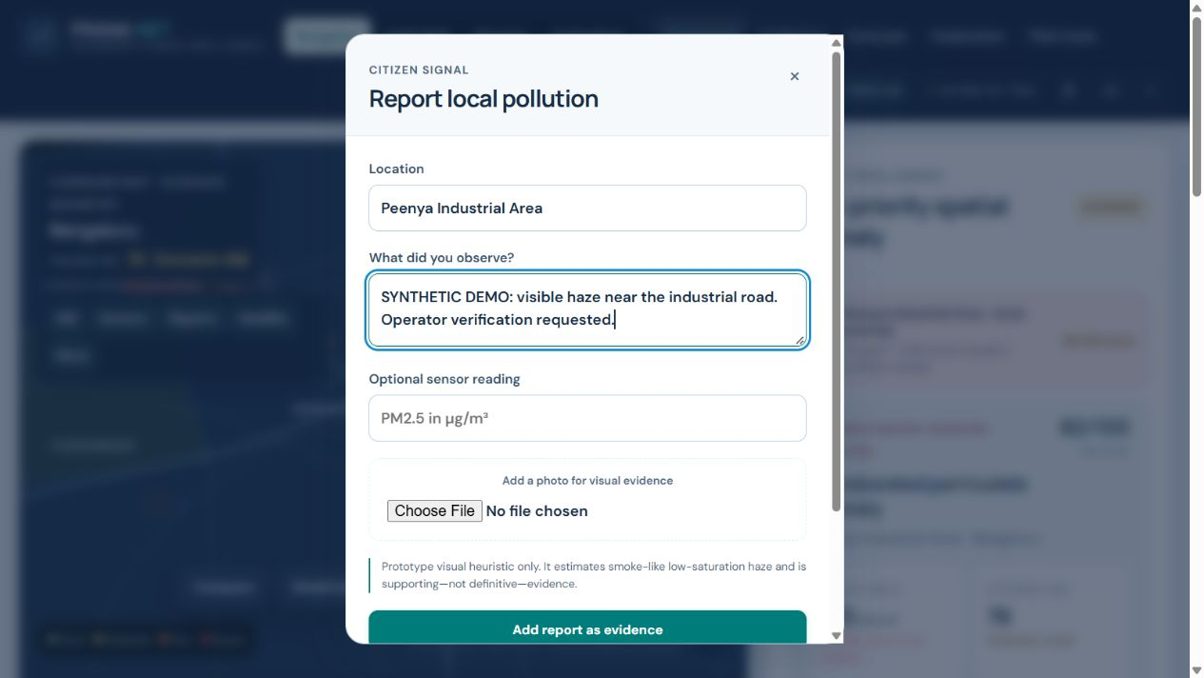
Citizen reporting
A lightweight intake flow
Residents describe an observation. Optional photo storage supports later review. The demo uses explicitly synthetic report content.
Local demonstration using synthetic evidence
PRANA-NET / VayuDrishti
11
Notes:
Photos: JPEG, PNG or WebP up to 3 MB. The image heuristic detects smoke-like haze but cannot confirm pollution or classify a source. Reports ask users to omit personal identifiers.
Source: current project source, README.md, dist/index.html, dist/features.js, server/worker.mjs and db/schema.ts. Repository: https://github.com/pesanish5-bot/vayusetu. Product captures show the local working demo with synthetic data. Original PRD supplies the broader vision only, not verified implementation or performance claims.

Slide 12
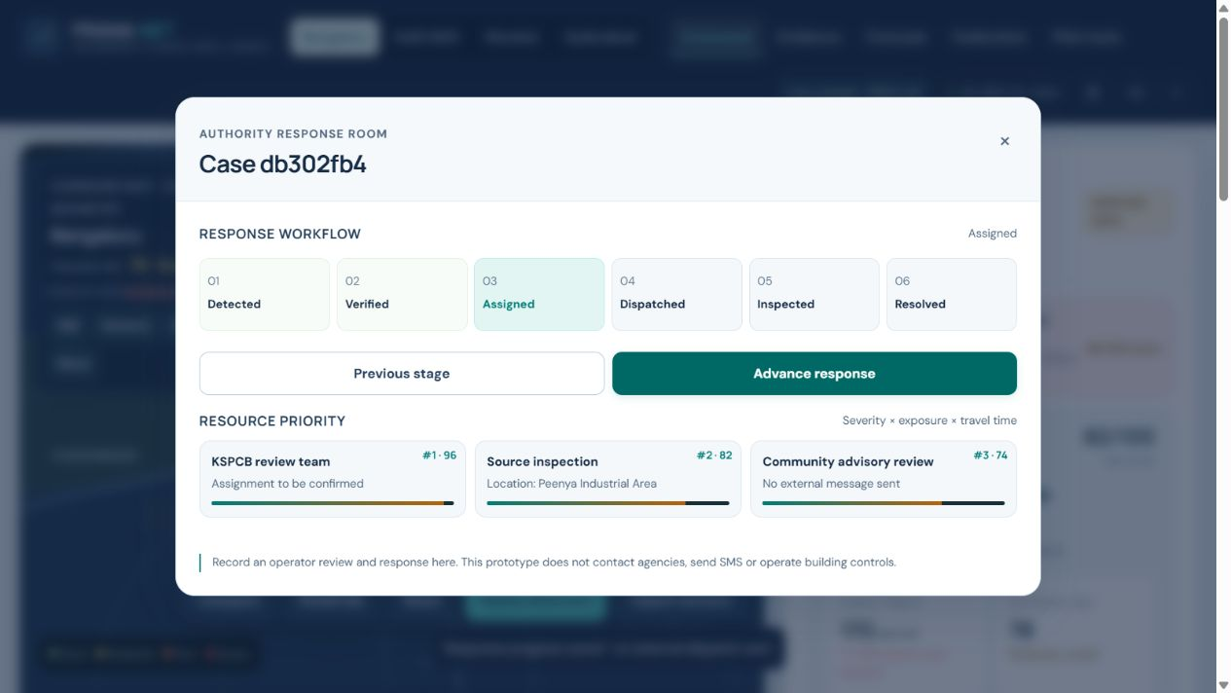
Recorded response progress
A saved incident workflow
Detected, verified, assigned, dispatched, inspected and resolved stages persist as review records.
Local demonstration using synthetic evidence
PRANA-NET / VayuDrishti
12
Notes:
These stage names are records only. The prototype does not contact agencies, send SMS, issue legal notices or control HVAC systems. A field operator must confirm actions outside this app.
Source: current project source, README.md, dist/index.html, dist/features.js, server/worker.mjs and db/schema.ts. Repository: https://github.com/pesanish5-bot/vayusetu. Product captures show the local working demo with synthetic data. Original PRD supplies the broader vision only, not verified implementation or performance claims.

Slide 13
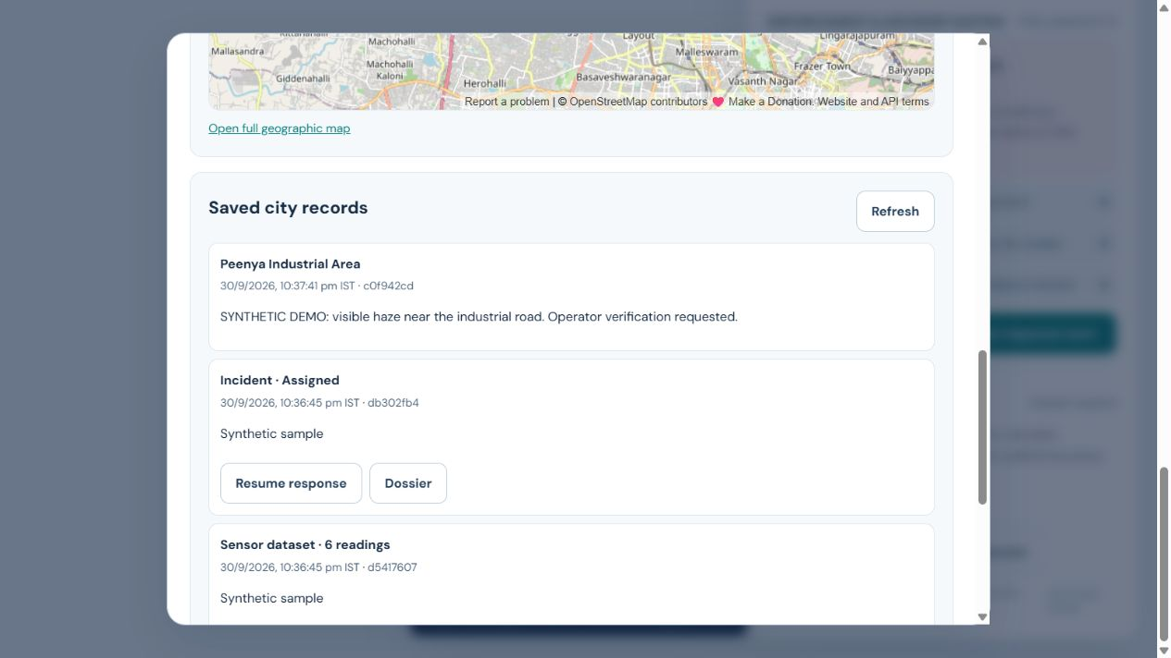
History and evidence dossiers
Evidence stays connected
Reports, sensor datasets and incidents remain available by city. Resume a case or export an HTML dossier for review.
Local demonstration using synthetic evidence
PRANA-NET / VayuDrishti
13
Notes:
The dossier is an operator review document, not a certified legal evidence package. Production persists records in D1 and photos in R2. JSON event packets omit raw media.
Source: current project source, README.md, dist/index.html, dist/features.js, server/worker.mjs and db/schema.ts. Repository: https://github.com/pesanish5-bot/vayusetu. Product captures show the local working demo with synthetic data. Original PRD supplies the broader vision only, not verified implementation or performance claims.

Slide 14
Current application architecture
Layer | Vercel deployment | Responsibility
Browser | HTML / CSS / JavaScript | Public views, rules and imports
API | Node.js serverless function | Protected record operations
Records | Private Vercel Blob JSON | Reports, datasets and incidents
Photos | Private Vercel Blob files | Authenticated media access
External context | Open-Meteo / CAMS and OSM | Regional weather, air and maps
PRANA-NET / VayuDrishti
14
Notes:
Source: current project source, README.md, dist/index.html, dist/features.js, server/worker.mjs and db/schema.ts. Repository: https://github.com/pesanish5-bot/vayusetu. Product captures show the local working demo with synthetic data. Original PRD supplies the broader vision only, not verified implementation or performance claims.

Slide 15
Data handling and security boundaries
Public dashboard
The dashboard is public; operators sign in to save records.
Private storage
Vercel Blob stores protected records and photos.
Validated writes
Payload limits and conditional updates protect record writes.
Next: user roles, consent, retention rules and audited access logs.
PRANA-NET / VayuDrishti
15
Notes:
Vercel dashboard is public. API records and photos require shared operator credentials through HTTP Basic authentication over HTTPS. Private Vercel Blob storage is accessed server-side. Original owner-private Site and its D1/R2 records remain separate. No tenant RBAC, retention workflow, access audit or regulatory certification is implemented.
Source: current project source, README.md, dist/index.html, dist/features.js, server/worker.mjs and db/schema.ts. Repository: https://github.com/pesanish5-bot/vayusetu. Product captures show the local working demo with synthetic data. Original PRD supplies the broader vision only, not verified implementation or performance claims.

Slide 16
Implementation versus the long-term vision
Working MVP | Further development
Four city contexts and regional model data | Calibrated hardware sensor ingestion
Evidence flags and an explainable rule | Validated source attribution models
Saved reports, photos and incident stages | Authorized agency workflows and advisories
Event schema exchange and dossier export | Federated training with tested privacy controls
Illustrative wind and plume views | Validated dispersion and exposure estimates
PRANA-NET / VayuDrishti
16
Notes:
Source: current project source, README.md, dist/index.html, dist/features.js, server/worker.mjs and db/schema.ts. Repository: https://github.com/pesanish5-bot/vayusetu. Product captures show the local working demo with synthetic data. Original PRD supplies the broader vision only, not verified implementation or performance claims.

Slide 17
A meaningful Google integration plan
Gemini
Draft a structured evidence summary for human review.
Maps
Add geographic routes and verified facility context.
Firebase
Evaluate operator sign-in and role-based access.
Planned work. Human review must remain the authority for source attribution and action.
PRANA-NET / VayuDrishti
17
Notes:
Proposed integrations only. No Gemini, Firebase or Google Maps credentials are configured today. Gemini structured output docs: https://ai.google.dev/gemini-api/docs/structured-output . Maps and Firebase roles here describe candidate integrations, not deployed or validated functionality.
Source: current project source, README.md, dist/index.html, dist/features.js, server/worker.mjs and db/schema.ts. Repository: https://github.com/pesanish5-bot/vayusetu. Product captures show the local working demo with synthetic data. Original PRD supplies the broader vision only, not verified implementation or performance claims.

Slide 18
Pilot design and evidence of impact
One corridor first
Partner with operators and co-locate calibrated sensors.
Event-level labels
Use reviewed incidents and normal periods with timestamps.
Compare outcomes
Measure missed events, false alerts and review time.
Proposed commercial path: paid institutional pilots after validation. No customer or revenue claims yet.
PRANA-NET / VayuDrishti
18
Notes:
Source: current project source, README.md, dist/index.html, dist/features.js, server/worker.mjs and db/schema.ts. Repository: https://github.com/pesanish5-bot/vayusetu. Product captures show the local working demo with synthetic data. Original PRD supplies the broader vision only, not verified implementation or performance claims.

Slide 19
Roadmap and selection readiness
Pilot foundation
Connect sensors, define consent and collect reviewed labels.
Operational validation
Benchmark detection and test the operator workflow.
Advanced intelligence
Evaluate Google tooling, dispersion and federated models.
Hackathon strength comes from a working demo and credible evidence. Selection cannot be guaranteed.
PRANA-NET / VayuDrishti
19
Notes:
Source: current project source, README.md, dist/index.html, dist/features.js, server/worker.mjs and db/schema.ts. Repository: https://github.com/pesanish5-bot/vayusetu. Product captures show the local working demo with synthetic data. Original PRD supplies the broader vision only, not verified implementation or performance claims.

Slide 20
Demo, source and next milestone
The next milestone is a reviewed field pilot.
GitHub source
github.com/pesanish5-bot/vayusetu
Live demo: vayusetu-seven.vercel.app
Working prototype · field validation is the next milestone.
PRANA-NET / VayuDrishti
20
Notes:
Vercel dashboard: https://vayusetu-seven.vercel.app . Source: https://github.com/pesanish5-bot/vayusetu . Demonstration video: PRANA-NET-YouTube-Demo-1080p.mp4, produced locally with synthetic data. Vercel has separate private storage; original Site records have not been migrated.
Source: current project source, README.md, dist/index.html, dist/features.js, server/worker.mjs and db/schema.ts. Repository: https://github.com/pesanish5-bot/vayusetu. Product captures show the local working demo with synthetic data. Original PRD supplies the broader vision only, not verified implementation or performance claims.

