Slide 1
Introduction to JSON
Michael Morris

Slide 2
Quotes that I live by
“I would never die for my beliefs because I might be wrong.”
“To die for an idea: it is unquestionably noble. But how much nobler it would be if men died for ideas that were true.”
“It's tough to make predictions, especially about the future.”
“The older I grow the more I distrust the familiar doctrine that age brings wisdom.”
“There are no solutions, only trade-offs”

Slide 3
Learning Objectives
Be able to understand the trade-offs between using JSON vs. XML
Be able to read a syntax diagram
Be able to recognize a valid JSON string and number
Be able to create a JSON object and array
Be able to recognize a JSON schema

Slide 4
JavaScript Object Notation (JSON)
A subset of JavaScript Programming Language (no functions)
Light weight text-based data exchange format
Uses C string conventions (e.g., \ as escape character)
The JSON syntax can be used to develop semantically rich applications (e.g., JSON Schema, JSON-LD) by adding meaning to object properties.

Slide 5
JSON (continued)
Used by most RESTful web services (APIs) for both request and response data
Used in web applications for data exchange using JavaScript (e.g., AJAX)
Can be marshaled (to string) and unmarshaled (to native data structure) directly with JavaScript and Node.js
All major programming languages provide JSON marshaling and unmarshaling tools.
JSON Schema standard is supported by third party tools (e.g., XML Spy, Oxygen, JetBrain IDEs, Visual Studio Code)

Slide 6
JSON Advantages over XML
Easier to read by humans
Easier to manipulate with most programming languages
Smaller payloads and less bandwidth required for tranmission
Easier to learn and understand
Evidence: JSON has replaced XML in many applications (configuration files, web services, data exchanges, AJAX, etc.).

Slide 7
XML Advantages
XML provides a comprehensive namespace construct. This is not part of basic JSON.
XML Schema provides more complex and sophisticated data modeling constructs (e.g., attributes, elements, extensions, restrictions, substitution groups).
XML Schema provides an extensive set of data types.
XML Schema sequence allows ordering of tags. JSON cannot set the order of properties.

Slide 8
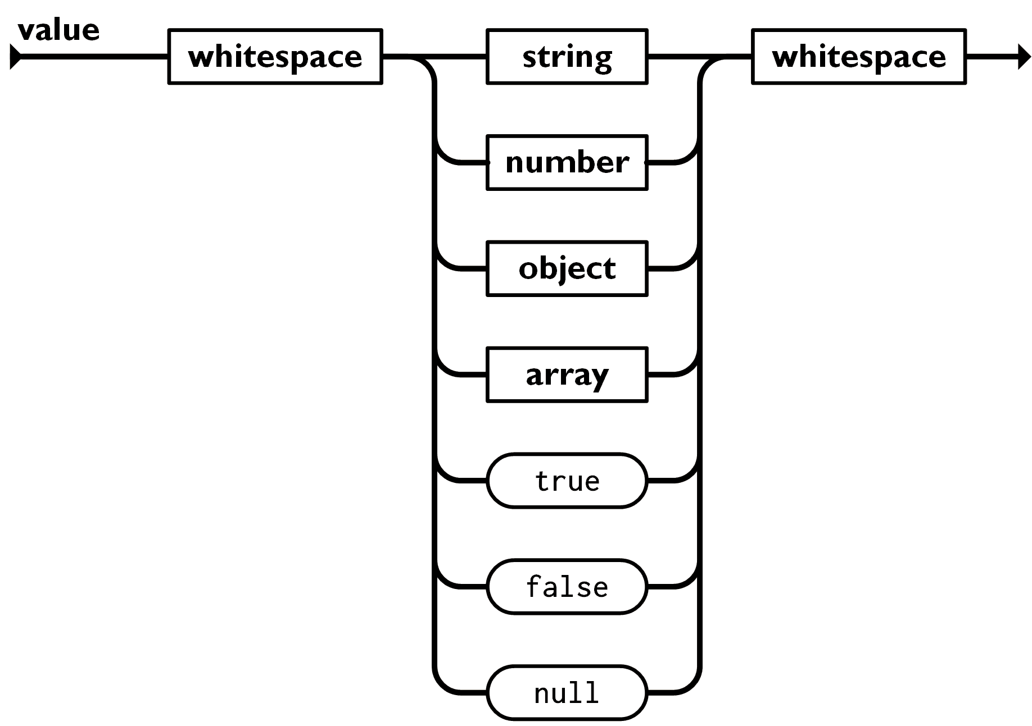
JSON Values
"Michael"
6.022E23
666
64.6
{"name": "Michael",
"location": "Iowa City"}
[1, 5, 9]
["a", "b, "c"]
[{"name": "Michael"},3, false]
true
false
null
Note: All the syntax diagrams in this presentation were borrowed from www.json.org

Slide 9
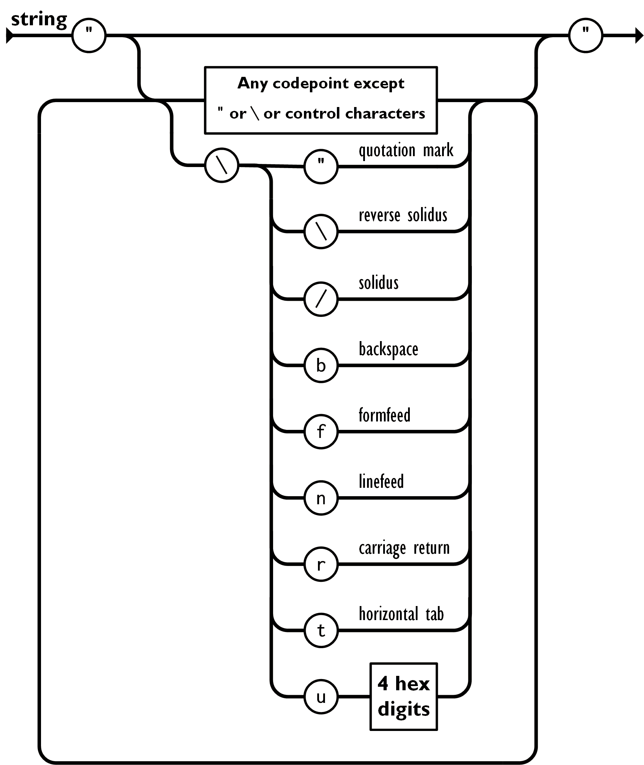
JSON String
examples:
"my name"
"pesc:transcript"
"\t\thelp"
"line 1\nline2"
"a Unicode code point: \u22F9"
Notes:
Some programming languages have problems with object property keys that include special characters or spaces so it is best practice not to use this type of key.
The Unicode character above is ⋹

Slide 10
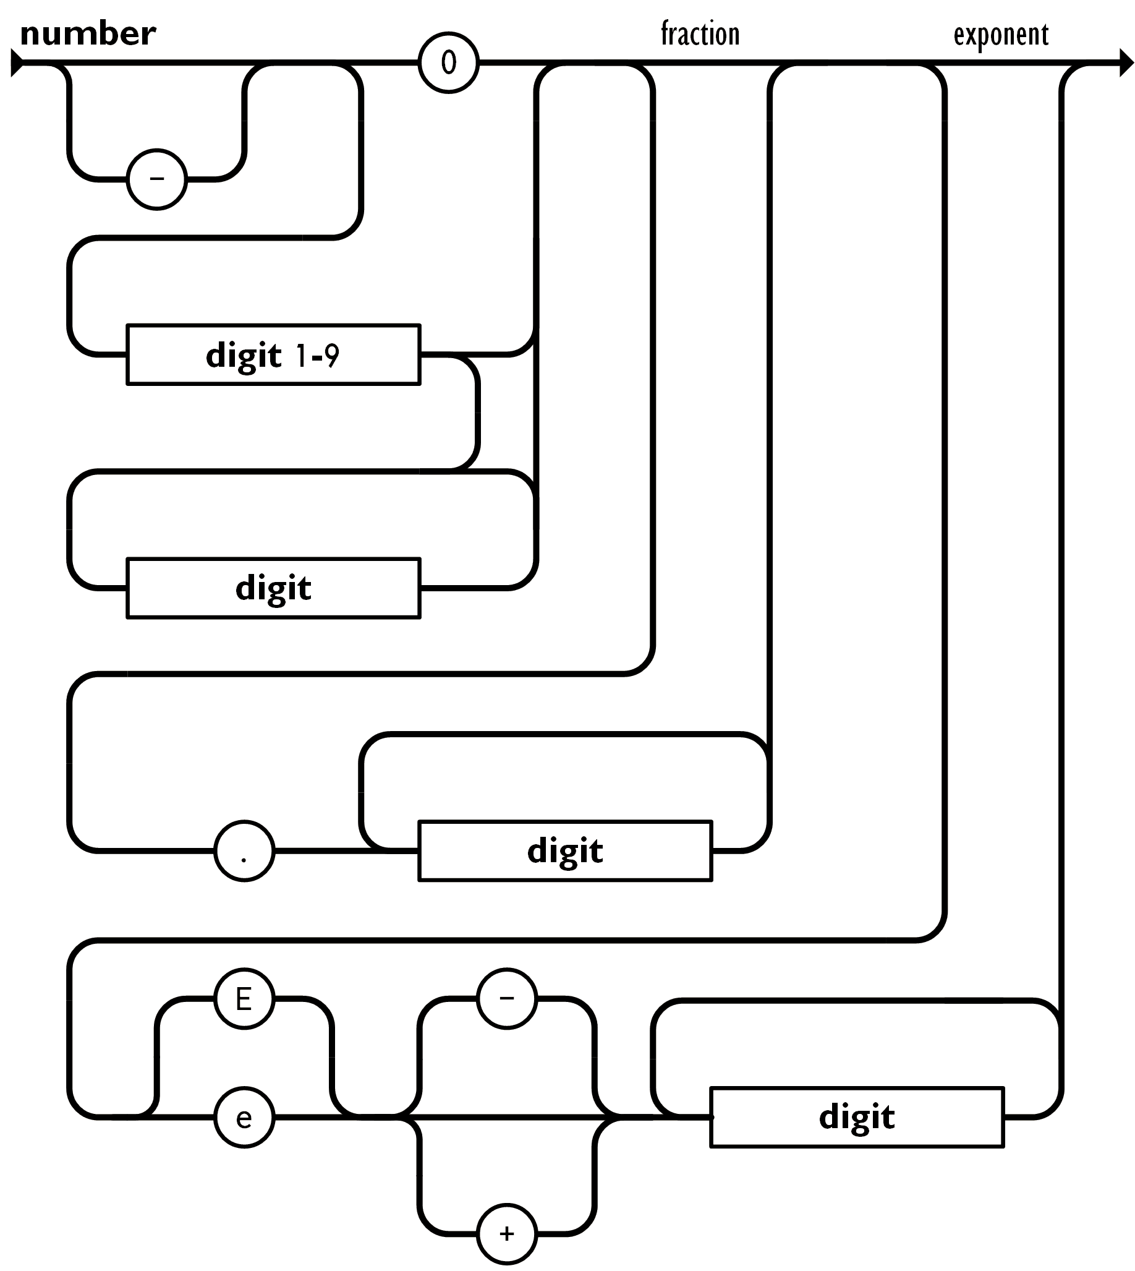
JSON Number
Valid:
-30
-30.123
15.134E23
32.1e-13
-0
0.0
0.38
3e5
Invalid:
003
3.5.4
+24

Slide 11
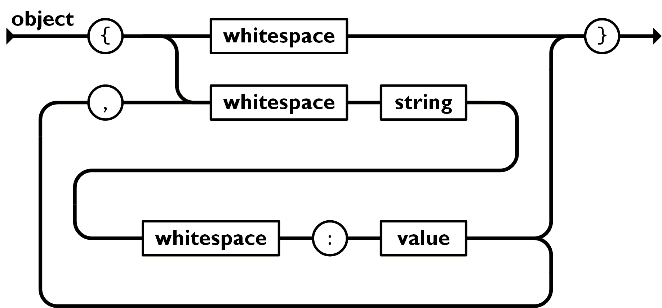
JSON Object
key
value
Example:
{"name": "Michael", "age": 39, "tee_times": [8, 9, 11]}
Object properties are key-value pairs. A programming language may change the order of the properties upon manipulation. For example, it may put them in lexical order by property key (aka property name).
There may not be duplicate keys in an object

Slide 12
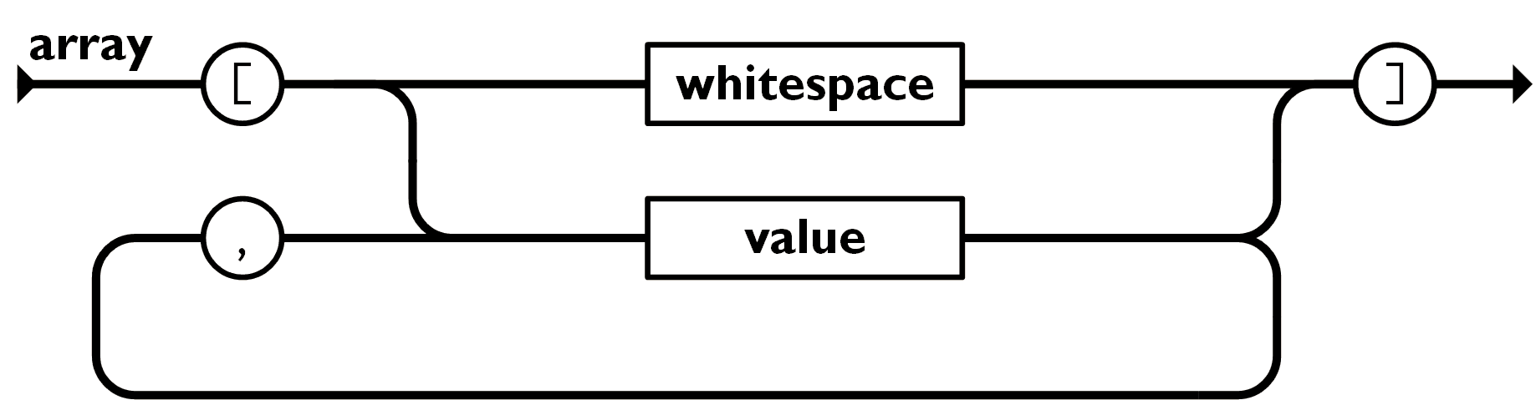
JSON Array
Example:
[{"name": "array", "size": 5}, "a string\n", 34.5e-2, [1, 5, 9], false]
Arrays can have mixed values (objects, arrays, and atomic objects)
Array values are ordered and are referenced in most programming languages by an index starting with 0.

Slide 13
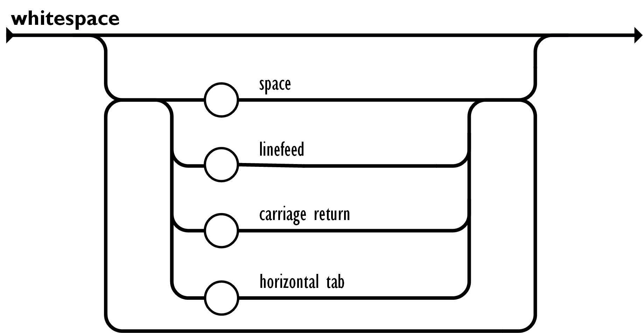
Whitespace
Having white space defined between tokens allows JSON to be made more readable by having spaces, new lines and tabs to format the JSON. We will review an example of formatted JSON later in this presentation

Slide 14
IMS Global Learning Tools Interoperability (LTI) POST Body
{
"oauth_consumer_key": "MyKey",
"lti_message_type": "basic-lti-launch-request",
"lti_version": "LTI-1p0",
"launch_presentation_return_url": "http://www.act.org",
"resource_link_id": "testing",
"user_id": "7015",
"roles": "Learner",
"oauth_callback": "about%3Ablank",
"oauth_signature_method": "HMAC-SHA1",
"lis_person_name_full": "MOYUA POV",
"context_id": "99888",
"context_label": "ACT Test Center",
"context_title": "Iowa City Test Center",
"launch_presentation_locale": "en-us",
"lis_person_name_given": "MOYUA",
"lis_person_name_family": "POV"
}

Slide 15
Example PESC JSON
{
"TransmissionData": {
"DocumentID": "12345CV",
"CreatedDateTime": "2016-02-29",
"TransmissionType": "Resubmission",
"DocumentTypeCode": "Application",
"Source": {…},
"Destination": {…},
"NoteMessage": ["First Message", "Second Message"
]
},
"Student": {…}
}

Slide 16
Preview of JSON Schema
How do we specify what properties go where in the document?
How do we validate that the values are appropriate? Numbers are numbers and dates are dates, and SCED codes are SCED codes.
How do we specify if a property is required in the document?
How do we specify if a required property's value can be null?
How can we specify if a property is present conditionally on another property value?
Answer: Use a JSON Schema to specify your JSON exchange.

Slide 17
Schema Example
{
"$schema": "http://json-schema.org/draft-04/schema#",
"description": "JSON Schema for PESC College Transcript",
"type": "object",
"additionalProperties": false,
"required": [
"Student",
"TransmissionData"
],
"properties": {
"NoteMessage": {
"items": {
"$ref": "#/definitions/NoteMessageType"
},
"type": "array"
},
"Student": {
"$ref": "#/definitions/StudentType"
},
"TransmissionData": {
"$ref": "#/definitions/TransmissionDataType"
},
"UserDefinedExtensions": {
"$ref": "#/definitions/UserDefinedExtensionsType"
}
},
"definitions": {…}
}

Slide 18
JSON Schema Snippet
{
"AgencyCodeType": {
"description": "A code that describes the type of agency that assigned the student's identification number",
"enum": [
"District",
"Migrant",
"MutuallyDefined",
"National",
"Province",
"Regional",
"State"
],
"type": "string"
},
"AgencyCourseIDType": {
"description": "The course ID that might have been assigned to this course by the state or other agency",
"maxLength": 30,
"minLength": 1,
"type": "string"
}
}

Slide 19
Questions

