Slide 1

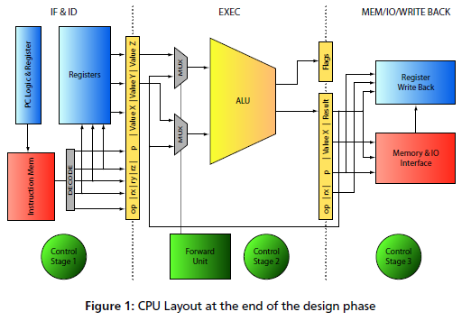
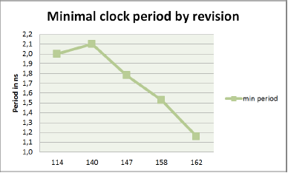
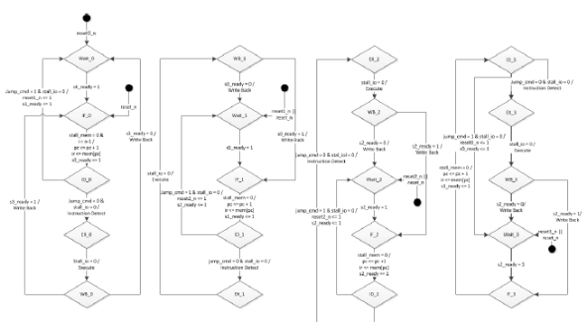
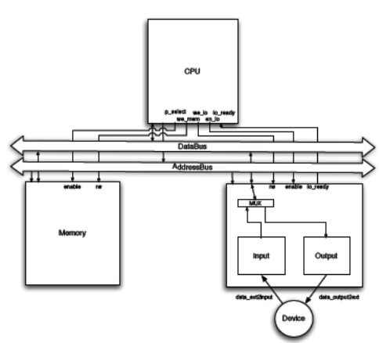
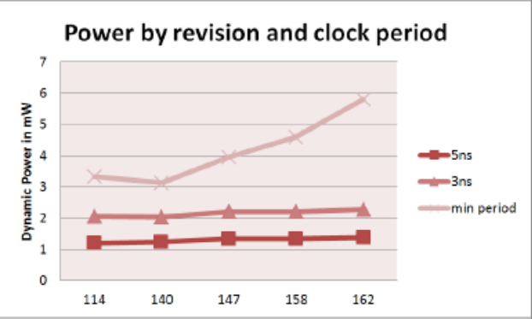
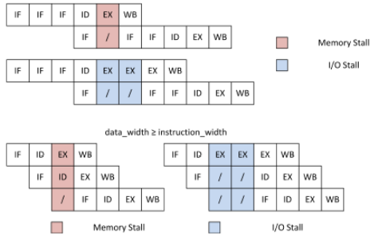
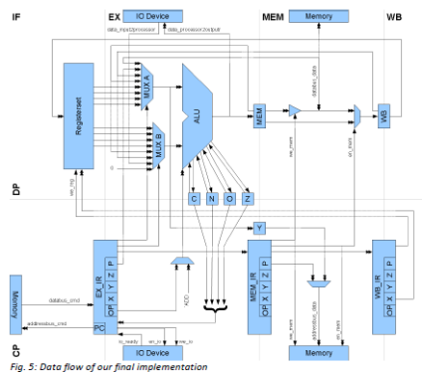
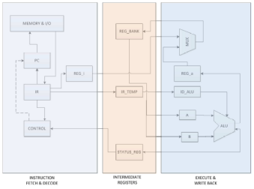
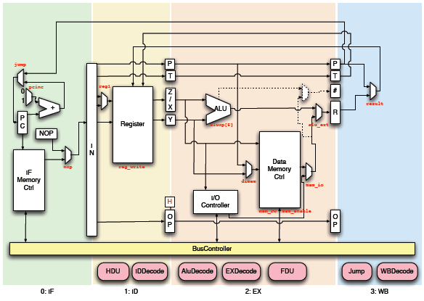
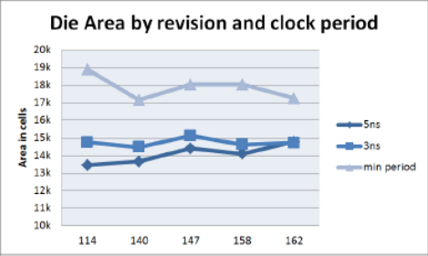
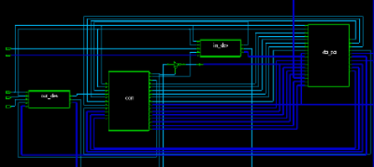
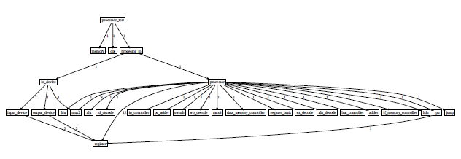
HDL Lab 2012
By courtesy of the teams of the HDL Lab 2011

Slide 2
HDL Lab 2012 - Outline
Introduction
  goals, organisation
Task 2012
Tool Tutorials
  Modelsim, Design Compiler, Verification
Break
  group assembly, accounts
How to begin
Questions & Answers

Slide 3
About me
Dipl.-Ing. Boris Traskov
Integrated Electronic Systems Lab, TU Darmstadt
Merckstraße 25
64283 Darmstadt
Email: boris.traskov@ies.tu-darmstadt.de
Room: S306-345B
Research Interests:
High-Speed Networking
FPGA & ASIC Design

Slide 4
HDL Lab - Goals
Go beyond Verilog:
  Simulator (Modelsim)
  Synthesizer (Design Compiler)
  Design Automation (Bash, TCL)
Learn to use:
  C/C++
  GCC
  Assembler
  make
And see past 0101 0100 0111 0010 1011 0101 0110
Get prepared for a thesis at IES! Get prepared for engineering!

Slide 5
HDL Lab - Organisation
Work in Groups of 4
  Some are already assembled, others will do so during the break.
10 work days Mo-Fr 6.08-17.08
Report submission until 24.08
Oral exam after report submission in groups.

Slide 6
Task 2012
Model a processor that executes the
Thumb instruction set
in (System)Verilog
At least 2 pipeline stages
Define test cases for verification
Analyse your design (timing, area, power,…)
Optimize for throughput (execution time)

Slide 7
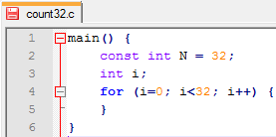
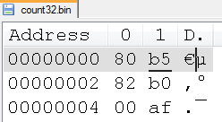
Tools – Software (1)
tool flow
test ride
text editor
program.c
make
gcc, as, ld,
binutils
program.elf
$> make count32
program.bin
program.elf.dasm
program.gold

Slide 8
Tools – Software (2)
Example test case : count32
Look at Appendix C and follow!
  Purpose: Counts variable „i“ from 0 to 31.
Workflow for creation of golden model:
  count32.dasm -> tells us „i“ is located @0x200
  count32.c -> tells us that the variable is initialized in with 0x76543210 for easy identification.
  -> tells us „i“ shall be 31 after execution
  count32.bin -> shows us the little-endian representation of i, “1032“@0x200 and “5476“@0x202
  count32.gold -> is an exact copy of count32.bin with
  “1F00“@0x200 and “0000“@0x202
  (Created manually with Notepad++ and hexedit plugin)
  See for yourself!

Slide 9
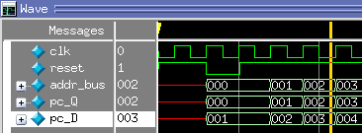
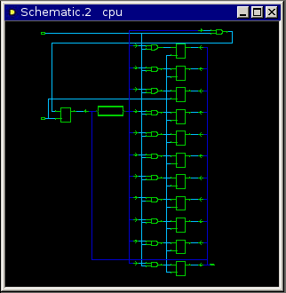
Tools – Hardware (1)
tool flow
test ride
text editor
module.v
testbench.v
Modelsim
Design Compiler
Verify functionality
by simulation
Map to std-cells,
DWBB,
analyse timing/ gate count…

Slide 10

Tools – Hardware (2)
Let‘s do it!

Slide 11
Short break
Let‘s build the remaining groups!
Useraccounts & passwords

Slide 12
How to begin (Monday)
Log on to IES
Download hdllab2012.zip from /home/borist/Public
Find manual.pdf and the other documentation files
Review and browse! You will need to look up information frequently throughout the lab. Knowing where to search for information is vital.

Slide 13
How to begin (Monday)
Understand the testprograms count32.c and memcpy46.c
Create the two coresponding binary files by running
  make count32
  make memcpy46
Take a look at the *.elf, *.dasm, *.bin files
Review the concept of „little-endianess“
Understand how assembler-instructions and binary representation corespond.
Consult the ARM-Architecture reference manual!

Slide 14
Monday
Run Modelsim with the example testbench
Run Design Compiler with the example module
Run the example synthesis scripts, review and understand the reports.
Understand the concepts.

Slide 15
How to begin (Monday)
Think about:
  What is the most time-consuming instruction? (propagation delay)
  How fast is a single-stage 32bit adder/subtractor in 130nm at most?
    Hint: Design Compiler knows the answer (if you ask the right question)!
  What do these two questions imply for your design? What are your options?

Slide 16
How to begin (Tuesday)
Review your results from Monday
Draw a block diagram of your design on paper
Think about how instructions pass through the pipeline
Discuss how to divide the work between each other. Make sure that:
  Everyone writes a test program and compiles it (if you don‘t know C, help each other, find simple examples on the net)
  Everyone practises Verilog coding and simulation
  Everyone practises design analysis with Design Compiler
  Everyone knows how your group‘s design works
No one left behind! If a team-mate struggles, help him/her!
And then you‘re on your own! (But we‘re glad to help)

Slide 17
Questions?
Ask me or Charly.
Mentoring:
  I‘m available for you all day. You‘ll find me in my office.
  If I talk to another group and you have License issues:
    Interrupt me!
Attendance
  Tell me when you have exams, you‘re sick or such…

Slide 18
Questions?
Behaviour in the lab
  Lab is reserved for you! If PCs are free, other students may work on their theses, projects,… Call me, if you don‘t find an empty PC!
  Keep food / sugary fluids away from the machines.
  Maintain low volume when discussing.

Slide 19
Questions?
Ask me or Charly.

Slide 20
Expectations and Assessment
Minimal expected outcome
  Functional design (2 example programs)
  Synthesizable design
Group effort
Individual effort

Slide 21
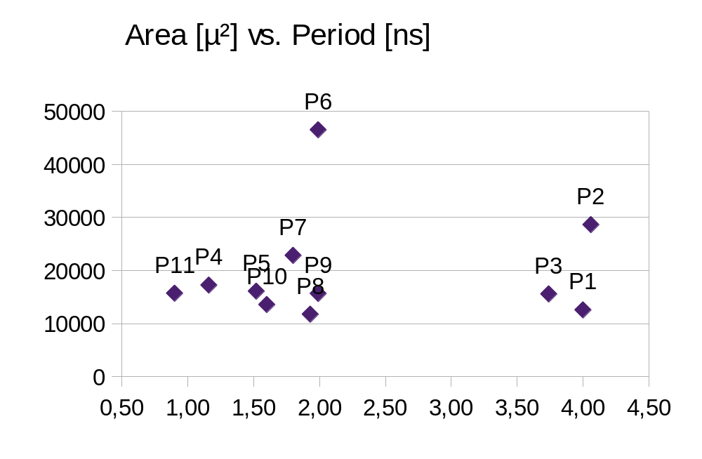
Retrospect 2011
solid design but
unbalanced pipeline
good datapath,
but messed up control logic
unequal work-distribution
lowest execution time
flawless design
excellent testbench
highest IPC
Example programs do not work
3 latches break timing analysis, so take this number with a grain of salt

