Slide 1

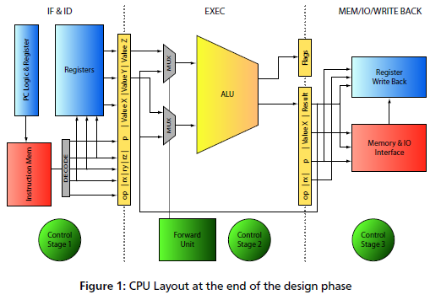
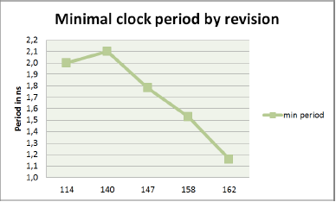
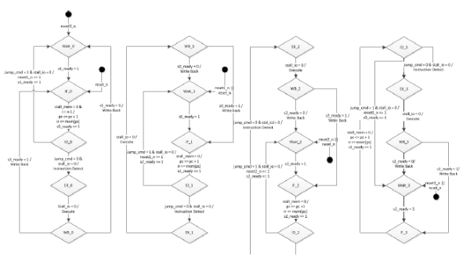
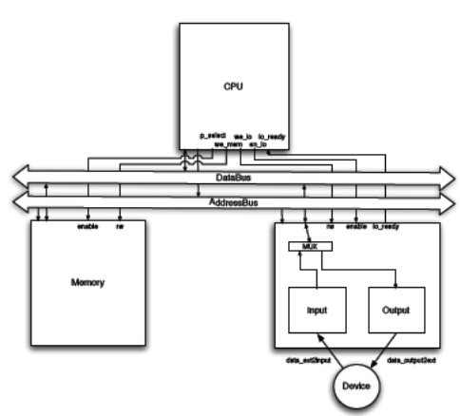
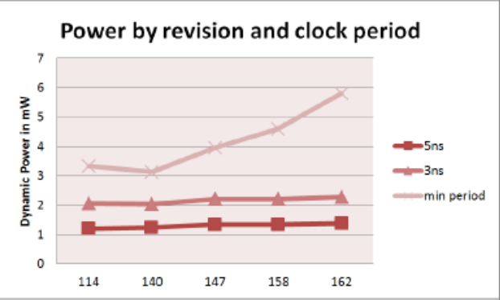
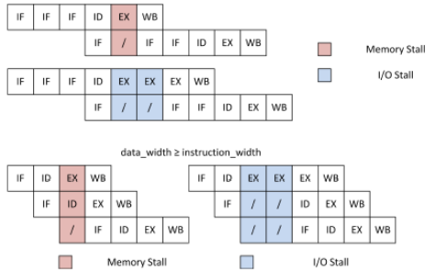
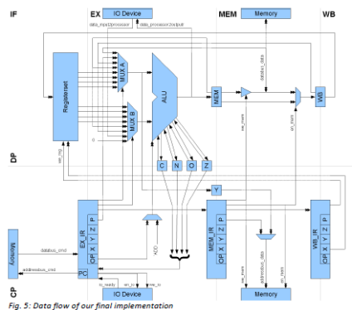
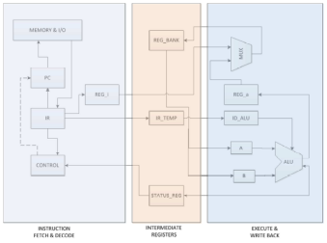
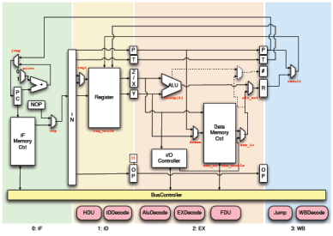
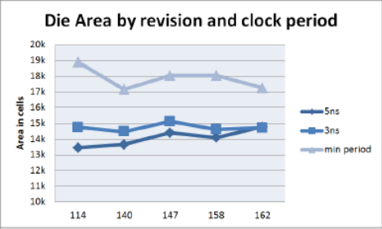
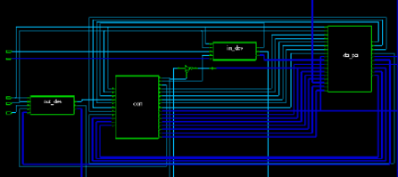
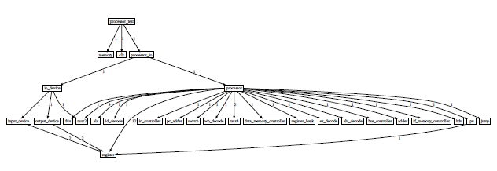
HDL Lab 2013
By courtesy of the teams of the HDL Lab 2012
05.08.2013 | IES, TU-DARMSTADT
Notes:
31. Juli 2013
|
| <number>

Slide 2
HDL Lab 2012 - Outline
Introduction
  goals, organisation
Task 2013
Review: Synchronous Pipeline
Tool Tutorials
  Modelsim, Design Compiler, Verification
Break
  group assembly, accounts
How to begin
Questions & Answers
05.08.2013 | IES, TU-DARMSTADT
Notes:
31. Juli 2013
|
| <number>

Slide 3
Who am I...
M.Sc. (Eng.) Haoyuan Ying (Charlie)
Integrated Electronic Systems Lab, TU Darmstadt
Merckstraße 25
64283 Darmstadt
Email: haoyuany@ies.tu-darmstadt.de
Room: S306-346
Research Interests:
Multi/Many Core Architectures
Network-on-Chip
EDA Design Methods
05.08.2013 | IES, TU-DARMSTADT
Notes:
31. Juli 2013
|
| <number>

Slide 4
HDL Lab - Goals
Go beyond Verilog:
  Simulator (Modelsim)
  Synthesizer (Design Compiler)
  Design Automation (Bash, TCL)
Learn to use:
  C/C++
  GCC
  Assembler
  make
Get prepared for a thesis at IES!
05.08.2013 | IES, TU-DARMSTADT
Notes:
31. Juli 2013
|
| <number>

Slide 5
HDL Lab - Organisation
Work in Groups of 4 (maybe 5...) with 2 user accounts.
  Some are already assembled, others will do so during the break.
  Hints:
  In one group, All of you should be albe to speak at least one same language (whatever English or German).
  Each group should have at least one member can speak English.
  Be nice to your team mates.
10 work days Mo-Fr 5.08.13-16.08.13
Report submission until 23.08
Oral exam after report submission in groups.
05.08.2013 | IES, TU-DARMSTADT
Notes:
31. Juli 2013
|
| <number>

Slide 6
Task 2013
Model a processor that executes the given c-programs
- assembled for the Thumb instruction set -
in SystemVerilog (or Verilog)
With clear-cut Fetch, Decode, Execute stages
  (more stages only if need be)
Use the binary program code for verification
Analyse your design:
  Max frequency [Mhz], area [gate-equivalents], resources
Optimize for throughput
  = execution time of the test programs
05.08.2013 | IES, TU-DARMSTADT
Notes:
31. Juli 2013
|
| <number>

Slide 7
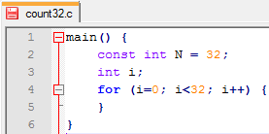
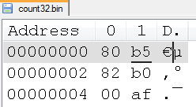
Tools – Software (1)
tool flow
test ride
text editor
program.c
make
gcc, as, ld,
binutils
program.elf
$> make count32
program.bin
program.elf.dasm
program.gold
05.08.2013 | IES, TU-DARMSTADT
Notes:
31. Juli 2013
|
| <number>

Slide 8
Tools – Software (2)
Example test case : count32
Look at Appendix C and follow!
  Purpose: Counts variable „i“ from 0 to 31.
Workflow for creation of golden model:
  count32.dasm -> tells us „i“ is located @0x200
  count32.c -> tells us that the variable is initialized in with 0x76543210 for easy identification.
  -> tells us „i“ shall be 31 after execution
  count32.bin -> shows us the little-endian representation of i, “1032“@0x200 and “5476“@0x202
  count32.gold -> is an exact copy of count32.bin with
  “1F00“@0x200 and “0000“@0x202
  (Created manually with Notepad++ and hexedit plugin)
  See for yourself!
05.08.2013 | IES, TU-DARMSTADT
Notes:
31. Juli 2013
|
| <number>

Slide 9
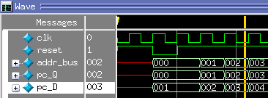
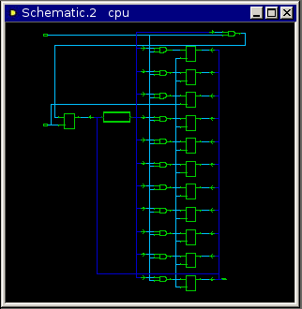
Tools – Hardware (1)
tool flow
test ride
text editor
module.v
testbench.v
Modelsim
Design Compiler
Verify functionality
by simulation
Map to std-cells,
DWBB,
analyse timing/ gate count…
05.08.2013 | IES, TU-DARMSTADT
Notes:
31. Juli 2013
|
| <number>

Slide 10

Tools – Hardware (2)
Let‘s do it!
05.08.2013 | IES, TU-DARMSTADT
Notes:
31. Juli 2013
|
| <number>

Slide 11
Short break
Let‘s build the remaining groups!
Useraccounts & passwords
05.08.2013 | IES, TU-DARMSTADT
Notes:
31. Juli 2013
|
| <number>

Slide 12
How to begin (Monday)
Log on to IES
Download hdllab2013.zip from /home/haoyuany/Public
Find manual.pdf and the other documentation files
Review and browse! You will need to look up information frequently throughout the lab. Knowing where to search for information is vital.
05.08.2013 | IES, TU-DARMSTADT
Notes:
31. Juli 2013
|
| <number>

Slide 13
How to begin (Monday)
Understand the testprograms count32.c and memcpy46.c
Create the two coresponding binary files by running
  make count32
  make memcpy46
Take a look at the *.elf, *.dasm, *.bin files
Review the concept of „little-endianess“
Understand how assembler-instructions and binary representation corespond.
Consult the ARM-Architecture reference manual!
05.08.2013 | IES, TU-DARMSTADT
Notes:
31. Juli 2013
|
| <number>

Slide 14
Monday
Run Modelsim with the example testbench
Run Design Compiler with the example module
Run the example synthesis scripts, review and understand the reports.
Understand the concepts.
05.08.2013 | IES, TU-DARMSTADT
Notes:
31. Juli 2013
|
| <number>

Slide 15
How to begin (Monday)
Think about:
  What is the most time-consuming instruction? (propagation delay)
  How fast is a single-stage 32bit adder/subtractor in 130nm at most?
    Hint: Design Compiler knows the answer (if you ask the right question)!
  What do these two questions imply for your design? What are your options?
05.08.2013 | IES, TU-DARMSTADT
Notes:
31. Juli 2013
|
| <number>

Slide 16
How to begin (Tuesday)
Review your results from Monday
Draw a block diagram of your design on paper
Think about how instructions pass through the pipeline
Discuss how to divide the work between each other. Make sure that:
  Everyone writes a test program and compiles it (if you don‘t know C, help each other, find simple examples on the net)
  Everyone practises Verilog coding and simulation
  Everyone practises design analysis with Design Compiler
  Everyone knows how your group‘s design works
No one left behind! If a team-mate struggles, help him/her!
And then you‘re on your own! (But we‘re glad to help)
05.08.2013 | IES, TU-DARMSTADT
Notes:
31. Juli 2013
|
| <number>

Slide 17
Expectations and Assessment
Minimal expected outcome
  Functional design (2 example programs)
  Synthesizable design
Group effort
Individual effort
Report quality (English)
05.08.2013 | IES, TU-DARMSTADT
Notes:
31. Juli 2013
|
| <number>

Slide 18
Lab Rules
Absence
Allowed: Health problems; Exams; Emergency issues;
Unallowed: Lazy on your beds; Family/Boy-Girlfriends visiting;...
Team-Work
Under NO circumstance you are allowed to blame other team members! If you have problems, simply talk to me.
Drink & Food
NO
Chairs
If you borrowed the chairs from other rooms, you HAVE TO return them at the end of the working day!
PC & Desk
You have to turn-off the working PCs at the end of the working day and keep your desks tidy and clean.
05.08.2013 | IES, TU-DARMSTADT
Notes:
31. Juli 2013
|
| <number>

Slide 19
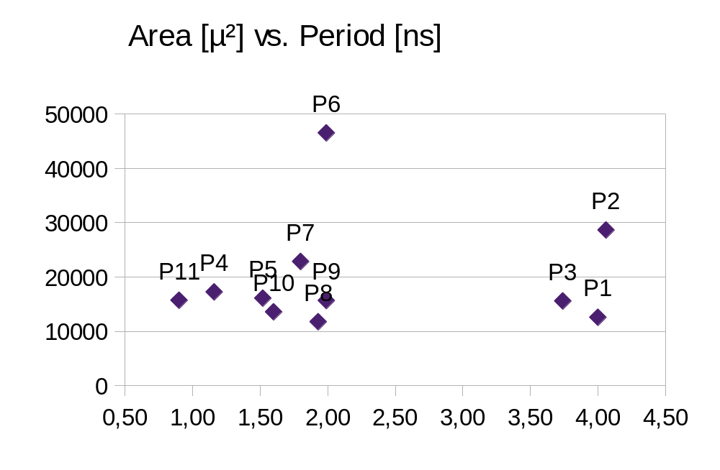
Retrospect 2012
solid design but
unbalanced pipeline
good datapath,
but messed up control logic
unequal work-distribution
lowest execution time
flawless design
excellent testbench
highest IPC
Example programs do not work
3 latches break timing analysis, so take this number with a grain of salt
05.08.2013 | IES, TU-DARMSTADT
Notes:
31. Juli 2013
|
| <number>

