Slide 1
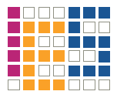
Design of an Accelerated Event-based Server
Bachelor Thesis
Institute of Computer Engineering
Integrated Electronic Systems Lab

Slide 2
Design of an Accelerated Event-based Server
Design of an Accelerated Event-based Server
Design of an Accelerated Event-based Server
nginx

Slide 3
Design of an Accelerated Event-based Server

Slide 4
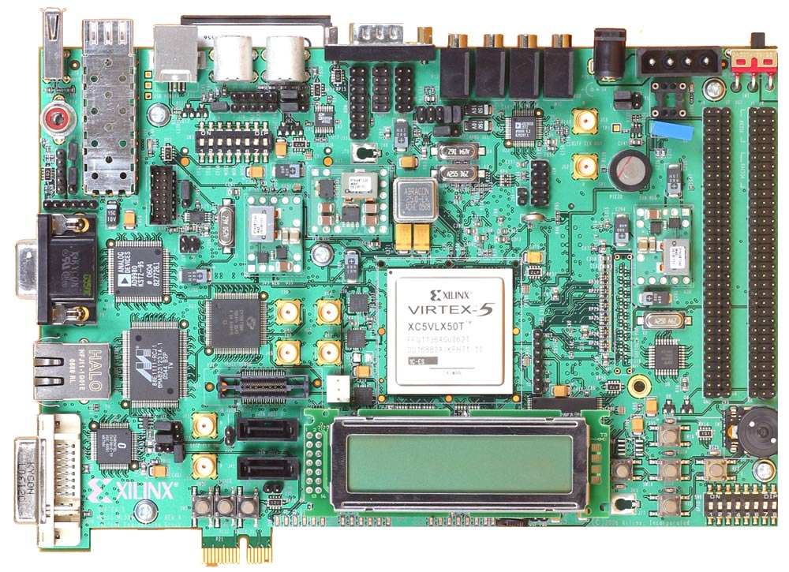

Base Hardware
(c) by Xilinx
(c) by Xilinx
Xilinx University Program XUPV5-LX110T Development System
XC5VLX110T

Slide 5
Agenda
Preceding Work
nginx
Performance Tests
TCP Offload Engine (TOE)
Conclusion

Slide 6
Preceding WORK
nginx
Performance Tests
TCP Offload Engine (TOE)
Conclusion

Slide 7
System Requirements
nginx
Operating System
?
fixed
Processor
Xilinx XC5VLX110T

Slide 8
System Requirements
nginx
Operating System (OS)
Processor
Hardware
Xilinx XC5VLX110T

Slide 9
Hardware Architecture
Ext. Peripherals
System on Chip (SoC)
System on Chip (SoC)

Slide 10
Hardware Architecture
Ext. Peripherals
MicroBlaze
Processor
Bus System
Memory Controller
256 MB DDR Memory
D-Cache
MMU
I-Cache
Div.
Mult.
Barrel Sh.
Interrupt
Controller
Timer
Network Interface
Clock
Generator
I/O
UART Controller

Slide 11
System Requirements
nginx
Operating System (OS)
Processor
Hardware
Xilinx XC5VLX110T

Slide 12
System Requirements
nginx
Software
Operating System (OS)
Processor
Hardware
Xilinx XC5VLX110T

Slide 13
Linux Kernel Compilation
Configuration
(.config)
Source code
Hardware System Specification
File system structure
Device Tree BSP
cpio
Device Tree Source
(.dts)
Initial RAM file system
Compiler, Linker
Device Tree Compiler (dtc)
Linux kernel image (elf file)

Slide 14
Preceding Work
„Design of an Accelerated Event-based Server“

Slide 15
Preceding Work
„Design of an Accelerated Event-based Server“
Hardware system & Linux OS
Project seminar

Slide 16
Preceding Work
„Design of an Accelerated Event-based Server“
Hardware system & Linux OS
nginx
Perf. measurements
TCP offload engine
Project seminar
Bachelor thesis

Slide 17
nginx
Preceding Work
Performance Tests
TCP Offload Engine (TOE)
Conclusion

Slide 18
Traditional, thread-based Architectures
process
t

Slide 19
Traditional, thread-based Architectures
request #1
response #1
request #2
response #2
thread 1
thread 2
process
t

Slide 20
Traditional, thread-based Architectures
request #1
response #1
request #2
response #2
thread 1
thread 2
system calls
process
t

Slide 21
Event-based Architectures
request #1
response #1
process
t

Slide 22
Event-based Architectures
request #1
response #1
process
event module (e.g. „epoll“)
t

Slide 23
Event-based Architectures
request #1
response #1
request #2
response #2
process
event module (e.g. „epoll“)
t

Slide 24
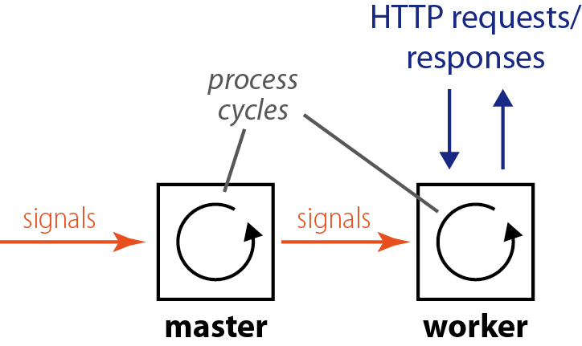
nginx – Overview
nginx processes:
Notes:
2 processes
Purpose of master and worker
Process cycle

Slide 25

nginx Configuration
parameters
auto config.
nginx build configuration

Slide 26
nginx Configuration
parameters
Write program to temp.c
Compile temp.c with configured compiler
Read back results
auto config.
nginx build configuration

Slide 27
nginx Configuration
parameters
auto config.
nginx build configuration

Slide 28
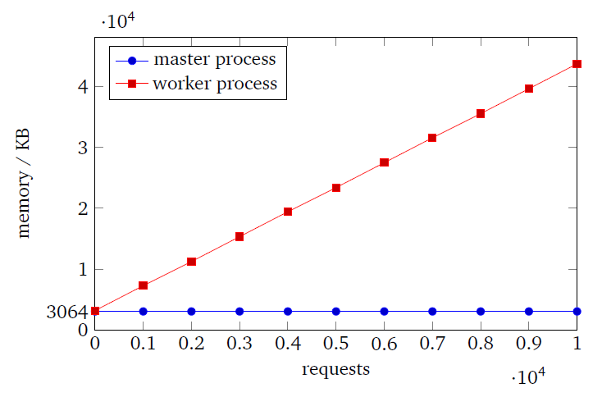
Memory Leaks
200 MB for about 50,500 requests

Slide 29
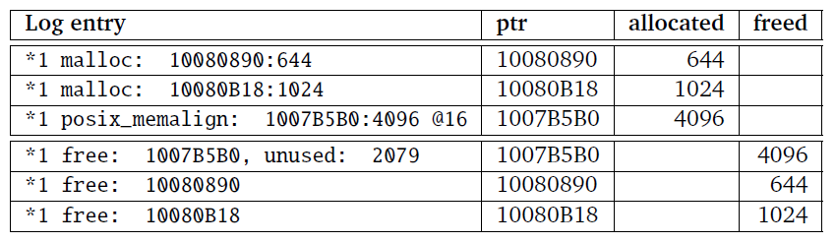
Memory-related Log Messages
Memory management related debug messages of a single request.

Slide 30
First Workaround
Restart worker processes:
kill –HUP <pid>

Slide 31
First Workaround
Restart worker processes:
kill –HUP <pid>

Slide 32
Integrated Solution

Slide 33
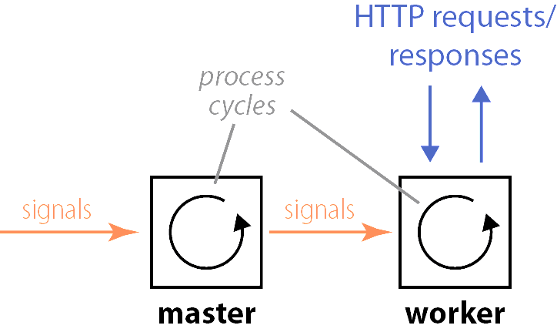
Workaround
(3) restart
worker
(1) Timer sends SIGALRM
(2) handle signal
& check free mem.
/proc/meminfo

Slide 34
Workaround
(3) restart
worker
(1) Timer sends SIGALRM
(2) handle signal
& check free mem.
--with-min-free-mem=[value]
/proc/meminfo
-> Tests: "51200" (kilobytes).

Slide 35
Performance Tests
Preceding Work
nginx
TCP Offload Engine (TOE)
Conclusion

Slide 36
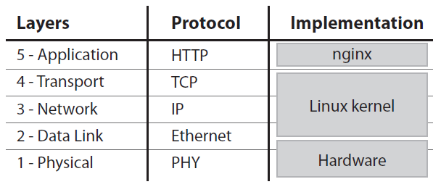
Layer Model

Slide 37
TCP/IP Specifics

Slide 38
TCP/IP Specifics
Anatomy of an HTTP packet:
Ethernet
header
IP
header
TCP
header
HTTP
header
data
1500 bytes (MTU)

Slide 39
TCP/IP Specifics
Anatomy of an HTTP packet:
Ethernet
header
IP
header
TCP
header
HTTP
header
data
1500 bytes (MTU)
HTTP „keep-alive“:
Establish
connection
Req. #1
Resp. #1
Req. #n
Resp. #n
Close connection
…

Slide 40
TCP/IP Specifics
Anatomy of an HTTP packet:
Ethernet
header
IP
header
TCP
header
HTTP
header
data
1500 bytes (MTU)
HTTP „keep-alive“:
Establish
connection
Req. #1
Resp. #1
Req. #n
Resp. #n
Close connection
…
Ports
1
–
65535
Server
Client
80

Slide 41
Tests
File | Size / bytes | TCP packets
index.html | 354 | 2
10K.html | 10,240 | 9
404 | 124 | 1

Slide 42
Tests
File | Size / bytes | TCP packets
index.html | 354 | 2
10K.html | 10,240 | 9
404 | 124 | 1
httperf […]
--rate=NNN \
--num-conns=3000 \
--num-calls=3
N : 20..120 conn./s

Slide 43
Test Results

Slide 44
Test Results

Slide 45
Test Results

Slide 46
Test Results

Slide 47
Error rates (%)

Slide 48
Average Response Times (ms)

Slide 49
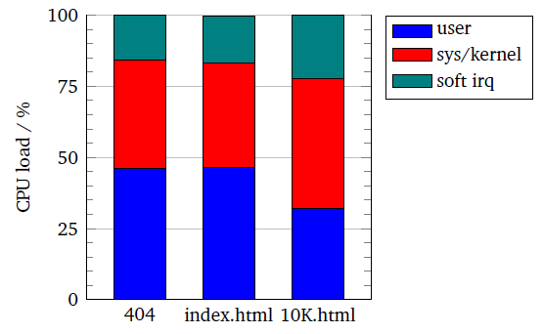
CPU Utilization

Slide 50
Network Throughput (kb/s)

Slide 51
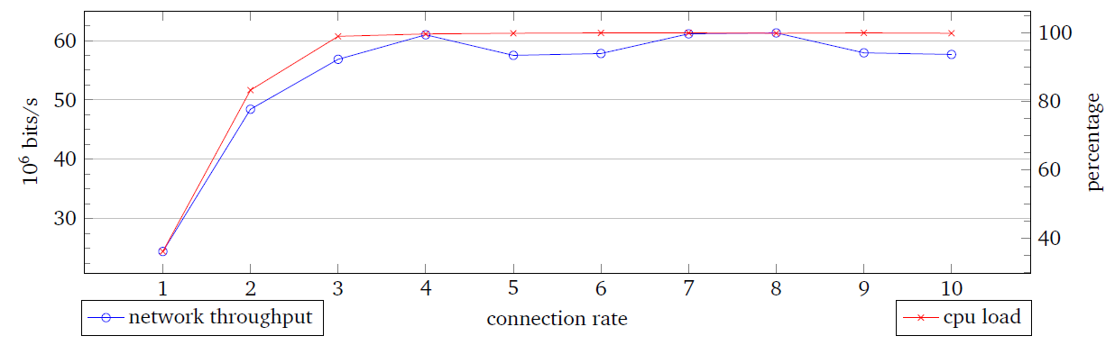
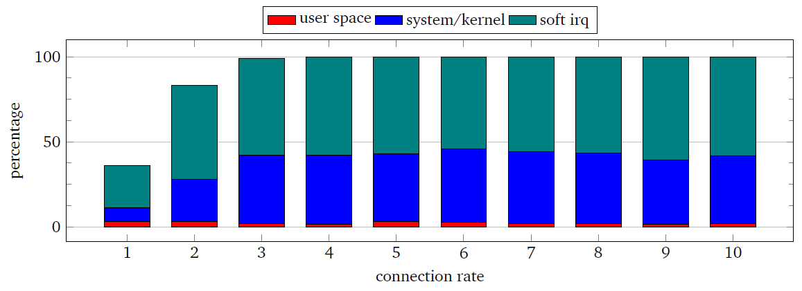
Network Throughput Tests

Slide 52
Linux Network Stack
User Space (e.g. nginx)
Socket Layer
Protocol Families
Linux
kernel
Network Interface
Soft.
irq
Network Device Drivers
Network Controller
Hard-
ware

Slide 53
TCP Offload Engine (TOE)
Preceding Work
nginx
Performance Tests
Conclusion

Slide 54
TOE Categories
Linux network stack
Hardware
Large Segment and Receive Offload (LSO/LRO)
Large
TCP packet
MTU-
sized
packets
TCP Chimney Offload
Hardware
Software
stack
TCP/IP
Full-stack TCP Offload
TCP/IP stack
in Hardware
Software
interface

Slide 55
Linux Network Stack
User Space (e.g. nginx)
Socket Layer
Protocol Families
Linux
kernel
Network Interface
Network Device Drivers
Network Controller
Hard-
ware

Slide 56
TOE Integration
User Space (e.g. nginx)
Socket Layer
short- cut TCP
Protocol Families
Linux
kernel
Network Interface
Network Device Drivers
TOE Device Driver
Network Controller
Hard-
ware
TCP Offload Engine (TOE)

Slide 57
TOE Integration
User Space (e.g. nginx)
Socket Layer
short- cut TCP
sk_buff
Protocol Families
Linux
kernel
Network Interface
Network Device Drivers
TOE Device Driver
Network Controller
Hard-
ware
TCP Offload Engine (TOE)

Slide 58
Conclusion
Preceding Work
nginx
Performance Tests
TCP Offload Engine (TOE)

Slide 59
Thank you for your Attention!

Slide 60
Questions?

