Slide 1
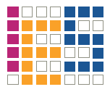
Design of an Accelerated Event-based Server
Project Seminar
Institute of Computer Engineering
Integrated Electronic Systems Lab

Slide 2
Design of an Accelerated Event-based Server
Design of an Accelerated Event-based Server
Design of an Accelerated Event-based Server
Design of an Accelerated Event-based Server

Slide 3
Agenda
Project Context
System Requirements
Hardware Architecture
Software
Demo & Conclusion

Slide 4
Project Context
System Requirements
Hardware Architecture
Software
Demo & Conclusion

Slide 5

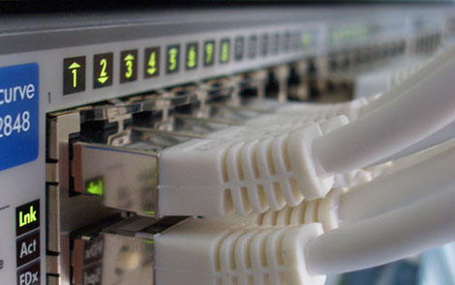
Project Context
High performance network
backends and nodes
Internet of things
(c) by ens-group.eu
(c) by scribbles-notes.blogspot.de, G.N. Nagaraj

Slide 6
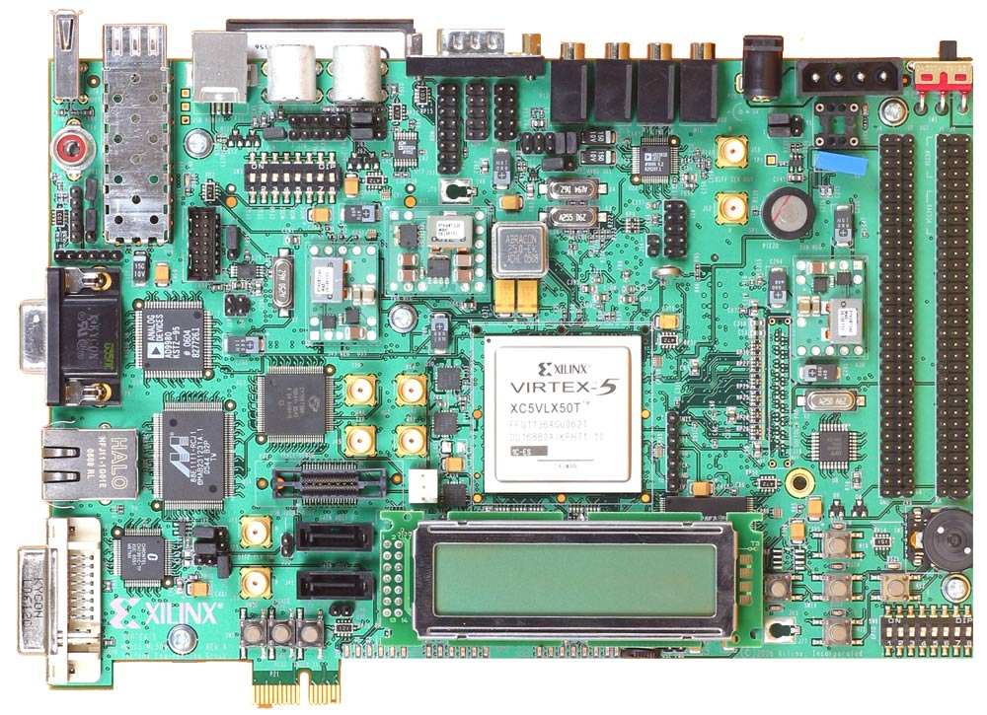
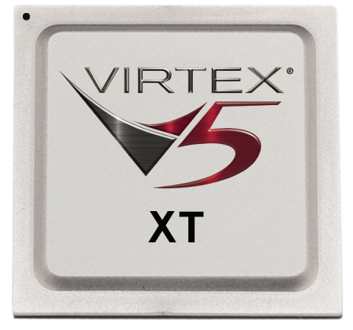
Base Hardware
(c) by Xilinx
(c) by Xilinx
Xilinx University Program XUPV5-LX110T Development System
XC5VLX110T

Slide 7
System Requirements
Project Context
Hardware Architecture
Software
Demo & Conclusion

Slide 8
System Requirements
nginx
Operating System
?
fixed
Processor
Xilinx XC5VLX110T

Slide 9
System Requirements
nginx
File system
Processes/Threads
Operating System (OS)
Processor
Xilinx XC5VLX110T

Slide 10
System Requirements
nginx
File system
Processes/Threads
Operating System (OS)
Processor
“Easy to implement”
Xilinx XC5VLX110T

Slide 11
System Requirements
nginx
File system
Processes/Threads
Operating System (OS)
Compatible architecture
Processor
“Easy to implement”
Xilinx XC5VLX110T

Slide 12
System Requirements
nginx
File system
Processes/Threads
Operating System (OS)
-> Linux
Compatible architecture
Processor
“Easy to implement”
Xilinx XC5VLX110T

Slide 13
System Requirements
nginx
File system
Processes/Threads
Operating System (OS)
-> Linux
Compatible architecture
MMU, Timers
Processor
“Easy to implement”
Xilinx XC5VLX110T

Slide 14
System Requirements
nginx
File system
Processes/Threads
Operating System (OS)
-> Linux
Compatible architecture
MMU, Timers
Processor
-> MicroBlaze
“Easy to implement”
Xilinx XC5VLX110T

Slide 15
Hardware Architecture
Project Context
System Requirements
Software
Demo & Conclusion

Slide 16
Hardware Architecture
Ext. Peripherals
System on Chip (SoC)
System on Chip (SoC)

Slide 17
Hardware Architecture
Ext. Peripherals
Processor
D-Cache
MMU
I-Cache
Div.
Mult.
Barrel Sh.

Slide 18
Hardware Architecture
Ext. Peripherals
Processor
Bus System

Slide 19
Hardware Architecture
Ext. Peripherals
Processor
Bus System
Memory Controller
Memory

Slide 20
Hardware Architecture
Ext. Peripherals
Processor
Bus System
Memory Controller
Memory
Network Interface

Slide 21
Network Interface
Soft-core
Hard-core

Slide 22
Network Interface
10/100 Mb/s
1000 Mb/s
OSI Network Layers
MII
GMII
Network
Reduced
Data
Path
Width
RMII
RGMII
Data Link
MII
Physical
Common
Interface

Slide 23
Hardware Architecture
Ext. Peripherals
Processor
Bus System
Memory Controller
Memory
Network Interface

Slide 24
Hardware Architecture
Ext. Peripherals
Processor
Bus System
Memory Controller
Memory
Interrupt
Controller
Timer
Network Interface
Clock
Generator
I/O
UART Controller

Slide 25
Clocks
100 MHz
Clock
Generator
100 MHz
External
clock
Processor, Bus, etc.
200 MHz
PLL0
Memory, MAC
200 MHz, 90°
Memory
125 MHz
MAC

Slide 26
Hardware Architecture
Ext. Peripherals
Processor
Bus System
Memory Controller
Memory
Interrupt
Controller
Timer
Network Interface
Clock
Generator
I/O
UART Controller

Slide 27
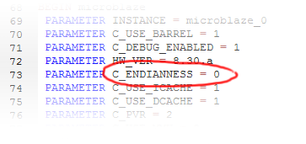
Endianness
Little vs. Big Endian
Virtex-5 restrictions

Slide 28
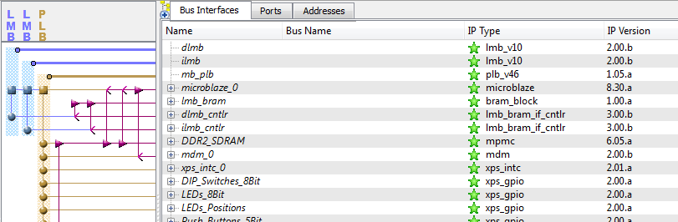
Generating the Hardware System
Xilinx Platform Studio (XPS)

Slide 29


Generating the Hardware System
Xilinx Platform Studio (XPS)
ISE Project Navigator
Synthesis (xst)
Translation (ngdbuild)
Mapping (map)
Place & Route (par)
.mhs & .ucf file
.bit file

Slide 30
Software
Project Context
System Requirements
Hardware Architecture
Demo & Conclusion

Slide 31
Linux Kernel
Kernel
vs.
Distributions
Mainline
(+ forks)
e.g. Ubuntu, Debian, openSUSE, Fedora, etc.

Slide 32
Linux Kernel
Xilinx / PetaLogix
Linux mainline
support for MicroBlaze
Version 2.6.30
9th June 2009

Slide 33
Cross Compilation
Cross Compiler
runs on top of / is compiled for
compiles for
Host Architecture
Target Architecture

Slide 34
Linux Kernel Compilation
Configuration
(.config)
Source code
Hardware System Specification
File system structure
Device Tree BSP
cpio
Device Tree Source
(.dts)
Initial RAM file system
Compiler, Linker
Device Tree Compiler (dtc)
Linux kernel image (elf file)

Slide 35
Demo
Project Context
System Requirements
Hardware Architecture
Software
Conclusion

Slide 36
Conclusion
Project Context
System Requirements
Hardware Architecture
Software

Slide 37
Next Steps
Compilation of nginx for MicroBlaze
Performance measurements and evaluation
Integration of TCP offload engine

Slide 38
Thank you for your Attention!

Slide 39
Questions?

