Slide 1
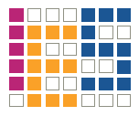
Design of an Accelerated Event-based Server
Project Seminar
Institute of Computer Engineering
Integrated Electronic Systems Lab

Slide 2
Design of an Accelerated Event-based Server
Design of an Accelerated Event-based Server
Design of an Accelerated Event-based Server
Design of an Accelerated Event-based Server

Slide 3
Agenda
Project Context
System Requirements
Hardware Architecture
Software
Conclusion

Slide 4
Project Context
System Requirements
Hardware Architecture
Software
Conclusion

Slide 5
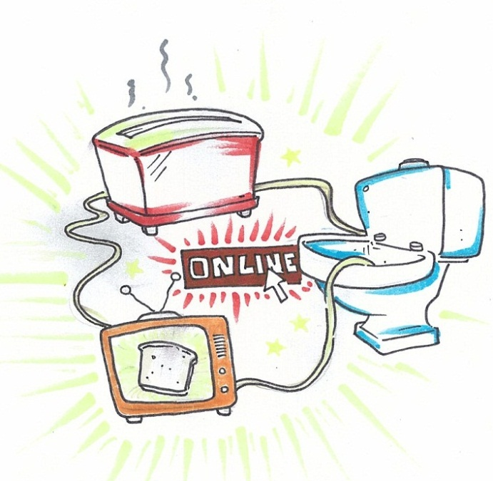
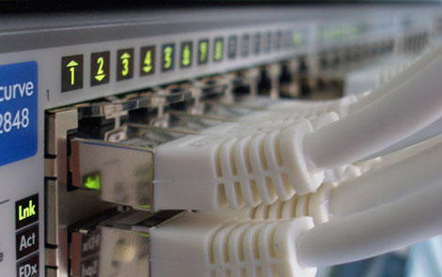
Project Context
High performance network
backends and nodes
Internet of things
(c) by ens-group.eu
(c) by scribbles-notes.blogspot.de, G.N. Nagaraj

Slide 6
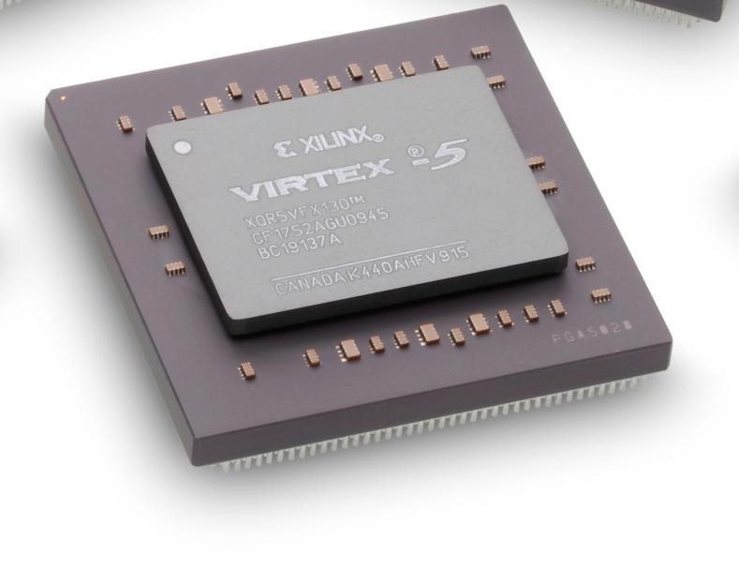
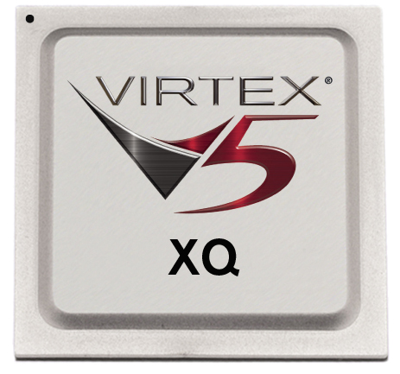
Project Context

Slide 7
System Requirements
Project Context
Hardware Architecture
Software
Conclusion

Slide 8
System Requirements
nginx
Operating System
?
fixed
Processor
Xilinx XC5VLX110T

Slide 9
System Requirements
nginx
Operating System
Processor
Xilinx XC5VLX110T

Slide 10
Hardware Architecture
Project Context
System Requirements
Software
Conclusion

Slide 11
Hardware Architecture
External Architecture / Processor
Bus system
Memory
Network interface
Clocks
Notes:
Schaltungstypen
Design-Muster

Slide 12
Clocks
System
External
clock
Clock generator
other cores

Slide 13
Software
Project Context
System Requirements
Hardware Architecture
Conclusion

Slide 14
Conclusion
Project Context
System Requirements
Hardware Architecture
Software

Slide 15
Thank you for your Attention!

Slide 16
Questions?

Slide 18
Architektur-Modelle
Flip-Flop-Designs
Zwei-Phasen-Latch-Designs
Ein-Phasen-Latch-Designs
Notes:
Schaltungstypen
Design-Muster

Slide 19
Architektur-Modelle
FLIP-FLOP-DESIGNS
Zwei-Phasen-Latch-Designs
Ein-Phasen-Latch-Designs

Slide 20
Einleitung
Architektur-Modelle
Weiterführende Konzepte
FAZIT
Notes:
Abschließend lässt sich festhalten, dass mit Hilfe von Scan-Techniken die Testbarkeit von zustandsbehafteten Schaltungen stark erhöht werden kann. Dies geht nicht ohne Kosten einher, die Auswirkungen dieser können jedoch gering gehalten werden, so dass Scan-Techniken als Umsetzungs-Konzept für Design for Testability eine gute Lösung darstellen.

