Slide 1

Dynamics of a Bio-Inspired Tail Modeled as an Elastic
Beam Across Media, Loadings, and Material Properties
Marwan Fayed, Parsa Esfandiari
263F-Final Presentation
12/10/2025

Slide 2
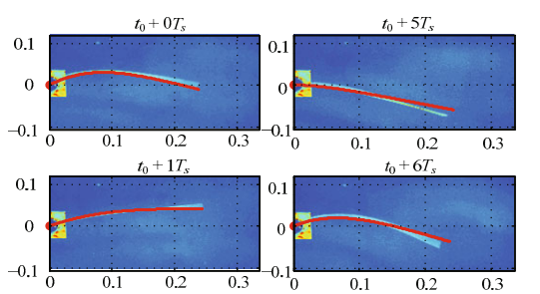
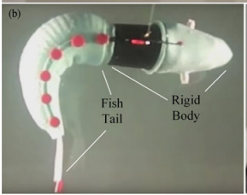
Motivation:
Many biological swimmers (fish, eels, spermatozoa) generate thrust by propagating curvature waves along slender tails.
At low Reynolds numbers, viscous forces dominate, and tail waveform strongly controls propulsion.
Robotic systems imitate these strategies using compliant tails for agility and disturbance rejection.
We need mechanics-grounded simulation tools linking elasticity, actuation, and viscous drag.

Slide 3
Background & Modeling Foundations
Elastic rod models capture stretching, bending, and torsion of slender structures.
McMillen & Holmes: elastic-rod theory for anguilliform swimming.
Saab et al.: benefits of compliant robotic tails, need for unified simulators.
Wang et al.: base-actuated robotic fish as modeling benchmark.
→ A gap remains: systematic mechanics-based exploration of tail actuation, stiffness, and fluid interactions.

Slide 4
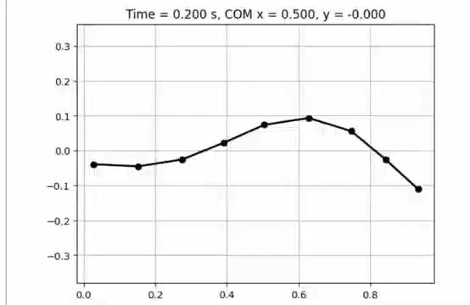
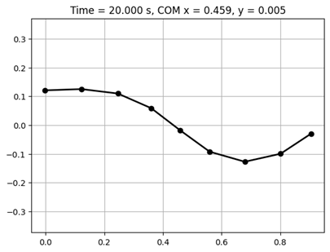
Discrete Elastic Rod (DER) Tail Model
9-node 2D discrete elastic rod.
Stretching + bending energies with analytic gradients & Hessians.
Natural curvature actuation (traveling wave along the tail).
Heterogeneous bending stiffness (stiffer head → more stable kinematics).
Anisotropic viscous drag (normal drag > tangential drag).

Slide 5
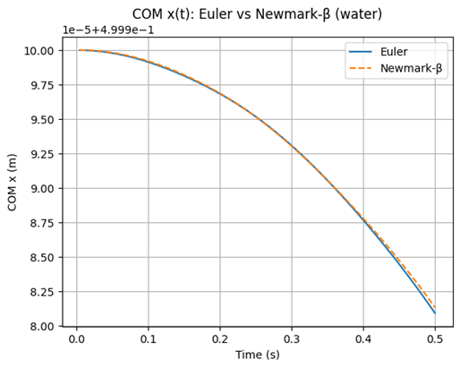
Time Integration & Solver
Fully implicit Backward Euler used for all sweeps.
Newmark-β implemented as cross-check.
Newton–Raphson solution each timestep with full Jacobian.
Both integrators show:
high stability under large curvature,
nearly identical COM trajectories.

Slide 6
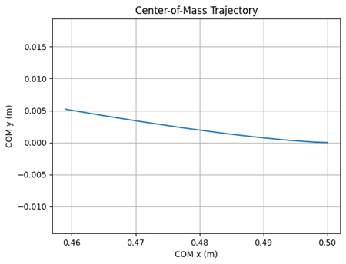
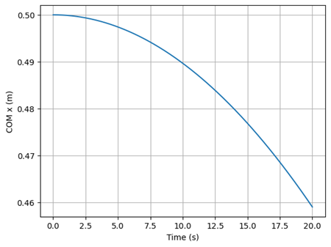
Baseline Tail Kinematics
Curvature wave produces smooth bending from head → tip.
Stiffer head reduces excessive bending and yaw.
COM drifts steadily with small lateral excursions.
Nodal motion matches expected amplitude envelope.

Slide 7
Multi-Parameter Sweep (192 Cases)
We varied:
Stiffness: E_factor=0.7,1.0
Radius / geometry
Density
Viscosity scaling
Medium: water vs glycerol
Curvature amplitude: 0.8, 1.2
Frequency: 1.0, 1.5, 2.0 Hz
Simulation details:
Duration: 0.5 s
Time step: 10−4 s
Recorded: deltax_net​, y_max, COM traces

Slide 8
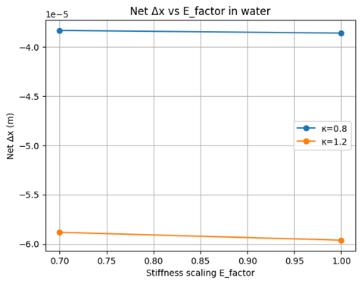
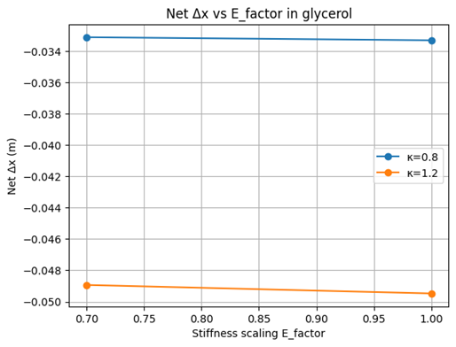
Effect of Stiffness on Propulsion
Net displacement is almost unchanged when stiffness varies 0.7 → 1.0.
Only minor differences in both water and glycerol.
Conclusion: stiffness is a weak control parameter within moderate ranges.

Slide 9
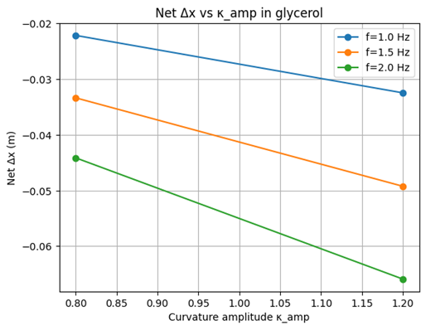
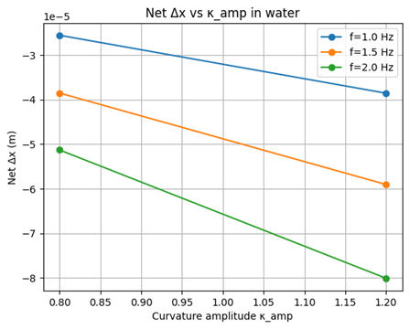
Effect of Curvature Amplitude
Net displacement increases nearly linearly with κ_amp.
Increasing κ_amp from 0.8 → 1.2 produces ~50–60% larger displacement in glycerol.
Same trend holds in water but with much smaller magnitude.

Slide 10
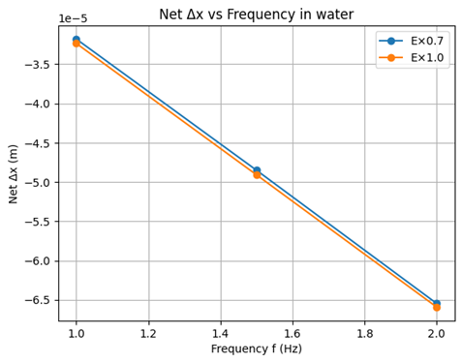
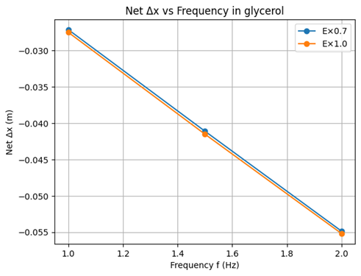
Effect of Frequency & Fluid Medium
Displacement magnitude increases almost linearly with actuation frequency.
Medium has huge effect:
Water: Δx ≈ 10^-5 m
Glycerol: Δx ≈ 10^-2 m
→ Three orders of magnitude difference due to higher viscous coupling.

Slide 11
Conclusions
Strongest propulsion drivers:
Curvature amplitude
Frequency
Moderate stiffness variations → minimal effect.
Medium viscosity → dominant scaling factor (glycerol ~1000× water).
Implicit Euler = accurate & efficient for large sweeps.
Framework enables systematic design exploration for soft-robotic tails.

Slide 12
Future Work
Add Resistive Force Theory or slender-body hydrodynamics.
Extend to 3D rods including torsion.
Simulate cross-media transitions (water ↔ gel ↔ air).
Enable inverse design of stiffness gradients and actuation patterns.
Complete energy analysis pipeline for efficiency metrics.

Slide 13
Thank You!

