Slide 1
Heuristic approaches to glass cutting optimization
Biserka Yovcheva
Petar Ivanov
Valentina Dyankova

Slide 2
Problem statement
The packing problem involves the orthogonal placement of a set of rectangles into a rectangular strip (or bin) of given dimensions so that no rectangles are overlapping
The cuts must be guillotine (edge–to–edge)
The goal is to:
  minimize the height (for strip packing)
  minimize the bins used (for equal bins)
  minimize the number of remaining glasses (after returning the unused cut pieces)
  ...

Slide 3
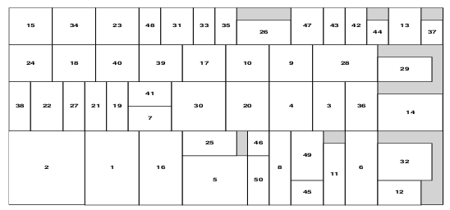
Sample packing result
Mumford-Valenzuela, Pearl Y. Wang, Janis Vick

Slide 4
Level oriented algorithms
Next Fit Decreasing Height (NFDH) – O(n)
First Fit Decreasing Height (FFDH) – O(n*logn)
Best Fit Decreasing Height (BFDH) – O(n*logn)
Worst Fit Decreasing Height (WFDH) – (n*logn)
All are guaranteed to produce results not worse then twice the optimal height of the strip cut.

Slide 5
Wei, Lijun, et al. "A goal-driven approach to the 2D bin packing and variable-sized bin packing problems." European Journal of Operational Research (2012)

