Slide 1
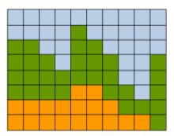
Dynamic Programming for General Pairwise MRFs
(4 papers from 2010 – 2012)
Petar Ivanov
Graphics and Media Lab
Moscow State University
Feb 2013

Slide 2

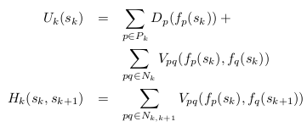
Problem statement
Given a pairwise Markov Random Field with energy E:
To optimize E by f(P)

Slide 3
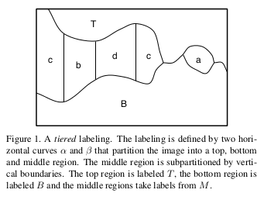
Felzenszwalb, Veksler – “Tiered Scene Labeling with Dynamic Programming”, CVPR 2010
Each column has its own label (+regions T and B)
Used for:
  Foreground/background
  Sky/ground/tree
O(mn²K²) after a nice O(n²) optimization
where we have m columns, n rows, K labels

Slide 4
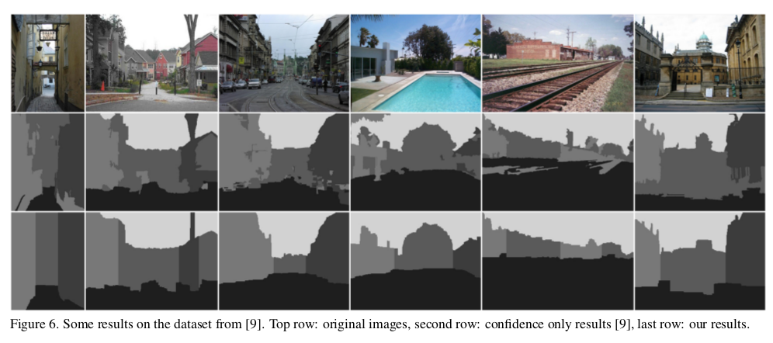
...results
Note: there may be at most
1 different label vertically (+Top & Bottom)
9.4sec on 300x250, K = 5

Slide 5
Vineet, Warrell, Torr –
“A Tiered Move-making Algorithm for General Pairwise MRFs”, CVPR 2012
iterative algorithm (slow but of high quality):
  current labeling
    → DP: K-label optimal tiered move (region choice)
      → next labeling
O(mn²K²) on iteration

Slide 6
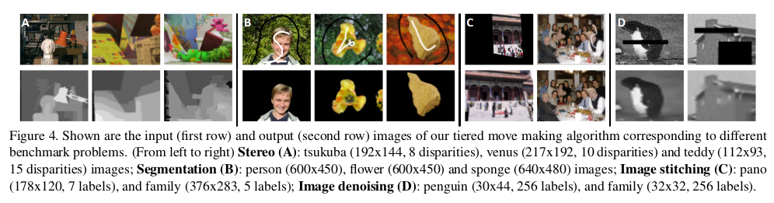
...results
Note: there may be many different labels vertically
10-15 times slower than α-expansion.

Slide 7

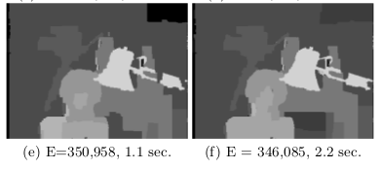
Olga Veksler – “Dynamic Programming for Approximate Expansion Algorithm”,
CVPR 2012
Single green label (+Top & Bottom):
Simple regions:
Some depth map results:
Great complexity:
O(mn) on iteration
...but the problem of iterating remains

Slide 8
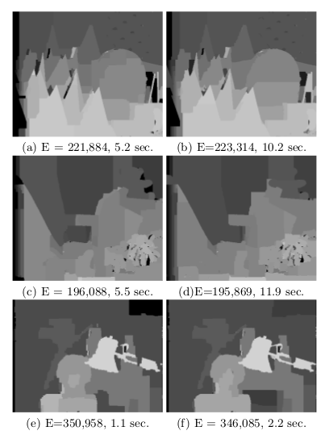
...results
Left: the new algorithm (Veksler, 2012)
Right: Some max-flow algo
Note: The new algorithm is fast but not very accurate so the author doesn't compare it with others

Slide 9
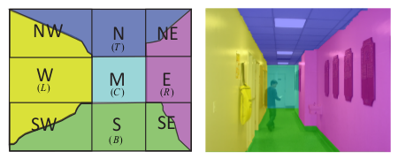
Bai, Song, Veksler, Wu – “Fast Dynamic Programming for Labeling Problems with Ordering Constraints”, CVPR 2012
N, W, E, S – integral images
NW, NE, SW, SE – DP
M – the best of O(n⁴) rectangles is chosen
by O(n³) queries for O(1)
Overall complexity O(n³)

Slide 10
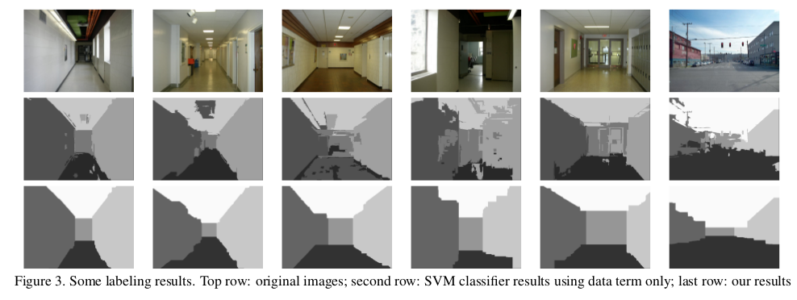
...results
2.2 seconds on 320 × 240 images

