Slide 1
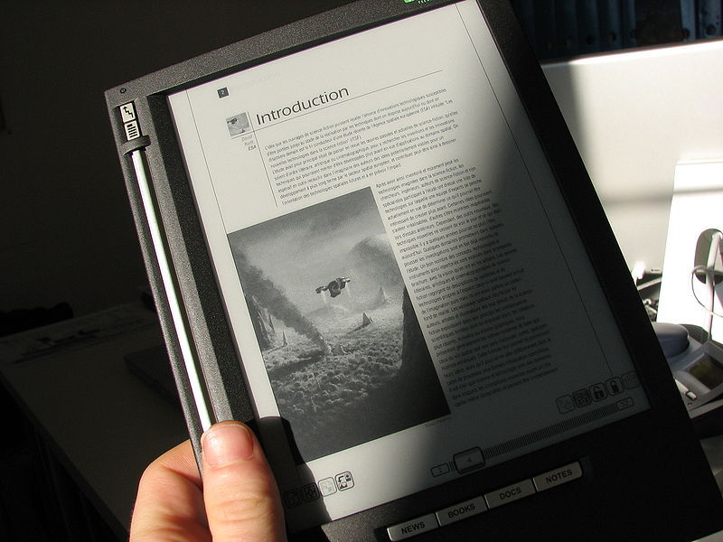
Electronic paper
(e-paper, electronic ink)
Petar Ivanov, 321 group Faculty of Computer Science, MSU

Slide 2


Properties: almost as contrast as a display

Slide 3
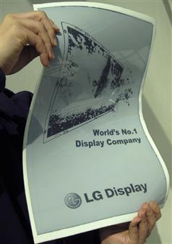
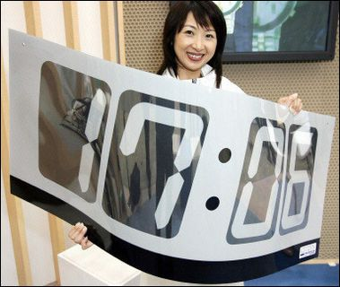
Properties: flexibile

Slide 4
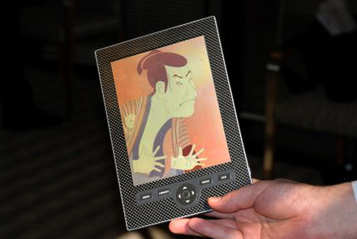
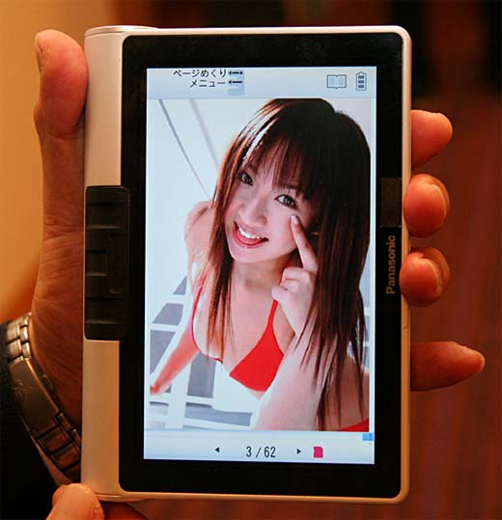
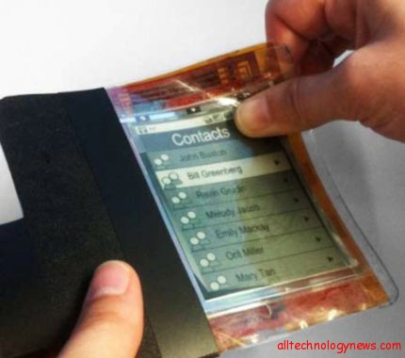
Properties: full-color soon

Slide 5
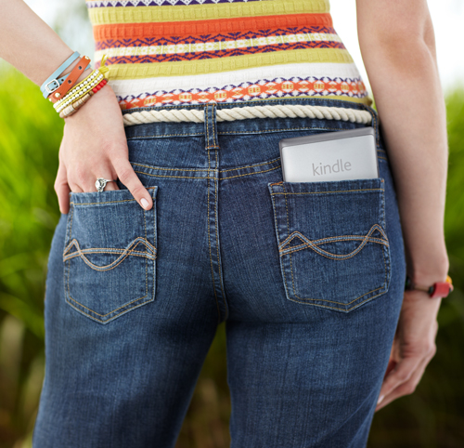

Properties: cheap and thin
$79.00 for a Kindle Wi-Fi with 6" E Ink Display

Slide 6
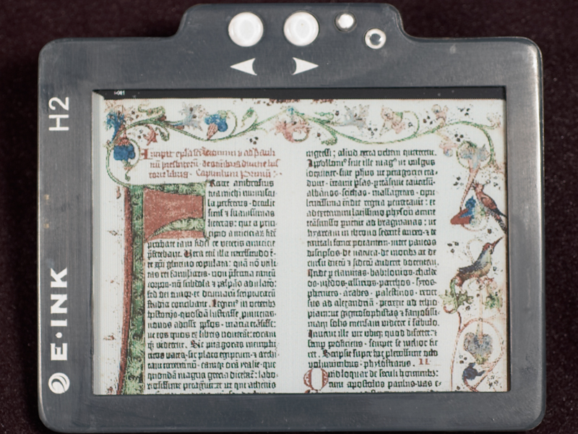
Properties: Reflects light like ordinary paper

Slide 7

Gyricon
(the first one)

Slide 8
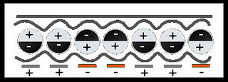
Gyricon
(the first one)
Developed in the 1970s by Nick Sheridon at Xerox's Palo Alto Research Center
Polyethylene spheres between 75–106m⁻⁶ (micrometres)
Each spere is a dipole with black and white sides, embedded in a transparent silicone sheet
The spheres float in oil so they can rotate freely

Slide 9
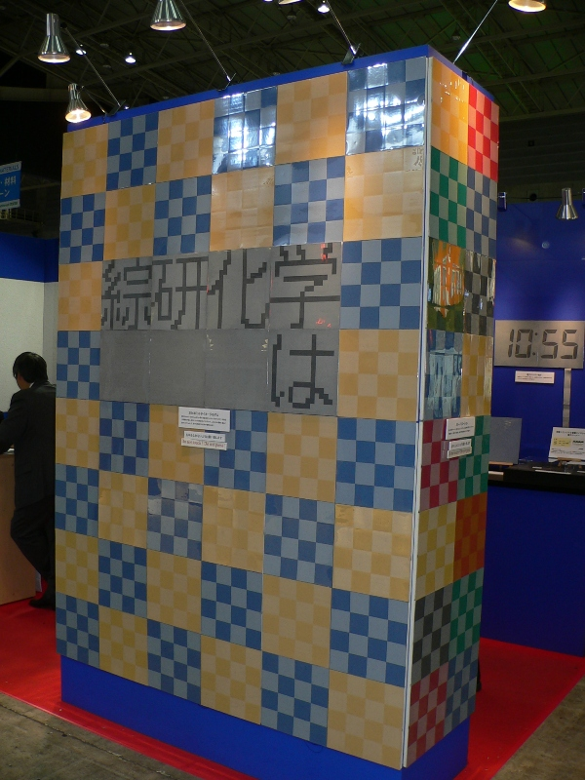
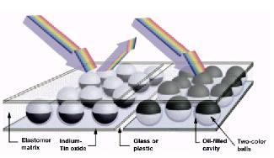
Gyricon: example

Slide 10
Electrophoretic
(the simpliest one)

Slide 11
Electrophoretic
Titania particles ~1m⁻⁶ in hydrocarbon oil
Spheres between two parallel, conductive plates separated by a gap of 10 to 100 micrometres
Dark-colored dye
When a voltage is applied, the particles migrate to the plate with the opposite charge
40% reflectance rate

Slide 12
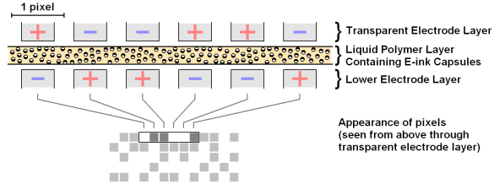
Electrophoresys

Slide 13
Electrophoretic display
(the widespread one)
Invented in 1990s by Joseph Jacobson, who later co-founded the E Ink Corporation
Uses the same old electrophoretic technology: filled with colored oil and charged particles
Transparent 40m⁻⁶ microcapsules in a layer of liquid polymer between two arrays of electrodes and plastic (80m⁻⁶ overall)
It is possible to use only one layer of electrodes beneath the microcapsules
55% reflectance rate

Slide 14
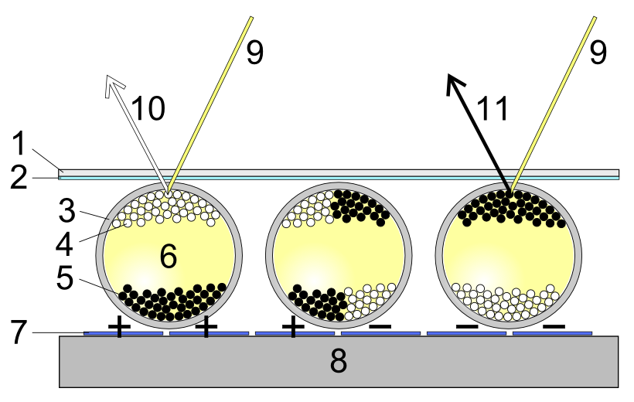
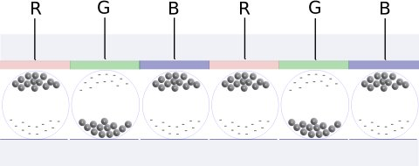
Electrophoretic display

Slide 15
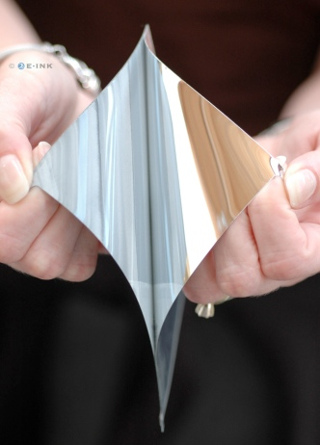
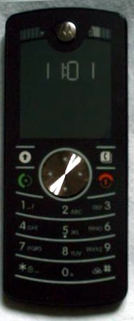
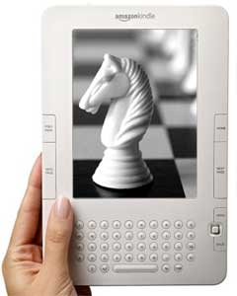
Electrophoretic display: examples
Motorola F3 Kindle

Slide 16
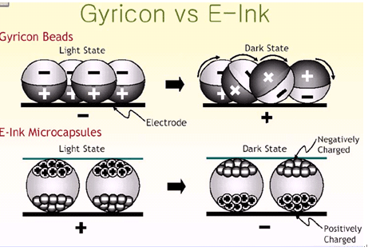
Comparison

Slide 17
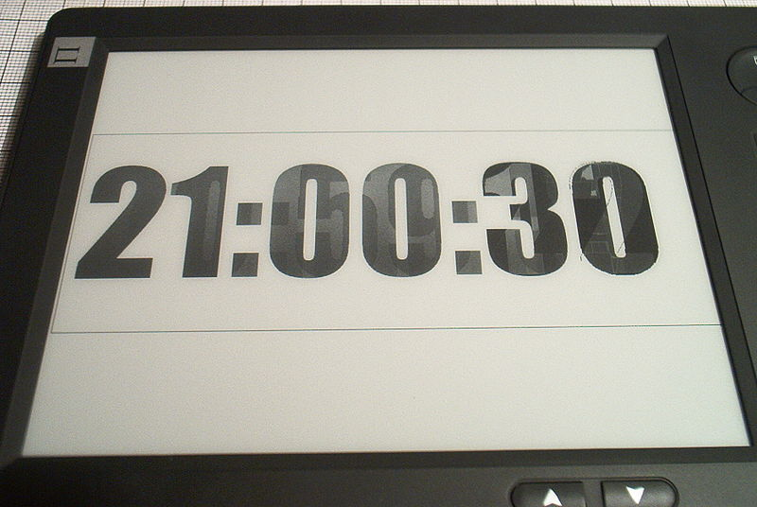
Electrophoretic display disadvantages
Very low refresh rate
Ghosting effect
In a R&D stage (research and development)
Low reflectance rate

Slide 18
Electrowetting
(the fast one)

Slide 19
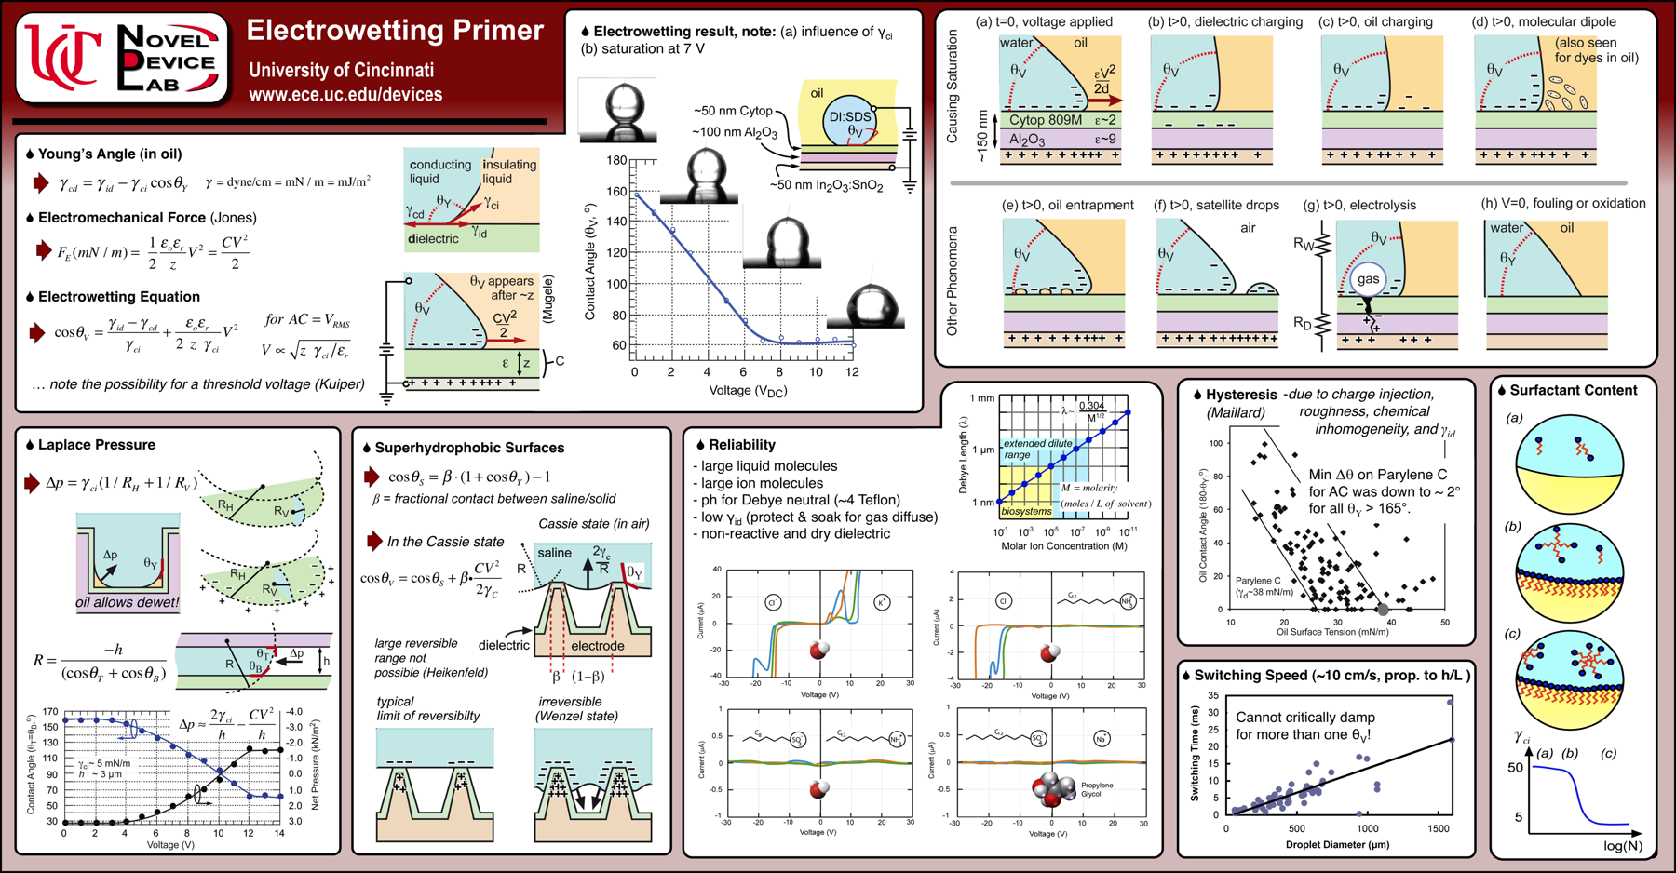
Electrowetting effect
Gibbs free energy required a certain area of the ink surface. There are both chemical and electrical components.

Slide 20
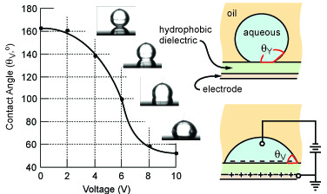
Electrowetting effect

Slide 21
Electrowetting
Electro-wetting display controls the shape of the water/oil by an applied voltage
With no voltage applied, the (coloured) oil forms a flat film between the water and a hydrophobic electrode, resulting in a coloured pixel
Switching between white and coloured reflection is fast enough to display video content
55% reflectance rate (expected to rise to 85%)

Slide 22
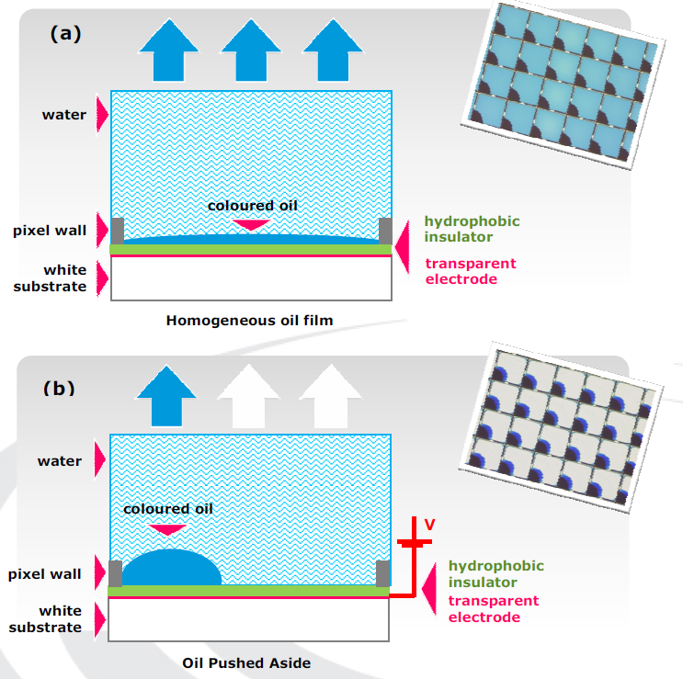
Electrowetting

Slide 23
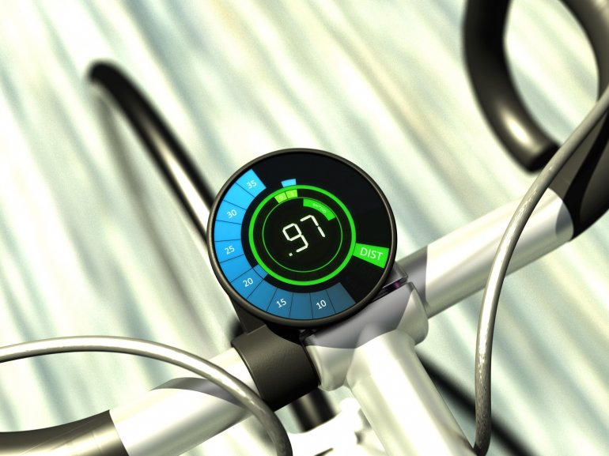
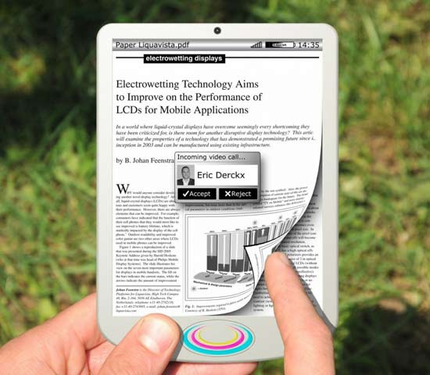
Electrowetting: animation hopes

Slide 24
Electrofluidic (2009)

Slide 25
Electrofluidic
A variation of electrowetting displays
Pigment inside a tiny reservoir (<5-10% of the pixel) instead of floating freely in water
Aluminum layer reflects light
Electromechanical pressure pulls the ink from the reservoirs into the channels
Could have reflectance rate >85%

Slide 26
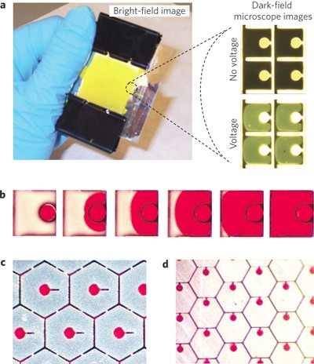
Electrofluidic display: cells

Slide 27
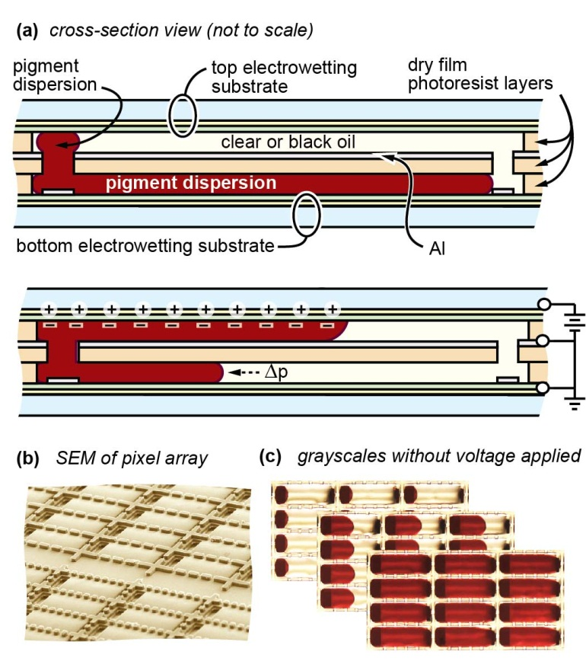
Electrofluidic Display:
Multi-stable (2010)
University of
Cincinnati

Slide 28
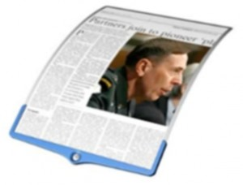
Electrofluidic:
Gammadynamic products
White state: 60-70%
Resolution: 75-300 DPI
Contrast ratio: >10:1
Viewing Angle: unlimited
Grayscale: 8-16 digital states
Colors: 1024
Saturation: >40%
Speed: <30 ms
Bistable: infinite
Voltage: 15V, single TFT active-matrix
Thickness: <40 µm active layer

Slide 29
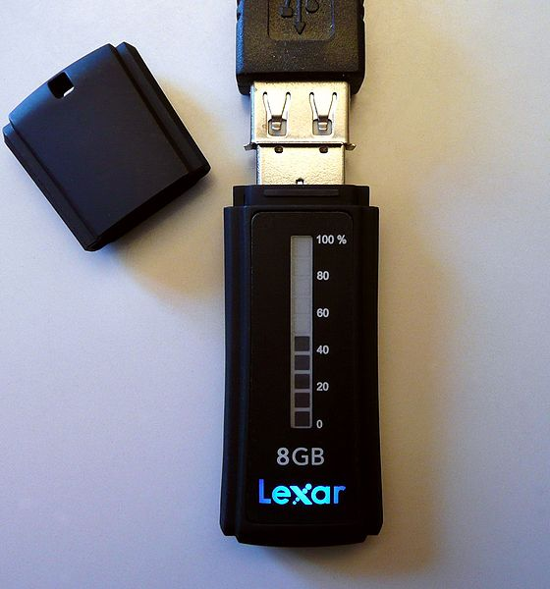
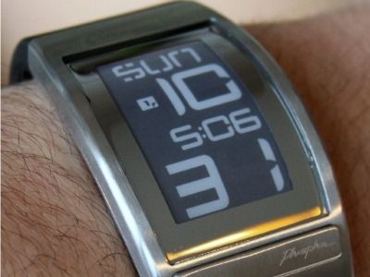
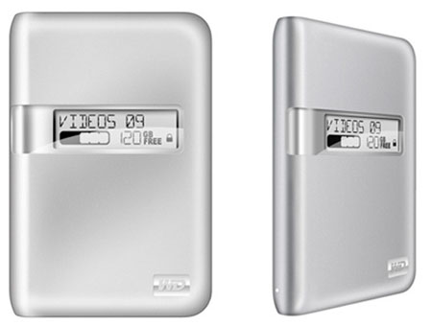
Applications: Gadgets

Slide 30
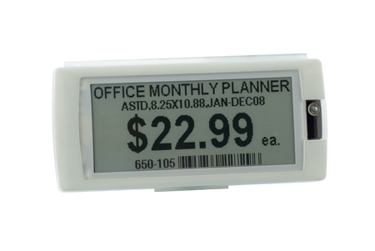
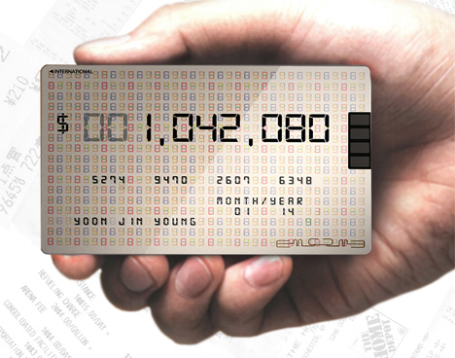
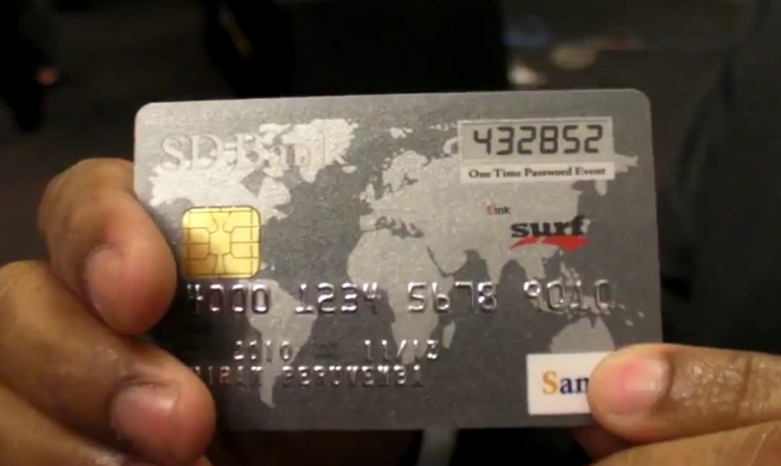
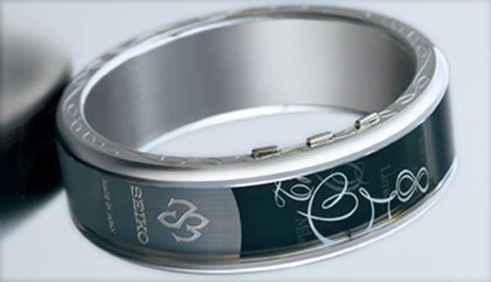
Applications: More gadgets

Slide 31
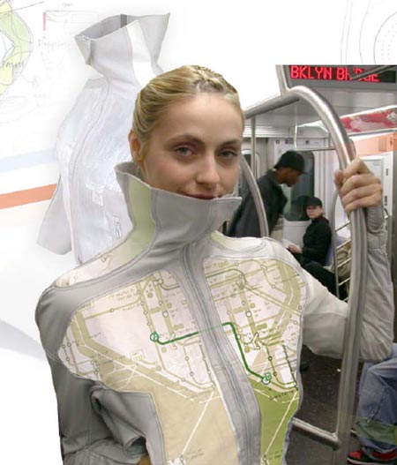
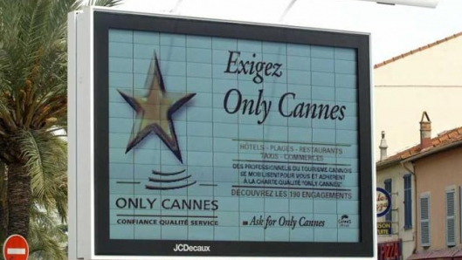
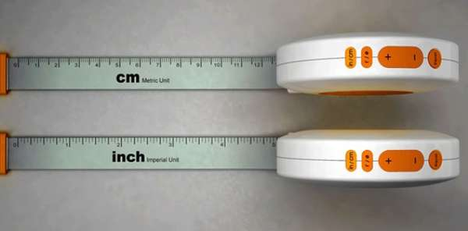
Applications: WTF

Slide 32
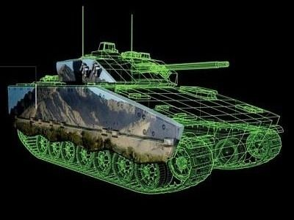
Britains using E-Ink to make tanks invisible

Slide 33

Comments
Main resources:
http://en.wikipedia.org/wiki/Electronic_Paper (01.11.2011)
http://www.epapercentral.com/electrofluidic-technology-enters-epaper-arena.htm
http://secs.ceas.uc.edu/devices/NDL_Research.html
http://secs.ceas.uc.edu/devices/NDL_Video.html
http://gammadynamics.net/

