Slide 1
Problem statement
Real-time people segmentation in stereo video
Input
Two stable video streams (left and right)
in a building corridor (constant conditions)
and a depth interval
Output
Dense (in both time and space) segmentation
on one of the streams (left)
of all the people (two-layer)
in the given depth interval

Slide 2
Planned approach
Dense depth estimation (DP, max-flows, etc.)
Ad-hod segmentation by energy formulation:
  Contrast
  Depth
  Motion
  Machine learning for people detection

Slide 3
Current situation
Somehow working
Middlebury Stereo Matcher C-code for depth estimation for a pair of frames
Nikita's BackgroundCut framework modified for depth
Testing material taken
15min video in MediaLab's corridor

Slide 4
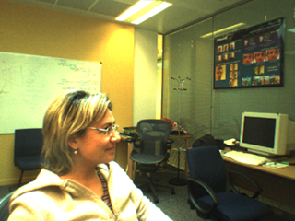
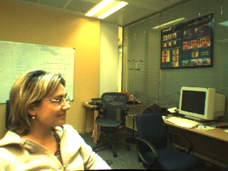
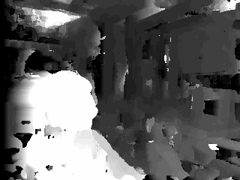
Workflow
1. Middlebury Stereo Matcher (best results using graphcuts)
left + right → disparity (depth map)

Slide 5

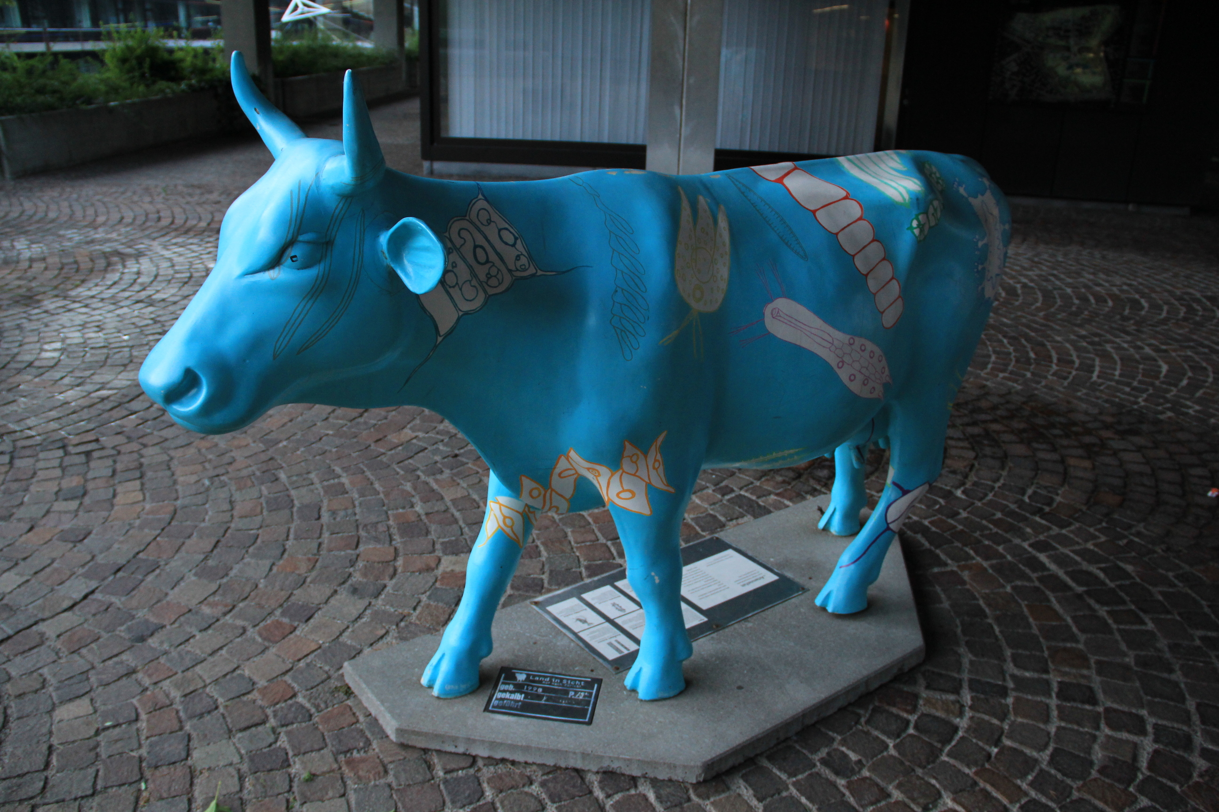
Workflow
2. Learning (local & global background models)
left + true segmentation mask + background → BG model

Slide 6

Workflow
3. BackgroundCut
left + disparity + BG model → segment

Slide 7
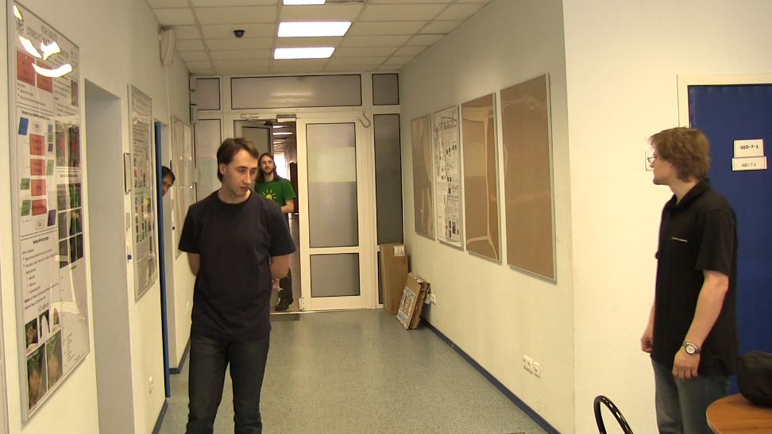
Workflow
4. Precision estimation (TODO)
segment + true-mask → precision

