Slide 1
Fast object detection
Petar Ivanov
17.09.2012

Slide 2
Problem statement
Real-time object segmentation in stereo video
Input
Two moving video streams (left and right)
positioned on a car (so a road is seen)
Output
Sparse space segmentation
and dense time segmentation
on one of the streams (left)
of the nearest objects (cars/pedestrians)
in all directions

Slide 3
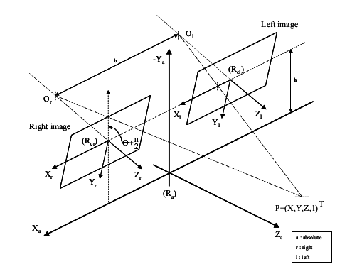
Assumptions
Rectified cameras
Calibrated cameras
Horizontal cameras
R. Labayrade et al., “Real Time Obstacle Detection in Stereovision on
Non Flat Road Geometry Through ”V-disparity” Representation”, 2002

Slide 4
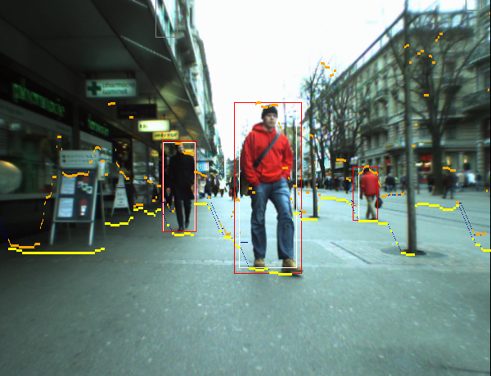
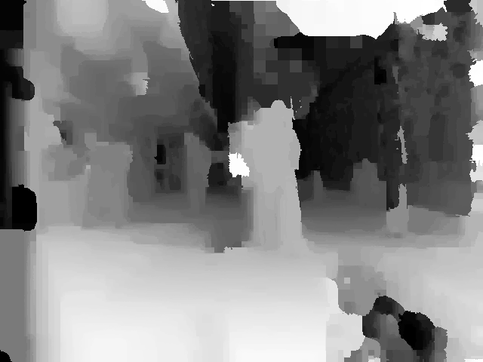
The naïve way
Choose a random algorithm (from hundreds) for disparity estimation (disparity ~ 1/depth)
If the road is flat then we already know its disparity for every row (the cameras are calibrated)
Every part with different disparity is an object
R. Benenson et al., “Stixels estimation without depth map computation”, 2011

Slide 5
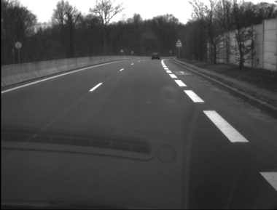
But what if the road is not flat?
Raphael Labayrade et al.,
“Real Time Obstacle Detection in Stereovision on Non Flat Road Geometry Through ”V-disparity” Representation”, 2002

Slide 6
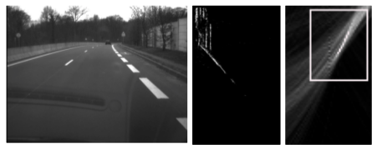
Labayrade et al., “Real time obstacle detection in stereovision on non flat road geometry through v-disparity representation”, 2002
Left image → disparity map (not shown) → V-disparity → Hough transform
How real objects look like in V-disparity map:
road → line (the steep determines if the road goes up or down)
car → vertical line
horizon → zero disparity
trees, lines, buildings, etc. → diffuse areas

Slide 7
Where is the road?
Miss solution 2002
(> 300 citations)
Labayrade et al., “Real time obstacle detection in stereovision on non flat road geometry through v-disparity representation”, 2002

Slide 8
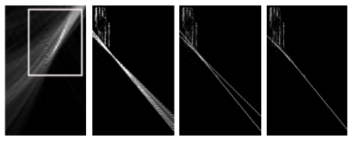
Labayrade et al., “Real time obstacle detection in stereovision on non flat road geometry through v-disparity representation”, 2002
Hough transform → k points ⇔ k lines → longitudinal profile
Choosing between min and max profile depends on whether the road is going upwards or downwards

Slide 9
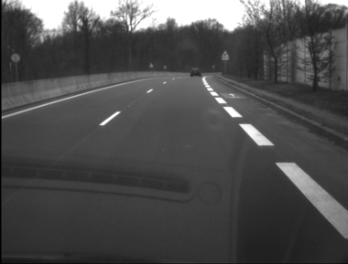
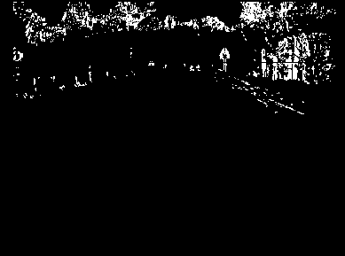
Labayrade et al., “Real time obstacle detection in stereovision on non flat road geometry through v-disparity representation”, 2002
disparity map →
{ v-disparity & Hough transform }
→ longitudinal profile of the road
Then computing the obstacle areas

Slide 10
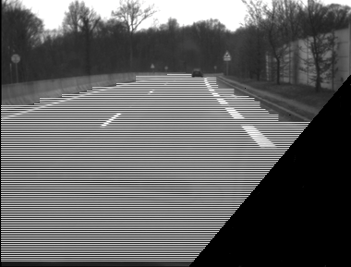
Labayrade et al., “Real time obstacle detection in stereovision on non flat road geometry through v-disparity representation”, 2002
Using some bottom-up greedy
the free space is constructed

Slide 11
Overall
Labayrade et al., “Real time obstacle detection in stereovision on non flat road geometry through v-disparity representation”, 2002
25 Hz on 380✕289 frames (in 2002) but a disparity map is needed (slow!)
Greedy free space estimation (a global optimization is possible!)

Slide 12
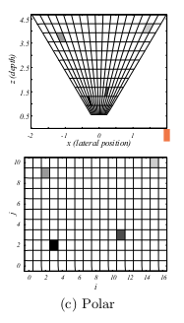
H. Badino et al., “Free space computation using stochastic occupancy grids and dynamic programming”, 2007
Occupancy grid is a 2D projection of the objects which shows the probability that a cell is occupied

Slide 13
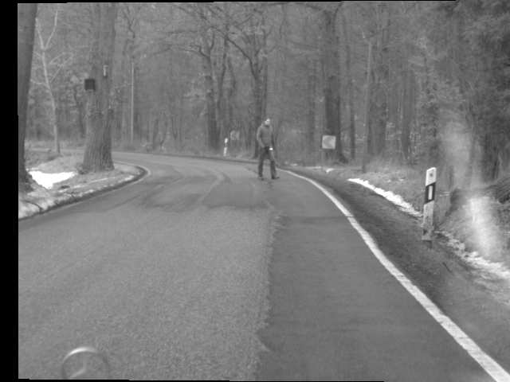

Polar occupancy grid
H. Badino et al., “Free space computation using stochastic occupancy grids and dynamic programming”, 2007

Slide 14
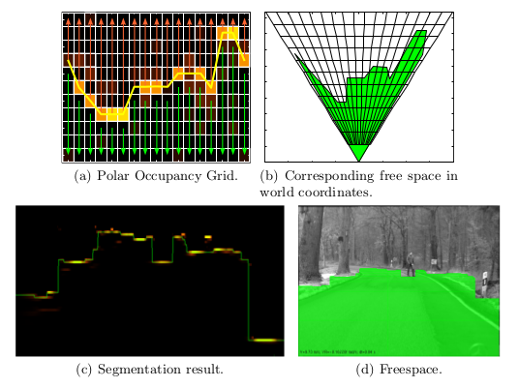
DP for estimating free space using the occupancy grid
H. Badino et al., “Free space computation using stochastic occupancy grids and dynamic programming”, 2007

Slide 15
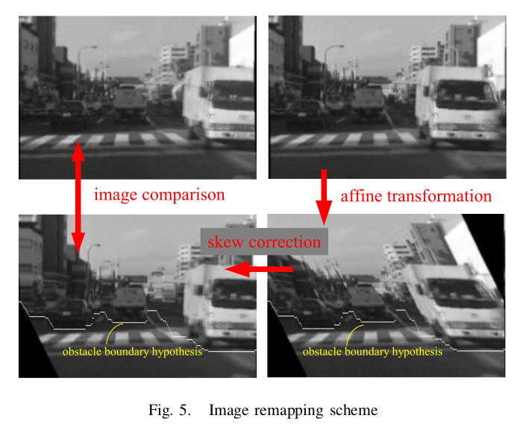
Kubota et. al, “A Global Optimization Algorithm for Real-Time On-Board Stereo Obstacle Detection Systems”, 2007
65fps on VGA (640x480) on 3.6GHz

Slide 16
Kubota et. al, “A Global Optimization Algorithm for Real-Time On-Board Stereo Obstacle Detection Systems”, 2007
Algortihm
Estimate road plane parameters using v-disparity image
Calculate a summed disparity space image (DSI) over edges (light-invariant): DSI represents the matching score between the reference and the target images with respect to disparity and horizontal position. Matching score: SSD and SAD rely on constant luminance assumption so only edges are used (Canny detector)
Find the best path in the DSI which represent the boundary between the road and obstacles

Slide 17
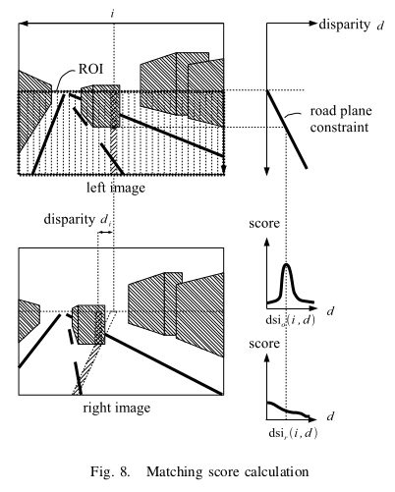
Kubota et. al, “A Global Optimization Algorithm for Real-Time On-Board Stereo Obstacle Detection Systems”, 2007
Estimate road plane parameters using v-disparity image

Slide 18
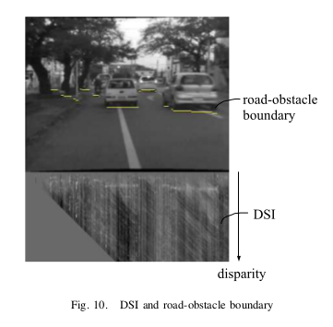
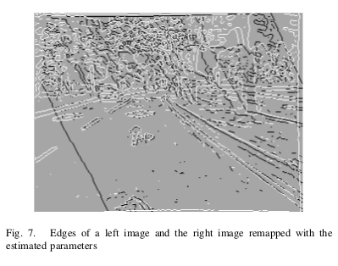
Kubota et. al, “A Global Optimization Algorithm for Real-Time On-Board Stereo Obstacle Detection Systems”, 2007
Summed disparity space image (DSI) over edges (light-invariant)

Slide 19
Kubota et. al, “A Global Optimization Algorithm for Real-Time On-Board Stereo Obstacle Detection Systems”, 2007
The DSI is calculated by repeating the following procedure
for every i and j:
Calculate the y-coordinate of the hypothetical road-obstacle boundary from the disparity value j and (2).
Calculate the matching score DSI_r (i, j) for the road region (pixels below the boundary) of the i-th column with the correspondence given by (1).
Calculate the matching score DSI_o (i, j) for the obstacle region (pixels above the boundary) of the i th column where the correspondence is given by horizontal translation of j pixels.

Slide 20
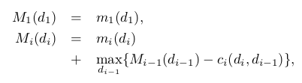
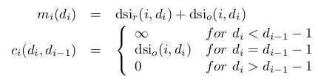
Kubota et. al, “A Global Optimization Algorithm for Real-Time On-Board Stereo Obstacle Detection Systems”, 2007
Global Optimization Using Dynamic Programming
no partial path
can have slope any steeper than 45 degree toward upward-left
WARNING: 縦書きused (not 横書き!)

Slide 21
Kubota et. al, “A Global Optimization Algorithm for Real-Time On-Board Stereo Obstacle Detection Systems”, 2007
Multiresolution scheme: bring the max resolution by exponentially increasing steps:
  the disparity recomputation is limited to some interval around the previous best disparity
  the DSI images are not recomputed if they were high enough on the previous step

Slide 22
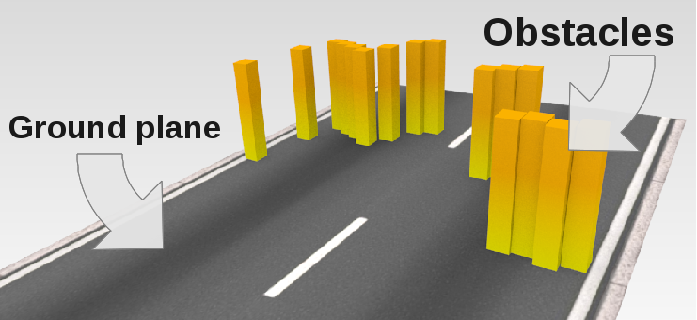
Hernan Badino et al.,“The Stixel World – A Compact Medium Level Representation of the 3D-World”, 2009
Stixel ≈
Sticks above the ground in the image
The stixel model consists of
  ground plane
  distance to the objects
  objects height
Free space estimation: background subtraction + DP from *
Stixels height estimation: DP with member function M(u,v,d)
* Free space computation using stochastic occupancy grids and dynamic programming – 2007

Slide 23
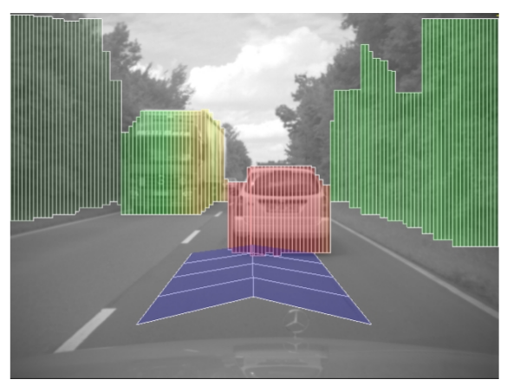
Hernan Badino et al.,“The Stixel World – A Compact Medium Level Representation of the 3D-World”, 2009
Building the Stixel-World
Dense stereo: Semi-Global Matching
Occupancy Grid
Free space estimation: background subtraction + DP
Height estimation: DP with member function M(u,v,d)
Stixel extraction

Slide 24
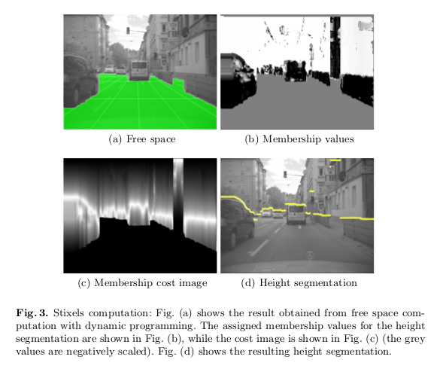
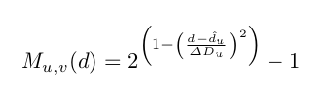

Hernan Badino et al.,“The Stixel World – A Compact Medium Level Representation of the 3D-World”, 2009
Height estimation
min
v
min

Slide 25
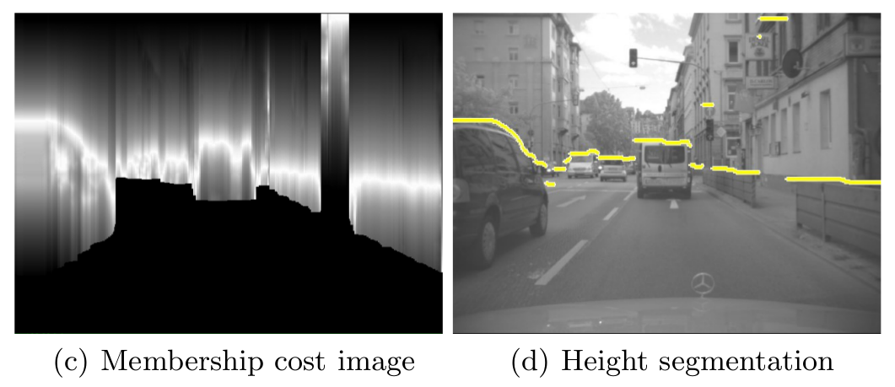


Hernan Badino et al.,“The Stixel World – A Compact Medium Level Representation of the 3D-World”, 2009
Final functional:
min
Smoothness:
min

Slide 26
Hernan Badino et al.,“The Stixel World – A Compact Medium Level Representation of the 3D-World”, 2009
VGA 40fps on 3 GHz

Slide 27
Benenson et al., “Stixels estimation without depth map computation”, 2011
Matching cost c(u,v,d) – SAD of a single pixel (u,v) on the left and (u+d,v) on the right image
Ground plane estimation by V-disparity method but without computing disparity maps: directly project the costs along the horizontal axis (u-axis) so that each pixel is the summed cost of every pixel along the v-disparity unidimensional slice

Slide 28
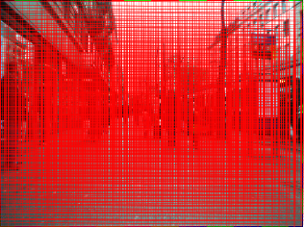
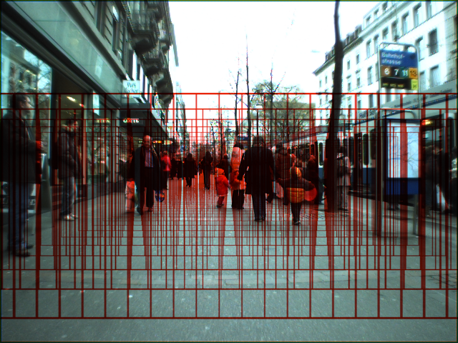
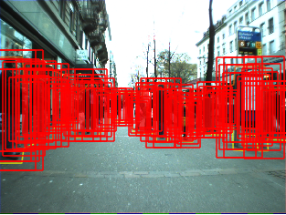
Benenson et al., “Stixels estimation without depth map computation”, 2011
75000 windows
2500 windows
650 windows
DP for stixels distance estimation
DP for stixels height estimation
Open source code in DOPPIA

Slide 29
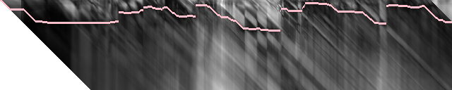


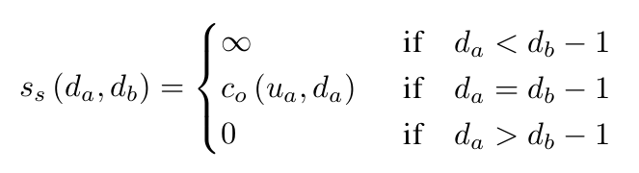
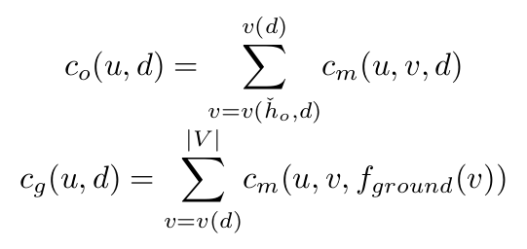
Benenson et al., “Stixels estimation without depth map computation”, 2011
DP for stixels
distance estimation
Similar to Kubota et. al, “A Global Optimization Algorithm for Real-Time On-Board Stereo Obstacle Detection Systems”, 2007

Slide 30
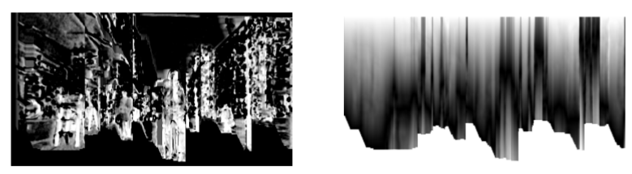
Benenson et al., “Stixels estimation without depth map computation”, 2011
DP for hight estimation
Membership value
Membership cost image
Similar to the Hernan Badino et al.,“The Stixel World – A Compact Medium Level Representation of the 3D-World”, 2009

Slide 31
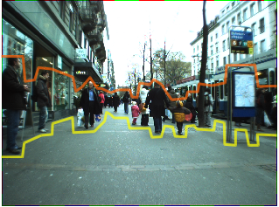
Benenson et al., “Stixels estimation without depth map computation”, 2011
  ~300Hz for ground plane estimation
~95Hz for ground plane + stixels distance estimation
~25Hz for ground plane + stixels distance + stixels height estimation

Slide 32
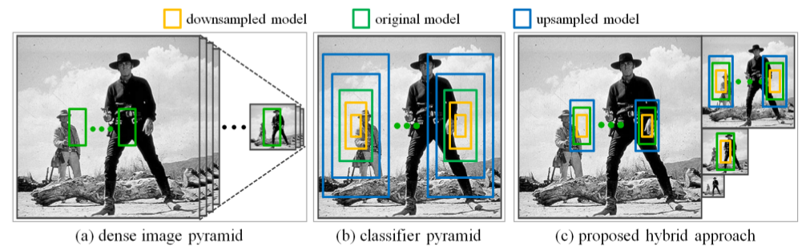
Dollár et al., “The Fastest Pedestrian Detector in the West”, 2010
Not stereo
Hybrid approach:
  – sparse image pyramid (instead of dense)
  – extrapolated features on different scales (instead of feature pyramid)

Slide 33
Dollár et al., “The Fastest Pedestrian Detector in the West”, 2010
Theorem of Ruderman and Bialek that various statistics of natural images are independent of the scale at which the images were captured
Exponential scaling law: E[ f(I, s+s0) / f(I, s0) ] = e^(-lambda*s)
0.25–0.5s on VGA images: 10 times faster than the sparse image pyramid approach

Slide 34
Dollár et al., “The Fastest Pedestrian Detector in the West”, 2010
Theorem of Ruderman and Bialek: various statistics of natural images are independent of the scale at which the images were captured
Exponential scaling law:
  f (I, s) ≈ f (I, 0) e^(−λs)
  where
    f(I, s) is a feature on the image I after downsampling by a factor of 2^s
    λ is a parameter (about 1.099) estimated empirically on test data

Slide 35
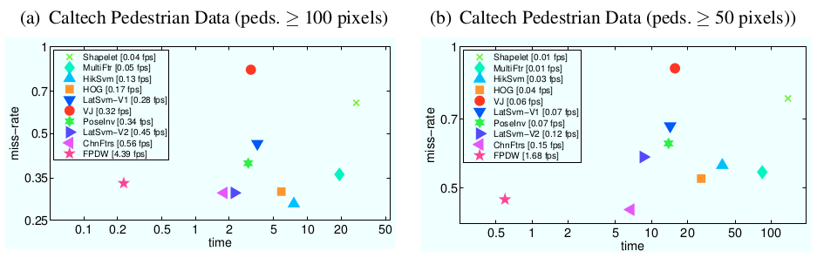
Dollár et al., “The Fastest Pedestrian Detector in the West”, 2010
5fps on VGA
Detection accuracy loss ~1–3%
0.25–0.5s on VGA images: 10 times faster than the sparse image pyramid approach

Slide 36
Benenson et al., “Pedestrian detection at 100 frames per second”, 2012
Ground plane estimate + stixels at about 135 Hz on CPU (without depth map computation)
Objects detection (GPU)
Viola and Jones idea “scale the features not the images”
improve on top of ChnFtrs (HOG+SVM) on GPU
Speed-up by using the FPDW but with N/K classifiers
Monocular: 50 fps
135 Hz from stereo-pair to stixels on CPU
Speed-up by sparsing the possible stixel positions
Open source code in DOPPIA

Slide 37
Benenson et al., “Fast stixel computation for fast pedestrian detection”, 2012
stixel distance estimation problems examined
wrong quantization: horizon objects are more fine grained than the near objects
ignores horizontal gradient
ground plane estimation domain changed from u-disparity to u-v-disparity
complexity: DP – O(Q*B^2), where Q is the number of stixels and B is the number of row bands; lowering Q from 128 to 50 and and lowering B from 1 pixel stixels to 2 pixel stixels must drop the time by a factor 7
Open source code in DOPPIA

Slide 38
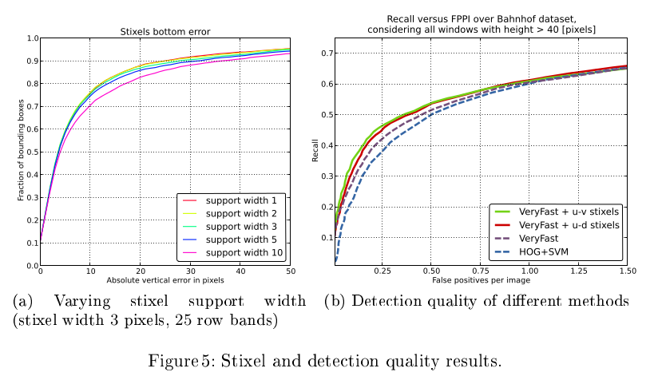
Benenson et al., “Fast stixel computation for fast pedestrian detection”, 2012
GPU-bound (165 Hz)

