Slide 1

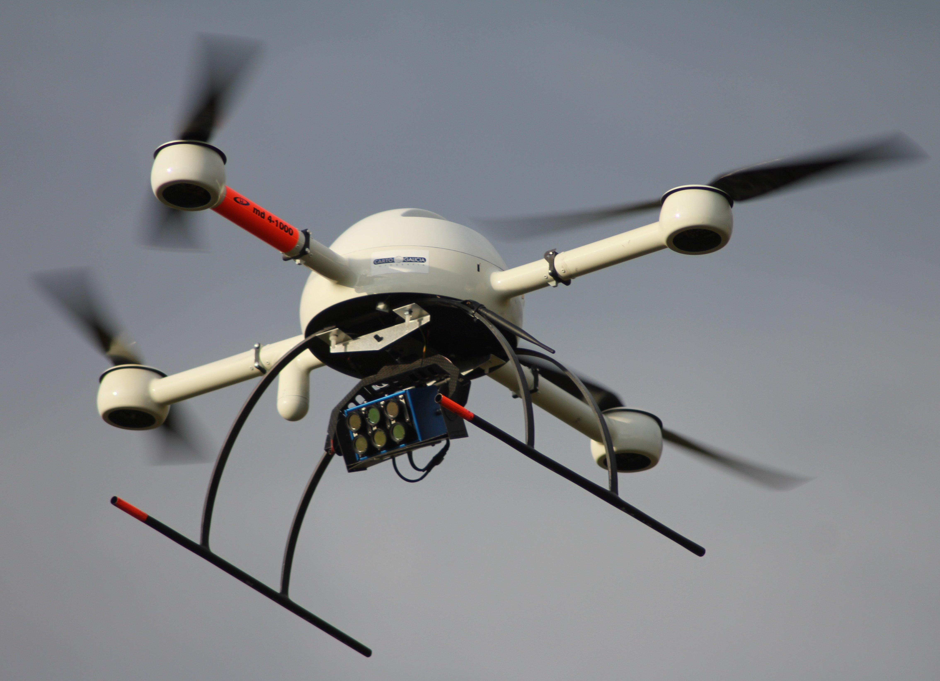
Visual approach to
Unmanned Aerial Vehicle (UAV)
Petar Ivanov
Graphics & Media Lab, CMC
Lomonosov Moscow State Unviersity
May 6, 2013

Slide 2
Sensors
Laser-based (accurate, but point-to-point)
Sonar-based (cheap, but inacurate)
Inertial-based (fast, but local errors grow with time)
Global sensing, e.g. GPS/ГЛОНАСС (cool, but without local features)
Vision-based (our method!)
  passive, long-range, high-resolution
  but maximal information gain by greedy
  there should be features and they should be distinct!

Slide 3
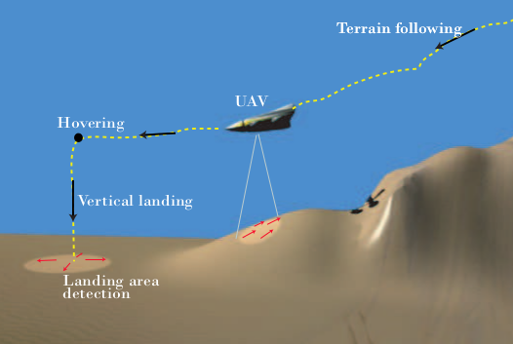
Visual odometry
Estimating position over time by consequtive imaging (Mars rovers use it too!)

Slide 4
Visual odometry
Image correction: lens distortion, noise
Frames comparison
  Correspondence of two images without a long term feature tracking
  Feature extraction and correlation
  Optical flow field
Outliers removal
Estimation of the camera motion from the optical flow
  Choice 1: Kalman filter for state estimate distribution
  Choice 2: Geometric transformation optimization
Repopulation of trackpoints

Slide 5
Visual odometry
Visual odometry can be incomporated with other odometry in a probabilistic scheme:
  IMU
  laser scanners
  wheel speed
  etc.

Slide 6
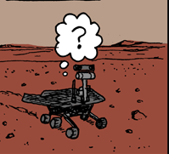
Robotics problem
Simultaneous localization and mapping
Where am I?
  Where I was?
  What happened since than?
  What do I see now?
    … (chicken)
What do I see now?
  What have I seen before?
  Where am I?
    … (egg)

Slide 7
SLAM history
30 years ago: metric and topological approaches
20 years ago: probabilistic approach → measuring the noise → noise map

Slide 8
SLAM
SLAM problem can be decomposed into two aspects:
  handling of map features
  handling of uncertainty
Many map-building algorithms not specifying the sensor type
Feature recognition & tracking, 3D reconstruction → Feature map
Vision Simultaneous localization and map-building (SLAM) approaches:
  Kalman filter (KF)-based
  Particle filter (PF)-based
  Expectation-maximization (EM)-based
  Set membership-based

Slide 9
SLAM difficulties
Data association problem (Is this the same tree?!)
Loop-closing problem (for consistent maps)
Bearing-only SLAM (no initial map)

Slide 10
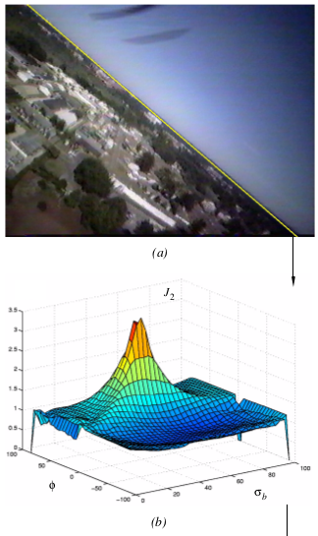
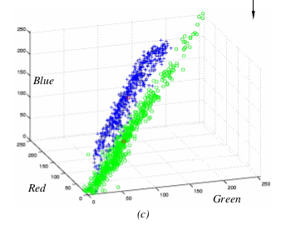
Ettinger, Nechyba, Ifju, Waszak –
“Towards Flight Autonomy: Vision-Based Horizon Detection for Micro Air Vehicles”, 2002

Slide 11
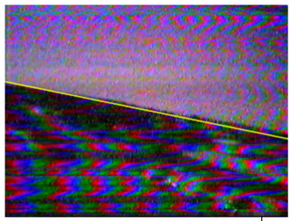
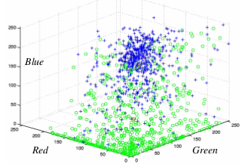
Ettinger, Nechyba, Ifju, Waszak –
“Towards Flight Autonomy: Vision-Based Horizon Detection for Micro Air Vehicles”, 2002
Complex scene

Slide 12
Ettinger, Nechyba, Ifju, Waszak –
“Towards Flight Autonomy: Vision-Based Horizon Detection for Micro Air Vehicles”, 2002
line horizon parametrization (m,b)
→ (m,b) grid calculation of
|sky_cov_matrix| + |ground_cov_matrix|
→ binary search optimization near the maximum
where |cov_matrix({Pixels})| increases with {Pixels} colors being more scattered

Slide 13
Ettinger, Nechyba, Ifju, Waszak –
“Towards Flight Autonomy: Vision-Based Horizon Detection for Micro Air Vehicles”, 2002
“[…] we first motivate the use of computer vision for the horizon detection task by examining the flight of birds (biological MAVs) […]”
Which is further explained as simply “birds have excellent eyes”.

Slide 14
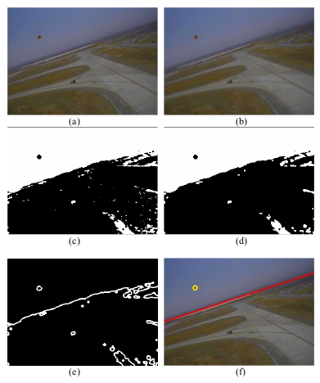

McGee, Sengupta, Hedrick – “Obstacle Detection for Small Autonomous Aircraft
Using Sky Segmentation”, 2012
Another horizon approach:
  SVM sky/non-sky segmentation
  Edges obtained by smoothing the binary image and obtaining 0.5 values
  Hough transform line detection
  Choose the most dangerous horizon line

Slide 15
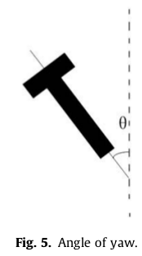
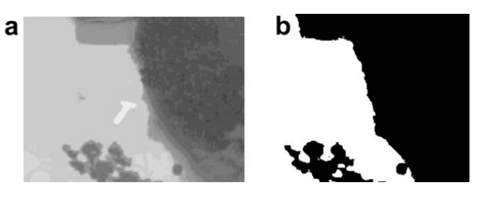
Xu, Zhang, Ji, Cheng, Tian – “Research on computer vision-based for UAV autonomous landing on a ship”, 2009
Infrared radiation images →
Otsu tresholding →
Sobel edge detection →
Affine moment invariants →
Calculating yaw

Slide 16
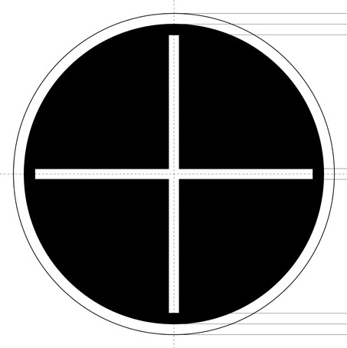
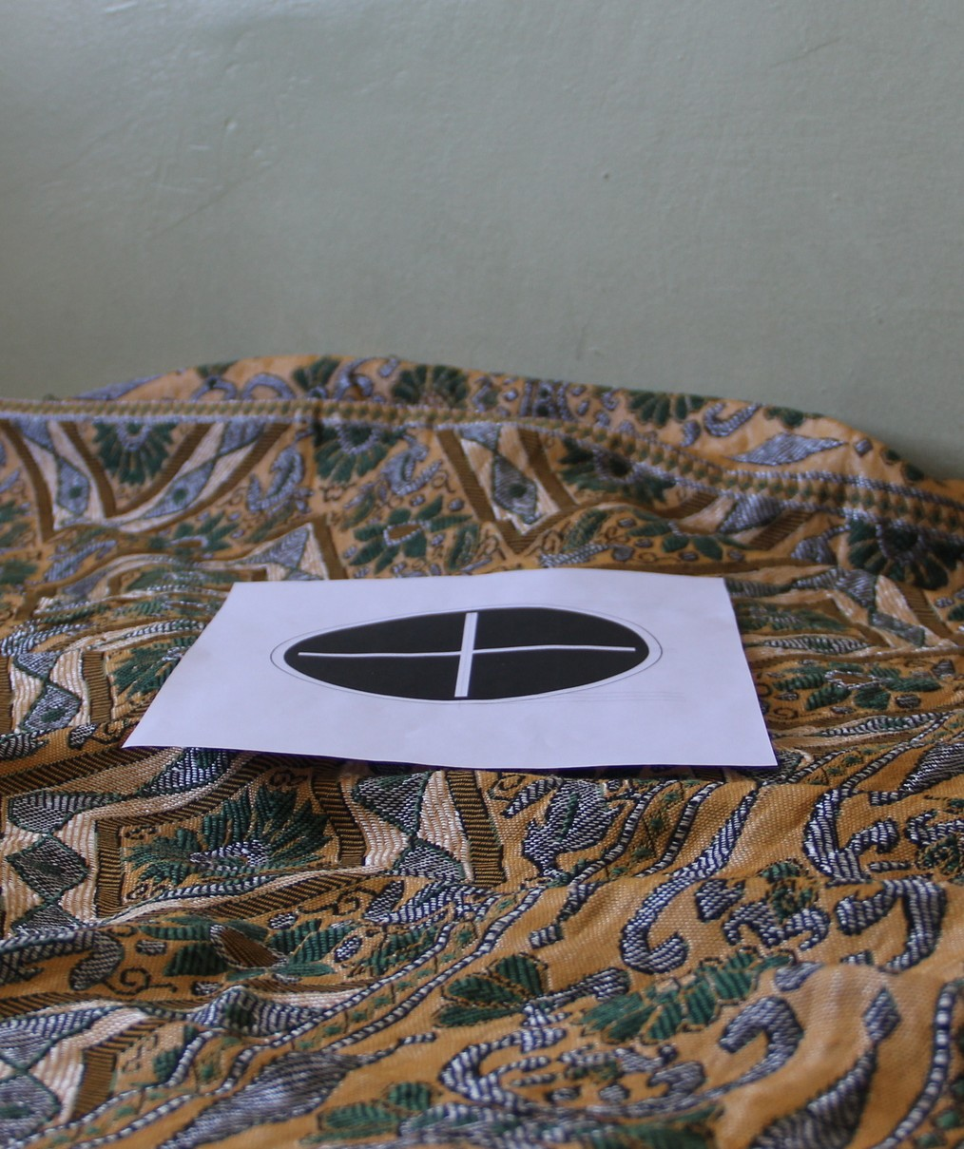
Наша точка посадки
1. Mapping black and white regions
2. Binarisation
3. Hough transform for the lines
4. Hough transform for the ellipse

Slide 17
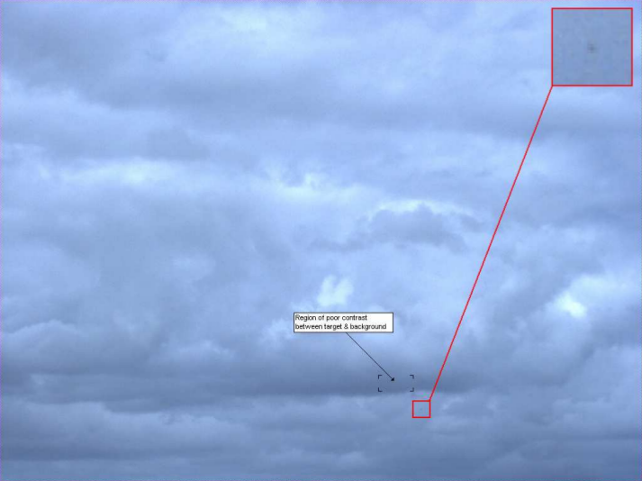
Carnie, Walker, Corke – “Computer-Vision Based Collision Avoidance for UAVs”, 2005

Slide 18
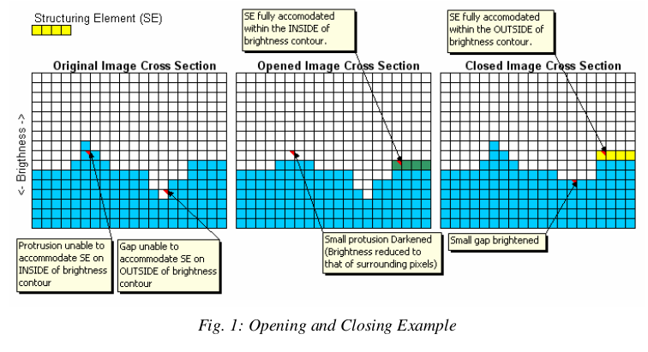

Carnie, Walker, Corke – “Computer-Vision Based Collision Avoidance for UAVs”, 2005
Close-Minus-Open
Track-before-detect temporal
Filtering Dynamic Programming

Slide 19
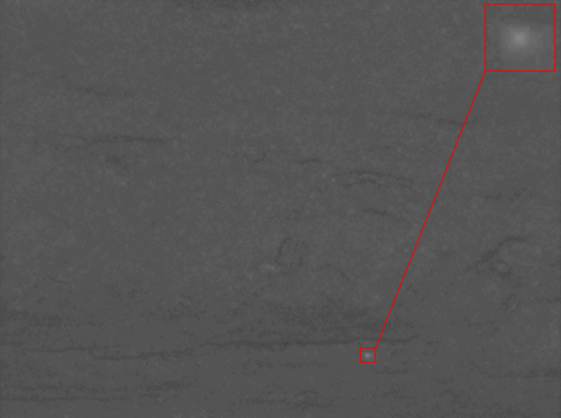
Carnie, Walker, Corke – “Computer-Vision Based Collision Avoidance for UAVs”, 2005
Dynamic Programming Output

Slide 20
Conclusion
Computer vision can help your flying robot:
  Measure distance (Stereo or Distance from Motion)
  Measure self-motion (Odometry)
  Find the horizon
  Find a place to land
  Detect a missile or a bird

