Slide 1
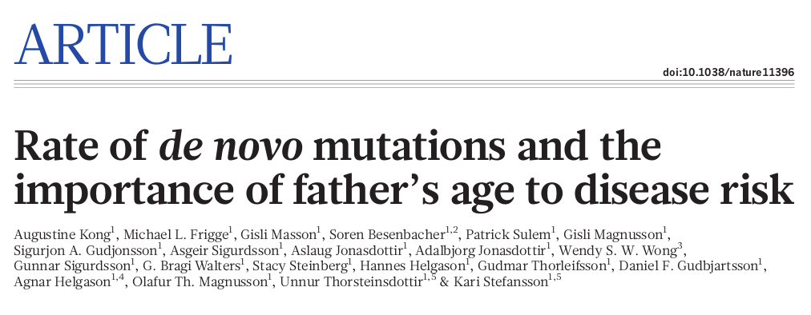
Nature, 2012

Slide 2
Abstract
Entire genomes of 78 Icelandic parent–offspring trios
Average father’s age 29.7 years
Average new/de novo mutation rate 1.2e-8 per nucleotide per generation
2 de novo mutations for every year of the father
Poisson blames the fathers

Slide 3
Who participated?
Some parents
44 children with autism
21 schizophrenic children
21 happy scientists
main conclusion: Schizophrenia and autism because of not freezing your sperm!

Slide 4
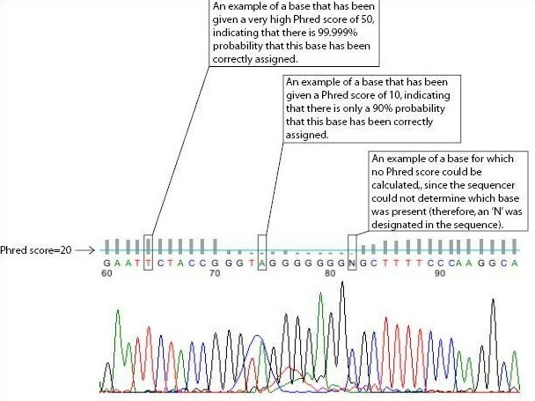
Phred score := -10*log(P)

Slide 5
Criteria for calling a de novo SNP mutation
where...
  lik(⋅) – likelihood based on Phred vals
  R – reference allele
  A – alternative allele
Input: ~2'000 human genomes
From all (A,R) pairs leave only:
(brand new mutation, not allele)
    lik(AR)/lik(RR) < 10'000 and lik(AA)/lik(RR) < 10'000
(Illumina lies?)
    >15 quality reads at the mutated site
lik(AR)/lik(RR) > 1e10 ???
for both parents, the ratio lik(RR)/lik(AR) is above 100
the number of A allele calls is above 30%
Output: ~5'000 candidate mutations.

Slide 6
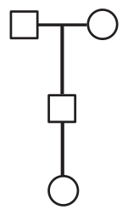
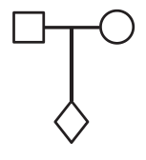
Two different approaches
papa
mom
papa
mom
proband
proband
x 63
child
x 5

Slide 7
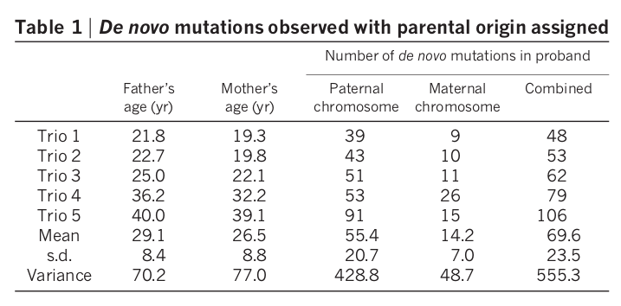
First approach:
Parent of origin is clear
papa
mom
proband
child
x 5

Slide 8
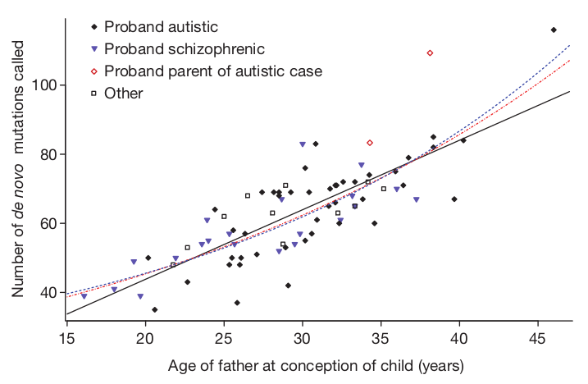
Second approach:
Who is the parent?
papa
mom
x 63
proband
Not enough grannies!

Slide 9
Three fitting models
Linear
Exponential
Exponential with mother's de novo mutation rate fixed at the mean value (14.2)

Slide 10
Mutations
5000 mutations
  73 exonic (2 stop and 60 non-synonymous)
  1800 intron
  2500 intergenic
18 times higher CpG transition rate (A↔G, C↔T)
2.5 times hight CpG transversion rate (A↔C/T, G↔C/T)
transition/transversion ratio is independent on age

Slide 11
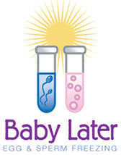
Advertisement
Transhumanism
Success rates depending on the age of the woman:
under 35, the success rate is around 19%
35–39, the success rate is around 15%
40–42, the success rate is around 7%

Slide 12
Open science
I donated my 23andme genotyping
to the general public
(https://opensnp.org/users/637)
What about you? :”)

