Slide 1
ZHAW · VISUALISATION & DATA SCIENCE STORYTELLING II · FS 2025/26
Optimising Product Placement
Using Grocery Purchase Data
An interactive dashboard that turns 3.2 million Instacart orders into assortment, cross-sell and retention decisions for grocery delivery.
Lara Pestrin · Jonathan Kull · Veprim Mehmeti

Slide 2
THE CHALLENGE
Grocery delivery lives or dies
by its assortment
THE QUESTIONS WE SET OUT TO ANSWER
1
Which products are purchased most frequently?
Quick-commerce platforms like Flink or Gorillas manage thousands of products and have to keep optimising what they stock — balancing customer demand, storage capacity and delivery efficiency.
Assortment planners and buyers make these calls every week, often from manual Excel reports. They need a faster, more intuitive, data-driven foundation — and that is what this project set out to build.
2
Which products are commonly bought together?
3
Which products earn the highest customer loyalty?
4
When — by day and hour — are orders placed?
5
What does this mean for assortment and retention?
Grocery Product Placement Analysis · Group 11
02 / 13

Slide 3
THE DATA
Built on 3.2 million real grocery orders
3.2M
206K
49.7K
21
Orders analysed
Unique customers
Unique products
Departments, 134 aisles
The Instacart Online Grocery dataset (2017) is a public, fully anonymised set of US grocery-delivery orders. It spans six linked tables — orders, order-products, products, aisles and departments — covering roughly 3.4 million orders in total, of which 3.2 million prior orders form the basis of every chart in this deck.
Good to know The data has no absolute dates (only day-of-week and hour) and reflects US shopping behaviour in 2017 — patterns, not exact forecasts.
Grocery Product Placement Analysis · Group 11
03 / 13

Slide 4


WHO IT'S FOR
Two people make these calls every week
Sandra
Marco
ASSORTMENT PLANNER
BUYER
34 · Business Administration · 5 years in grocery retail · medium data literacy, no coding
28 · Retail Management · 2 years in e-commerce grocery · comfortable with KPIs, no coding
NEEDS A fast visual overview of top products and what sells together — without manual Excel prep.
NEEDS Evidence for listing, delisting and supplier talks — and a way to spot loyal niche products.
PAIN Reports are slow and error-prone; co-purchase relationships are invisible in current tools.
PAIN Decisions lean on intuition; high-loyalty 'hidden gems' never show up in standard sales reports.
Grocery Product Placement Analysis · Group 11
04 / 13

Slide 5
THE PRODUCT
An interactive Streamlit dashboard
Built for exploration, not static reporting. Three sections mirror the way planners and buyers actually think about the business.
01
02
03
KPI Overview
Product Development
Customer Retention
The landing page — six headline metrics for instant orientation.
What sells, and what sells together.
Who comes back, and when.
Orders, customers, products
Reorder rate & peak hour
Top department
Top sellers
Department sales
Products bought together
Reorder rate
Hidden gems
Shopping-time heatmap
Run it locally: streamlit run deployment/app.py
Grocery Product Placement Analysis · Group 11
05 / 13

Slide 6
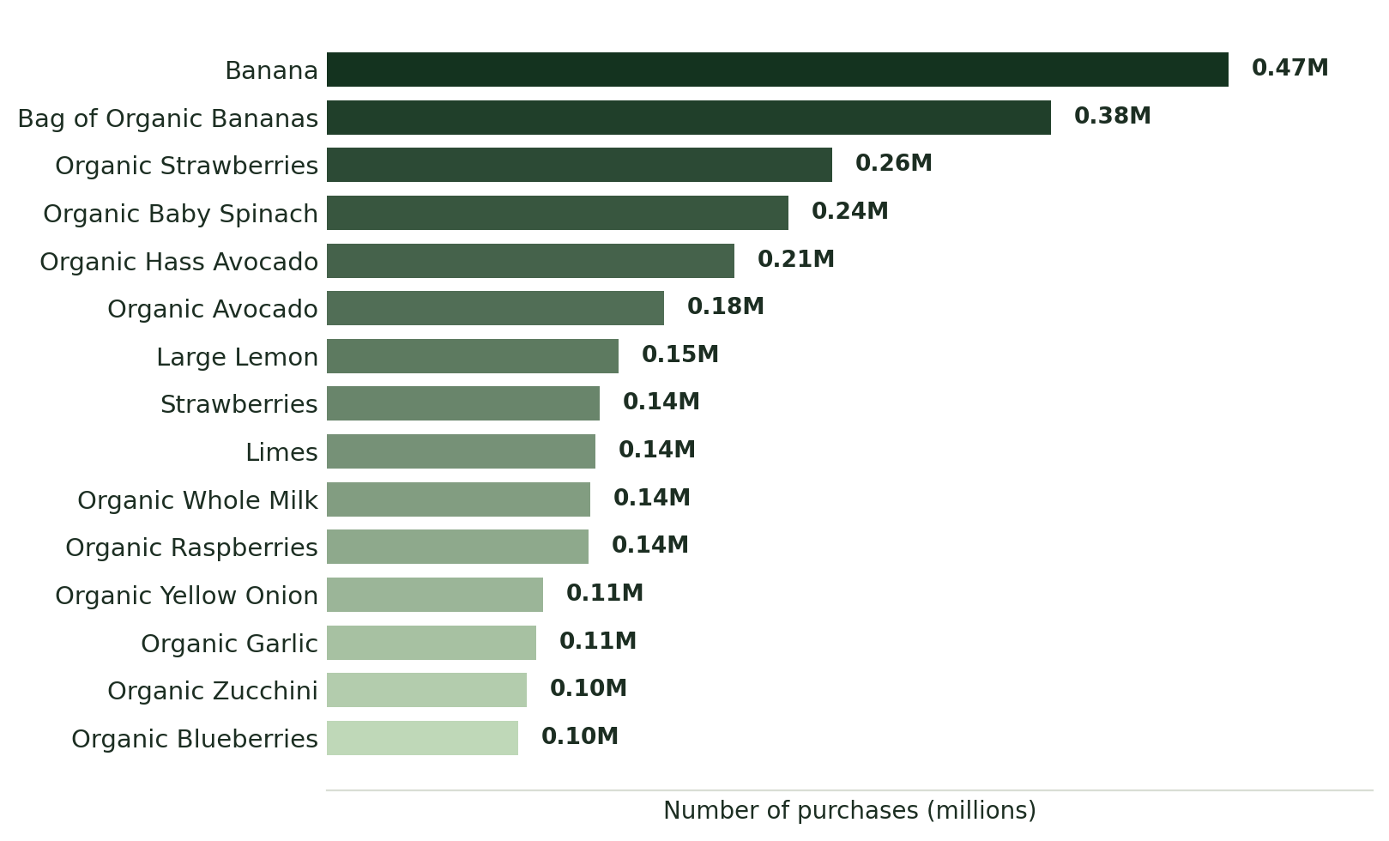
RESULT 01 · PRODUCT DEVELOPMENT
Fresh produce owns the top of the basket
KEY FINDING
The entire top 15 is fresh fruit and vegetables.
Bananas lead at 0.47M purchases, followed by Bag of Organic Bananas and Organic Strawberries. More than half of the top sellers carry an “Organic” label.
RECOMMENDATION Fresh produce and a credible organic range are non-negotiable for the core assortment.
Grocery Product Placement Analysis · Group 11
06 / 13

Slide 7
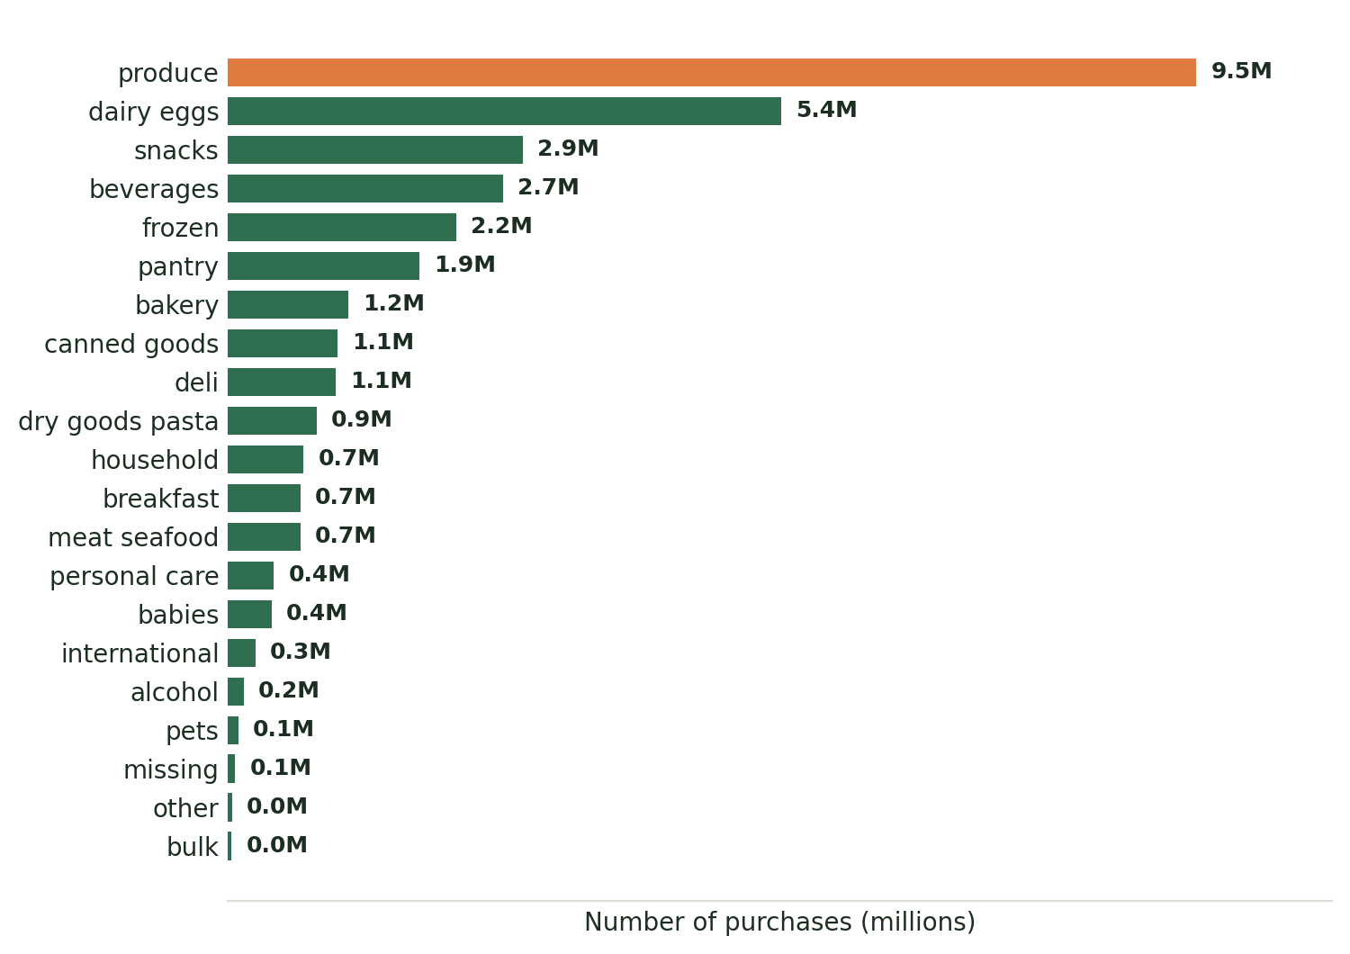
RESULT 02 · PRODUCT DEVELOPMENT
Produce drives almost a third of all volume
KEY FINDING
Produce and Dairy & Eggs dwarf every other department.
Produce drives ~9.5M purchases and Dairy & Eggs ~5.4M. The next tier — snacks, beverages, frozen, pantry — is all convenience food. Bulk, alcohol and pets barely register.
RECOMMENDATION Anchor the assortment on produce and dairy; treat convenience categories as the growth layer.
Grocery Product Placement Analysis · Group 11
07 / 13

Slide 8
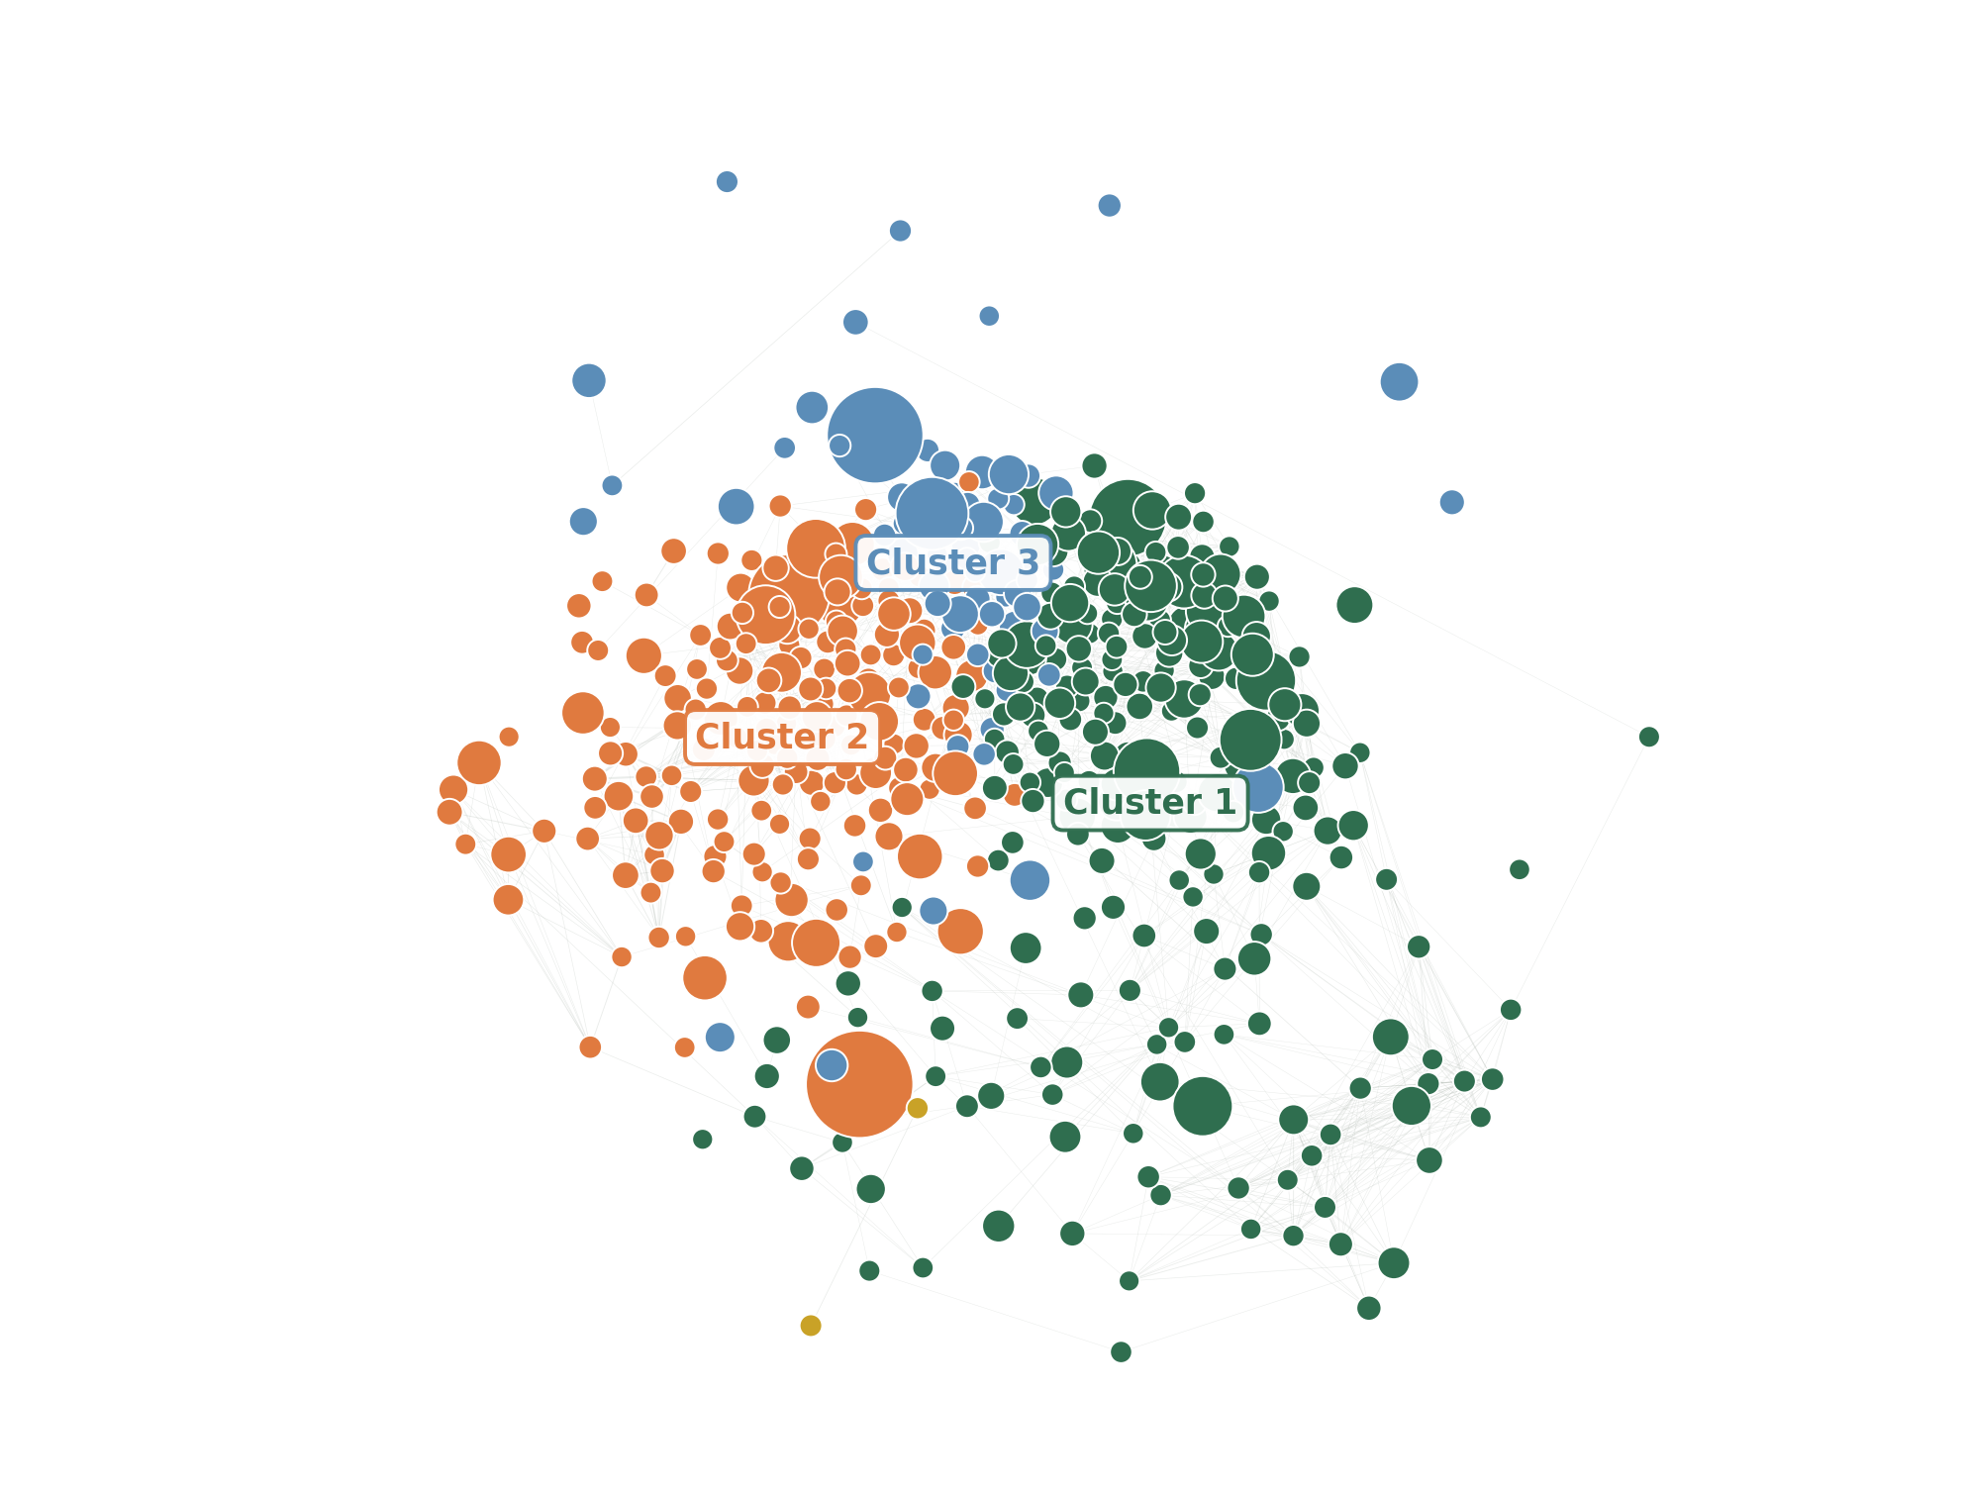
RESULT 03 · PRODUCT DEVELOPMENT
Co-purchase analysis reveals natural baskets
KEY FINDING
Products bought together far more than chance form three clear clusters among the 500 most-purchased items (lift ≥ 2):
Fresh vegetables & aromatics spinach, avocado, onion, garlic, lemon
Everyday fruit & milk banana, berries, apples, whole milk
The organic basket organic bananas, berries, almond milk
RECOMMENDATION Group cluster members in the same app category, recommend across links, and bundle the strongest pairs.
Grocery Product Placement Analysis · Group 11
08 / 13

Slide 9
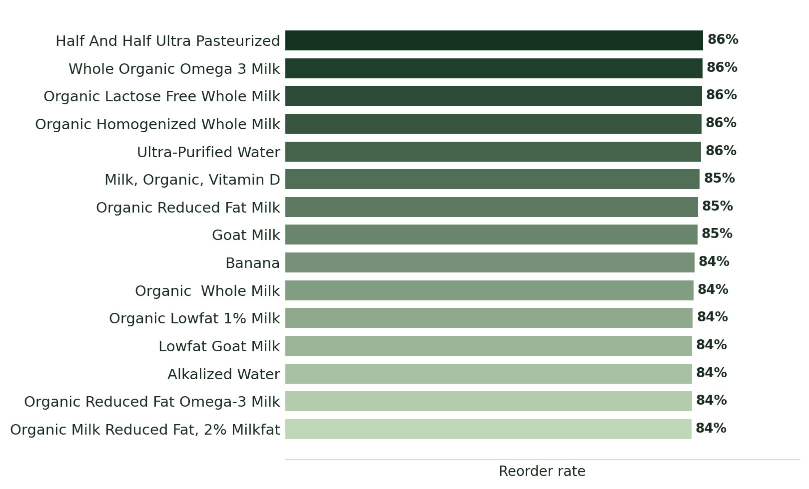
RESULT 04 · CUSTOMER RETENTION
Customer loyalty is built on milk
KEY FINDING
Loyalty runs on milk and water.
The overall reorder rate is 58.9% — a highly habitual base. Among products with 500+ purchases, the highest reorder rates (84–86%) are almost entirely milk and water.
RECOMMENDATION Everyday staples are ideal candidates for subscriptions and automatic reorder reminders.
Grocery Product Placement Analysis · Group 11
09 / 13

Slide 10
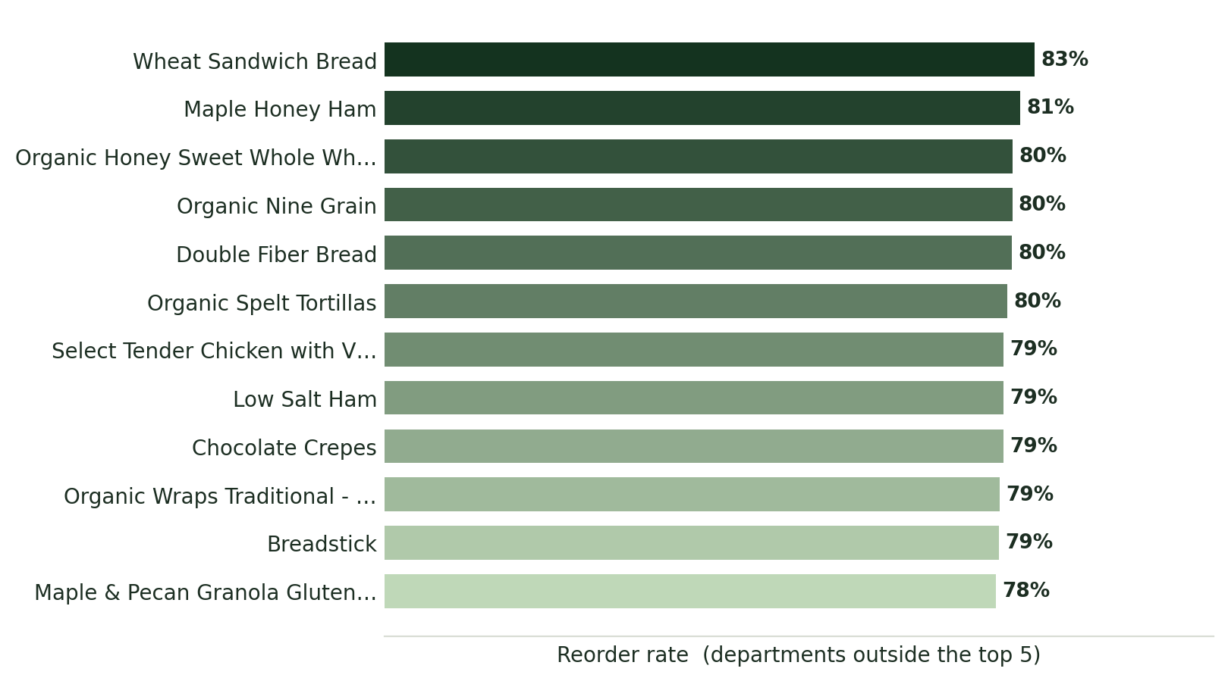
RESULT 05 · CUSTOMER RETENTION
Hidden gems: small categories, loyal fans
KEY FINDING
Small categories, surprisingly loyal customers.
Outside the five biggest departments, breads, hams and wraps still reach 78–83% reorder rates despite low volume — a loyal base that is invisible in standard reports.
RECOMMENDATION Protect these niche products from delisting; they punch above their volume in retention.
Grocery Product Placement Analysis · Group 11
10 / 13

Slide 11
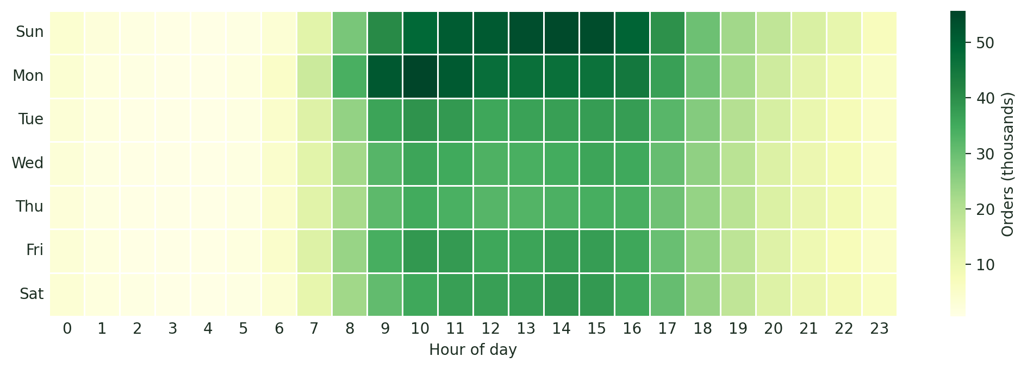
RESULT 06 · CUSTOMER RETENTION
Sunday and Monday mornings carry the week
KEY FINDING Orders cluster on Sunday and Monday, roughly 9:00–16:00, and fall away sharply before 7:00 and after 19:00. RECOMMENDATION Staff up for the weekly peak; push promotions on Saturday evening to catch early planners.
Grocery Product Placement Analysis · Group 11
11 / 13

Slide 12
WHAT IT MEANS
From data to assortment decisions
01
02
03
04
Build on fresh
Bundle the clusters
Subscribe the staples
Protect the gems
Make produce and a credible organic range the non-negotiable core of the assortment.
Group co-purchased products together and cross-sell across the strongest links.
Offer milk, water and other high-reorder staples as subscriptions and auto-reorders.
Keep loyal niche products on the shelf — they retain customers despite low volume.
FOR SANDRA
FOR MARCO
FOR SANDRA
FOR MARCO
Grocery Product Placement Analysis · Group 11
12 / 13

Slide 13
THANK YOU
Three million orders,
one clear shelf strategy.
The dashboard turns anonymised purchase data into decisions Sandra and Marco can act on — faster, more intuitively, and without writing a line of code.
Repository github.com/peslar01/ad24-11-grocery-product-placement-analysis Run it streamlit run deployment/app.py
Lara Pestrin · Jonathan Kull · Veprim Mehmeti

