Slide 1
ZHAW · VISUALISATION & DATA SCIENCE STORYTELLING II · FS 2025/26
Optimising Product Placement
Using Grocery Purchase Data
Turning 3.2 million Instacart orders into assortment, cross-sell and retention decisions for grocery delivery.
Lara Pestrin · Jonathan Kull · Veprim Mehmeti

Slide 2
THE CHALLENGE
Grocery delivery lives or dies by its assortment
THE QUESTIONS WE SET OUT TO ANSWER
1
Which products are purchased most frequently?
2
Which products are commonly bought together?
Thousands of products.
Weekly stocking decisions.
Today — mostly intuition.
3
Which products earn the highest customer loyalty?
4
When — by day and hour — are orders placed?
5
What does this mean for assortment and retention?
Grocery Product Placement Analysis · Group 11
02 / 13

Slide 3
THE DATA
Built on 3.2 million real grocery orders
3.2M
206K
49.7K
21
Orders analysed
Unique customers
Unique products
Departments, 134 aisles
The public Instacart 2017 dataset — six linked tables, fully anonymised.
Grocery Product Placement Analysis · Group 11
03 / 13

Slide 4


WHO IT'S FOR
Two people make these calls every week
Sandra
Marco
ASSORTMENT PLANNER
BUYER
34 · Business Administration · 5 years in grocery retail · no coding
28 · Retail Management · 2 years in e-commerce grocery · no coding
NEEDS
NEEDS
A fast visual overview of what sells — and what sells together.
Evidence for listing, delisting and supplier negotiations.
PAIN
PAIN
Slow, manual reports; co-purchase patterns are invisible.
Decisions lean on gut feel; loyal niche products stay hidden.
Grocery Product Placement Analysis · Group 11
04 / 13

Slide 5
THE PRODUCT
An interactive Streamlit dashboard
Built for exploration, not static reporting.
01
02
03
KPI Overview
Product Development
Customer Retention
• Orders, customers, products
• Reorder rate & peak hour
• Top department by volume
• Top sellers by purchase count
• Department sales breakdown
• Aisles bought together (pairs, heatmap, network)
• Reorder rate by product
• Hidden gems — loyal niches
• Shopping-time heatmap
Run it locally: uv run streamlit run deployment/app.py
Grocery Product Placement Analysis · Group 11
05 / 13

Slide 6
RESULT 01 · PRODUCT DEVELOPMENT
Fresh produce owns the top of the basket
WHAT WE FOUND
Every one of the top 15 products is fresh fruit or vegetables.
Grocery Product Placement Analysis · Group 11
06 / 13

Slide 7
RESULT 02 · PRODUCT DEVELOPMENT
Produce drives almost a third of all volume
WHAT WE FOUND
Produce and Dairy & Eggs dwarf every other department.
Grocery Product Placement Analysis · Group 11
07 / 13

Slide 8
RESULT 03 · PRODUCT DEVELOPMENT
Co-purchase analysis reveals natural baskets
WHAT WE FOUND
Co-purchase patterns fall into three natural baskets.
Cluster 3
Fresh vegetables & aromatics
spinach, avocado, onion, garlic, lemon
Everyday fruit & milk
Cluster 1
banana, berries, apples, whole milk
Cluster 2
The organic basket
organic bananas, berries, almond milk
Grocery Product Placement Analysis · Group 11
08 / 13

Slide 9
RESULT 04 · CUSTOMER RETENTION
Customer loyalty is built on milk
WHAT WE FOUND
Loyalty runs on milk and water — 84 to 86% reorder.
Grocery Product Placement Analysis · Group 11
09 / 13

Slide 10
RESULT 05 · CUSTOMER RETENTION
Hidden gems: small categories, loyal fans
WHAT WE FOUND
Niche breads and deli items keep 78 to 83% of their buyers.
Grocery Product Placement Analysis · Group 11
10 / 13

Slide 11
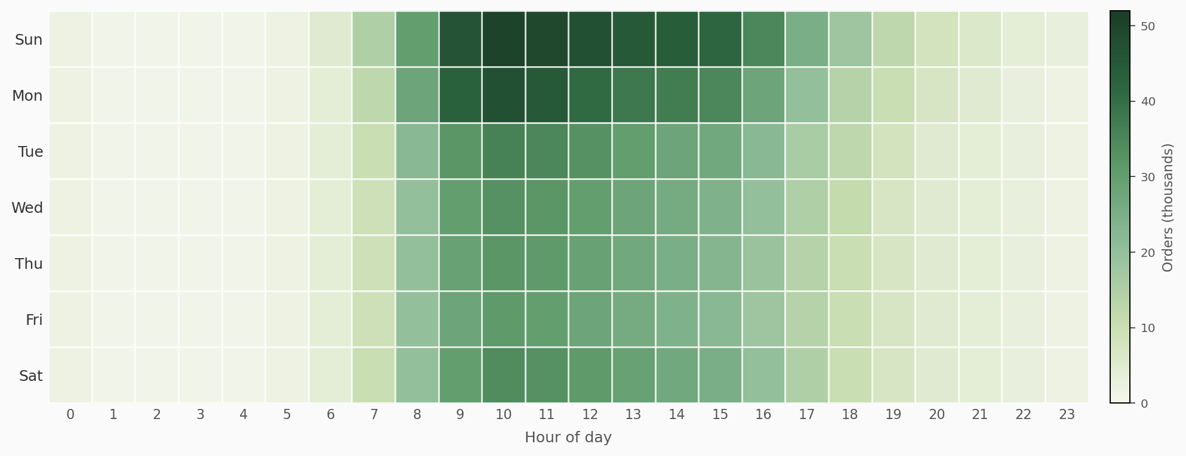
RESULT 06 · CUSTOMER RETENTION
Sunday and Monday mornings carry the week
WHAT WE FOUND
Orders cluster on Sunday and Monday, roughly 9:00 to 16:00 — and fall away sharply outside daytime hours.
Grocery Product Placement Analysis · Group 11
11 / 13

Slide 12
WHAT IT MEANS
From data to assortment decisions
01
02
03
04
Build on fresh
Bundle the clusters
Subscribe the staples
Protect the gems
Produce and organic are the core.
Group and cross-sell what sells together.
Milk and water — auto-reorder offers.
Keep loyal niche products on the shelf.
FOR SANDRA
FOR MARCO
FOR SANDRA
FOR MARCO
Grocery Product Placement Analysis · Group 11
12 / 13

Slide 13
THANK YOU
Three million orders,
one clear shelf strategy.
Anonymised purchase data, turned into decisions Sandra and Marco can act on — without writing a line of code.
Repository
github.com/podsv-fs26-ad24/ad24-11-grocery-product-placement-analysis
Run it
uv run streamlit run deployment/app.py
Lara Pestrin · Jonathan Kull · Veprim Mehmeti

